Slide 1
What is the first thing that represents you in an interview?
What is a resume?

Slide 2

Resume
Relevant and
Effective
Summary of
Updated and
Meaningful skills
Efficiently crafted on paper

Slide 3
Learning Outcomes
Understand the need and importance of a resume
Identify the attributes of ITM format of resume
Create effective resumes

Slide 4
Realities a resume faces
6 seconds is the average amount of time recruiters look at a resume
59% or more of recruiters reject candidates due to poor grammar or spelling errors or even worse, mere alignments
98.8% of the Fortune 500 companies use an ATS to screen incoming resumes

Slide 5
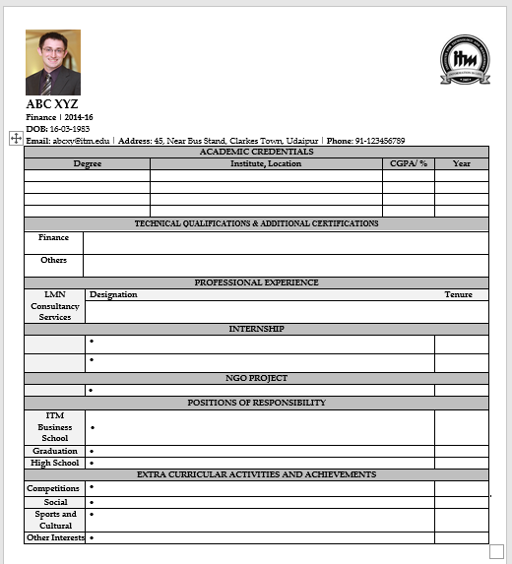
The ITM format of resume

Slide 6
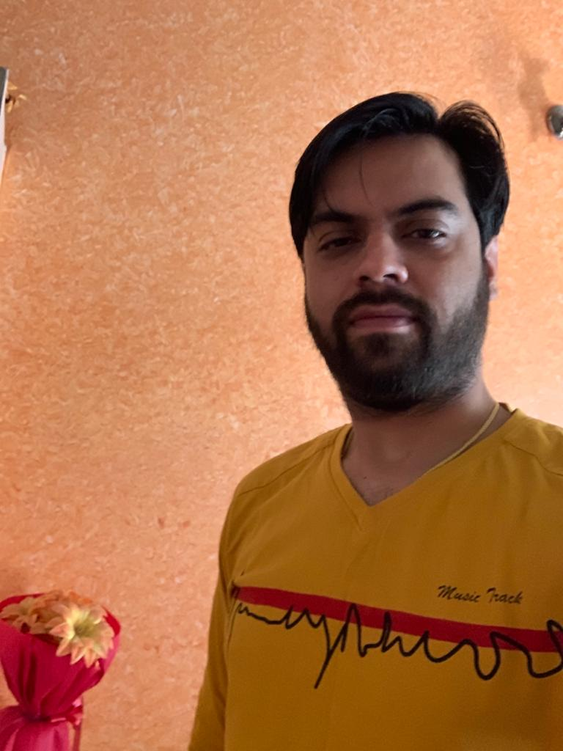
What’s wrong with the photograph?
Background
Grooming
Attire/Dress code
Expression

Slide 7
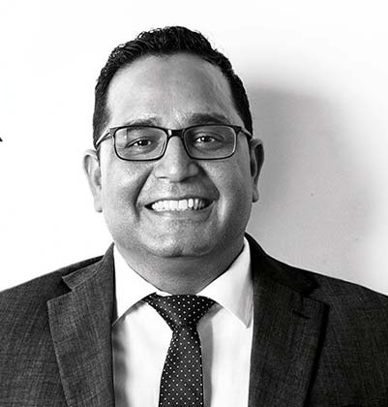
So what is a considerable photograph for a resume?
Formal, clear background
Well groomed
Formal attire
Smile on the face
Notes:
Deepinder Goyal – CEO - PAYTM Founder

Slide 8





ITM logo
Which one do you use???

Slide 9
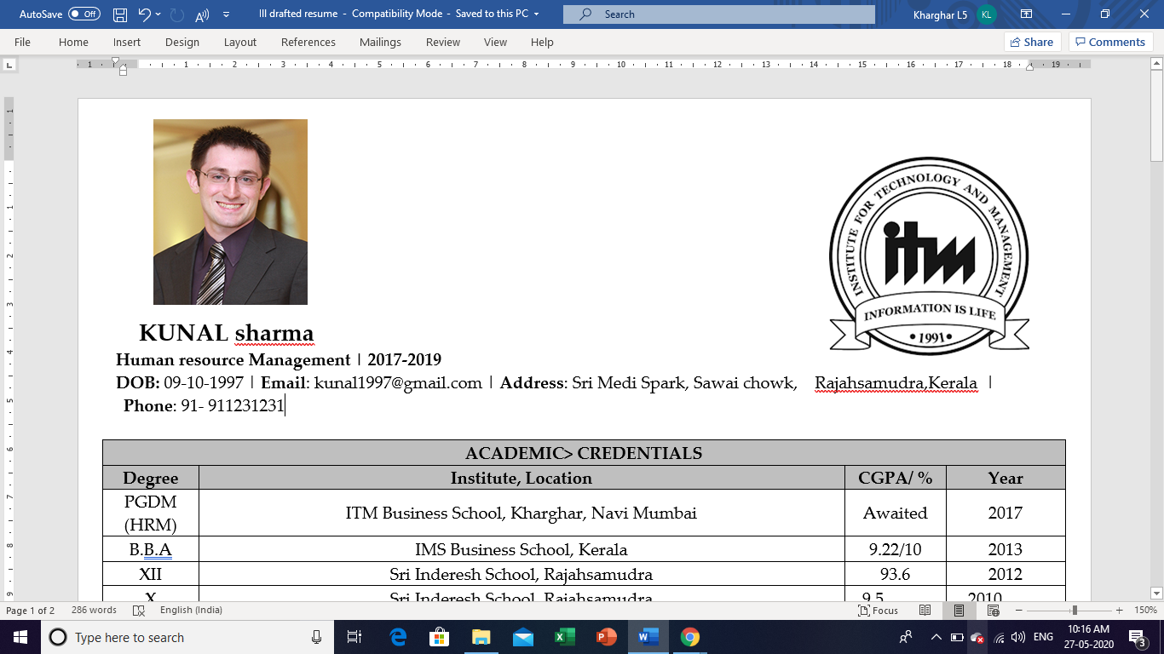
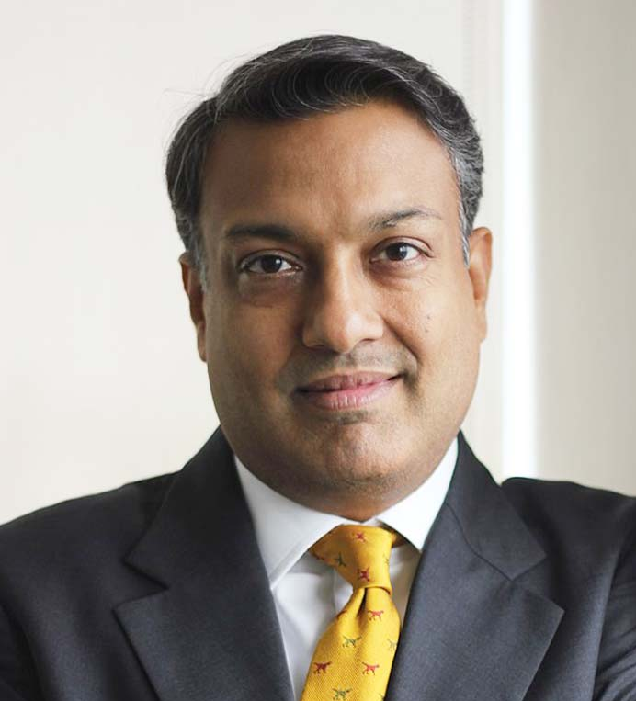
Resume header
Inappropriate size of logo and photograph
All caps font in Name
No uniformity in font
Misalignment in text
Extra space and no space error
Personal Email-id
Sumant Sinha
Notes:
Sumant Sinha – Founder and Chairman – Renew Power

Slide 10
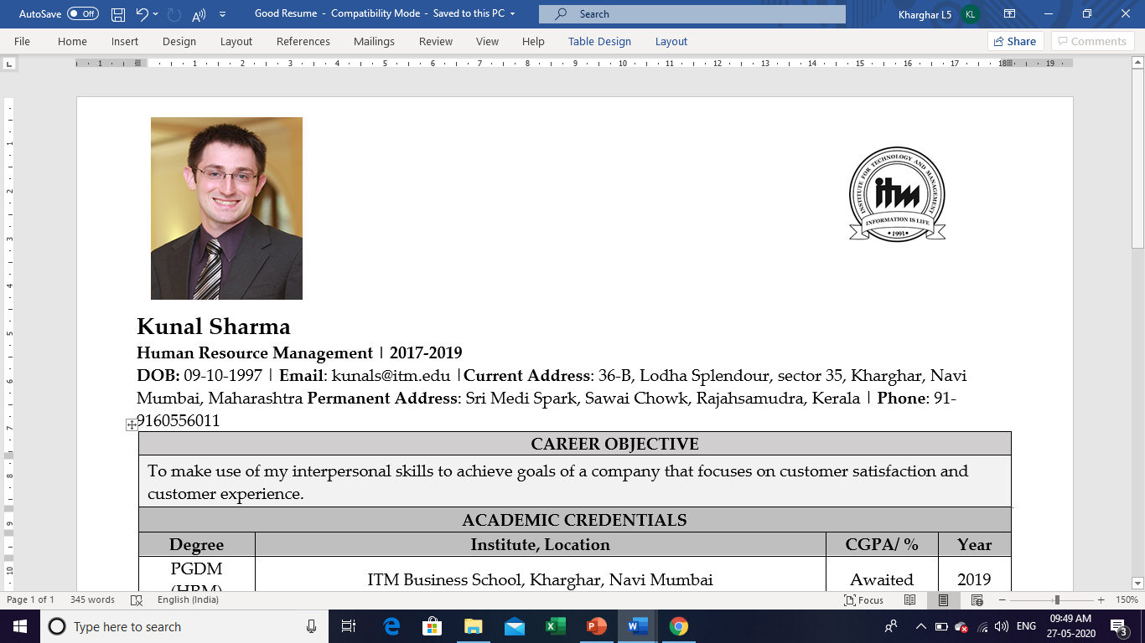
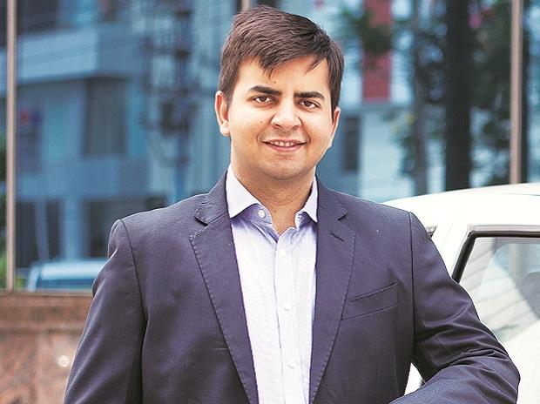
Bhavish Aggarwal
Notes:
Bhavish Aggarwal – Ceo for Ola Cabs

Slide 11
What is your career objective?
Analyse the job description
Customize your career objective
Do not give fake information

Slide 12
Career objective
“Seeking the role of Social Media Marketing Manager to utilize my 6 years of social media and content development experience in identifying trends, engaging users and increasing brand awareness through innovative marketing strategies and campaigns.”
“Seeking a rewarding Entry Level Financial Analyst position to utilize learnings in financial reporting, forecasting, and planning and knowledge of accounting software.”

Slide 13
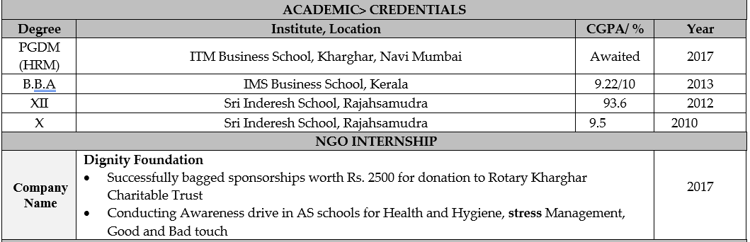

Slide 14
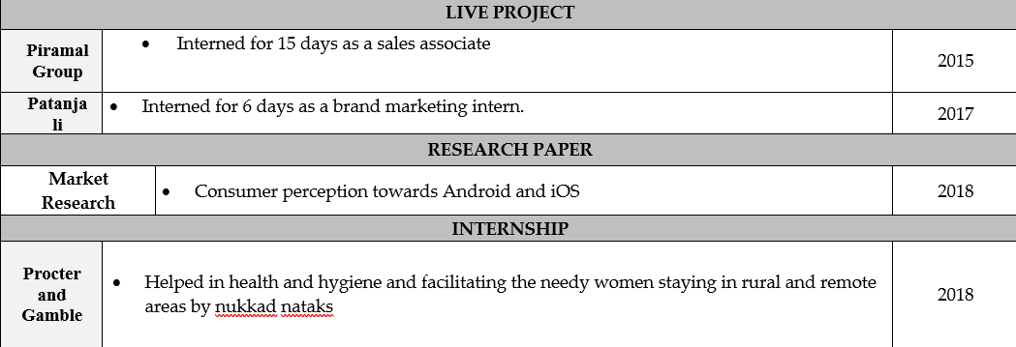
Poor Alignment
No time order of information (Reverse chronological order should be followed)

Slide 15
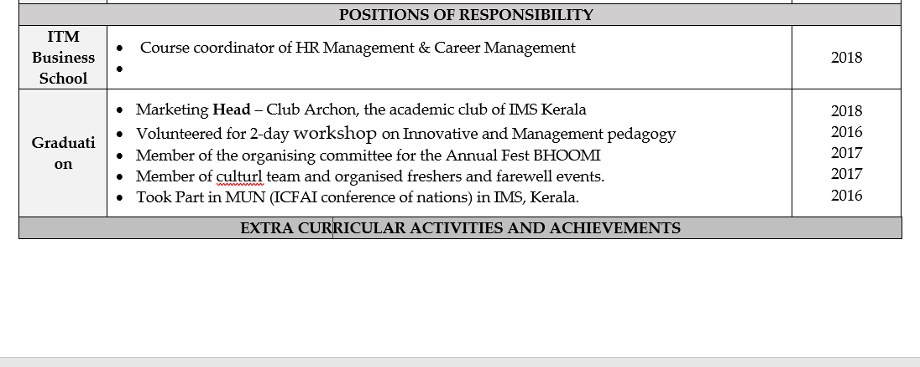

Slide 16
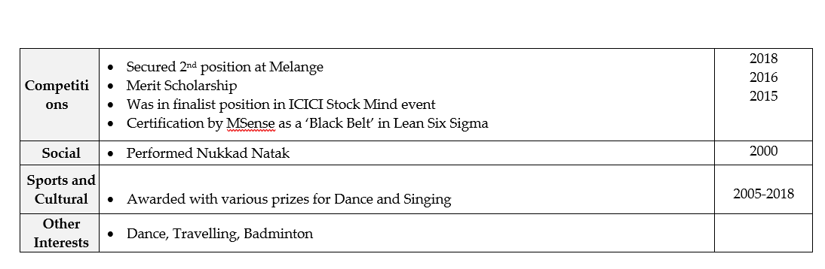

Slide 17
Use of action verbs
Accomplished
Achieved
Analyzed
Adapted
Balanced
Collaborated
Coordinated
Communicated
Compiled
Conducted
Contributed
Completed
Created
Delegated
Directed
Established
Expanded
Improved
Implemented
Increased
Initiated
Notes:
past

Slide 18
Instructed
Led
Organized
Participated
Performed
Presented
Proposed
Resolved
Researched
Set Up
Supervised
Supported
Trained
Worked
Use action verbs in the past tense only

Slide 19
Description of your work
  “ Created portfolio deck and recommendations for various clients as per their needs”
  “Led the total disbursement process for business units from different countries like Sweden, Germany and France.“
  “Conceptualized a new blog initiative that united engineers, designers and writers, generating over 3 million organic sessions and introducing over 1 million unique users to the website.”

Slide 20
Checklist
ITM logo
Photograph
Career Objective
Academic credentials
Work Experience(if any)
Internship
Live Projects
NGO Internship
Extra curricular Activities and other Achievements
Other Interests

Slide 21
https://drive.google.com/drive/u/0/folders/1T47SANJjoJ5bQv_V2ACE8yYLajCXzCZM (ill drafted resume)
https://drive.google.com/drive/u/0/folders/1T47SANJjoJ5bQv_V2ACE8yYLajCXzCZM (well drafted resume)

Slide 22
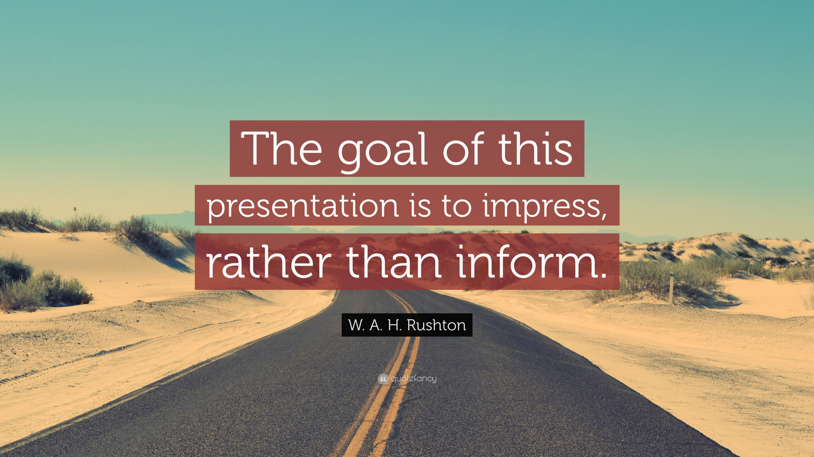
document

