Slide 1
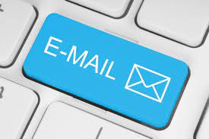
Day 2

Slide 2
Recap

Slide 3
Learning Objectives
The participants will be able to:
Understand and write email with proper etiquette.
Apply drafting types of emails.

Slide 4
Email etiquettes
Keep your tone professional
Subject: ABC Company meeting confirmation.
Dear [Prospect name],
It was great to speak with you on the phone earlier. I hope those spring storms give you a break soon!
You should have received a calendar invite from me for the demo we agreed upon for Tuesday, May 7 at 2:00 p.m. . You'll also find an agenda and talking points attached below.
Please let me know if you have any questions.
Best Regards,
[Your name]

Slide 5
Keep your tone professional
Avoid negative phrases. They can make you seem more anxious, irritated, or worried than you truly are.
Examples: Mistakes, issues, failure, delay, problem, crisis, trouble, unfortunate, consequence.
Don’t be sarcastic. There’s a good chance your recipient won’t get the joke -- and you’ll seem like a jerk.
Example: “I’d ask my team to review it tomorrow, but as you probably know, no one actually gets work done on Friday.
Cut out adjectives. They can make you sound overly emotional.
Examples: Very, really, extremely, highly, grave, serious, deeply

Slide 6
Email etiquettes
Avoid vague subject lines
Subject: Hello!
Hi-
Great talking to you on the phone today; Can't wait to tell you more about how ABC Company can help you're company. I scheduled the demo we discussed earlier and you can find the agenda here: https//www.longesturlever.com/donteverdothistoyourprospects.
Talk to you son.
Cheers -- [Your name]
Bad subject line:
Hi
Good subject line:
Summary of today’s meeting

Slide 7
Email etiquettes
Casual email greetings include:
Hi
Hey/ there
Formal email greetings include:
Dear [first name]
Dear Mr./Ms. [last name]
And which ones should you never use
Yo: Too informal
[Name]!: Too off-putting
[Name]
Hey!: Too intimate and eager
To whom it may concern: Too impersonal
All: Too cold
Choose your email salutation carefully

Slide 8
Email etiquettes
Leave the right impression with your email sign-off
Informal sign-offs:
Thanks
Thanks again
Formal sign-offs:
Thank you
Thank you for your time
Closing lines you shouldn’t be using:
Sincerely: Too outdated
Regards: Too unfriendly
Cheers
Enjoy the weekend
Talk to you [tomorrow, on Wednesday, when you get back]
Have a wonderful [day, weekend]
Warmly: Too relaxed
Respectfully: Too random

Slide 9
Email etiquettes
Use sentence case
Capitalize the first letter of the first word in a sentence and proper nouns.
Don’t capitalize much
All capital letters means “Shouting at some one”
Resist emojis in email

Slide 10
Email etiquettes
Know the difference between:
There/they’re/their
Its/it’s
Effect/affect
Your/you’re
Too/two/to
Loose/lose
I/me/myself
TIP:
Grammarly is a free tool that scans everything you write for grammar and spelling mistakes. Not only will it catch issues in real time, it’ll also send you a weekly report highlighting common trends.

Slide 11
Email etiquettes
Always use standard fonts and formatting
Do not use funny fonts, fun colors, and offbeat formatting.
Always use the standard font. Never use a color beside black.
Don’t bold or italicize more than one word (or string of words) in a single email.
Shorten your URLs
Pasting entire URLs into your email takes up valuable space and looks messy.
Create hyperlinks or insert a shortened URL.
Wrong: Check out this article on sales emails.
Right: Check this out: https://bit.ly/2sl3DDH

Slide 12
Email etiquettes
Call out attachments
Indicate somewhere in your email you’ve included an attachment so your recipient doesn’t overlook it.
Make sure you’re reattaching files when you add someone to an email chain, or they won’t be able to see them. (An alternative? Simply forward them the thread.)
Perfect your email signature
Even if you write the most fluent, persuasive message in the world, a poorly designed signature will make you seem like an amateur.
Should be relatively small, simple, and restrained.
Stick to your name, job title, LinkedIn URL and/or company website, and phone number.

Slide 13
Email etiquettes
Fill out your email fields properly
To:
This field is simple. Add the email address of the person you’re trying to contact.
Cc:
If you’d like to include someone else on the message Cc them. You’re essentially saying, “Hey, read this, but don’t feel obligated to respond.
Bcc:
Bccing also copies your contact to the email, but no one besides them will see they received it. In other words, if you send an email to Michael Scott and Bcc Jim Halpert, Michael won’t know Jim got it as well.

Slide 14
Email etiquettes
Use 'Reply all' sparingly
Reply:
When you click "Reply," you respond directly to the person who emailed you last.
If you respond directly to the initial message, your reply will go to the original sender of the email.
If you respond to someone else’s email in the thread that follows, you will end up replying just to that person.
Reply all:
When you select "Reply all," you email back everyone who is either in the "To" or “Cc" fields.
The benefit of "Reply all" is letting those in the thread know a certain issue has been addressed

Slide 15
Email etiquettes
Think before forwarding
Some emails are not intended to be forwarded. If a contact is sending you private or sensitive information, use high caution before forwarding it along.
When forwarding a long email thread, a common courtesy is to summarize what’s being discussed below so the recipient knows exactly what you want from them.
There’s nothing worse than getting forwarded a 50-chain thread with a note that just says, “see below.
If you’d like your forwarded email to start a new email ,simply include your own commentary in the subject line.
Same Thread Subject Line: FW: notes from Tuesday
New Thread Subject Line: Check this out! FW: notes from Tuesday

Slide 16
Email etiquettes
Respond in a timely manner
Set informative out-of-office replies
Don't add that 'Sent from my phone'
Assume everything that you write is a public document.
Avoid talking about other people in an email message.
Reread your message before sending it, and rephrase if necessary.
Do not make demands.
If you receive a confusing or unclear email message – Ask politely for clarification.

Slide 17
Drafting Certain types of EMails
Drafting an Email:
• An Apology
• Requesting for Information
• Asking for Clarification
• Addressing Multiple people
• Writing a Complaint

Slide 18
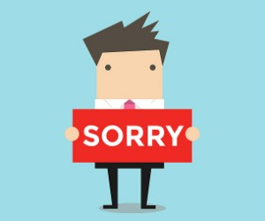
Apology EMail
Try not to begin with Apology straight away. “I’m sorry..”
• State what have you done about
it
• What caused it
• Apologize
• Suggestions

Slide 19
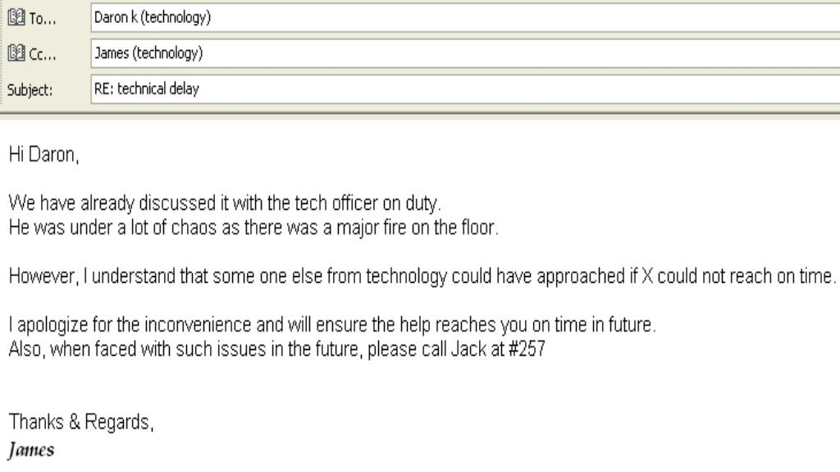
Apology EMail

Slide 20

Requesting for Information
• State the request
• Support with details
• Specifications
20

Slide 21
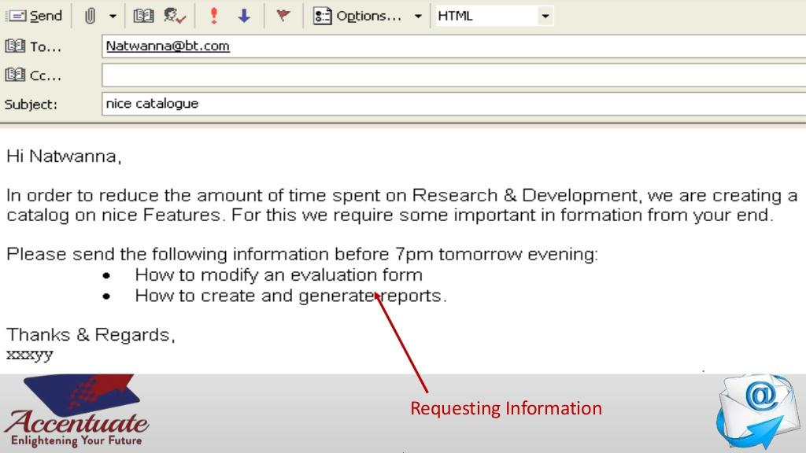
Requesting for Information
Requesting Information

Slide 22
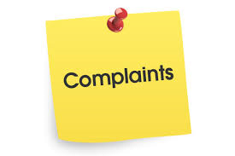
Writing a Complaint
• You should briefly state the history of the problem to provide context for your reader
• Explain the attempts you made previously to resolve the problem
• Show why it is critical for the problem to be resolved by your reader
• Offer suggestions on ways you think it can be resolved or how you are willing to help in the matter

Slide 23
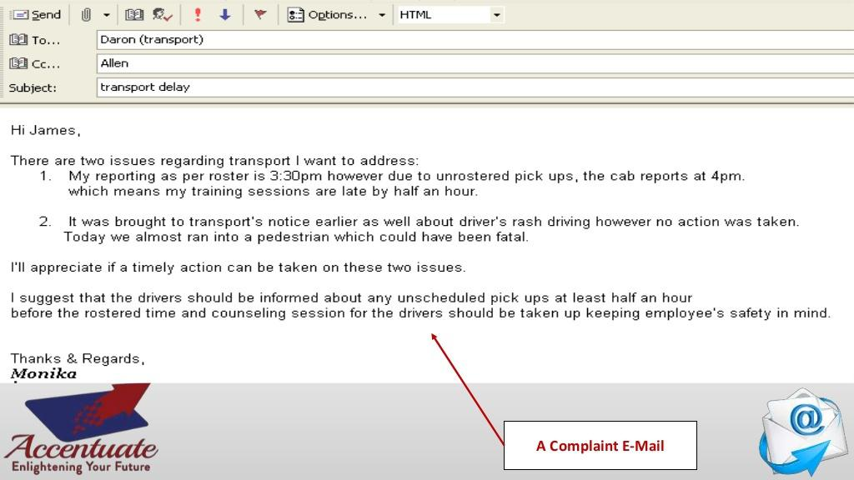
Writing a Complaint
A Complaint E-mail

Slide 24
When your message is too long
Create an elevator Summary
Provide a table of contents on the first screen of your email
If you require a response from the reader, then be sure to request that response in the first paragraph of your E-mail
Create headings for each major section

Slide 25
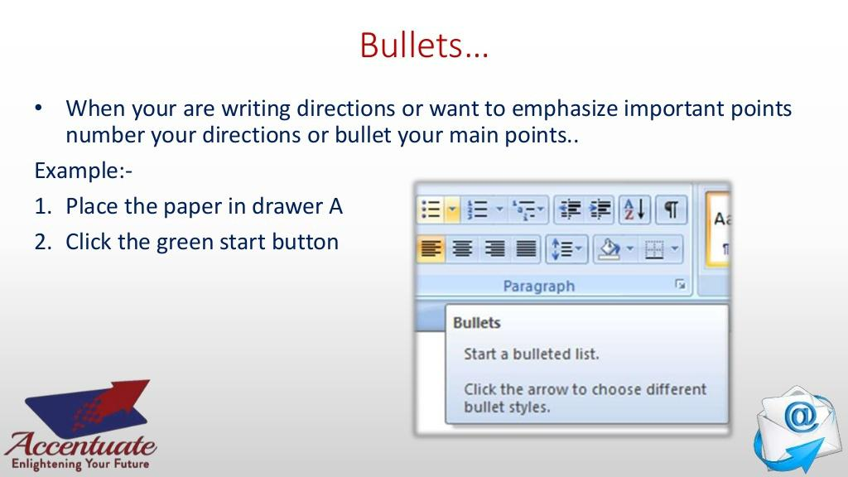
Bullets
When you are writing directions or what to emphasize important points number your directions or bullet your main points.
For example:
Place the paper in drawer A
Change the format

Slide 26
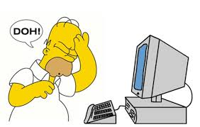
Replying To a Wrongly Sent Email
If you have sent an email in error or to the wrong recipient:
• Send a follow-up message to explain the
mistake
• Request to ignore the message
• Apologize briefly

Slide 27

Replying To a flaming Email
Understand the purpose of the email
Examine the recipient list
Determine the intent of a reply

Slide 28
Assessment

Slide 29


