Slide 1

Day 1

Slide 2
Learning Objectives
The participants will be able to:
Identify the need for self introduction
Express their ideas in the most interesting and lucid manner
Apply their experiences to answer questions / narrate stories
Assess the quality of their content w.r.t. an interview

Slide 3


Slide 4

Choose a mystery box
Read the questions well
30 seconds for preparation & 2-3 minutes for presentation
Be cautious of your presentation, grammar, vocabulary, confidence & content
The best speaker of the day wins a PRIZE!

Slide 5
1
2
3
4
5
6

Slide 6
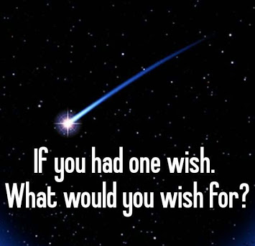
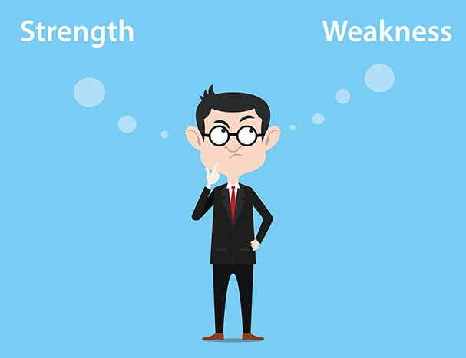
Mystery Box 1

Slide 7

Mystery Box 2
Plot / Story line
Characters
Lessons
Quotes
Notes:
If the student isn’t an avid reader then the trainer may ask any student from the class to voluntarily take this topic and speak.

Slide 8


Mystery Box 3
& Lessons Learnt

Slide 9


Mystery Box 4
Talk about a difficult situation which you made possible with your hard work and determination

Slide 10

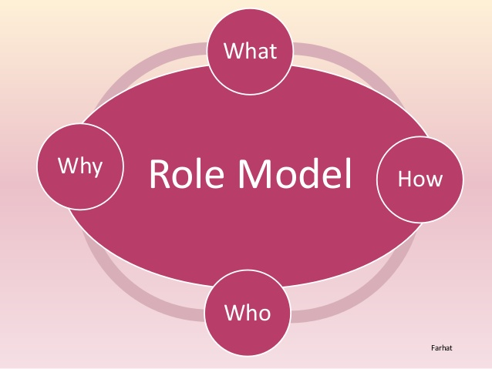
Mystery Box 5

Slide 11
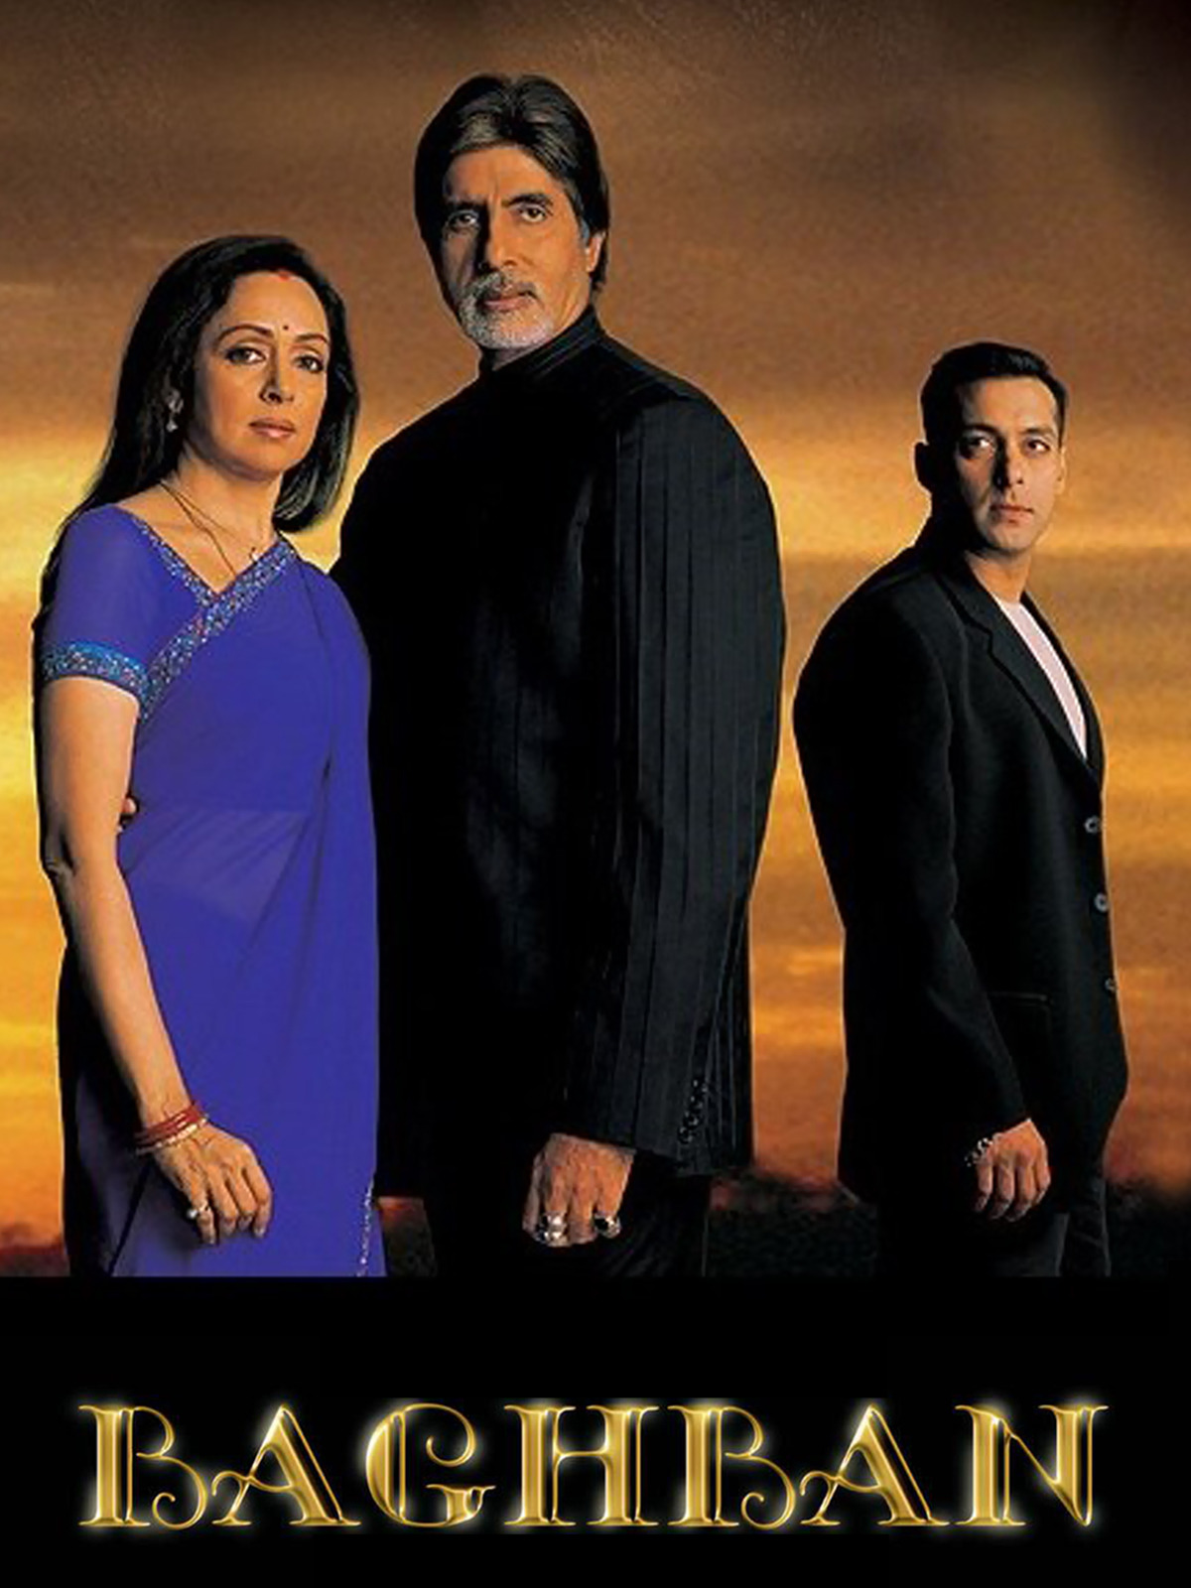

Mystery Box 6
Management
Lessons that you’ve learnt from
or
Notes:
The trainer needs to make sure that the student who speaks on this topic has to be aware of all the characters and the movie plot. If the student isnt aware of them, the trainer may call other student who has seen the movies.
https://blogs.siliconindia.com/mnarayan/Management-Lessons-from-Bollywood-Movies-bid-1SAzVq0684502091.html

Slide 12
7
8
9
10
11
12

Slide 13

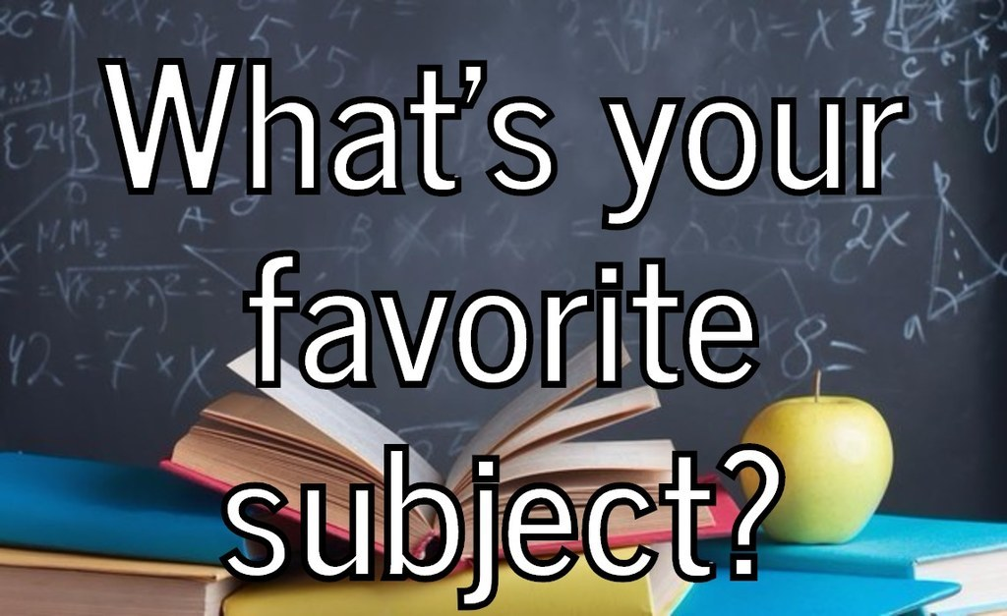
Mystery Box 7
Justification / examples for adjectives
Subject – reasons for liking the same, achievements ?

Slide 14

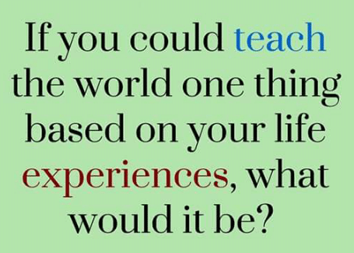
Mystery Box 8

Slide 15


Mystery Box 9
Notes:
If the student who picked this Mystery Box isn’t an Engineer then the trainer may swap with another student.

Slide 16


Mystery Box 10
Give an example of your

Slide 17


Mystery Box 11

Slide 18


Mystery Box 12
Best Vacation you’ve had
Share any 3 facts on

Slide 19
13
14
15

Slide 20
Mystery Box 13
What did you want to be when you were younger? Why were you inclined towards it?
What one habit would you like to start and why?
What one bad habit would you like to break?

Slide 21
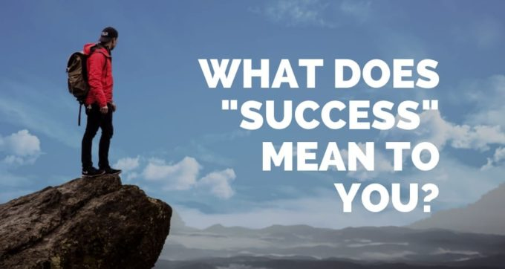

Mystery Box 14

Slide 22
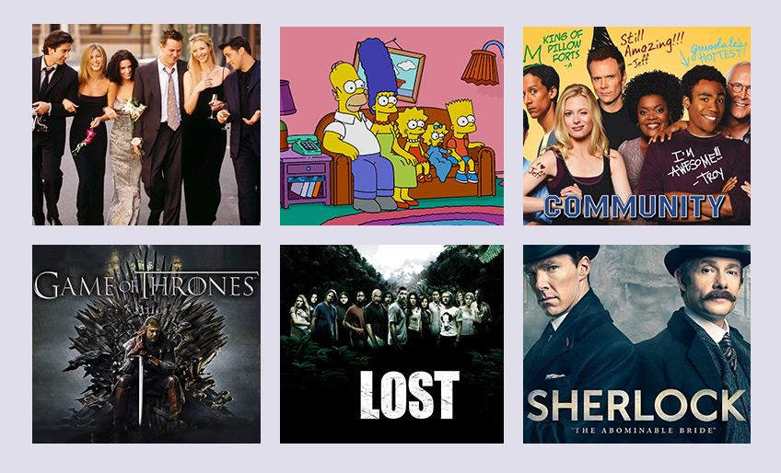
Mystery Box 15
Favourite series? Why ?
Liked Characters?
Lessons ?
Favourite Quotes
Notes:
It could be any series, not necessarily the ones mentioned in the picture

Slide 23


Slide 24

Day 2
Break the Silence
Speak Up

Slide 25
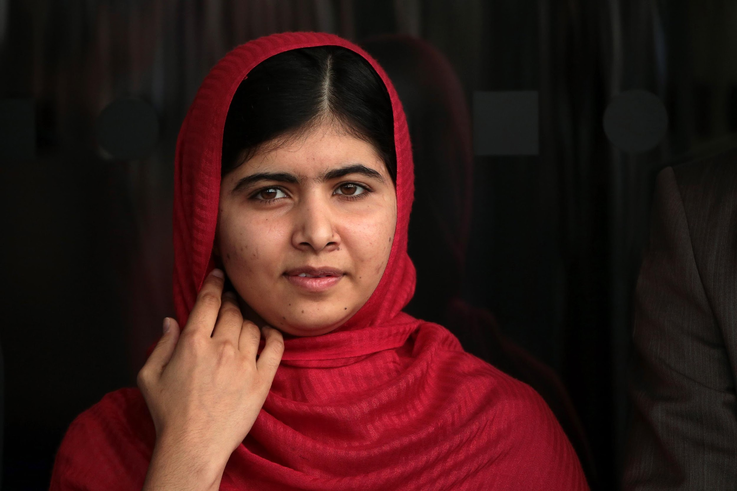
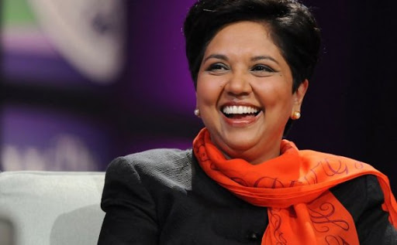
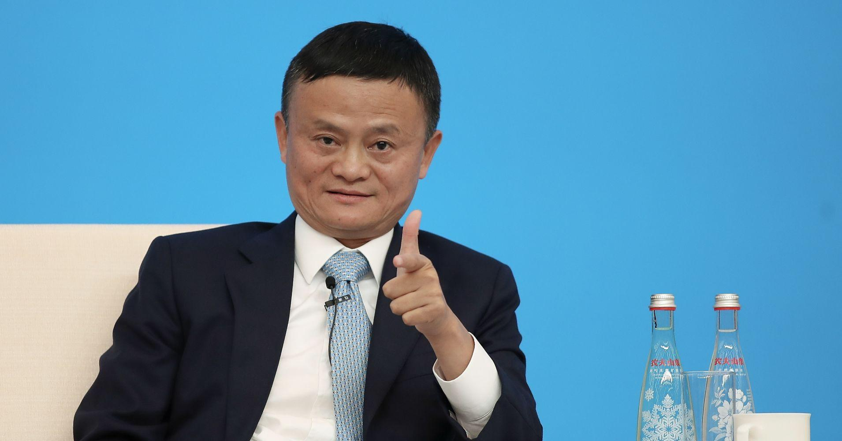
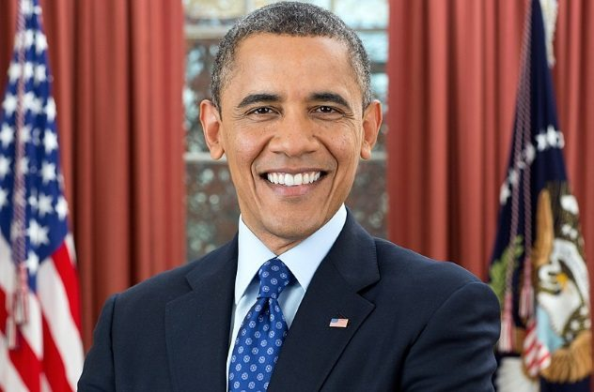
Which one would you want to be & why?
If you could take one quality from each, which one would it be?

Slide 26
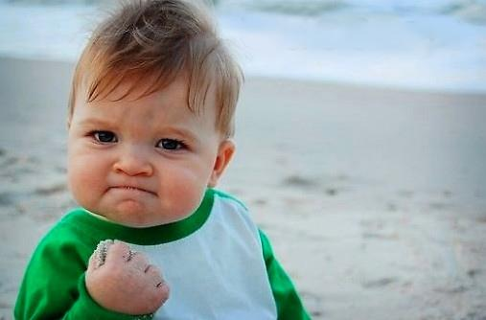
If you could solve one problem in the world, what would it be and why?
What practical skill do you wish you had and why?
Why Marketing / Finance / HR?
Notes:
The trainer would have to change the specialization as per their respective batches for the last pointer.

Slide 27

Impact on the world – Economic, Political, Financial, Geographical, etc
Impact on India
Impact on business
Rich v/s poor
Developed V/s Developing countries
China’s role – pros and cons
Notes:
The trainer may ask the student to take up any 3 pointers from the list.

Slide 28
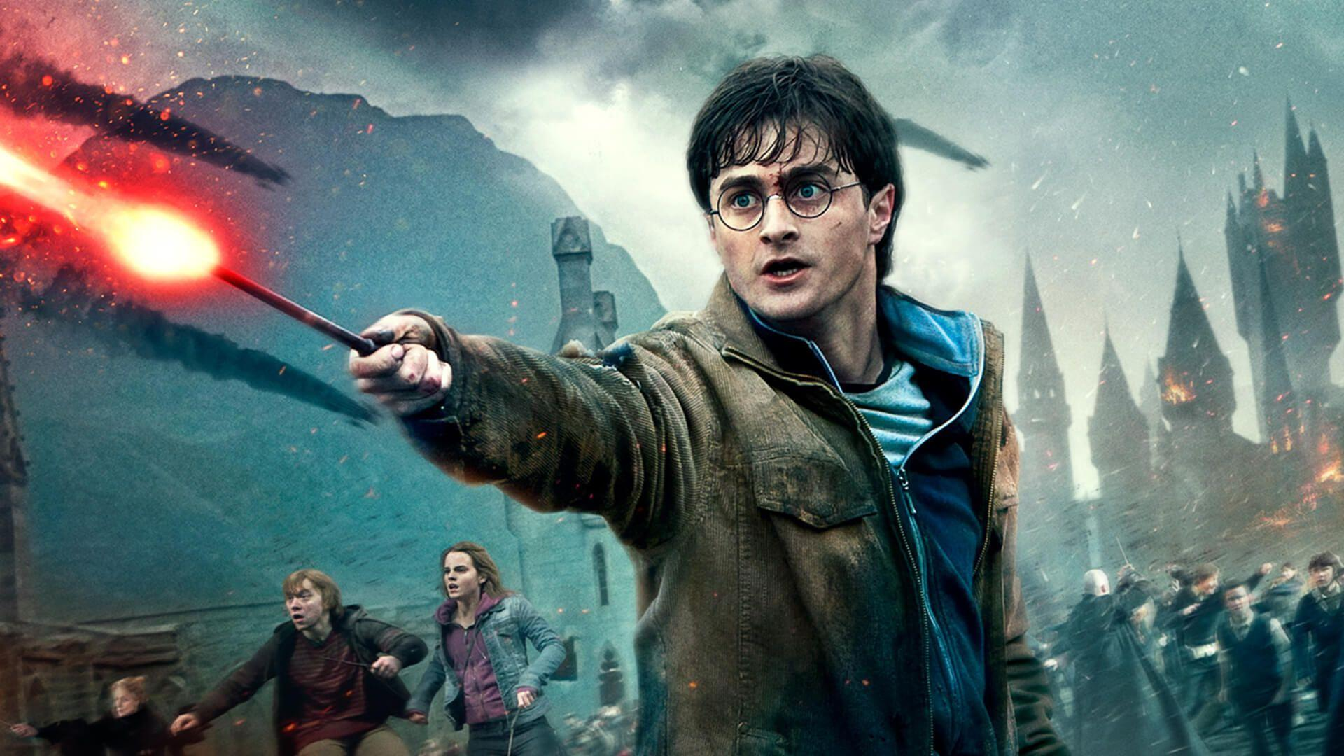
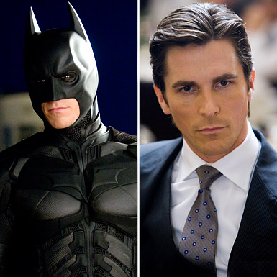
If you could be one of them, who would you be & why?
Your choices define YOU, not your abilities
Notes:
The trainer needs to make sure that the student who speaks on this topic has to be aware of both the characters and the movie plot. If the student isnt aware of them, the trainer may call other student who has seen the movies.

Slide 29

Give two situations where you showcased
What kind of a person would you refuse to
work with? Why?

Slide 30
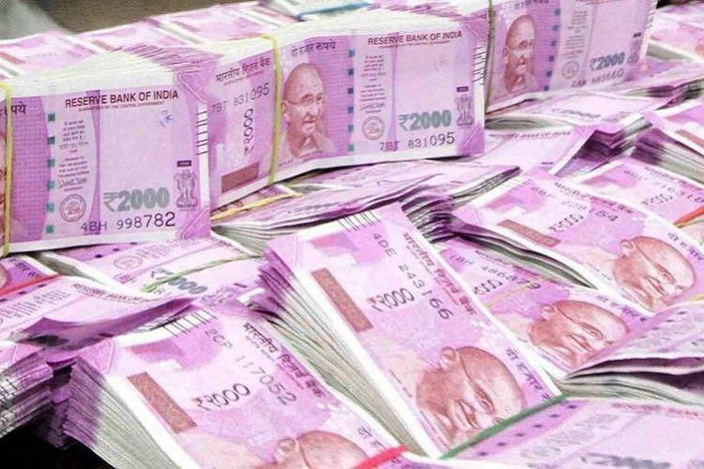





Rate on a scale of 1-6 as per importance & give reasons

Slide 31


Give examples for both

Slide 32


Describe the Best & Worst movie you’ve seen
Notes:
It could be ANY movie. The posters are added only for reference. Students can pick any BEST and WORST of their choice. Justification is necessary.

Slide 33
Think!
If you could meet one person (dead / alive), who would it be ? Why?
If you could ask him / her for ONLY one thing what would that be?
When was the last time you were reprimanded and what was it about?

Slide 34


What makes you _____ ?
Steps for Improvement?

Slide 35


Slide 36

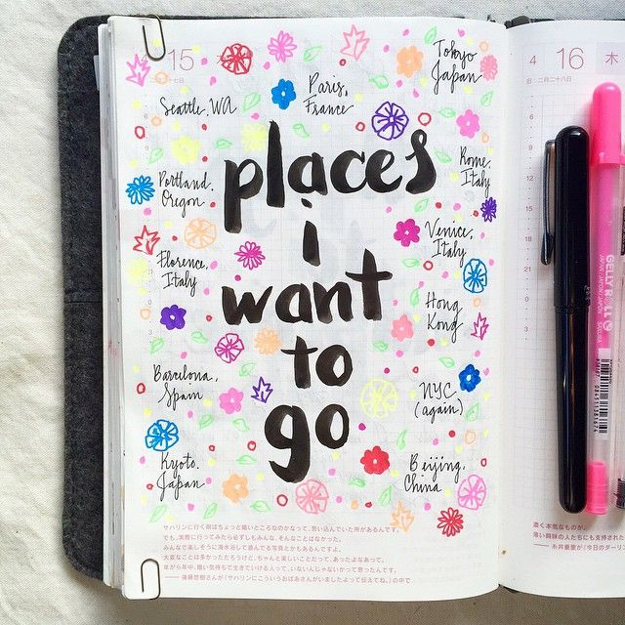
Mention
Your contribution

Slide 37
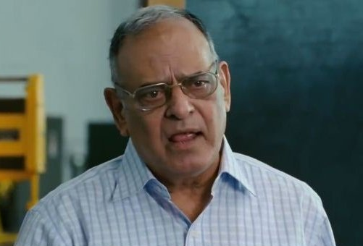
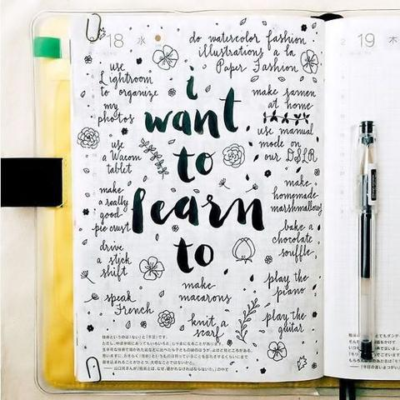


Will you please elaborate?

Slide 38

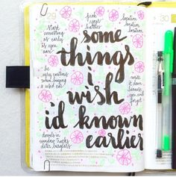
Mention at least 3

Slide 39


Management Lessons that you’ve learnt from
or
Notes:
The trainer needs to make sure that the student who speaks on this topic has to be aware of both the characters and the movie plot. If the student isnt aware of them, the trainer may call other student who has seen the movies.
https://blogs.siliconindia.com/mnarayan/Management-Lessons-from-Bollywood-Movies-bid-1SAzVq0684502091.html

Slide 40
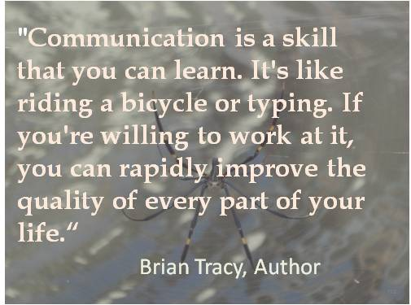

Slide 41


Day 3
Roll your Dice
&

Slide 42


Slide 43


If you could be, what would your day be like?
Who’s the political leader you look up to?

Slide 44


What was the most courageous thing you’ve ever done?
If you could have dinner with five people,
who would they be and why?

Slide 45
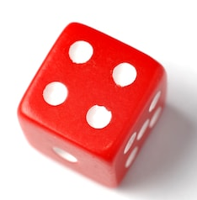
What was the most difficult decision you ever had to take?
Do you believe in hard work or smart work? Give examples.

Slide 46

Form your Life Story using these words
Good | Three | Kind
Amazing | Two | Travel
Mumbai | Education | Experience

Slide 47

If your life were a movie, what would the title be and why?
If you were reborn as an animal, what would it be and why?
When was the last time you were recognized for something good?

Slide 48

What’s the best advice you’ve got so far?
Was MBA your first choice? If yes, why? If no, why?

Slide 49


Slide 50

Mention 3 things you hope to learn at ITM
What was the last thing you googled?

Slide 51

Describe your last failure and learnings from it.
Your secret talent?

Slide 52

Form your Life Story using these words
Fun | Target | Beautiful
Superb | Sorrow | Lie
Perfect | Hundred | Zero

Slide 53

Who is your mentor or hero? What do you admire about the person?
If you have several, list them all, and mention all the qualities that inspire you
What hardships or challenges did you overcome? And how did you do it?

Slide 54

What makes you feel great about yourself?
What do you think is the key to success?
What excites you the most and brings out the best in you?

Slide 55

What are your favourite movie lines? Why? (Translate them in English if any other language)
Which movie character do you resonate with & why?
Describe the ITM campus that you’ve seen so far.

Slide 56
What advice/ message you’d want to give to your classmates and why?
What qualities of your parents/ siblings you look up to
and wish to imbibe?
If you could solve one problem of the world, what would it be
and how do you plan to solve the same.

Slide 57
Your number one goal at ITM and how do you plan to achieve it.
Mention one materialistic item you dream to possess. Help
us visualize the same (House, car, bike etc.)
How did you spend your quarantine?

Slide 58
Form your Life Story using these words
Passion | Value | Money
Trip | Resolution | Life
Happy | One | Years

Slide 59


Slide 60


Day 4
to

Slide 61

Talk about your favourite Brand
Notes:
It could be ANY brand irrespective of the picture given here or not

Slide 62

Communication skills in the 21st Century
Importance?
What areas do you wish to improve?
How is it crucial?

Slide 63

Give your first Ted Talk
Choose any topic of your choice OR replicate a TED Talk you’ve seen

Slide 64

Read Think Link - Proverb Story
Read the 3 proverbs carefully.
Delve into your past and think of an instance relating to each proverb
Link each proverb with your stories and narrate
Conclude the learnings with a focus on how the stories will impact your career / job /
corporate life / education / personal life / skills
Each student gets a minute to prepare and 2-3 mins for presentation.

Slide 65



Read Think Link - Proverb Story

Slide 66


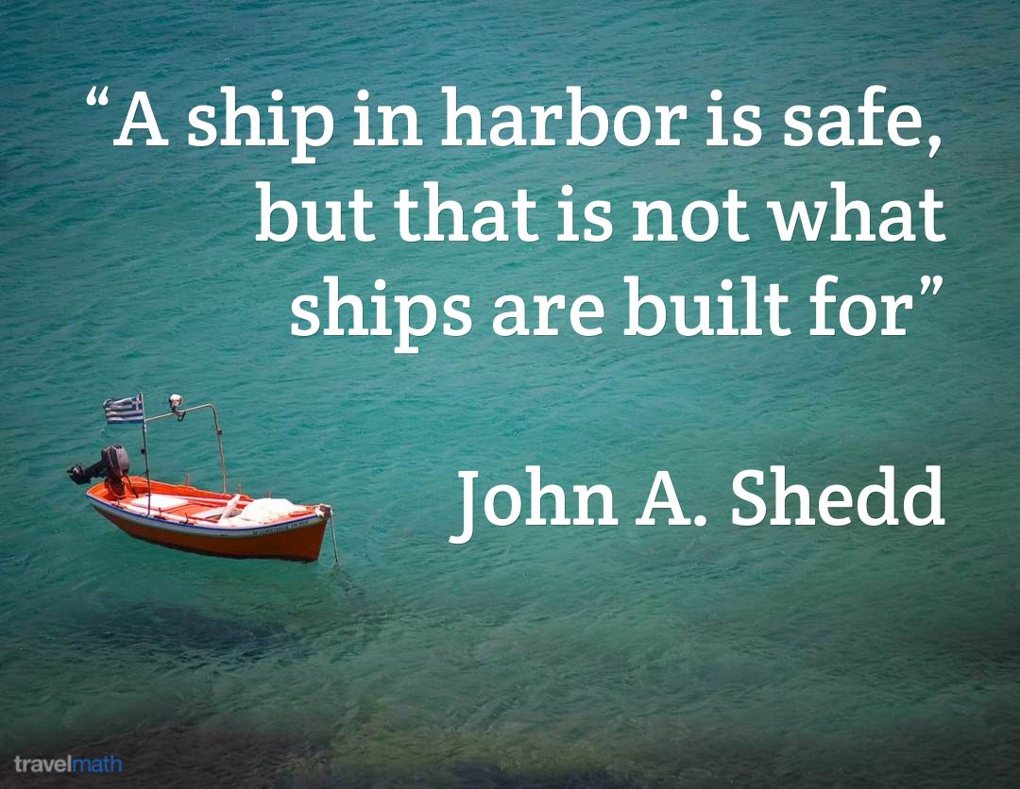
Read Think Link - Proverb Story

Slide 67

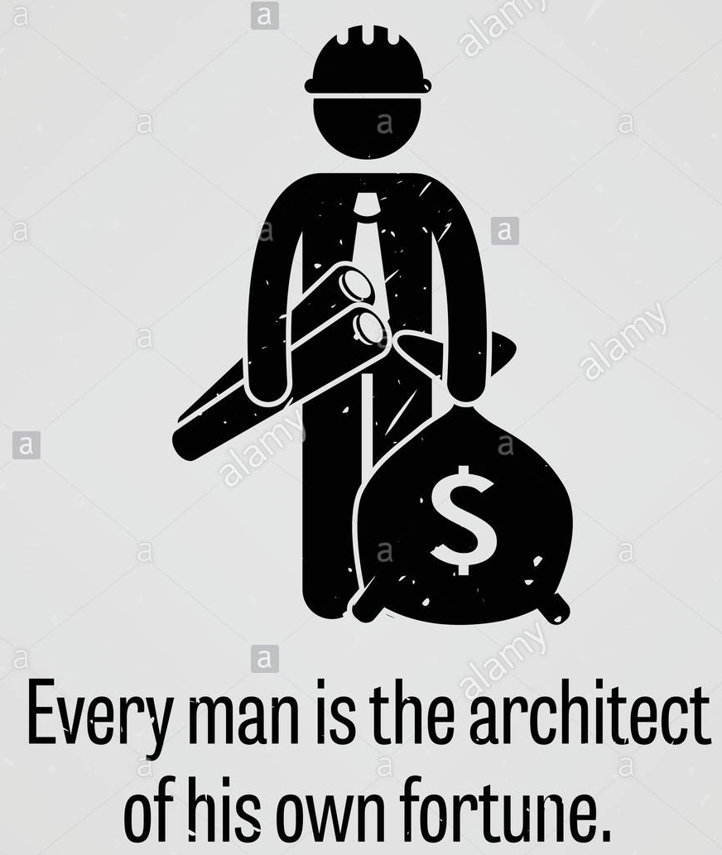

Read Think Link - Proverb Story

Slide 68



Read Think Link - Proverb Story

Slide 69
Speak Tweak Repeat
Look at the sequence of pictures carefully
Narrate the story as per the sequence
Bring your own twist to the story w.r.t. a management angle after the picture narration
Repeat the learnings with a focus on how the story can impact your career / job / corporate life / education / personal life
1 minute to prepare and 2-3 minutes for presentation

Slide 70
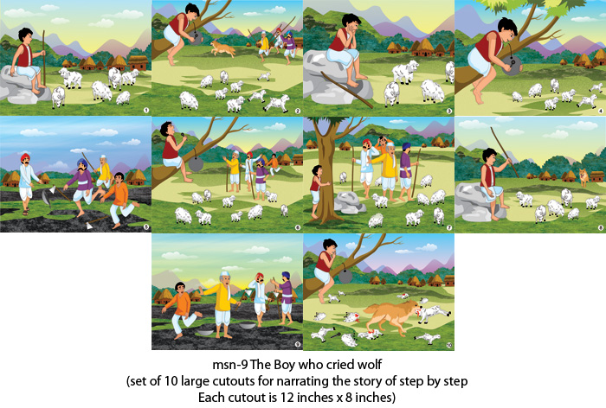
Speak Tweak Repeat - Picture Narration
Notes:
The boy who cried wolf

Slide 71
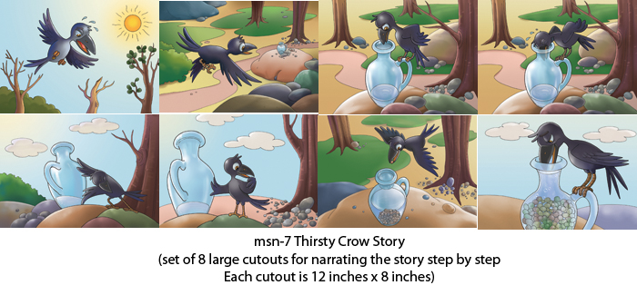
Speak Tweak Repeat - Picture Narration
Notes:
The thirsty crow

Slide 72
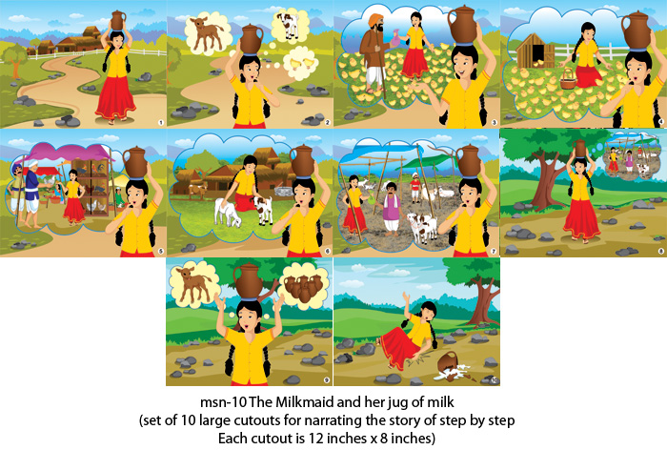
Speak Tweak Repeat - Picture Narration
Notes:
The Milkmaid and her Jug of Milk

Slide 73
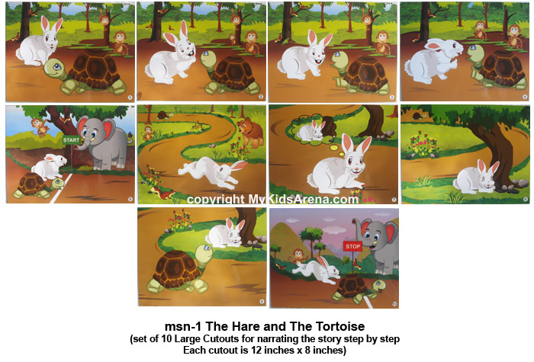
Speak Tweak Repeat -Picture Narration
Notes:
The hare and tortoise

Slide 74

Speak Tweak Repeat -Picture Narration
Notes:
2-friends and the bear

Slide 75
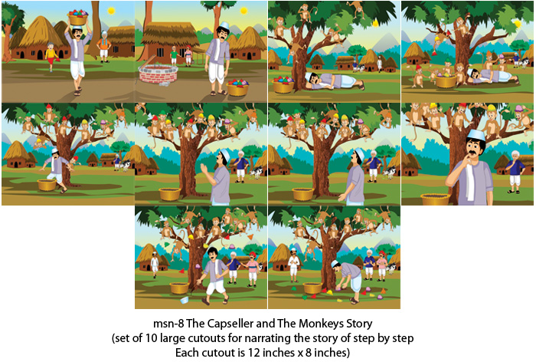
Speak Tweak Repeat -Picture Narration
Notes:
The cap seller and monkeys

Slide 76
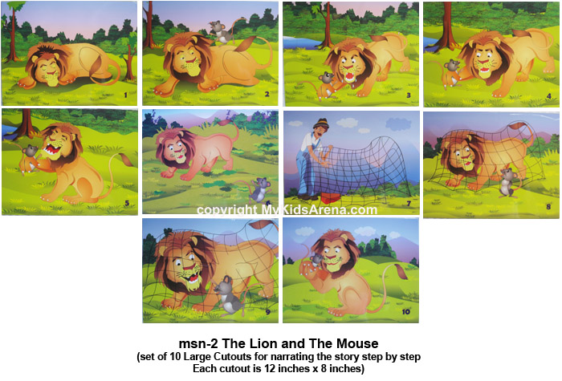
Speak Tweak Repeat -Picture Narration
Notes:
The lion and the mouse

Slide 77
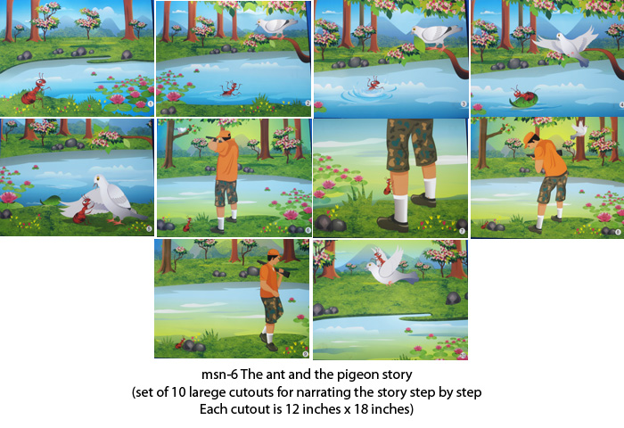
Speak Tweak Repeat -Picture Narration
Notes:
The ant and pigeon

Slide 78
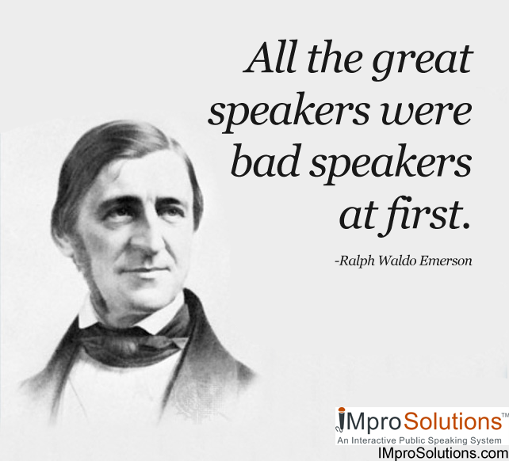

Slide 79


