Slide 1






16/06/21
Report Writing
‹#›

Slide 2

Report writing
16/06/21
Report Writing
2

Slide 3
Learning Objectives
The participants will be able to:
1. Understand the meaning & purpose of report.
2. Write a problem statement for a report.
3. Understand the parts of report.
4. Write report
16/06/21
Report Writing
‹#›

Slide 4
What is a report?
A report is an orderly, objective communication of factual information that serves some business purpose.
Orderly
Objective communication
Factual
A report must serve some business purpose.
Present the information in an order to give maximum clarity.
Showing relationships among various parts of the report.
Good transition
Unbiased approach to the facts presented.
The report seeks truth, regardless of consequences.
Deriving logical meaning and presenting ideas clearly and fairly to others.
The basic ingredient of the report is factual information- events, records, and the various forms of data that are communicated in the conduct of business.
16/06/21
Report Writing
4

Slide 5
What a report does?
Provide information
Analyze
Recommend.
16/06/21
Report Writing
5

Slide 6
What a report does?
In the year 2018-20, the sales recorded by our company was worth Rs 10 million. Our net profits are up by 13 percent, year on year, and our total sales have risen from Rs 23 million to Rs 28 million this year. Our employee strength has grown from 2,321 to 2620 in this financial year. Our expenditure have risen from 10 percent of sales to 13 percent of sales.
This report is providing only information
16/06/21
Report Writing
6

Slide 7
What a report does?
The sales figures growth has been achieved because of our ability to crack new markets down south and to retain most of the business that we had last year. Almost all the 96 contracts were renewed and another 16 were added, which gave the additional figures. The presence of our company in trade shows held in Delhi boosted our figures, and we have been able to convert a couple of our leads from there.
This report is analysing how profits were up
16/06/21
Report Writing
7

Slide 8
What a report does?
It is recommended that we aggressively continue to search for new contracts and newer markets down south and look at promoting our products and services via trade shows. A basic analysis has revealed that most of the clients are coming in owing to our presence at trade shows, and we must utilize this to the fullest potential.
Above paragraph is giving recommendations.
16/06/21
Report Writing
8

Slide 9
Need for report writing
1. Voluntary reports
2. Authorized reports.
16/06/21
Report Writing
9

Slide 10
Purpose of report
1.Decision making
2. Planning
3.To solve a problem or situation.
4.To maintain permanent records of events or situations.
5. As a means of communication with key stakeholders ( society, government, people and shareholders)
16/06/21
Report Writing
10

Slide 11
Types of reports
Oral report
2. Written report
3. Formal and informal
4. Short and long
16/06/21
Report Writing
11

Slide 12
Preparation to write a report
16/06/21
Report Writing
12

Slide 13
1. Problem Statement
Work on a report logically begins with a need.
Once you have been assigned the task of writing a report, establish the problem clearly in mind,
Once you understand the problem, next logical step is to state it in writing (problem statement) clearly.
Problem statement in three forms:
1. Infinitive phrase: [The purpose of the report is….] “To determine the cause of decreasing sales at Store X.”
2.Question: “What are the causes of decreasing sales at store X?”
3.Declarative statement: “ Store X sales are decreasing, and management wants to know why.”
16/06/21
Report Writing
13

Slide 14
Preparation to write a report.
2. Determination of Factors (factors of the problem)
Factors may be subtopics of the main topic.
  Example
  Problem statement: To review operations of company X from January 1 through March 31.
  Factors:
  1. Production
  2. Sales
  3. Financial status
  4. Plant and equipment.
  5. Product development
  6. Personnel.
Use of subtopics in Informational reports
16/06/21
Report writing
14

Slide 15
Preparation to write a report.
2.Determination of Factors (factors of the problem)
Example:
Problem statement: Why have sales declined at the Bandra store?
Explanations (factors)
Competitor's activities have caused the decline
Changes in the local economy have caused the decline.
Consumer behaviors have caused the decline.
16/06/21
Report Writing
15

Slide 16
Question
For the following problem situation, write a clear statement of the problem and list the factors involved. When necessary, you may use your imagination to supply any additional information needed.
a. XYZ, Inc., wants a study made to explain its high employee turnover.
16/06/21
Report Writing
16

Slide 17
Preparation to write a report.
3.Gathering the needed information
Conducting the research that will produce the needed information.
4. Applying the findings to the problem.
5. Organizing the report information.
16/06/21
Report Writing
17

Slide 18
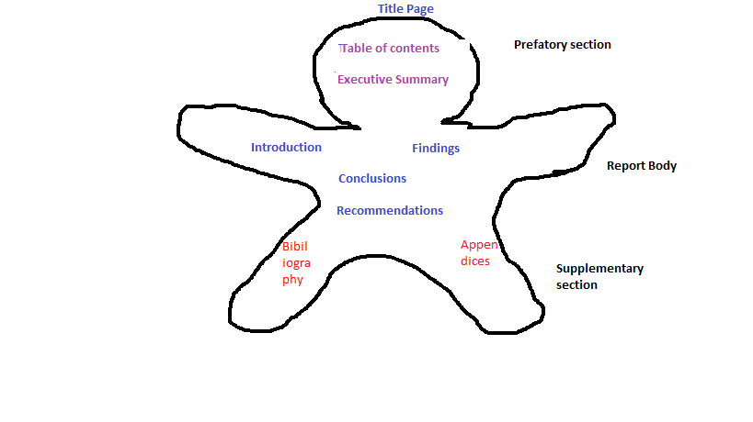
Parts of a report
16/06/21
Report Writing
18

Slide 19
Preparing a report
Prefatory part
16/06/21
Report Writing
19

Slide 20
Title page
The title should be indicative of the content of the report
Title page includes the title, author, date and frequently the name of the person or organization that requested for report.
Keep the title short, i.e., 8-10 words.
Be creative but relevant while thinking of the title. The five W’s and one H
16/06/21
Report Writing
20

Slide 21

16/06/21
Report Writing
21

Slide 22
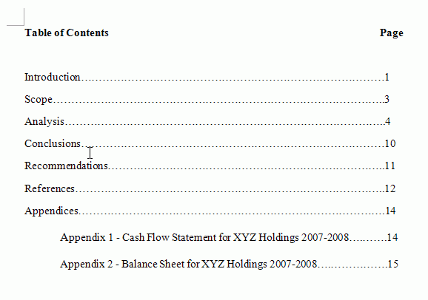
Table of contents
Analytical overview of the report and the order in which information is presented
16/06/21
Report Writing
22

Slide 23
Executive summary
Summary of entire report, covers all sections in short.
Overview of entire report.
It is designed chiefly for the busy executives who may not have time to read the whole report; but it may also serve as preview or review for those who will thoroughly read the report text.
16/06/21
Report Writing
23

Slide 24
Report Body
16/06/21
Report Writing
24

Slide 25
Introduction
Introduces the topic of the report in context.
Explains the problem and/ or motivation for the project.
States the aim/s of the project.
The scope and limitation of the report.
16/06/21
Report Writing
25

Slide 26
Sources and Methods of Collecting Data
It is advisable to tell the reader how you collected the report information. (Library, research, interviewing)
If it is library research – mention publications consulted.
If you used interviewing – mention sample determination, questionnaire construction and procedures followed.
Mention the techniques used to analyze the data.
16/06/21
Report Writing
26

Slide 27
Findings
Results of investigation, research and calculation.
16/06/21
Report Writing
27

Slide 28
Conclusions
Inferences the writer draws from the finding.
A report conclusion answers what you said you wanted to accomplish in your problem statement.
16/06/21
Report Writing
28

Slide 29
Recommendations
Write the actionable points in the order of priority to take decisions.
2. Recommendations are interpretations based on the conclusions.
16/06/21
Report Writing
29

Slide 30
Supplementary Section
Appendix
Used for supplementary information that supports the body of the report, which cannot be placed in the report because of its volume.
Many report writers use online forums of the company to share such material with the audience.
Possible contents might be questionnaires, summary tables, additional references and other reports.
As a rule, one should not include in the appendix the charts, graphs sketches, and tables that directly support the report. Instead, one should place them in the body of the report where they support the findings.
16/06/21
Report Writing
30

Slide 31
Supplementary Section
Bibliography
List of sources you used to get information for your report.
Included at the end of report.
Ex: Texts, articles, publications, online sources, interviews etc.
16/06/21
Report Writing
31

Slide 32
Assignment for next Session
Write an informational report on the last/recent function that took place at your home. Make necessary assumptions wherever required.
Students are instructed to give presentation on the reports written in the next session.
Please recall structure of the report while writing.
16/06/21
Report Writing
32

Slide 33

16/06/21
Report Writing
‹#›

