Slide 1

The Roadmap…

Slide 2

Why Managerial Communication

Slide 3


Slide 4
Learning objectives:
To get acquainted with all the topics under Managerial Communication.
To be able to identify the selected essential topics.
To meet the required expectations by the employers.
To apply the skills for better communication.

Slide 5
Do you know what is your Strength?
How much would you rate yourself on a scale of 10?
What things should fade away from yourself?

Slide 6

About

Slide 7
What do you think to be the important elements during Presentation?
How do you feel that someone gets impressed by?
What qualities of people influences you to be like them?

Slide 8


Slide 9
Are you able to do the right thing at right time and hit the right chord, timing is crucial.
How many of you keep a schedule for your entire day?

Slide 10
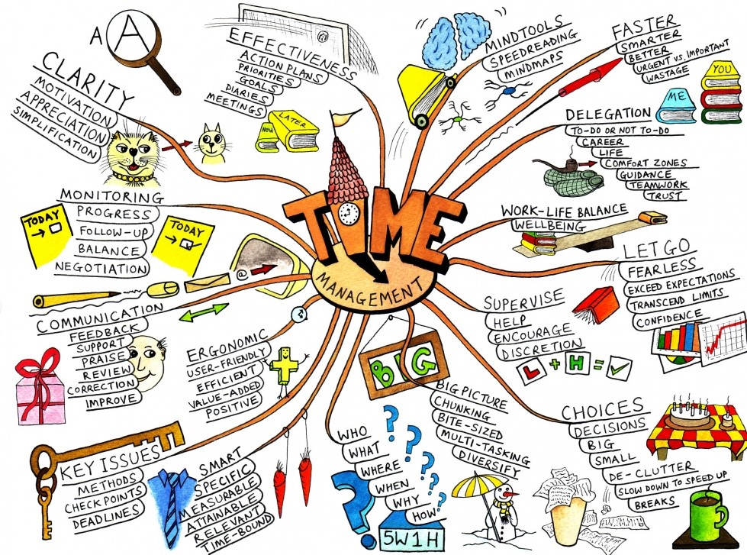

Slide 11

ST

Slide 12


Slide 13
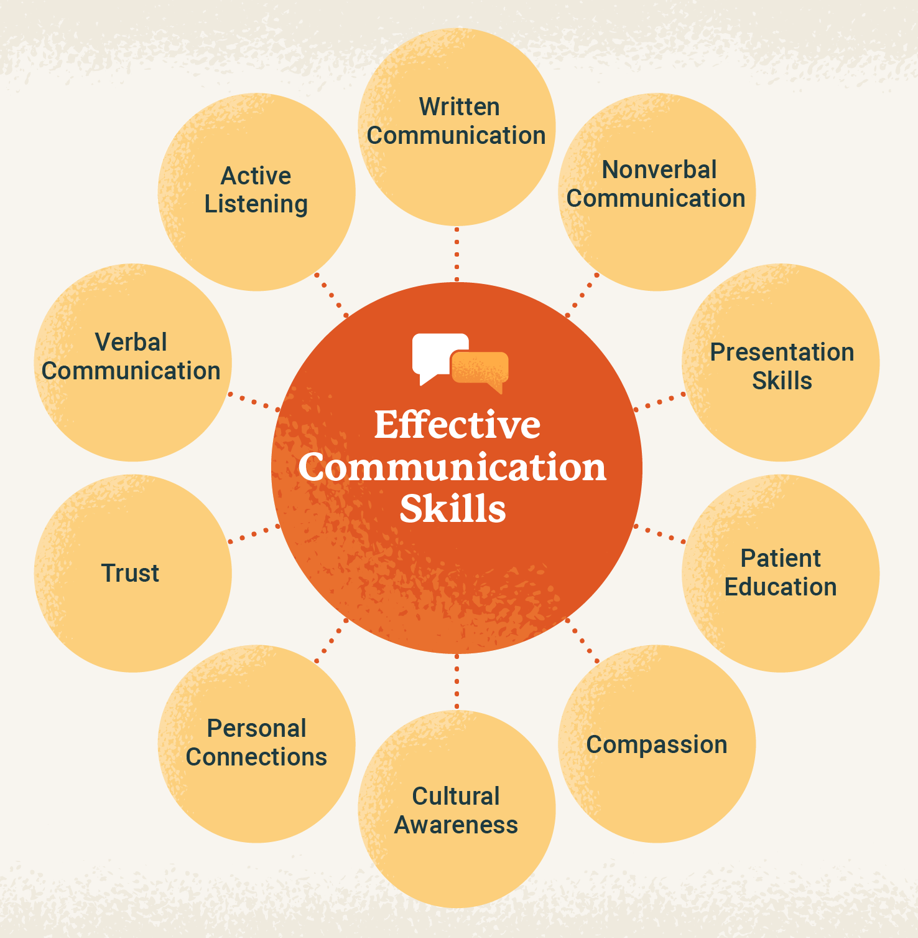

Slide 14


Slide 15
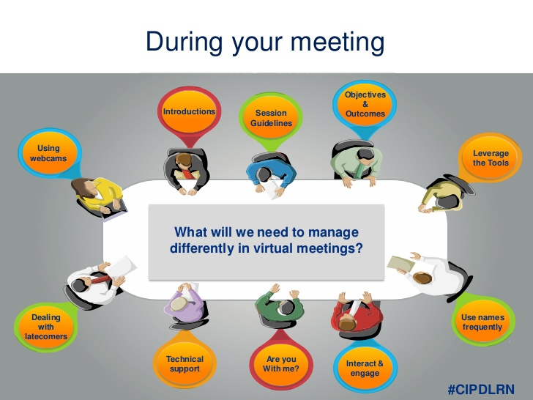

Slide 16
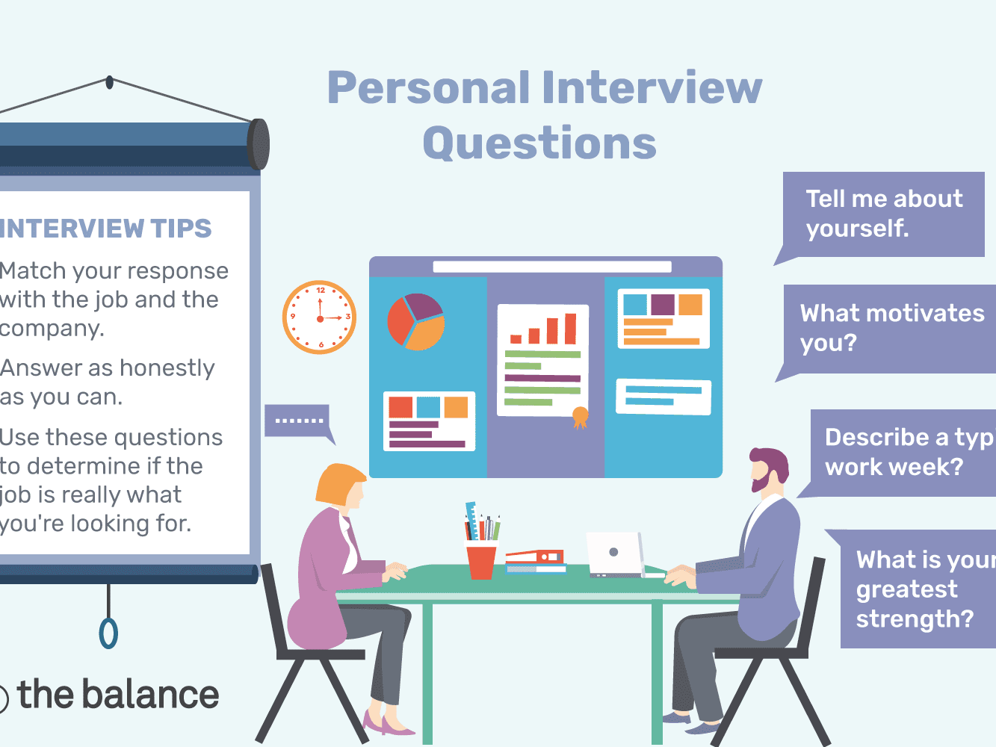


Slide 17

AssAssessment
Assessment
Internal Exam :
External Exam :

Slide 18


