Slide 1

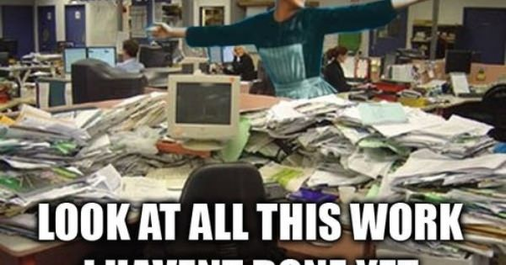

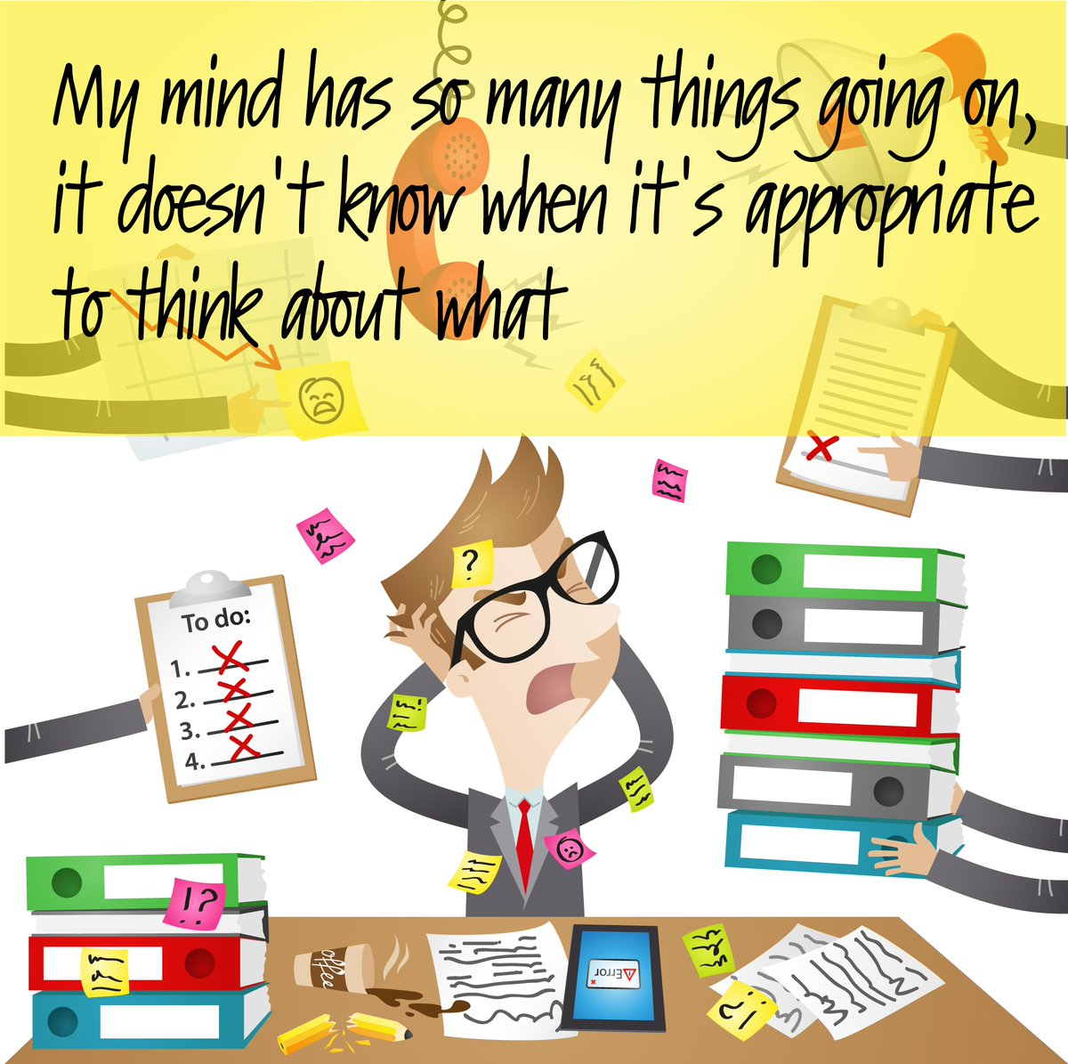
Oh! I am late again.
.
.
I have to search my project file
but my table is a mess.
I am still not ready for the presentation
I have not yet taken my breakfast and the meet is about to start….
03-06-2021
Time management
‹#›

Slide 2
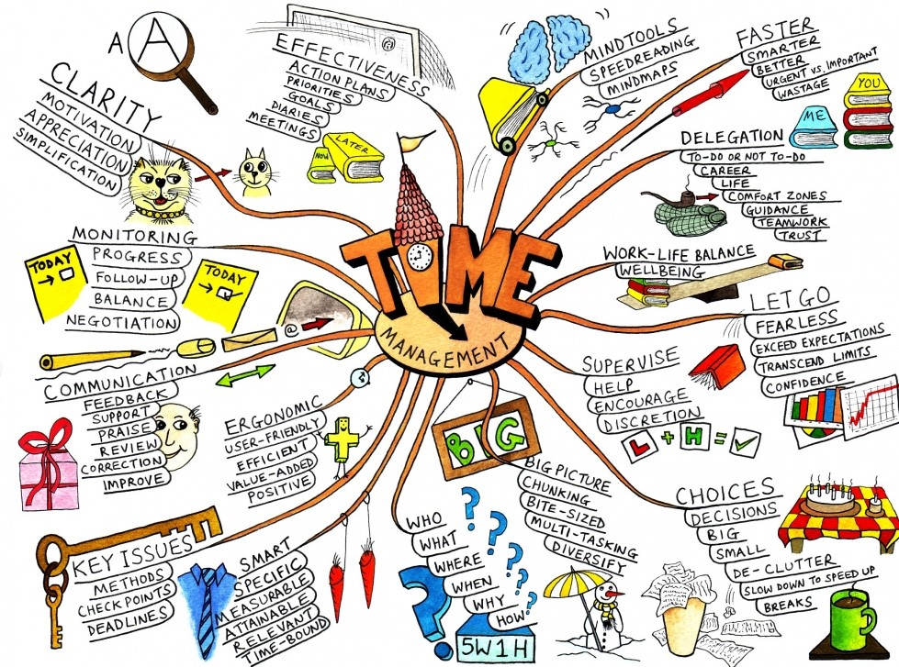
03-06-2021
Time management
‹#›
Notes:
The trainer explains the importance of time and how we use it differently based on specific goal setting and their requirement accordingly.
‹#›

Slide 3
Learning Outcomes
Understand what Time means to each one of us.
Understand what is Time management with it’s need and importance.
Evaluate and be able to manage the time .
Evaluate your daily routine according to the Time Management Matrix.
To overcome the major pitfalls of Time management.
03-06-2021
Time management
‹#›

Slide 4
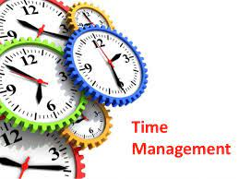
What is Time Management
The art of arranging,
organizing, scheduling and budgeting one’s time for
the purpose of generating one’s effective work and
productivity is known as
time management.
03-06-2021
Time management
‹#›

Slide 5
Why do we need Time Management ?
To Save Time
To reduce stress
To function effectively
To increase our work output
To have more control over our responsibilities
03-06-2021
Time management
‹#›

Slide 6

STEPHEN COVEY IDENTIFIED
4 WAVES IN TIME MANAGEMENT
1. Notes and Checklists
Recognition of the demands on energy & time.
2. Calendars and appointment books
Scheduling with some focus on the future.
3. Prioritization
Comparison of the relative worth of activities.
4. Self management
Realization that time cannot be managed - it is ourselves that we have to manage.
03-06-2021
Time management
‹#›
Notes:
Slide is self explanatory
‹#›

Slide 7
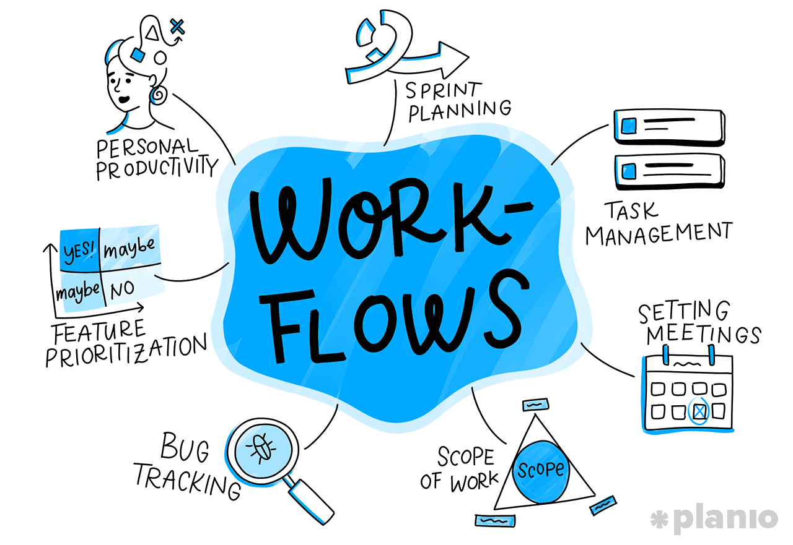
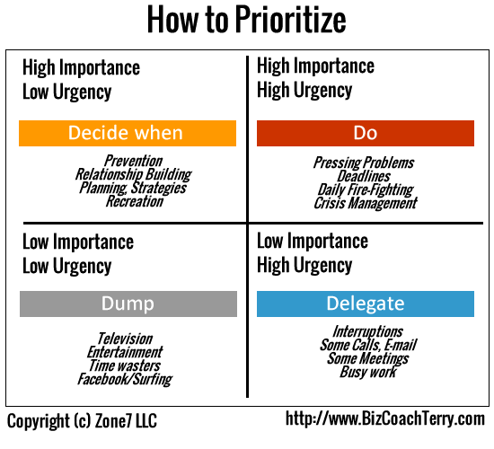
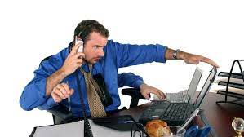
How to Manage Time?
1. Review your current workflows and routine
2.Prioritizing the task
3. Avoid Multitasking
03-06-2021
Time management
‹#›

Slide 8


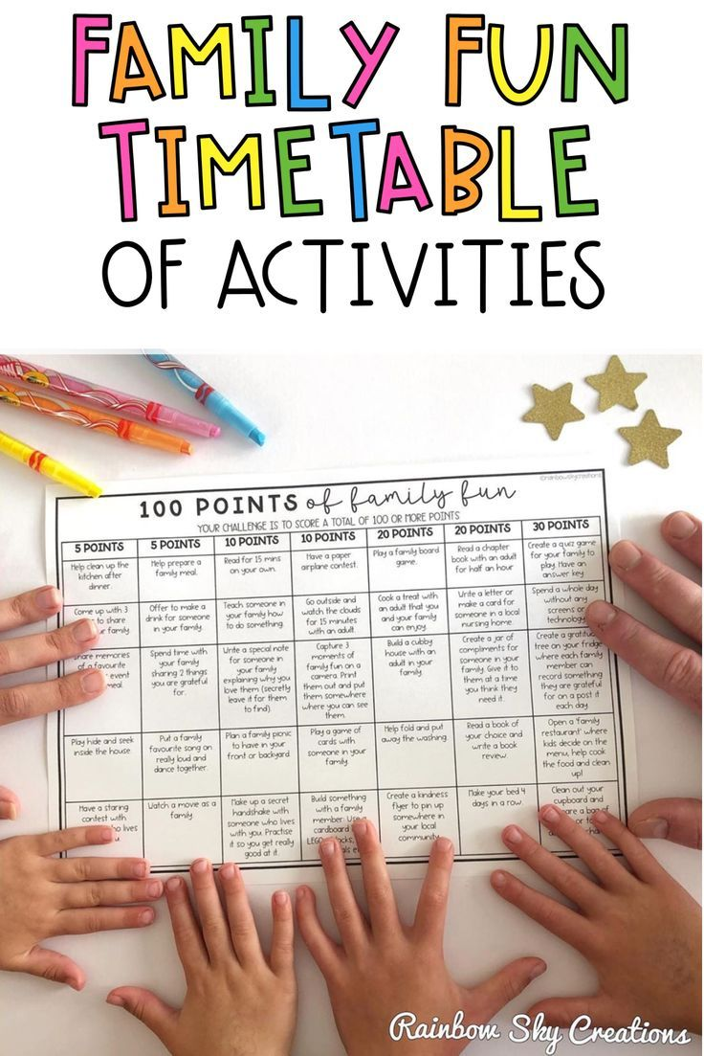
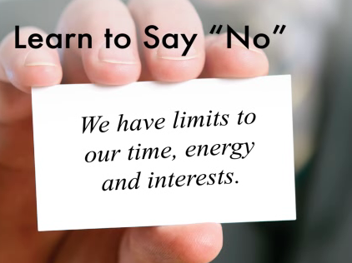

How to Manage Time?
4. Learn the power of saying No
5.Don’t get distracted
6.Leave time for relax-fun
03-06-2021
Time management
‹#›

Slide 9
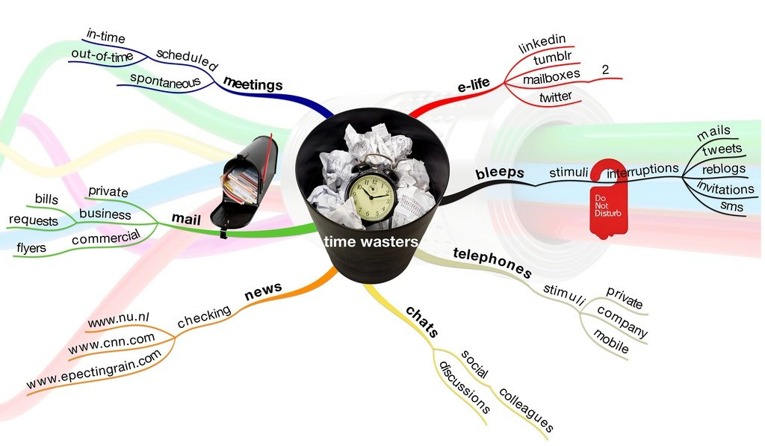
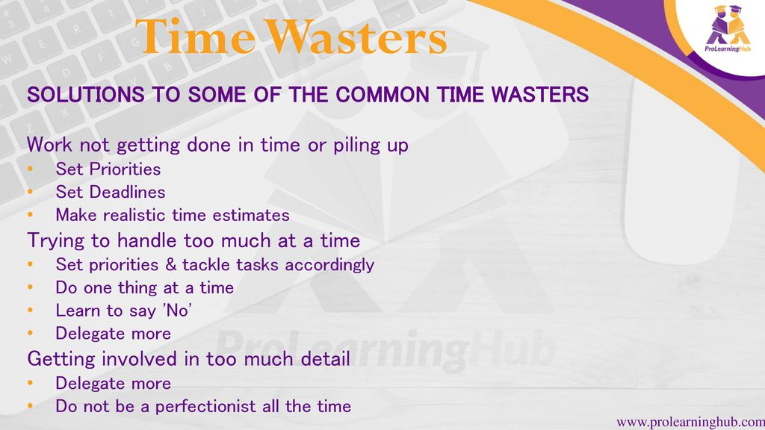
Time Wasters
03-06-2021
Time management
‹#›

Slide 10
Inside the mind of a master Procrastinator
https://www.youtube.com/watch?v=arj7oStGLkU
03-06-2021
Time management
‹#›
Notes:
To be shared amongst students before the class to see and be able to relate during the lecture session.
‹#›

Slide 11

Problem 1 - Procrastination
Common Pitfalls of Time Management
Putting off doing the things that you should be doing at this point!
Solution:
List all tasks that you are currently
putting off
Remove two from the list by doing them now!
Plan and set a schedule for dealing with
the rest
Reward when tasks are completed
Punish when tasks are not completed
on schedule
03-06-2021
Time management
‹#›
Notes:
Let’s deal with the biggest 3 problems that hampers our management of time. 1. Procrastination
‹#›
‹#›

Slide 12
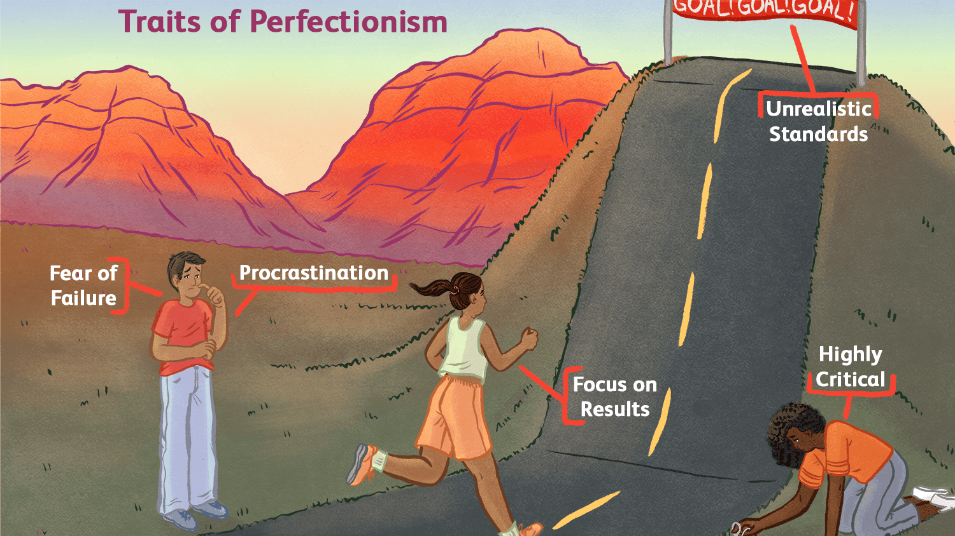
Problem 2 -Paralyzing perfectionism
This is a failure to recognize the difference between excellence and perfection
Excellence-Achievable,-Healthy,-Satisfying,-Realistic
Perfection-Unattainable,-Frustrating,-Unrealistic
03-06-2021
Time management
‹#›
Notes:
2. Paralyzing perfection
‹#›

Slide 13

Problem 3 – Setting unchallenging objectives
Objectives need to be set that challenge
you in a realistic manner and take heed of resource availability. Otherwise you are busy without any possibility of success.
03-06-2021
Time management
‹#›
Notes:
3.Setting Unchallenging objectives.
‹#›

Slide 14
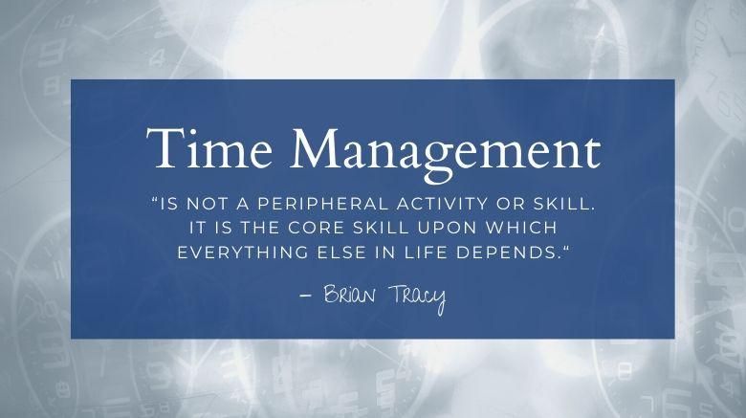
03-06-2021
Time management
‹#›
Notes:
Remember.
At the end the trainer asks the participants if they have any questions for the trainer.
‹#›

Slide 15

03-06-2021
Time management
‹#›

