Slide 1
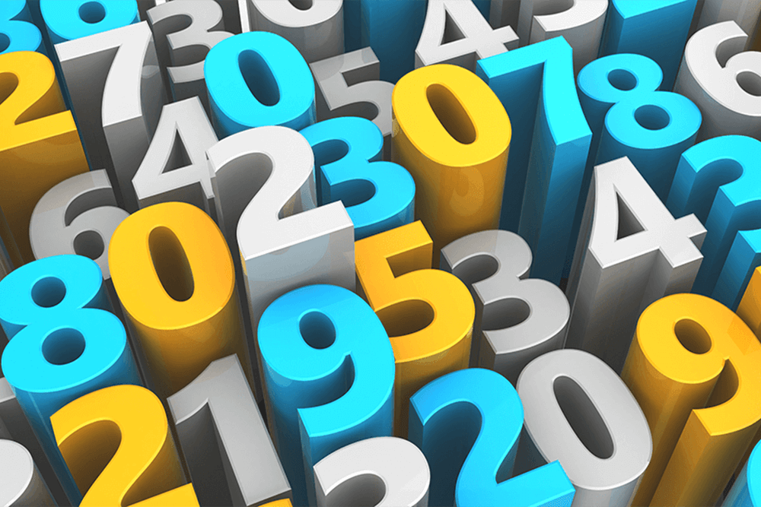
NUMBERS

Slide 2
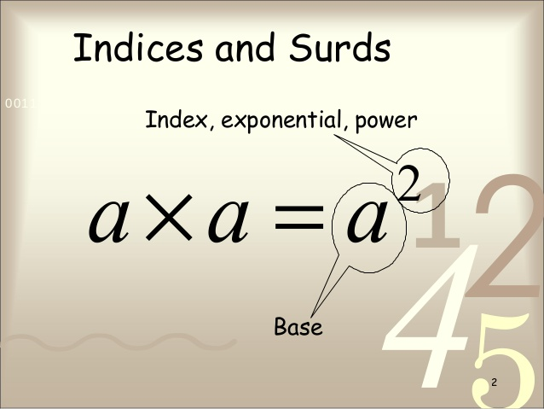

Slide 3
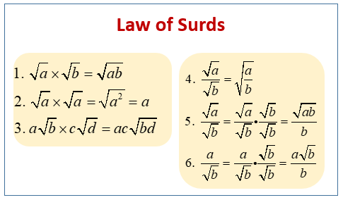

Slide 4
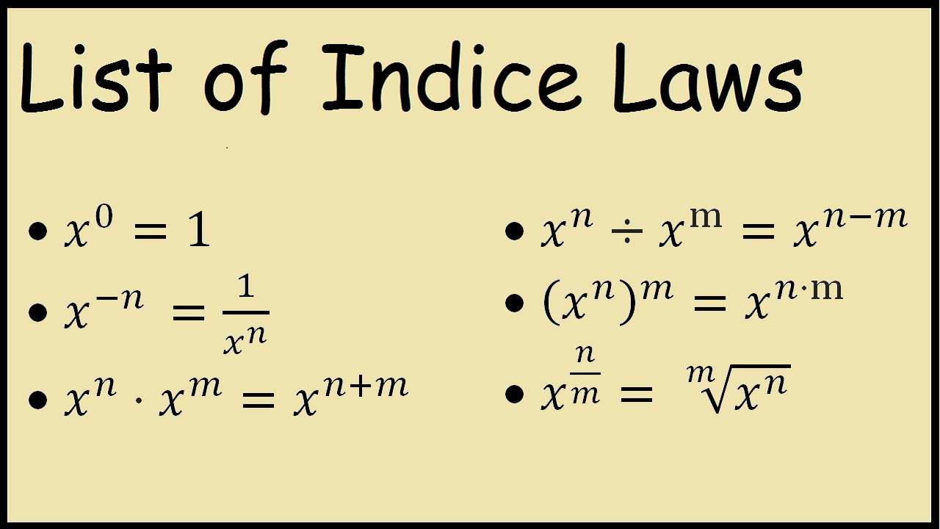
s

Slide 5
Try this out !!
If 3^{(x - y)} = 27 and 3^{(x + y)} = 243, then find x and y.
3^(x-y)= 3^3, 3^(x+y) = 3^5
x-y = 3, x+y = 5
2x = 8 or x=4
y=1

Slide 6
Try this out !!
(25)^{7.5} x (5)^{2.5} ÷ (125)^{1.5} = 5?
(25)^{7.5} x (5)^{2.5} ÷ (125)^{1.5}
(5^2)^7.5 x (5)^2.5 ÷ (5^3)^1.5
5^(2 x 7.5) x (5)^2.5 ÷ 5^(3 x 1.5)
(5^15) x (5^2.5) ÷(5^4.5)
5^(15+2.5 -4.5)
5^13
13 Answer.

Slide 7
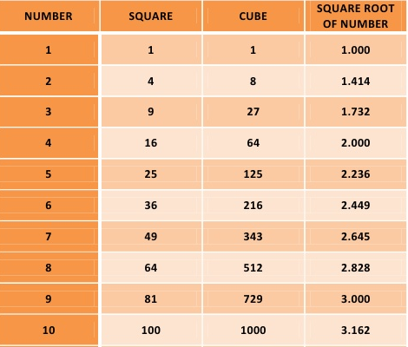
Boost your memory

Slide 8
Find the unknown:
x/ √128 = √162 /x
x^2= √(128 * 162)
x^2= √(64 * 2*2*81)
x=8*2*9
x = 144

Slide 9
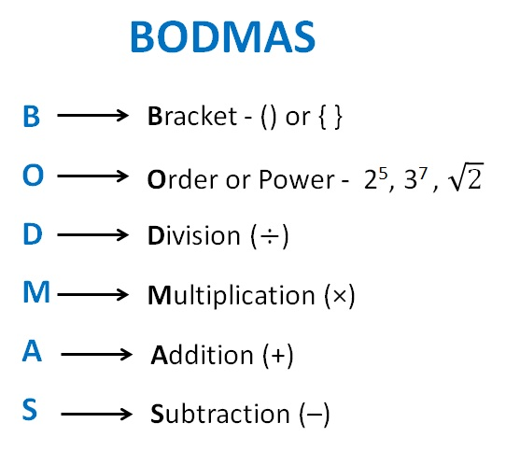

Slide 10
Simplify please !!
8-8+8 ÷4+4x2-2
8-8+2+4x2-2
8-8+2+8-2
8

Slide 11
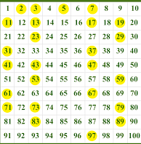
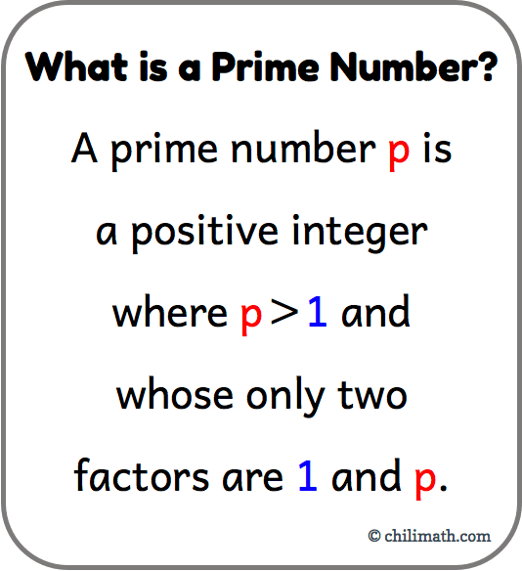

Slide 12
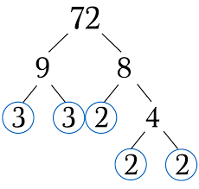

Slide 13
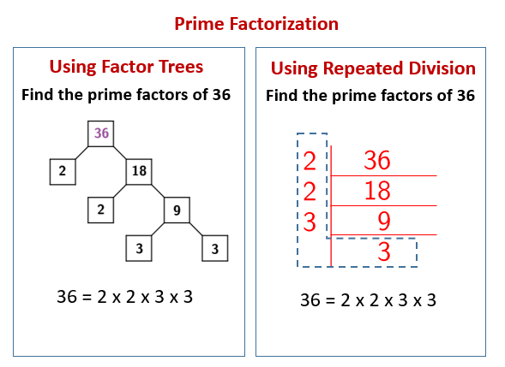

Slide 14
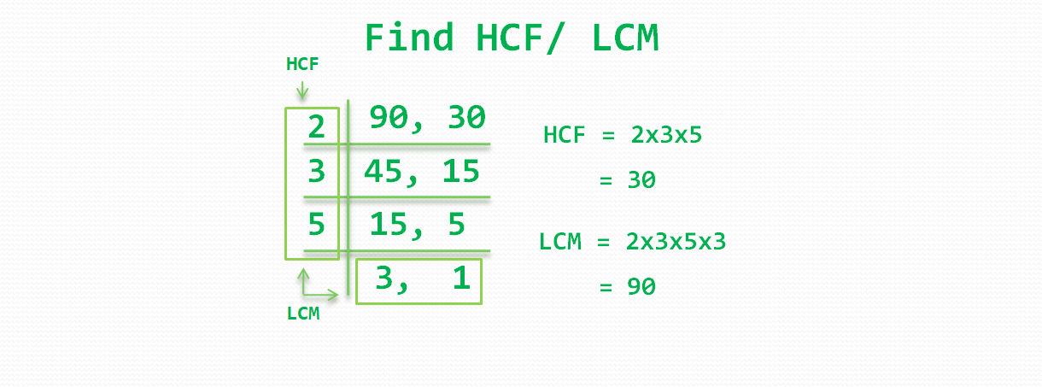

Slide 15
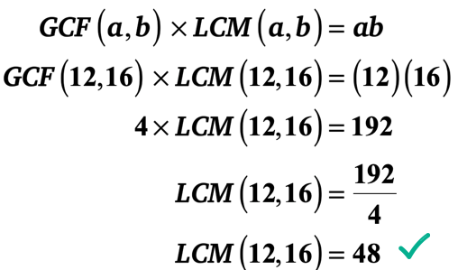

Slide 16
Try this out !!
Find the least number, which when divided by 12, 15, 20 and 54 leaves in each case a remainder of 8.
Required number = (L.C.M. of 12, 15, 20, 54) + 8
= 540 + 8
= 548.

Slide 17
One more….
The product of two numbers is 4107. If the H.C.F. of these numbers is 37, then find the greater number.
Let the numbers be 37a and 37b
37a x 37b = 4107
ab = 3
This is possible only if either a=1 & b=3 or a=3 & b=1
So the numbers are 37x1 and 37 x 3
Hence the greater number is 37x3=111

Slide 18
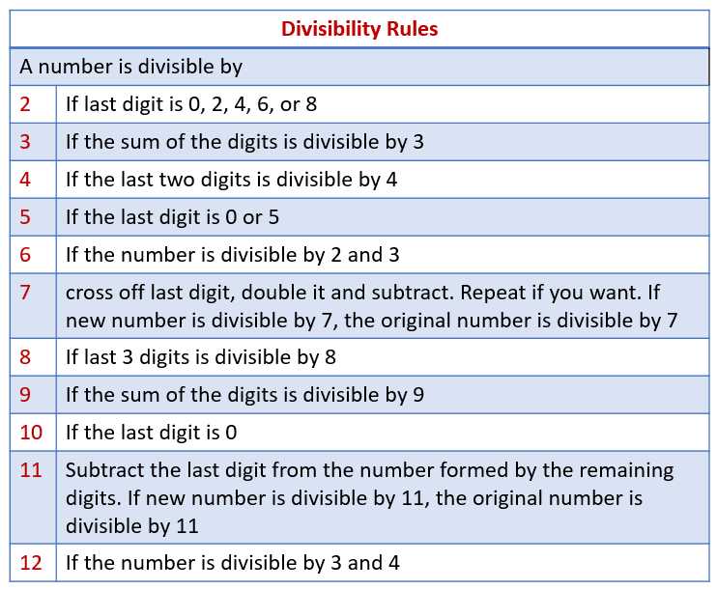

Slide 19
Check whether 6336 is divisible by 132.
If a number "A" is divisible by all factors of another number say "B", then "A" is divisible by "B“
Example factors of 6= 2*3;
Any number that is divisible by both 2 and 3 will be divisible by 6 always
In this question, we will factorize 132 in to 4*3*11 so that we can check whether all numbers are divisible by them..
If yes, then the number is divisible by 132.

Slide 20
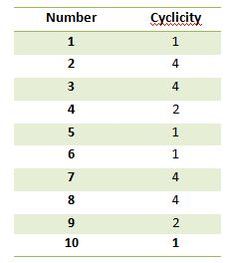

Slide 21
What is the unit digit in
{(6374)¹⁷⁹³ x (625)³¹⁷ x (341⁴⁹¹)}?
Unit digit in (6374)¹⁷⁹³ = Unit digit in (4)¹⁷⁹³
Unit digit in (6374)¹⁷⁹³ = Unit digit in [(4²)⁸⁹⁶ x 4]
Unit digit in (6374)¹⁷⁹³=Unit digit in (6 x 4) = 4
Similarly, Unit digit in (625)³¹⁷ = Unit digit in (5)³¹⁷ = 5
And Unit digit in (341)⁴⁹¹ = Unit digit in (1)⁴⁹¹ = 1
Required digit = Unit digit in (4 x 5 x 1) = 0.

Slide 22


Slide 23
If 42573K is divisible by 72, then the value of K will be?
72 = 2 x 2 x 2 x 3 x 3 or 72= 8 x 9
If a number is divisible by both 9 and 8, it will be divisible by 72
Now apply divisibility test of 8, last 3 digits should be divisible by 8
This gives k=6
Applying divisibility test of 9, Sum of all the digits should be divisible by 9
This also gives k=6
Hence, K=6

Slide 24
The HCF of two numbers is 38 and their LCM is 98154.
If one of the numbers is 1558, what is the other number?
Let the other number be ‘a’.
Using the formula
HCF x LCM = Product of two numbers
38 x 98154 = 1558 x a
This gives a= 38 x 98154
1558
a = 2394

Slide 25
LCM of two numbers is 14 times their HCF. The sum of LCM and HCF is 600. If one number is 280, then find the other number.
Let the other number be ‘a’.
Let LCM=l, HCF=h
280a=lh
l=14h
l+h=600
15h= 600 or h = 40
l= 14 x 40 = 560
a= lh/280
a= 560 x 40 / 280
a= 80

Slide 26
The least number of five digit which is exactly divisible by 12,15 and 18 is?
Smallest five-digit number = 10000.
LCM (12, 15, 18) = 180.
(10000 / 180) gives a dividend of 55 leaves a remainder of 100.
Therefore, we need to add (180 - 100) = 80 to 10000 in order to make the sum divisible by 180.
Therefore, the answer is (10000 + 80) = 10080.

Slide 27
What is the unit digit in
{(6374)¹⁷⁹³ x (625)³¹⁷ x (341⁴⁹¹)}?
Check for the cyclicity of 4, 5 and 1
Unit digit in (6374)¹⁷⁹³
= Unit digit in (4)¹⁷⁹³
= Unit digit in [(4²)⁸⁹⁶ x 4]
= Unit digit in (6 x 4) = 4
Unit digit in (625)³¹⁷
= Unit digit in (5)³¹⁷
= 5
Unit digit in (341)⁴⁹¹
= Unit digit in (1)⁴⁹¹
= 1
Required digit
= Unit digit in (4 x 5 x 1)
= 0

Slide 28
A number, which when divided by 32 leaves a remainder of 29. If this number is divided by 8, then the remainder will be?
Dividend= divisor x quotient + remainder
Let x be the given number and k be the quotient.
x = 32k + 29
x= 8(4k + 3) +5
i.e when x is divided by 8, the quotient is 4k+3 and the remainder is 5.

Slide 29
How many numbers between 1 and 1000 will be divisible by 7?
Dividing 1000 by 7
1000/7=142.8571
so 142 numbers are there between 1 to 1000 are divisible by 7

Slide 30
How many numbers between 55 and 555, including both the extreme values, is divided by 5?
The sequence of this series is as follows 55, 60, 65, 70, 75, ……, 545, 550, 555.
This is an A.P with nth term 555, first term, a= 55, d=5
a_{n} = a + (n − 1) × d
555 = 55+(n-1)5
500 = 5n – 5
n = 505/5
n =101

Slide 31
If 50 is added to the 50% of the same number, then the number becomes itself. What is the number?
Let the number be ‘a’
50+a/2 =a
a/2 =50
a=100

Slide 32
The smallest number by which 66 must be multiplied to make the resultant divisible by 18?
66 = 6 x 11
18 = 6 x 3
Clearly, 66 must be multiplied by 3 to be divisible by 18.

Slide 33
2-2+2-2+2-2….101 Terms=?
Clearly, alternate positive and negative values of 2 will get cancelled till 100 terms.
101th term would again be 2 which is not cancelled
So the answer is 2

Slide 34
6+12+18+24+…..60, is equal to?
It is an AP with first term , a=6, common difference, d= 6 and no: of terms, n= 10
Sum of n terms of an AP, Sn= n/2[ 2a+(n-1)d]
So, required sum = 5[ 12+(9x6)]
required sum = 5 x 66 = 330

Slide 35
¾ of a number is 20 more than half of the same number. What is the required number?
let the number be ‘a’
3a/4 = 20 + a/2
a/4= 20
a= 80

Slide 36
Find the unit digit of 251^97 + 44^65 + 63^63 + (34*76)
unit digit of 251^97 = 1
unit digit of 44^65 = 4
unit digit of 63^63 = 7
unit digit of 34*76 = 4
1+4+7+4= 16 => unit digit =6
Apply cyclicity of numbers
Add all the unit digits

Slide 37
107 x 107 + 93 x 93 = ?
107 = 100+7
93 = 100-7
a=100, b=7
We have:
[(a+b)^2 +(a-b)^2]
[(a+b)^2 +(a-b)^2] = 2[a^2 +b^2]
107x107+93x93 = 2[100^2 + 7^2]
2[10000+49] = 20098

Slide 38
Find (469 + 174)² - (469 - 174)²
^{469 x 174}
Here a=469, b=174
[(a+b)^2 - (a-b)^2] = 4ab
4ab /ab = 4
Required answer = 4

Slide 39
(25)^{7.5} x (5)^{2.5} ÷ (125)^{1.5} = 5?
Using the laws of indices,
LHS = 5 raised to the power [(2 x 7.5) + 2.5 – (3 x 1.5)]
= 5 raised to the power [15+2.5 – 4.5]
= 5 raised to the power 13

