Slide 1


Slide 2

Basics
Equation: two parts give same value on comparison
Mathematical expression on both sides of ‘=‘ should be equal in magnitude.

Slide 3
Basics
Constant: value does not change
Variable: value may change. Unknown quantity
Tip: take all the variables on one side and all the constants on the other side of ‘=‘.

Slide 4
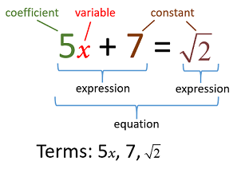

Slide 5
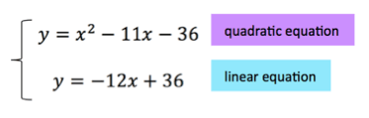
Linear Vs. Quadratic Equations
Degree: the highest power of any variable: 1 in case of linear and 2 in case of quadratic
Graph: Straight line in case of linear equation and curve in case of quadratic

Slide 6
It’s your turn !!
A man has some hens and cows. If the number of heads be 48 and number of feet be 140, then find the number of hens.
Let there be x hens and y cows
x + y = 48 & 2x + 4y = 140
x + y = 48 & x+2y = 70
Solving the two equations, we get y= 22
x = 48 – 22 = 26
Number of hens = 26

Slide 7
Try one more ….
The sum of two numbers is 80. If the larger number exceeds 4 times the smaller number by 5, then find the smaller number.
Let the larger number be x and then the smaller one will be 80-x
x = 4(80-x)+5
x = 320 – 4x + 5
5x = 325
x = 65
Smaller number = 80-65=15

Slide 8
And this one….
The perimeter of a rectangle is 82m and its area is 400 sq. m. Find the breadth of the rectangle.
Let l & b be the length and breadth of the rectangle respectively
Given, 2(l+b)=82 , lb =400
l+b =41 , lb=400
(400/b)+b = 41 or (41-b)b=400
Solving for any of these equations will give the answer
Hint: We could have considered only one variable assuming breadth to be x and length as 41-x

Slide 9
Solving (41-b)b=400
-b^2+41b=400
b^2 -41b +400 = 0
(b-16)(b-25) = 0
b=16 or b = 25

Slide 10
Averages
Sum of Observations/No: of Observations
Also called as mean
Total(sum)= Average x No: of Units (observations)
Corrected Average= [(Incorrect Average x No: of items) – incorrect value + correct value] / No: of items

Slide 11
Some Rules
If each one of some given numbers is increased by k, then their average is increased by k.
If each one of some given numbers is multiplied by k, then their average is multiplied by k.
If a journey is covered from A to B at u Km/hr and the return journey is covered at v Km/hr, then average speed during the whole journey is : [2uv/(u+v)] Km/hr.

Slide 12
It’s your turn !!
The average weight of a class of 24 students is 35 Kg. If the weight of the teacher be included, the average rises by 400 gms. Find the weight of the teacher.
Total weight of 24 students= (24x35)= 840 Kg
Total weight of 24 students and 1 teacher = (25x35.4) Kg = 885 Kg
Weight of the teacher = (885-840) Kg
Weight of the teacher = 45 Kg

Slide 13
Try one more ….
The average of 11 results is 50. If the average of first six results is 49 and that of last six is 52, find the sixth result.
Sum of 11 results= (11x50)=550
Sum of first six results = (6x 49) =294
Sum of last six results = (6x 52) = 312
6th result = 294+312-550
6th result = 56

Slide 14
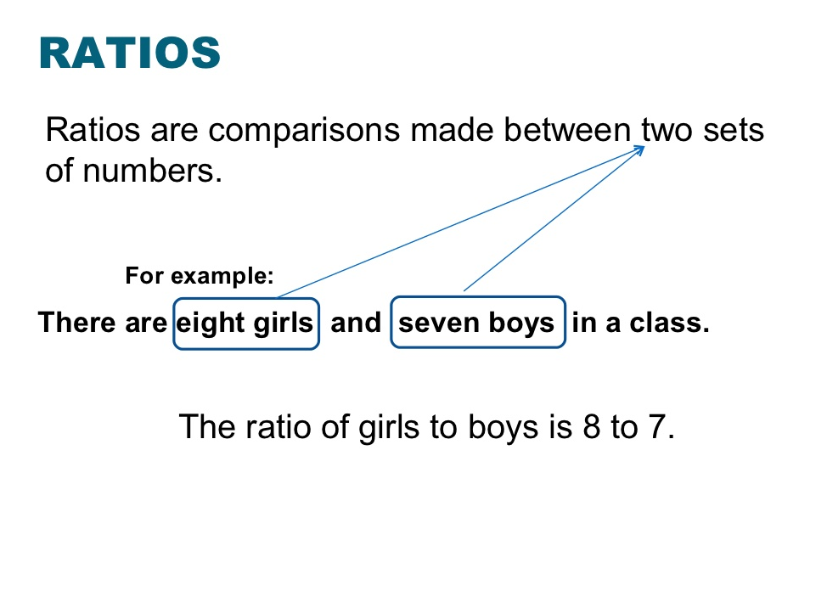
Ratio and Proportions

Slide 15
How to express ratios
x : y
x/y
X is to y

Slide 16
Rules
When writing ratios, the numbers should be written in the order in which the problem asks for them
Reduce given ratio to simple fractions to optimize and speed up calculations

Slide 17
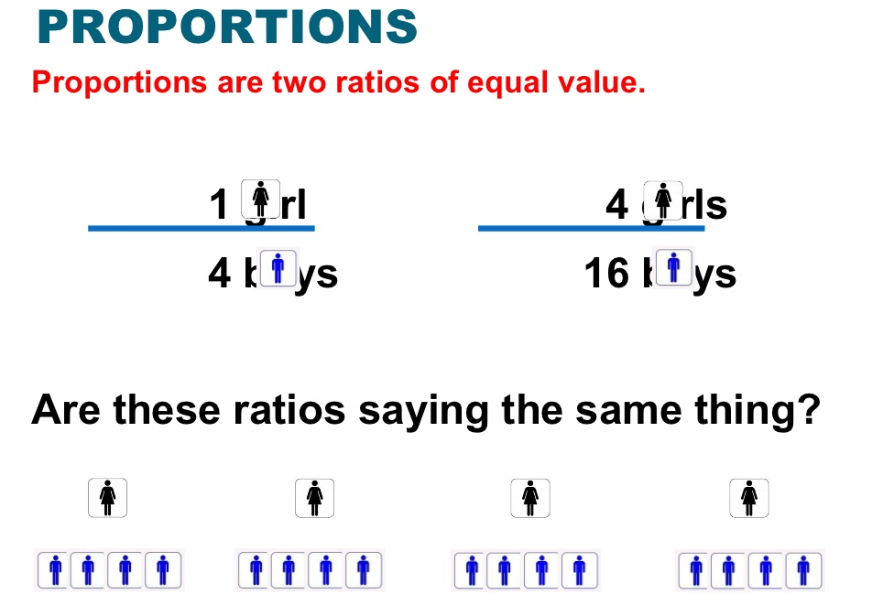

Slide 18
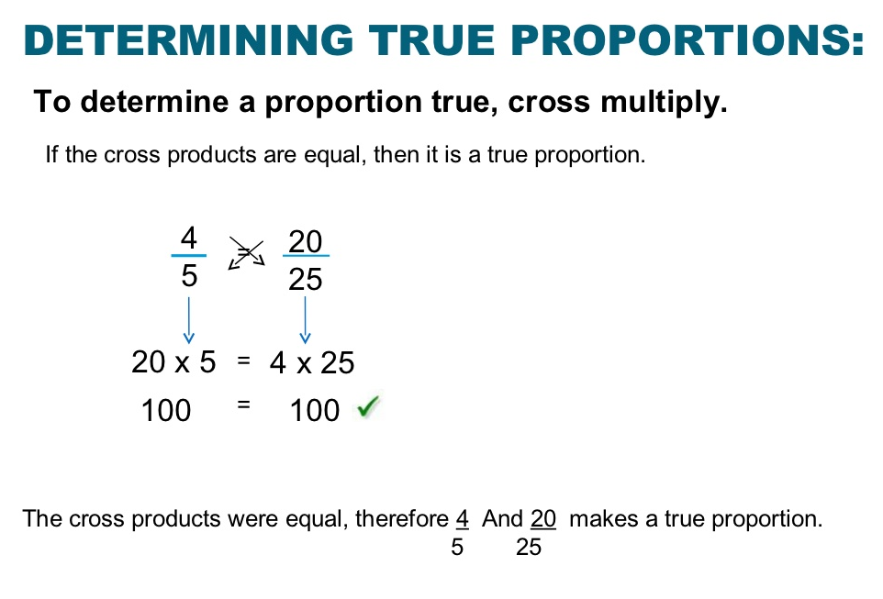

Slide 19
It’s your turn !!
Salaries of A and B are in the ratio 2 : 3. If the salary of each is increased by Rs. 4000, the new ratio becomes 40 : 57. What is B's salary?
Let the original salaries of A and B be 2x and 3x respectively
(2x+4000): (3x+4000) = 40: 57
57(2x + 4000) = 40(3x + 4000)
114x+228000 = 120x+160000
6x=68000 => x=34000/3
B’s original Salary= 3x=3(34000/3)= Rs. 34000
B’s present salary= Rs. 34000+Rs 4000
B’s present salary= Rs. 38000

Slide 20
Tips for problems on ages
Read the question carefully, form the equation and solve.
Note: You will need as many equations to solve a problems as are the number of variables in the equation.

Slide 21
It’s your turn !!
The sum of the present ages of a father and his son is 60 years. Six years ago, father's age was five times the age of the son. After 6 years, what will be the son's age?
Let the present ages of son and father be x and (60 -x)years respectively.
Then, (60 - x) - 6 = 5(x - 6)
54-x = 5x-30 or 6x=84 or x=14
Son’s age after 6 years will be = x+6 = 14+6 = 20 years.

Slide 22


Slide 23
Question
Eight years from now, Anu will be twice as old as she was six years ago. What is her present age?
Let her present age= x years
Her age 8 years from now=(x + 8) years
Her age 6 years ago= (x – 6) years
According to question, x + 8 = 2(x-6)
X+ 8 = 2x -12
X = 20 years
Present age of Anu = 20 years

Slide 24
The ratio of ages of A and B is 11 : 8 and the sum of their ages is 38 years. What will be the ratio of the ages of A and B, eight years from now?
A:B= 11:8, A+B=38
Let A’s age = 11x and B’s age = 8x
So, 11x+8x=38
19x=38 => x=2
A’s present age= 11x 2= 22 yrs, B’s present age= 8x2= 16 years
8 years from now, ratio= (22+8)/(16+8) = 30/24 = 5/4
= 5:4
Q
U
E
S
T
I
O
N

Slide 25
Question
Also, 3x-8=2(2x-8)
3x-8 = 4x-16
x=8 years
So Suresh’s present age = 2x8= 16 years.
Eight years ago, Ramesh was twice as old as Suresh. If the ratio of their ages is 3:2 now, what is Suresh’s present age?
Let their present ages be 3x and 2x years respectively
8 years ago=> R’s age= 3x-8 and S’s age= 2x-8

Slide 26
OR
Let their present ages be x and y years respectively
x/y= 3/2……..(1)
8 years ago=> R’s age= x-8 and S’s age= y-8
Also, x-8=2(y-8)
x-8 = 2y-16
2y-x=8…………(2)
Use value of x from (1) into (2),
2y-(3/2)y=8
y/2=8 => y=16 years.
Eight years ago, Ramesh was twice as old as Suresh. If the ratio of their ages is 3:2 now, what is Suresh’s present age?

Slide 27
Question
A mother is seven times as old as her daughter now, but two years hence she will be only five times as old. What is the mother’s present age?
M=7d
M+2 = 5(d+2)
7d+2=5d+10
2d= 8 => d=4
So, M= 7x4 = 28 years
Mother’s present age = 28 years

Slide 28
Question
The present ages of Kunal and Anand are in the ratio 6 : 5. Five years hence, the ratio of their ages will become 13 : 11. What is Anand’s present age?
K:A= 6:5
Let Kunal’s age= 6x and Anand’s age= 5x
5 years hence, Kunal’s age= 6x+5, Anand’s age= 5x+5
(6x+5)/(5x+5)= 13/11
11(6x+5)=13(5x+5)
66x+55 = 65x+65 => x= 10
So, Anand’s present age = 5x10=50 years

Slide 29
Question
Nishit’s present age is 2/7 the age of his father. Four years from now, his age will be one-third the age of his father. What is the present age of Nishit?
Let Nishit’s father’s age = x yrs
Then Nishit’s age= 2x/7 years
(2x/7)+4 = (x+4)/3
Solving the equation gives
x+28 = 84
x= 56
Nishit’s age = 2* 56/7 = 16 years

Slide 30
Question
Subodh’s present age is two-fifth the age of Shyam. After 8 years, he will be half as old as Shyam. 8 years from now, what will be the age of Shyam?
Let Shyam’s age = x yrs
Subodh’s age = 2x/5 yrs
(2x/5)+8 = (x+8)/2
(x+8)/2 – (2x/5) = 8
x+ 40 = 80
x=40
8 years from now, age of Shyam= 48 years

Slide 31
Question
solve :
X+6 = (y+6)*7/23 &&
(X-4)/(y-4) = 1/9
            OR
            (next slide)
6 years from now, Nikhil’s age will be 7/23 times his father’s age. Four years ago, the ratio of their ages was 1 : 9. What is the present age of Nikhil’s father?

Slide 32
Let 4 years ago, Nikhil’s & his father’s age be respectively
x and 9x years
Their respective present ages would be (x+4) & (9x+4 ) years
6 years from now, ages would be (x+ 10) & (9x+10) years resp.
Now, (x+ 10) = 7 (9x+10)/23 => 23x+230 = 63x+70 => x=4
present age of Nikhil’s father= 9x+4 = 36+4 = 40 years

Slide 33
Tell me now !!
Nine years hence, the age of Varsha will be two-thirds the age of Maya. Five years ago, the age of Varsha was half the age of Maya. What will be the age of Maya five years hence?
24 years
The ratio of the present ages of A and B is 7 : X . After 6 years, the age of B will be 42 years. The sum of their ages, four years ago, was 56 years. What is the value of X?
9

Slide 34
The average Age of A, B, C and D is 26. The average of B and D is 28. What is the average age of A & C?
Question
[(26x4) – (28x2) ]/2 = 24

Slide 35
Since avg. age of 4 people is 26 yrs
So, their total age will be 26x4 = 104 yrs
Avg age of B&D = 28 yrs
So, their total age will be = 28 x2 = 56 years
Total age of A&C = 104-56 = 48 yrs
So, their avg age will be 48/2 = 24 years
Solution

Slide 36
Why don’t you try this now ???
The average age of Ria, Sia and Tia is 24 years. After excluding Sia’s age, the average age becomes 16. What is Sia’s age?
40 years
(24x3)-32

Slide 37
And this…..
The average age of 40 Students and a teacher is 24 years. The average age of only the students is 0.5 years less than the average age of the 40 students and the teacher. What is the age of the teacher (in years)?
44 years
(41x24) –(40x23.5)

Slide 38
Question
A+B+C= 350 x3 = 1050 …….(1)
A= C+50………. (2)
B=2C …………..(3)
Use (2) &(3) in (1)
C+50+2C+C=1050
C= 250
So, A= 300
The average of the daily incomes of A, B, and C is 350. If A earns Rs. 50 more than C and B earns twice as much as C, what is the daily income of A?

Slide 39
Question
A+5+B=32
A+B= 27……..(2)
Use (2) in (1),
27+C=45
C= 18
The average of 3 numbers A, B and C is 15. If 5 is added to A, the average of A and B becomes 16. What is the value of C?
A+B+C=45……….. (1)

Slide 40
Question
The average age of Priya and her daughter Ruchi is 32 and the average age of Shiv and his son Prem is 36 years. If Prem and Ruchi are 22 and 18 years old respectively, what is the average age of Shiv and Priya?
Priya + Ruchi =64 yrs
Ruchi = 18 yrs => Priya = 46 yrs
Shiv + Prem = 72 yrs
Prem = 22 yrs => Shiv = 50 yrs
Avg(Shiv+ Priya) = (46+50)/2
= 48 yrs

Slide 41
Question
If Jason purchases 2 shirts for Rs. 179 each and Three shirts for Rs. 189 each, what is the average price that Jason paid for each shirt?
[(2x179)+(3x189)]/5
Rs. 185

Slide 42
Question
The average temperature of the first three days of a week is 37 -degree C and that of the next three days is 31-degree C. Also, the average temperature of the whole week is 34 degree Celsius. What is the temperature of the last day of the week?
(34x7) – (37x3) – (31x3)
34 degrees

Slide 43
Question
The average weight of 6 students increases by 2 kg if a student weighs 48 kg is replaced by another student. What is the weight of the new student?
Let the avg. weight of 6 students be x Kg
Total weight = 6x Kg.
New Total weight = 6(x + 2) Kg
6x-48+weight of new student = 6(x+2)
Weight of new student = 48+12
= 60 Kg

Slide 44
Question
A batsman makes a score of 198 in his 23rd Inning and thereby increases his average by 7. What is his total score before the 23rd Inning?
Let his average score before the 23rd Inning be k
(22k+198)/23 = k+7
22k+198 = 23k + 161
k = 37
So, his total score before the 23rd Inning 22x k = 814 runs

Slide 45
Question
What number should be added to each term in the ratio 19:43, so that it becomes equal to 2:3?
Let k should be added
19+k : 43+k = 2:3
3(19+k) = 2(43+k)
57 + 3k = 86+2k
k = 29

Slide 46
Question
78 is divided into two parts such that the ratio between those two parts is 7:6. What is the product of those two parts?
Let one part be k and the other part be 78-k
K:(78-k) = 7:6
6k=7(78-k)
13k = 546 => k=42
product of those two parts= 42x 36 = 1512

Slide 47
Question
The sum of three numbers is 98. If the ratio of the first to second is 2:3 and that of the second to third is 5:8, what is the second number?
Let a, b, c be the three numbers
a+b+c = 98
a:b= 2:3, b:c=5:8
a= 2b/3, c=8b/5
2b/3 + b + 8b/5 = 98
49b/15 = 98 => b=15x2
b= 30

Slide 48
Question
If one-fifth of three-fourth of two-third of a number is 46, what is 35% of the number?
Let the number be k
(1/5)(3/4)(2/3) k = 46
k/10=46 => k=460
35% of k= 35 x 460/100
= 7x23
=161

Slide 49
Try it yourself !!
35% of a number is equal to four-fifth of another number. What is the ratio between 25% of the first number and 60% of the second number?
If A:B is 3:8, B:C is 5:3, C:D is 4:5, Find D:A .

Slide 50
Question
If the incomes of A and B are in the ratio 3:4 and their expenditures are in the ratio 2:3, what is the ratio of their savings?
Data Inadequate

Slide 51
Question
A certain recipe needs 4kg sugar for every 9kg of wheat. If 143 kg of this sweet is to be made, how much sugar is required?
Sugar: Wheat = 4:9
Let required sugar be 4k and req wheat be 9k
13k = 143
k = 11
So, req. sugar = 4x11 = 44 Kg

Slide 52
Question
A, B and C play cricket. A’s runs and B’s runs are in the ratio 3:2. C’s runs and B’s run in the ratio 2:3. If they together score 342 runs, how many runs does A score?
A:B= 3:2, C:B= 2:3, A+B+C=342
B= 2A/3
C= 2B/3 => C= 4A/9
Now, A + (2A/3)+(4A/9) = 342
19A/9 = 342
A = 9 x 18
A = 162

Slide 53
Question
Seats for Mathematics, Physics and Biology in a school are in the ratio 5:7:8. There is a proposal to increase these seats by 40%, 50% and 75% respectively. What will be the new ratio of seats?
M:P:B = 5:7:8
Let originally the seats be
M=5k, P=7k & B=8k
No: of increased seats
M=140 x 5k/100 = 7k
P=150 x 7k/100 = 21k/2
B=175 x 8k/100 = 14k
New Ratio = 7:21/2:14
=14: 21: 14

Slide 54


