Slide 1

Percentages

Slide 2
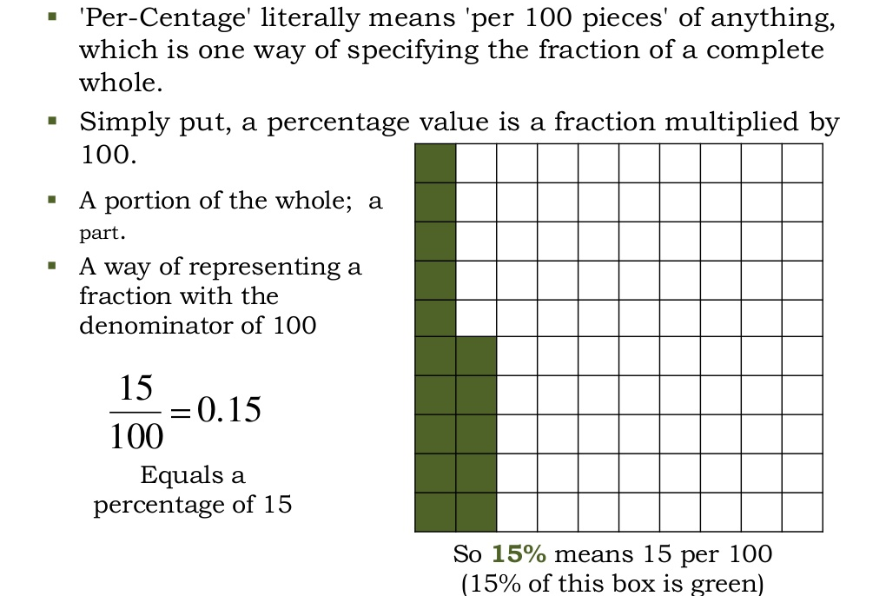

Slide 3
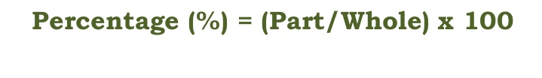
If I get 350 marks out of 500, my percentage marks are calculated as:
(350/500)x100 = 70%

Slide 4
Fractions and Percentage
x%= x/100
5%= 5/100= 1/20
y/z= (100y/z)%
1/4= (100*1)/4 % = 25 %

Slide 5
Example
What percent of 120 is 90?
Let x% of 120 =90
120x/100 =90
x = (90 x 100)/120
x = 75%

Slide 6

Important Formulae

Slide 7
Example
The total population of a village increased from 1,80,00 to 22, 500 in a decade. What is the average percentage increase of population per year of that village?
Population increase in 10 years = (22500- 18000) = 4500.
Increase% = (4500/18000 x 100)% = 25%
Required average = (25/10)% = 2. 5%

Slide 8
Try it yourself !!
The annual sales of company B were Rs 96,000 in fiscal year 95-96 and Rs 1,08,000 in fiscal 96-97. What was the % increase in turnover?
12.5%

Slide 9
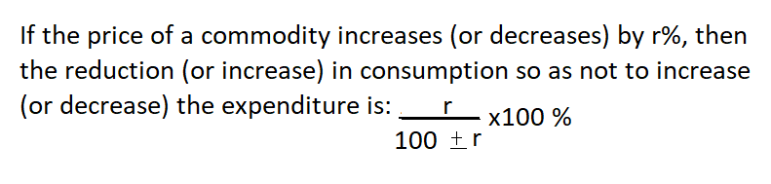
Important Formulae

Slide 10
Example
The prices of OIL decreases by 30%. What should be the increase in the consumption so as to keep the expenditure constant?
Possible inc. in consumption = r x 100 = 3000/ 70
100-r
= 300/7 = 42.85%

Slide 11
Try it yourself !!
If the price has fallen by 10% what percent of its consumption be: increased so that the expenditure may be the same as before?
100/9 %

Slide 12
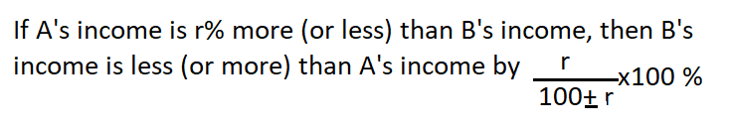
Important Formulae

Slide 13
Example
The salary of Mr. X is 30% more than that of Mr. Y . Find what percent of Mr. Y’s salary is less than Mr. X’s?
Using the concept on the previous slide, Mr. Y’s salary is less than Mr. X’s by
[30/(100+30)] *100
= 3000/130

Slide 14
Try it yourself !!
Tom’s income is 20 % less than Jerry’s. How much is Jerry’s income more than Tom’s?
25%

Slide 15
Try one more….
If y exceeds x by 25%, then x is less than y by?
20%
25 x 100 / (100+25) = 25 x100/125
= 100/5 = 20 %

Slide 16


Slide 17
70% of 320 + 45% of 240
(70x320)/100 + (45x240)/100
(7x32) +(9x12)
224+108
332

Slide 18
16 2/3 % of 600 + 33 1/3 % of 180
50/3 % of 600 + 100/3 % of 180
(50 x600)/ (3 x100) + (100 x180)/(3x100)
(50x600 /300) + (100 x180/300)
100 + 60 = 160

Slide 19
2 is what percentage of 50?
Let 2 be k % of 50
2 = 50k/100
K= 4
So, 2 is 4% of 50

Slide 20
What will be 80% of a number whose 200% is 90?
Let the number be k
200k/100 = 90 => k= 45
80% of k = 80 x 45/100
= 36

Slide 21
How much 60% of 50 is greater than 40% of 30?
(60 x 50 / 100 ) - ( 40 x 30 / 100)
30-12
18

Slide 22
Question
The difference between 31% of a number and 15% of the same number is 576. What is 17% of the same number?
Let the number be k
31% of k - 15% of k = 576
16k/100 = 576
k =3600
17% of k = 17 x 3600/100
= 17x36
= 612

Slide 23
Try it yourself !!!
The difference between the value of a number increased by 25% and the value of a same number decreased by 30% is 22. What is the Original Number?
(125-70)k/100 = 22 = 40

Slide 24
Question
The monthly income of a person was 13500 and his monthly expenditure was 9000. Next Year, his income increased by 14% and his expenditure by 7%. What was the percentage increase in his Savings?
Original savings = ₹ (13500 – 9000) = ₹ 4500
28%
New income = 13500 + 14% of 13500 = 13500(114/100)= 135 x 114 = ₹ 15390
New Expenditure = 9000 + 7% of 9000 = 9000(107/100) = 90 x 107 = ₹9630
New Savings = ₹5760
% inc. in savings = (5760-4500)x 100
4500

Slide 25
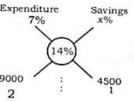
Short cut
(7*2)+(x*1) = 14
(2+1)
14+x = 42
X = 28 %

Slide 26
Question
Since the prices of sugar reduced by 20%, Rohan was able to purchase 6 Kg more for Rs. 240. What was the original price per kg of sugar?
80xy/100 + 480x/100 = xy
20y/100 = 480/100
Y= 24
X= 10
Unit price (Rs) | Quantity (KG) | Total Price
x | y | xy=240
80x/100 | Y+6 | 80x(y+6)/100 = 240

Slide 27
Question
If the price of a commodity is decreased by 20 % and its consumption is increased by 20%, what will be the increase or decrease in expenditure on the commodity?
Short cut:
% dec = X^2/100
= 400/100
= 4%

Slide 28
% change = [(96xy/100) – xy] X 100 xy
= - 4 x 100/100
= 4% (- sign shows a decrease)
Original Price (Rs.) | x
Original Quantity/Consumption (Kg) | y
Total Price (Rs.) | xy
New Price (Rs.) | 80x/100
New Quantity (Kg) | 120y/100
Total Price (Rs.) | 80 x /100 * 120y/100 = 96xy/100

Slide 29
Try it yourself !!
A square is converted into a rectangle by increasing one of its sides by 5 % and reducing the other by 5 %. What will be the % change in the area of the two figures?
0.25% decrease

Slide 30
Example
Two friends, Akash & Beenu had some candies each. One of them had 15 candies more than the other. The candies with Akash was 60% of the total candies with them. How many candies did each have?
Let the candies with Akash and Beenu be (x + 15) and x respectively.
Therefore, x + 15 = 60/100(x + 15 + x)
(x + 15) = 3/5(2x + 15)
5x + 75 = 6x + 45
x = 30
So, Akash and Beenu have 45 and 30 candies respectively.

Slide 31
Example
An engineering student must secure 36% marks to pass. He gets 130 marks and fails by 14 marks. What is the maximum No. of marks?
Let the maximum marks be x.
Passing marks = 130+14= 144
Also, 36 % of x = 144
36x/100=144
x = (144*100)/36 =400

Slide 32
Question
The price of apples decreases by 15%. As a result, Reena increases her consumption by 20%. The percentage increase in expenditure is?
85 x 120 ab /100 = 102 ab/100
% inc. = (102 ab/100 – ab) X 100 = 2%
ab
 | Price | Quantity | Total
Original | a | b | ab
New | 85a/100 | 120b/100 | 85 * 120 ab /10000

Slide 33
Question
A fruit seller had some apples. He sells 40% apples and still has 420 apples. How many apples did he have originally?
Let originally, he has k apples
Then, 60% of k = 420
60k/100 = 420 => k = 420 x 100 / 60
K = 700

Slide 34


