Slide 1


Slide 2
Terminologies
Cost Price
Selling Price
Profit
Loss
Marked Price
Discount
Successive Discounts

Slide 3
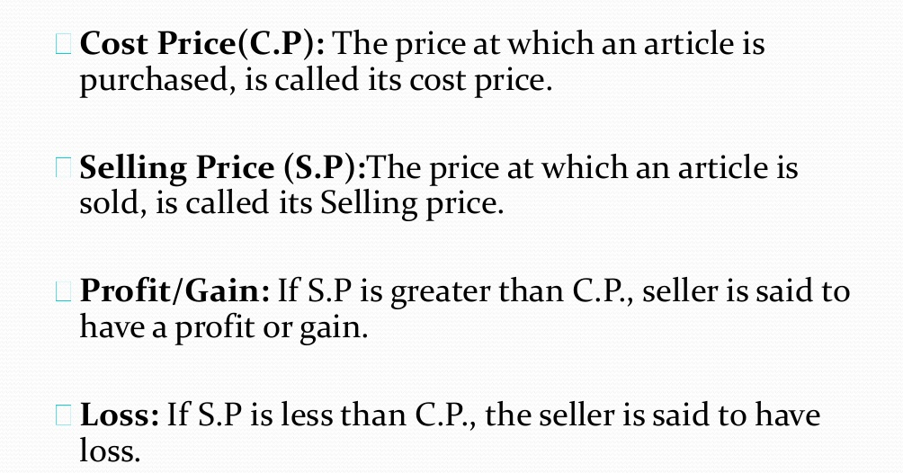

Slide 4
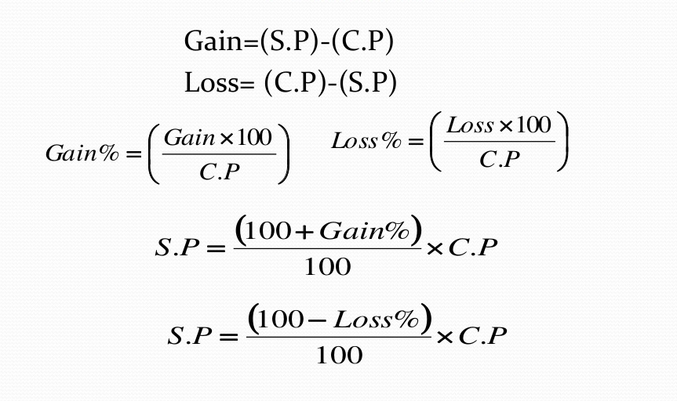
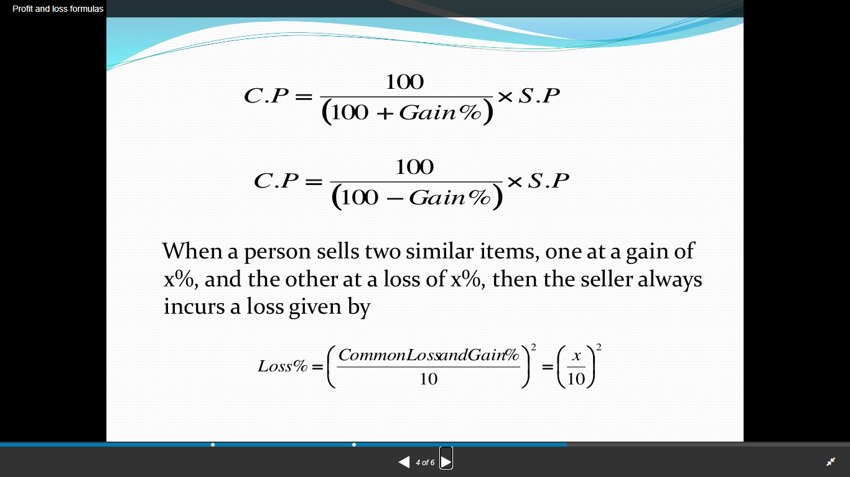

Slide 6
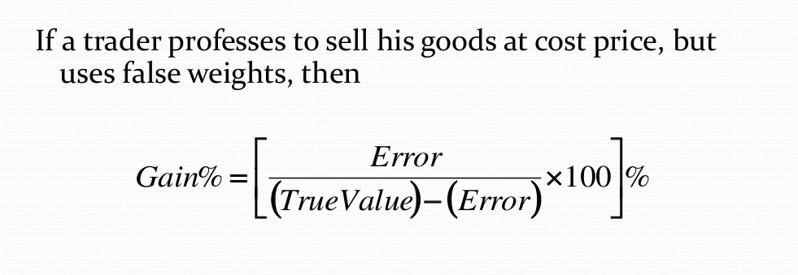

Slide 7
Practice makes a man perfect !

