Slide 1
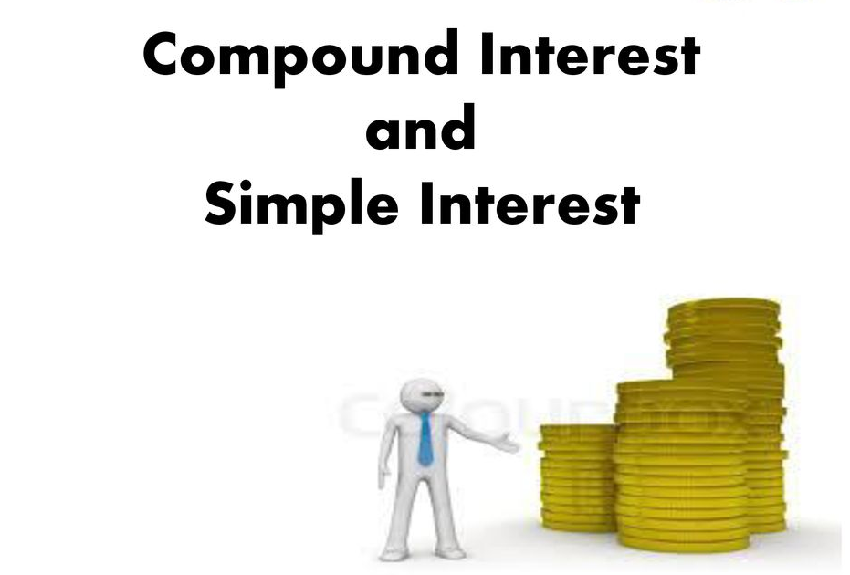

Slide 2
Interest
Cost of money
Money paid as service charge by borrower to lender

Slide 3
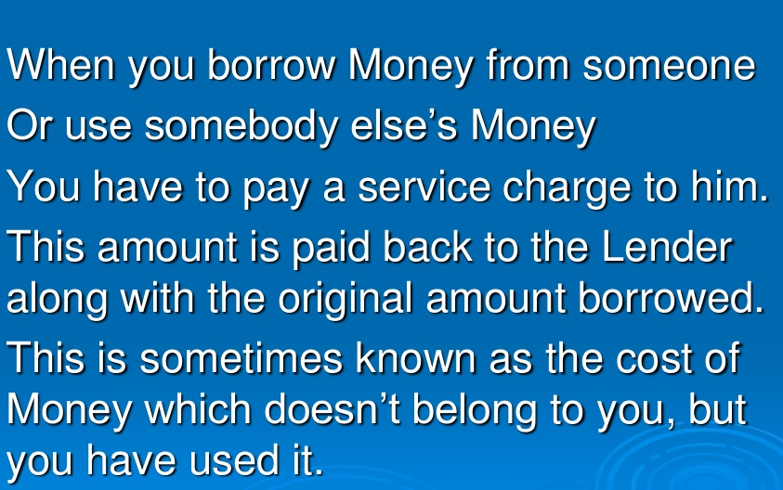

Slide 4
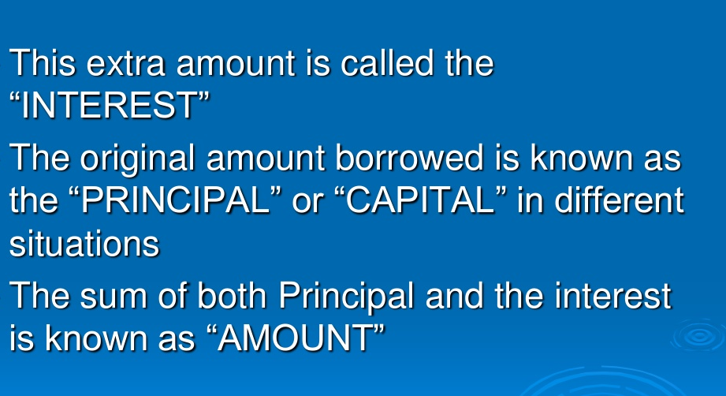

Slide 5
Other factors used in calculation
Rate of interest
Time period

Slide 6
Types of Interest
Simple
Compound

Slide 7
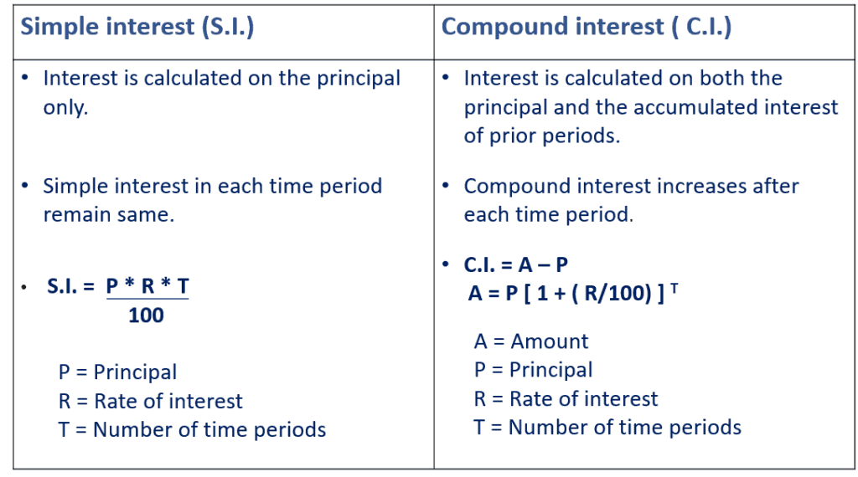

Slide 8


