Slide 1
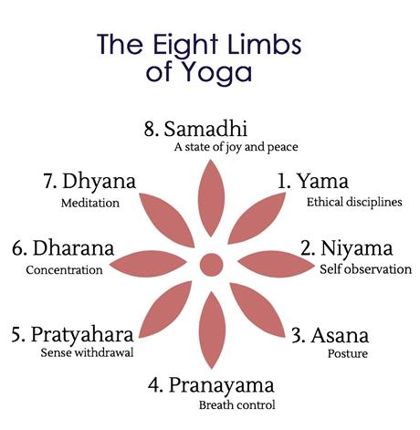
Ashtanga Yoga of Sage Patanjali
Patanjali's eight-fold path offers guidelines for a
meaningful and purposeful life.

Slide 2
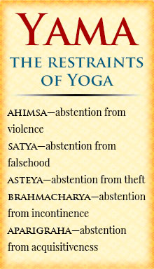
Yama - the first of the Eight Limbs of Yoga outlined in the Ashtanga yoga.
1 : Ahimsa — don’t harm - Non-violence - abstinence from causing any pain or harm whatsoever to any living creature, either by thought, word or deed. When we become aware of how our thoughts, words and actions can hurt others – and even ourselves! – we are encouraged to make different choices. And when we say “others”, its about people, as well as animals, and our planet – all living things.
2 : Satya — be truthful - It is more than just telling the truth. One’s actions should be in accordance with one’s words and thoughts
3 : Asteya — don’t steal - Non-stealing - This involves being happy and content with what we need and not always coveting unnecessary and luxury items. Basically, don’t take things from others that are not yours to have – this includes objects, time, or even ideasAsteya tells us that if we want fairness from others, we need to be fair in all our dealings, with us and to others.
4 : Brahmacharya — be in control of your senses - Control of the senses and celibacy. . In the broad sense it means control of the senses or indriyas . You are born as a sentient and intelligent being – you are in complete control of yourself, and the choices you make. Brahmacharya encourages us to temper our senses – what we eat, what we view, what we experience in general – so that we are not ruled by addictions or habits..
5 : Aparigraha — don’t be greedy - Non-hoarding and non-acceptance of gifts. How many shoes/clothes/things do you really need?! For this final yama, we are asked to consider: how much do we really NEED in our lives to live and find happiness? And how much of the “stuff” that we surround ourselves with, really stops us from being happy?

Slide 3
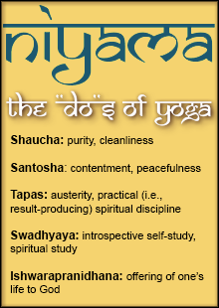
Niyama – The Second Limb
1 : Saucha — clean your body, mind and environment
This is more than just washing with soap – do you keep a ‘clean’ body by feeding it healthy foods and exercising it? Do you keep a healthy outlook on life, and let go the thoughts that can stick you in the mud? Do you surround yourself with friends who love and support you, and do you do the same for them? Remember: all of this supports the mind’s quest in finding stillness and ultimate happiness.
2 : Santosha — develop inner peace
This is all about finding your inner Peace, and then growing it. Recognizing those things in your life that make you agitated, or anxious, or fearful and letting them go. Giving yourself permission to be in the moment (Self awareness), cultivate mindfulness, meditate, and grow your gratitude.
3 : Tapas — practise self-discipline
When we practise self-discipline (getting up and going for that early morning walk, or doing those yoga stretches before class), we find inner reserves of strength and endurance we never knew we had.
4 : Swadhyaya — study yourself
Awareness is everything – who we are and what motivates us. If you want to make changes in your life, you need to know what’s there for the changing – the good and the not-so-good that lies within you. Seeing who we truly are is the first step towards self-transformation and inner peace.
5 : Ishvara Pranidhana — surrender
Life happens – we don’t always see the whys and wherefores, but we can trust that whatever is going on, it’s OK., whether you believe in a god and the universe. The ultimate meaning of ishvara pranidhana is to surrender to the rhythm of life. And what helps us to surrender? Practising an attitude of gratitude.

Slide 4

Asanas – The Third Limb
Asanas are the postures and comprise the third limb.
Through the practice of asanas, we develop the habit of discipline and the ability to concentrate, both of which are necessary for meditation.
It is steady and effortless, practiced with complete awareness and concentration on breathing in the final posture.

Slide 5
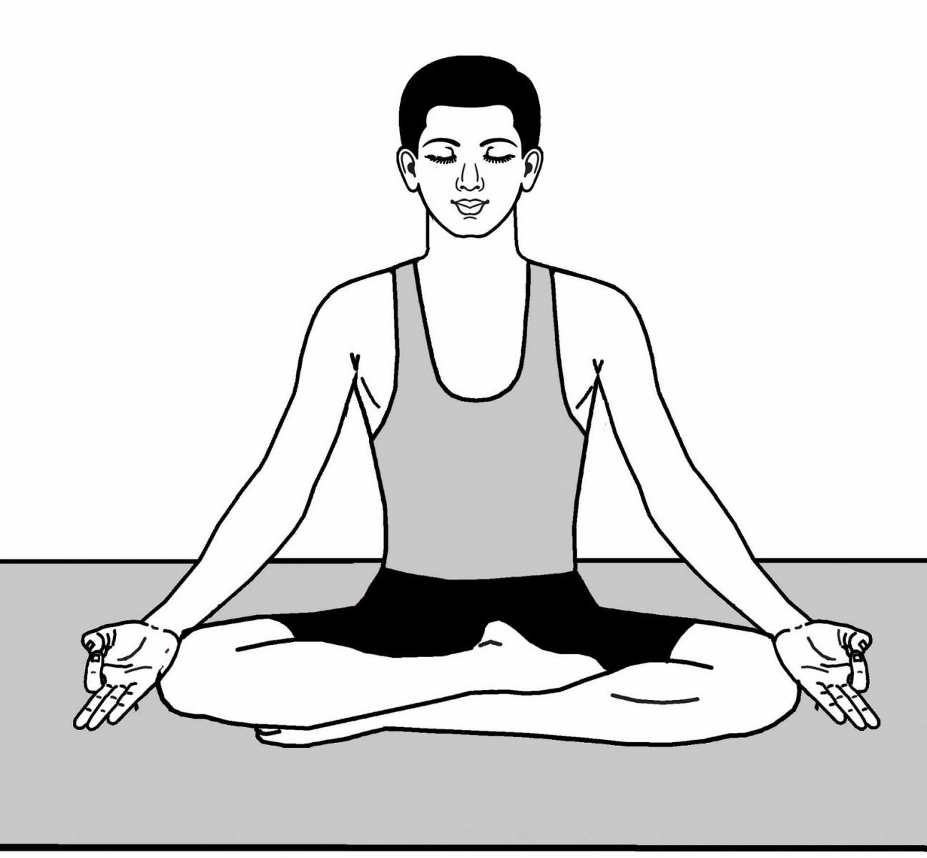
Pranayama – The Fourth Limb
It is controlled discipline breathing .
It is the fourth stage consists of techniques designed to gain mastery over the respiratory process while recognizing the connection between the breath, the mind, and the emotions.

Slide 6
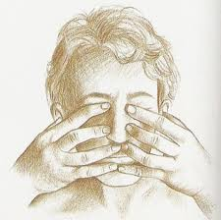
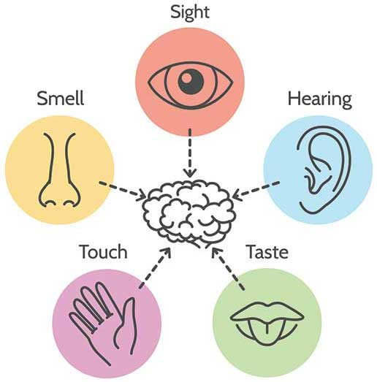
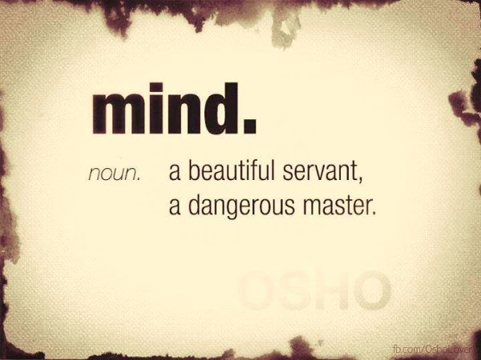
Pratyahara – The Fifth Limb
It is the fifth limb, means withdrawal of senses.
One of the most important yet, least discussed, taught or practiced limbs of yoga.
It is during this stage that we make the conscious effort to draw our awareness away from the external world and outside to internal.
With awareness cultivating a detachment from our senses, we direct our attention internally.
Pratyahara is the method of controlling the distracted mind through the withdrawal of your senses.
It leads to relaxation, inner stability, and self-awareness.
You can become a master of your body and mind.

Slide 7
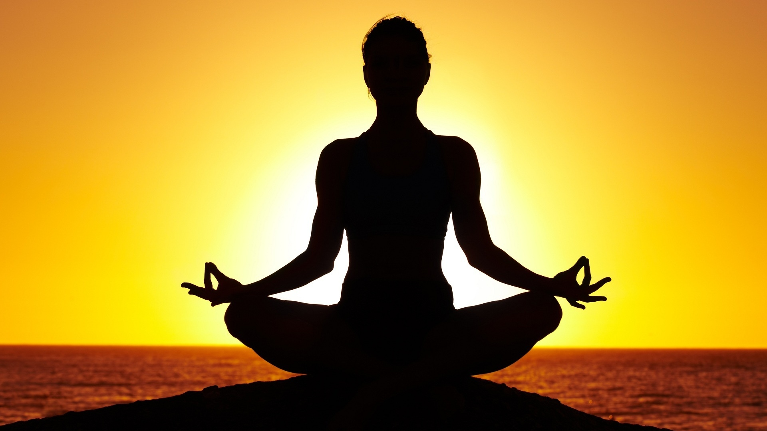
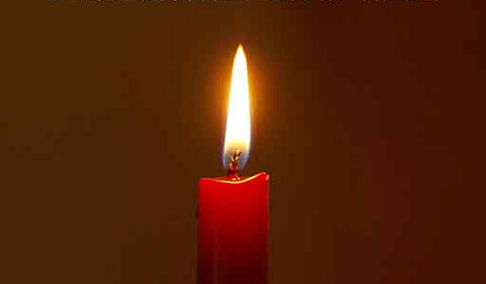
Dharana – The Sixth Limb
The practice of pratyahara creates the setting for the next step i.e. dharana, or concentration.
Having liberated ourselves of outside distractions, we can now deal with the distractions of the mind itself.
In the practice of concentration we learn to slow down the thinking process by concentrating on a single mental object: Counting of your breath, feeling the breath, an image of a deity, or the silent repetition of a sound.
We have already begun to develop our powers of concentration in the previous three stages of Asana, Pranayama & Pratyahara.
In asana and pranayama, although we pay attention to our actions, our attention travels.
In pratyahara we become self-observant; now, in dharana, we focus our attention on a single point.
Extended periods of concentration naturally lead to meditation.

Slide 8
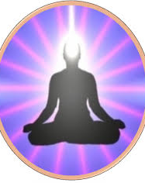
Dhyana - The Seventh Limb
Dhyana, Meditation or contemplation is the uninterrupted flow of concentration.
Even though concentration (dharana) and meditation (dhyana) may appear to be one and the same, a fine line of difference exists between these two stages.
Where dharana practices one-pointed attention, dhyana is ultimately a state of being totally aware without focus.
At this stage, the mind has calm down, and in the stillness, it produces few or no thoughts at all.
While this may seem a difficult if not impossible task, remember that yoga is a process.
Even though we may not attain the "picture perfect" pose, or the ideal state of consciousness, we benefit at every stage of our progress.

Slide 9
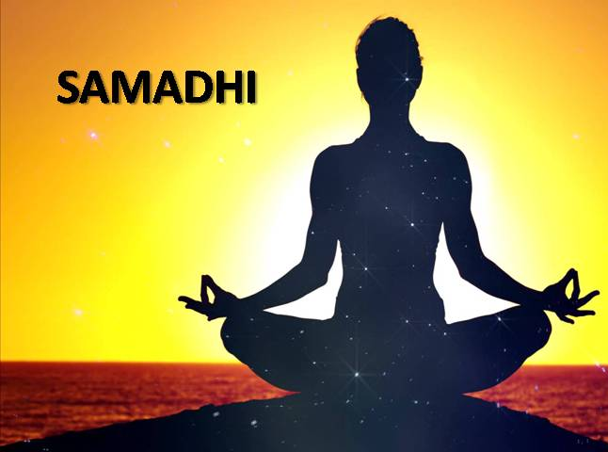
Samadhi – The Eighth Limb
Samadhi is the eighth and final stage of Ashtanga Yoga.
The meditator comes to realize a profound connection to the Divine, an interconnectedness with all living things.
With this realization comes the experience of bliss and being at one with the Universe.
This is the ultimate stage of yoga—enlightenment—can neither be bought nor possessed. It can only be experienced.

Slide 10
Thank You

