Slide 1
BANKING
A bank denotes a financial institution dealing in money. A bank is an institution that is prepared to accept deposits of money and repay the same on demand.
A banker (i.e., person or a corporation) deals in credit and money i.e. it accepts deposits from those who want to commit their wealth to safety and earn interest thereon, and lends money to the needy through cheques and advances and loans of various sorts.
FUNCTIONS OF BANKS
It accepts deposits from the customers, who can take back their money at will. A saving bank also pays interest to customers on their deposits and is popular with small savers.
A bank lends money to needy people at a certain interest rate. Banks give loan to agriculturists, industrialists and businessman who invest it in their ventures to their own profit and to the economic advancement of the country.
A bank issues notes and creates other inexpensive media of exchange-a note or a cheque. The issue of notes is entrusted to the Reserve Bank of the country.

Slide 2
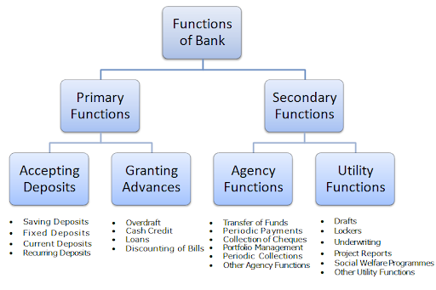
FUNCTIONS OF BANK

Slide 3
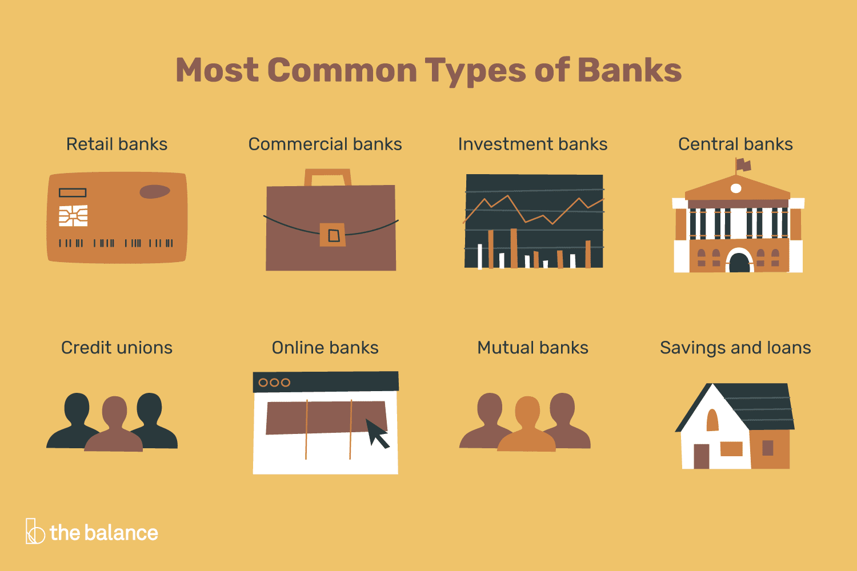
TYPES OF BANKS

Slide 4
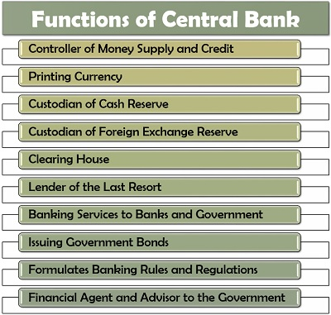
FUNCTIONS OF CENTRAL BANK

Slide 5
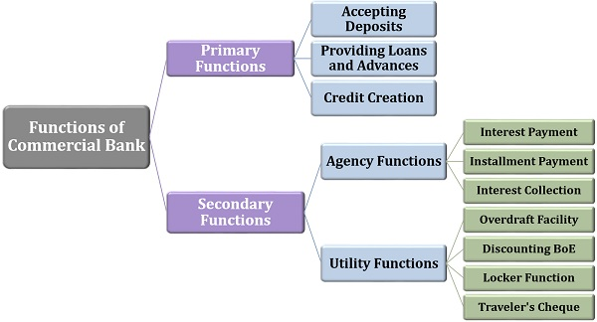
FUNCTIONS OF COMMERCIAL BANK

Slide 6
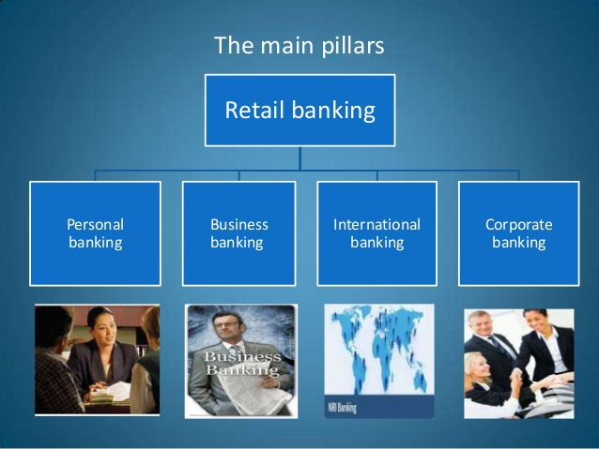
FUNCTIONS OF RETAIL BANKS

Slide 7
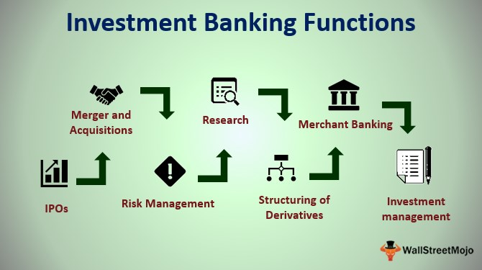
FUNCTIONS OF INVESTMENT BANKS

Slide 8
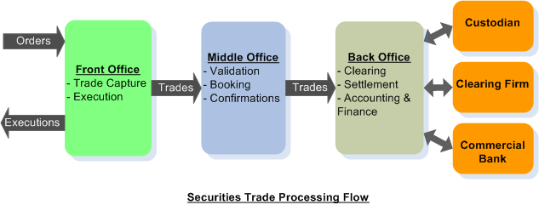
PROCESS FLOW OF A TRADE

Slide 9
CREDIT UNION AND ONLINE BANKS
Credit unions - These are similar to banks, but they are not-for-profit organizations owned by their customers (while investors own most banks). Credit unions offer products and services more or less identical to most retail and commercial banks. The main difference is that credit union members share some characteristic in common (where they live, their occupation, or organizations they belong to, for example).
Online banks operate entirely online—there are no physical branch locations available to visit with a teller or personal banker. Many brick-and-mortar banks also offer online services, such as the ability to view accounts and pay bills online, but internet-only banks are different. Internet banks often offer competitive rates on savings accounts, and they’re especially likely to offer free checking.
Mutual banks are similar to credit unions because they are owned by members (or customers) instead of outside investors
Savings and loans are less prevalent than they used to be, but they are still important. This type of bank was important in making home ownership mainstream, using deposits from customers to fund home loans. The name savings and loan refers to the core activity they perform: take savings from one customer and make loans to another.

Slide 10
OVERVIEW OF BLOCKCHAIN
The blockchain is an undeniably ingenious invention – the brainchild of a person or group of people known by the pseudonym, Satoshi Nakamoto.
The blockchain is an incorruptible digital ledger of economic transactions that can be programmed to record not just financial transactions but virtually everything of value.” – Don & Alex Tapscott, authors Blockchain Revolution (2016).
By allowing digital information to be distributed but not copied, blockchain technology created the backbone of a new type of internet. Originally devised for the digital currency, Bitcoin, (Buy Bitcoin) the tech community has now found other potential uses for the technology.
Bitcoin, a type of digital currency that operates independently from a central bank, but the tech behind that system most people are not familiar with is blockchain. There are many different blockchains—public and private—and they allow anyone to send value anywhere in the world where the blockchain file can be accessed. Think of each chain as an online database stored in a distributed, peer-to-peer fashion. The storage devices for the database are not all connected to a common processor and each block

Slide 11
APPLICATION OF BLOCKCHAIN IN BANKING AND FINANCIAL INDUSTRY
Blockchain technology can potentially disrupt the financial industry that we know and use today. Here are just a few of the top ways I believe it will transform finance and banking:
Fraud Reduction
Even though blockchain is new technology, its potential to reduce fraud in the financial world is getting a lot of attention since 45% of financial intermediaries such as stock exchanges and money transfer services suffer from economic crime every year. Most banking systems around the world are built on a centralized database that is more vulnerable to cyberattack because it has one point of failure rather than many—once hackers breach the one system they have full access. The blockchain is essentially a distributed ledger where each block contains a timestamp and holds batches of individual transactions with a link to a previous block. This technology would eliminate some of the current crimes being perpetuated online today against our financial institutions.
Know Your Customer (KYC)
Financial institutions spend anywhere from $60 million up to $500 million per year to keep up with Know your Customer (KYC) and customer due diligence regulations according to a Thomson Reuters Survey. These regulations are intended to help reduce money laundering and terrorism activities by having requirements for businesses to verify and identify their clients. Blockchain would allow the independent verification of one client by one organization to be accessed by other organizations so the KYC process wouldn’t have to start over again. The reduction in administrative costs for compliance departments would be significant.

Slide 12
APPLICATION OF BLOCKCHAIN IN BANKING AND FINANCIAL INDUSTRY
Smart Contracts
Because blockchains can store any kind of digital information, including computer code that can be executed once two or more parties enter their keys, blockchains enable us to have smart contracts. This code could be programmed to create contracts or execute financial transactions once a certain set of criteria has been achieved—delivery of products could signal an invoice to be paid for example.
Payments
Blockchain disruption could be highly transformative in the payments process. It would enable higher security and lower costs for banks to process payment between organizations and their clients and even between banks themselves. In the current reality, there are a lot of intermediaries in the payment processing system, but blockchain would eliminate the need for a lot of them.
Trading Platforms
It’s exciting to contemplate the changes that might occur with our trading platforms if they relied on blockchain-based technology. There’s no doubt that the risk of operational errors and fraud would be dramatically reduced. NASDAQ and the Australian Securities Exchange are already exploring blockchain solutions to reduce costs and improve efficiencies.

