Slide 1
Consumers and the Diffusion of Innovations

Slide 2
How are new products and services accepted?
Notes:
This chapter looks at consumers’ acceptance of new products, also called the diffusion of innovation. The products can be new to the world or can be smaller changes, such as a new flavor for an existing chewing gum.

Slide 3
Diffusion Process
The process by which the acceptance of an innovation is spread by communication to members of a social system over a period of time.
Notes:
The diffusion process concerns the spread of the new product or service to the members of society. It has four important elements, including the innovation, the channels of communication, the social system, and time.

Slide 4
Elements of the Diffusion Process
The Innovation
The Channels of Communication
The Social System
Time
Notes:
These are the four critical elements of the diffusion process. They will be discussed on the following slides.

Slide 5
1. The Innovation
Firm-oriented definitions
  Product is “new” to the company
Product-oriented definitions
  Continuous- small changes
  Dynamically continuous- disruptive , but changes in method and style
  Discontinuous-adapts to a totally new way of doing things and the existing one becomes outdated.
Notes:
Innovation is often defined in terms of the firm, the product, the market, or the consumer. A firm-oriented definition looks from the perspective of the company and asks whether the product is new to the firm.
The product-oriented definitions of innovation can be put in three classes. A continuous innovation tends to be a small change. It does not really change the consumers’ pattern. A dynamically continuous innovation is somewhat more disruptive. You continue to do something you have done before, but there are often changes in your methods and style. Most extreme is a discontinuous innovation, where the consumer adapts to an entirely new way of doing something. The iPod is a good example of discontinuous innovation when you compare it to the tape deck or handheld CD player.

Slide 6
1. The Innovation - Product Characteristics
Relative Advantage
Compatibility
Complexity
Trialability
Observability
Degree to which consumers consider it superior to existing substitutes
Degree to which consumers feel it is consistent with their present needs, values, and practices
The degree to which it is difficult to understand or use
The degree to which it can be tried on a limited basis
The degree to which its benefits can be observed, imagined, or described
Notes:
These five product characteristics help explain why some new products tend to get accepted more than others. They are presented with their explanation in this slide. Again, think about the iPod and how it has so many of these characteristics.

Slide 7
2. Channels of Communication
Channels of communication
  Marketer to consumer
  Consumer to consumer
Notes:
It is one thing to design and manufacture an innovative product and yet another to have consumers aware and interested in the product. The marketer must develop strategies to inform the marketplace and to have people in the market, especially those who have purchased the product or are influential, to talk and recommend the new product.

Slide 8
3. The Social System
Modern social systems accept more innovation due to their:
  Positive attitude toward change
  Advanced technology and skilled labor force
  Respect for education and science
Notes:
A social system has a large impact on the diffusion of innovation. A marketer is more able to reach a small and more closely knit social system. Furthermore, the tighter group is more likely to discuss your product. Modern social systems tend to accept innovation due to their characteristics as seen on this slide.

Slide 9
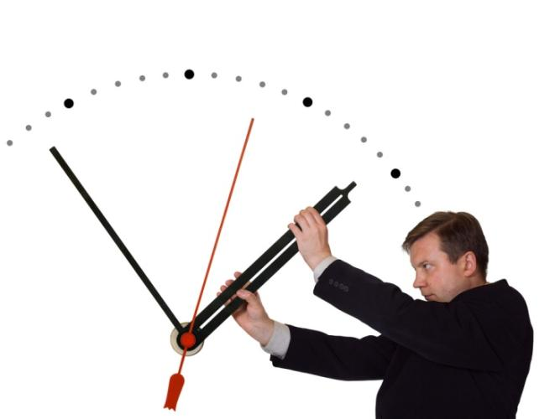
4. Time
Purchase Time
Adopter Categories
Rate of Adoption
Notes:
These are the three main issues in the importance of time in the diffusion process. Purchase time can differ when we consider the differences in complexity in the consumer decision process. Some of the adopter categories will accept or try the new product faster than other categories. The time it takes for each consumer to adopt a product influences the time for the overall adoption process.

Slide 10
Adopter Categories
Category 1 - Innovators
First to buy the mini netbook
Category 2 – Early adopters
Will buy mini netbook shortly after its introduction
Category 3 – Early Majority
Members of the 1st ½ of the “mass market” who would purchase the mini netbook
Category 4 – Late Majority
Second half of the “mass market” who would purchase the mature mini netbook
Category 5 – Laggards
Very last to purchase the mini netbook, if at all
Notes:
There are 5 major adopter categories which flow in order from the innovators who are the earliest to purchase to the laggards who are the latest. Were you one of the last to purchase a Smartphone? (blackberry or iPhone)

Slide 11
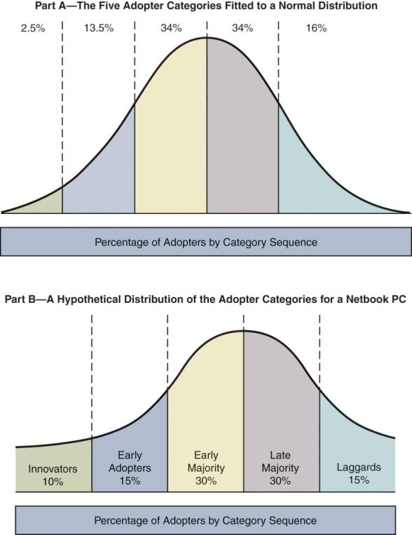
Diffusion Curves for Adopter Categories
Notes:
Here we can see the 5 categories explained on the earlier slide as the percent of the population in which they represent. You can see in this example how well the bell curve for the distribution fits the distribution for a Netbook PC.

Slide 12
Discussion Question
Which adopter category are you?
Does it differ with different product categories?
How about your parents, what category are they?
Is age a factor in innovation behavior?
Notes:
You may find yourself in different categories for different types of products. You also may find yourself more innovator then older generations.

Slide 13
Rate of Adoption
How long does it take a new product to be adopted by the members of a social system?
Product | Number of years
Pager | 41
Telephone | 38
Cable television | 25
Fax machine | 22
VCR | 9
Cell pone | 9
PC | 7
Time Required for Electronic Products to Penetrate 10 percent of UK market
Notes:
The speed or rate of adoption for a product can be very fast or slow. In general, all rates are picking up over time due to increased communication and global distribution systems.

Slide 14
Adoption Process
The stages through which an individual consumer passes in arriving at a decision to try (or not to try), to continue using (or discontinue using) a new product.
Notes:
Here we look individually at each consumer rather than how a product makes it through the marketplace. What states does the consumer pass through before making the decision to purchase or not purchase a new product? The five stages will be given on the following slides.

Slide 15
Stages in Adoption Process
NAME OF STAGE | WHAT HAPPENS DURING THIS STAGE | EXAMPLE
Awareness | Consumer is first exposed to the product innovation. | Eric sees an ad for a 23-inch thin LCD HDTV in a magazine he is reading.
Interest | Consumer is interested in the product and searches for additional information. | Eric reads about the HDTV set on the manufacturer’s Web site and then goes to an electronics store near his apartment and has a sales person show him the unit.
Evaluation | Consumer decides whether or not to believe that this product or service will satisfy the need –a kind of “mental trial.” | After talking to a knowledgeable friend, Eric decides that his TV will fit nicely on top of the chest in his bedroom. He also calls his cable company and finds out that he can exchange his “standard” cable box at no cost for an HDTV cable box.
Notes:
The next two slides outline the five stages in the adoption process and provide an example of each.

Slide 16
Stages in Adoption Process
NAME OF STAGE | WHAT HAPPENS DURING THIS STAGE | EXAMPLE
Trial | Consumer uses the product on a limited basis | Since the HDTV set cannot be “tried” like a small tube of toothpaste, Eric buys the TV at this local electronics store on his way home from work. The store offers a 14-day full refund policy.
Adoption (Rejection) | If trial is favorable, consumer decides to use the product on a full, rather than a limited basis – if unfavorable, the consumer decides to reject it. | Eric loves his new HDTV set and expects many year of service from it.

Slide 17
The Consumer Innovator
The earliest purchasers of a new product
Tend to have higher level of:
  Education
  Social interaction
  Opinion leadership
  Venturesomeness
  Social Status
Notes:
The consumer innovator is very important to a marketer. Furthermore, these individuals tend to have very specific personality traits and social standing characteristics. This web link brings you to a web site often visited by fashion innovators. The products on this site tend to be very expensive, which could tie to higher incomes from educational levels.

Slide 18

The Consumer Innovator
Interest in product category
Opinion leader
Personality traits
  Perceived risk and venture someness
  Less loyal
  Exposed to more media
Notes:
The innovator is usually very interested in the product category. They may buy magazines based around these products or constantly visit retailers, websites, and blogs devoted to the sources. They also tend to be opinion leaders, a topic discussed in an earlier slide.
As mentioned in an earlier slide, the consumer innovators will tend to share some characteristics. Three of these are worth bringing to special attention. If a consumer tends to have lower perceived risk, they are more apt to try a new product. Venturesomeness, a related concept to risk as it is a measure of the consumer's willingness to accept risk for new products, could also be a signal of an innovator.
There are certain purchase and consumption characteristics of an innovator. They tend to be less brand loyal, are deal prone, and are heavy users of the product category in which they innovate. Finally, their media habits show us they have a greater total exposure to magazines, especially those involved in the category where they innovate.
This web link goes to Computerworld, one of the many computer and high-tech specific sites that would be frequently visited by an innovator of technology and computer products.

Slide 19

The Consumer Innovator
Social characteristics
  Socially accepted
Demographic characteristics
  Younger, educated and professionals
Notes:
Innovators tend to be more socially accepted and involved than noninnovators. They belong to more groups and are more involved in those groups. In addition, they tend to be more educated, younger, and professionals.

