Slide 1


Slide 2



Slide 3
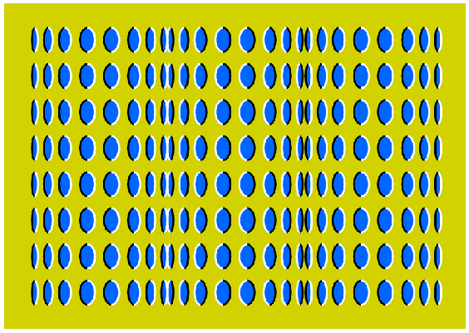

Slide 4
PERCEPTION

Slide 5
Perception
The process by which an individual selects, organizes, & interprets stimuli into a meaningful and coherent picture of the world
How we see the world around us

Slide 6
Perception
It is based on each person’s own needs, values and expectations.
It is not actual but what they think .

Slide 7
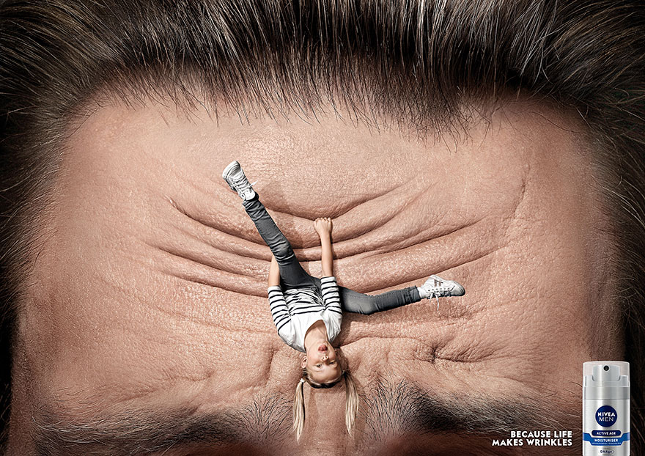

Slide 8


Slide 9


Slide 10
How it happens?
Selective about the stimuli we recognise
Subconsciously organise the stimuli we recognise
Interpret the stimuli based on our expectations.

Slide 11
Elements of Perception
  Sensation
  Absolute threshold
  Differential threshold
  Subliminal perception

Slide 12
Sensation
A stimulus is any input to any of the senses – products, packaging, commercials, brand names, etc.
Sensory receptors are the human organs that receive the sensory inputs.
Sensory Branding- Burning sensation of Pain killer balms, strong tea, smooth skin, silky hair…
Volkswagon – Talking newspaper.

Slide 13
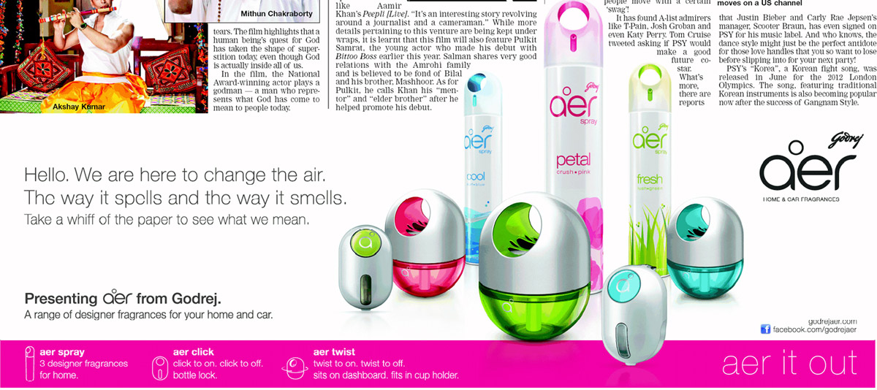

Slide 14
Sensation
Sensation is the immediate and direct response of the sensory organs to stimuli.
As sensory input decreases, the ability to detect changes in input increases.
Eg. Pindrop silence.
Notes:
Sensation is the response of the sensory organs, including the eyes, ears, nose, mouth, and skin. Most of marketing focuses on sight and sound but much research is being done on smell and touch. The web link on this page connects to a company that uses smell as a marketing tactic.
Advertisers must reach the absolute threshold for consumers to be able to experience their advertising tactic. It is interesting that the absolute threshold changes over time. Consumers adapt and get used to a certain ad or message so no longer notice it. This is one of the reasons why advertisers change their ads frequently.

Slide 15
Sensory Thresholds
The Absolute Threshold
The Differential Threshold

Slide 16
The Absolute Threshold
Threshold – the lowest intensity of a stimulus that can be registered.
Absolute Threshold- The lowest level at which an individual can experience a sensation.
The point which differentiates between “something” and “nothing”.
Example: Absolute threshold of driver driving on highway to notice billboard.- the distance at which he can notice the Billboard.

Slide 17
Absolute Threshold
If you are driving through a corridor of billboards, your Absolute Threshold ----------------------
Increases or Decreases?

Slide 18
Absolute Threshold
As our exposure to stimulus increases we notice less.
Sensory Adaptation- Getting used to…

Slide 19
Ambush Marketing
Placing ads in places where consumers do not expect to see them but cannot avoid them.
Guerrilla marketing is an advertisement strategy concept designed to promote products or services in an unconventional way with little budget to spend.
Eg- ambush, buzz, viral…

Slide 20
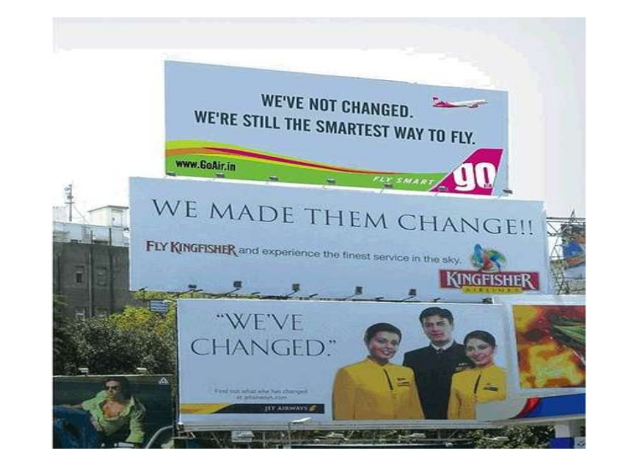

Slide 21
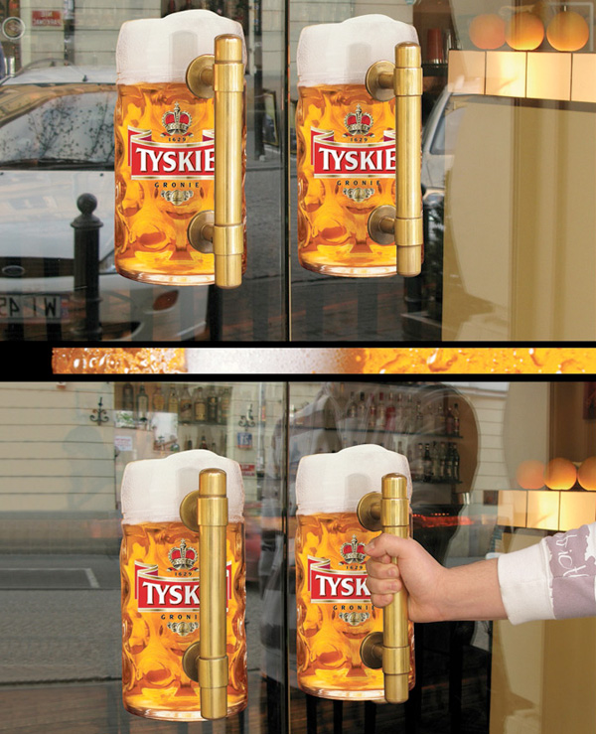

Slide 22
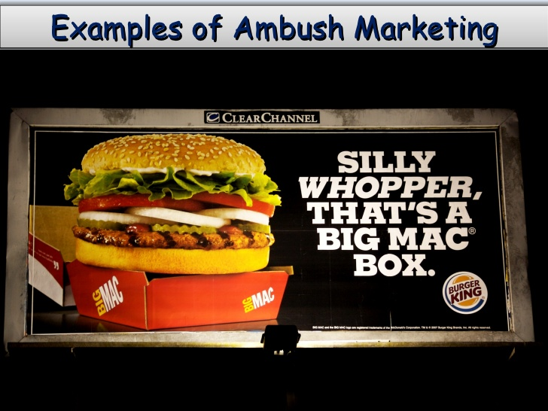

Slide 23
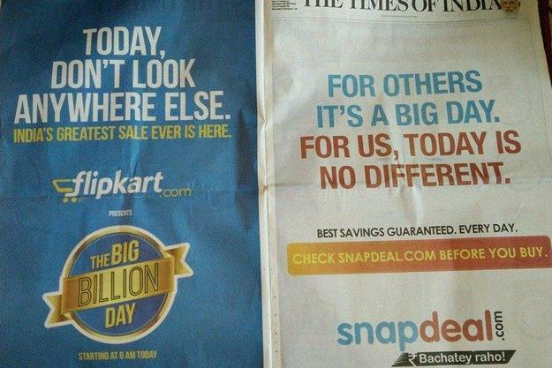

Slide 24
The Differential Threshold
The minimum difference that can be detected between two stimuli is called the ‘differential threshold’ or j.n.d. – just noticeable difference.

Slide 25
Differential Threshold
(Just Noticeable Difference – j.n.d.)
Minimal difference that can be detected between two similar stimuli
Weber’s law
  The j.n.d. between two stimuli is not an absolute amount but an amount relative to the intensity of the first stimulus
  The stronger the initial stimulus, the greater the additional intensity needed for the second stimulus to be perceived as different.
Notes:
Marketers are very concerned with the differential threshold, which is also called the just noticeable difference. It was a German scientist named Ernst Weber who realized that this difference was not a fixed amount. The best example is when you buy a low-priced product like a cup of coffee from Starbucks. A $1 increase in your tall coffee would be noticed by you. But if you were buying a laptop whose price changed from $455 to $456 you might not even notice.

Slide 26
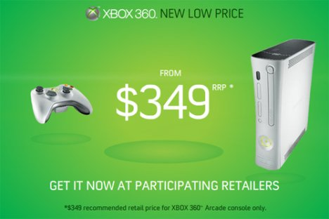

Slide 27

Marketing Applications of the JND
Need to determine the relevant j.n.d. for the products
  so that negative changes are not readily visible to the public, reduction in size, increase in price)
  so that product improvements are quite apparent to consumers.

Slide 28
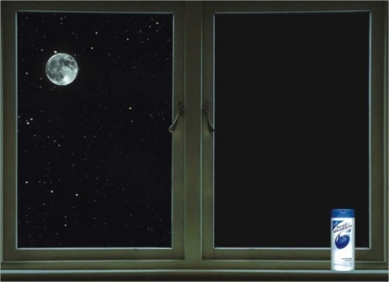

Slide 29
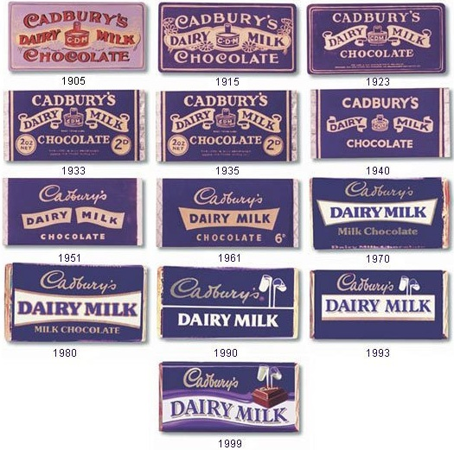

Slide 30
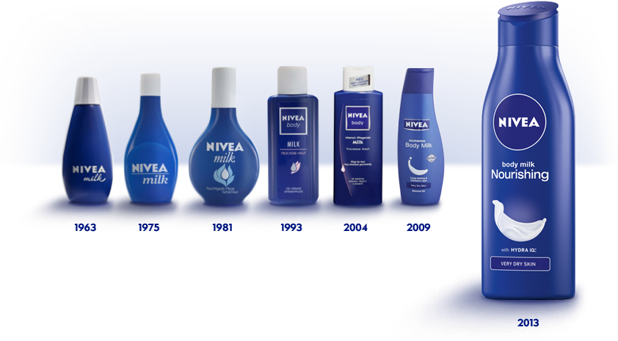

Slide 31


Slide 32
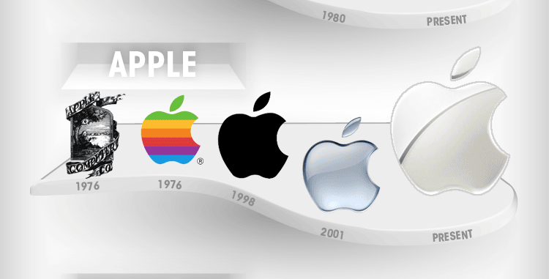

Slide 33
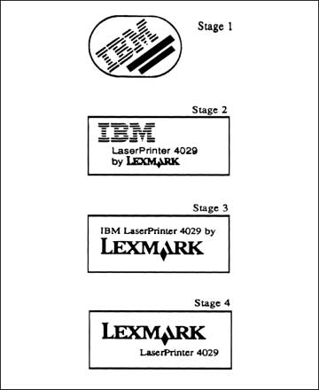
Gradual Changes in Brand Name Fall Below the J.N.D.

Slide 34
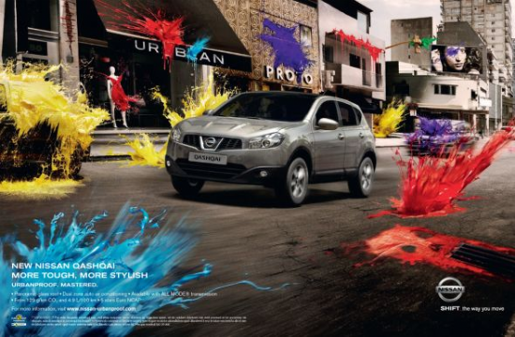

Slide 35
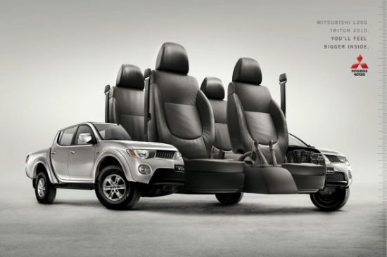

Slide 36
Subliminal Perception
Stimuli that are too weak or too brief to be consciously seen or heard
  They may be strong enough to be perceived by one or more receptor cells.
Notes:
People have been fascinated by subliminal perception for over 50 years. The question is whether stimuli that are not consciously sensed can still be perceived and are therefore capable of altering behavior. At this point, there is no research that shows that it directly changes attitudes or purchase behavior. No doubt, there will continue to be research on this subject as many feel that there is indeed an effect from subliminal perception.

Slide 37


Slide 38
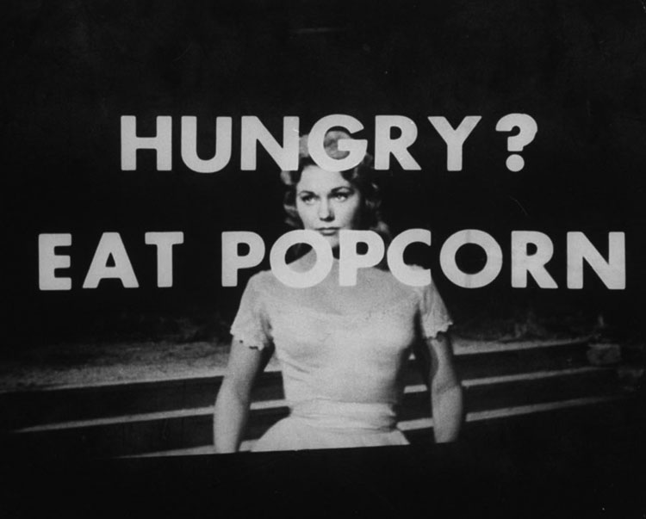

Slide 39
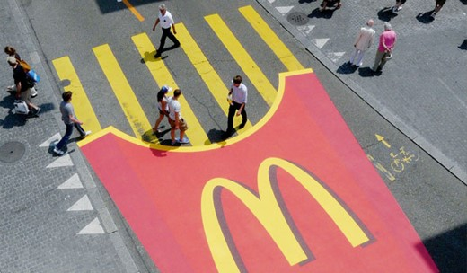

Slide 40




Slide 41
Perceptual Process
STIMULI
Sights
Sounds
Smells
Tastes
Textures
Sensory Receptors –
EXPOSURE
Attention
Selection
organize
interpretation

Slide 42
Aspects of Perception
Selection
Organization
Interpretation

Slide 43
1. Perceptual Selection:
Selection depends on
  External factors
  Internal Factors

Slide 44
Perceptual Selection - External
Contrast
Size
Intensity
The larger the size of the stimuli, the more likely it is to be perceived
The larger the force or power of a stimuli, the greater the chances of it getting perceived
Motion
Repetition
Familiarity and Novelty
A new stimuli in a familiar setting or a familiar stimuli in a new setting increase the chances of perceptual selectivity
Any stimuli that stands out from the rest of the environment is more likely to be noticed
Anything that moves has greater chances of being perceived
A repeated stimuli is more likely to be noticed

Slide 45
Perceptual Selection - Internal
Needs and Motivation
Past Experience

Slide 46

Why Are Consumers
Likely to Notice This Ad?

Slide 47
The Attention-Getting Nature of a Dramatic Image

Slide 48
Discussion Questions
What marketing stimuli do you remember from your day so far?
Why do you think you selected these stimuli to perceive and remember?
Notes:
If you think about it, you might be surprised at what you have seen today. Did you go online to Google? If so, you probably had many contextual search ads appearing on your screen. Also consider outdoor advertisements you may have seen, including billboards, taxi tops, and rail advertising.

Slide 49
Perceptual Selection: Important Concepts – Gestalt Psychology
Selective Exposure
Consumers seek out messages which:
Selective Attention
Heightened awareness when stimuli meet their needs
Perceptual Defense
Screening out of stimuli which are threatening
Are pleasant
They can sympathize
Reassure them of good purchases
Consumers prefer different messages and medium
Perceptual Blocking
Consumers avoid being bombarded by:
Tuning out
Notes:
These four concepts are very important to consider when understanding how consumers select which stimuli they will perceive. In general, they are selective as to what they are exposed to – what messages they seek out. Once exposed, they are selective of their attention to some messages over others. Consumers might even screen out or block messages that they consider threatening or overwhelming. Gestalt psychology tries to understand the laws of our ability to acquire and maintain meaningful perceptions in an apparently chaotic world.

Slide 50
How to overcome Selective Perception?
Using of innovative concepts to grab the consumer’s attention
Give their ads maximum exposure so that consumers come across them frequently.
Could tactically expose people to the ads at the strategic times, places and in relevant contexts.
  E.g. airing ad of Castrol GTX?
Select programs that have relevance to the prime viewers of the program.
  E.g. ad of chocolate? / ad of Energy drink?

Slide 51
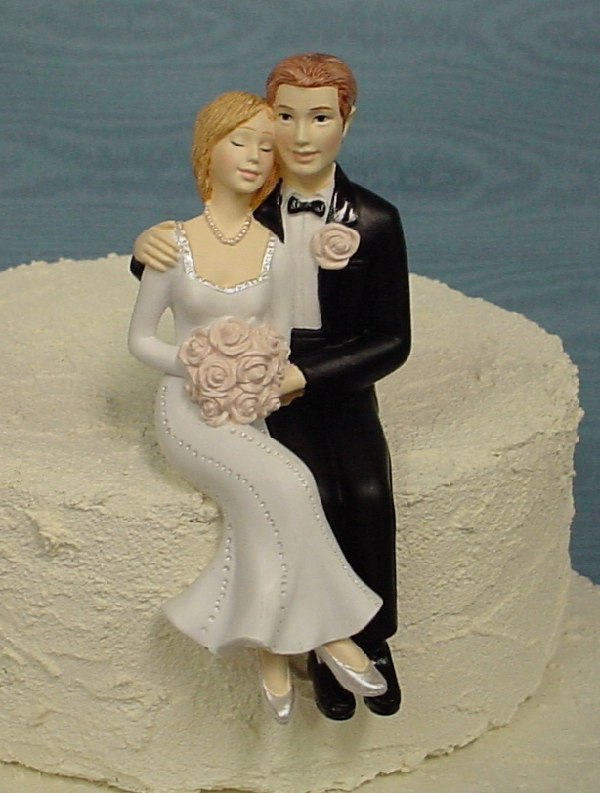

Slide 52

The Unexpected Attracts Attention

Slide 53

Fevicol – Catching the attention

Slide 54
2. Perceptual Organization
People tend to organize the stimuli from the environment, because they don’t want to analyze the stimuli independently.

Slide 55
Organization
Principles
People tend to organize perceptions into figure-and-ground relationships.
The ground is usually hazy.
Marketers usually design so the figure is the noticed stimuli.
  A.d. of Safari
Figure and ground
Grouping
Closure
Notes:
Organization refers to how people organize stimuli into groups and perceive them as a whole. There are three major principles of perceptual organization, including figure and ground, grouping, and closure. The first, figure and ground, has to do with contrast. An advertiser wants just enough contrast so that the figure is noticed but that the background adds a sensory effect. Product placement, when a product appears in a movie or television show, can be considered a figure and ground issue. The advertiser wants the product (figure) to be noticed as it blends in with the ground (character in the show). This web link takes you to a very fun site called sporcle. The quiz that is opened for you refers to the top brands, organized by product category. Is this similar to how you organize these brands? How did you do on the test?

Slide 56
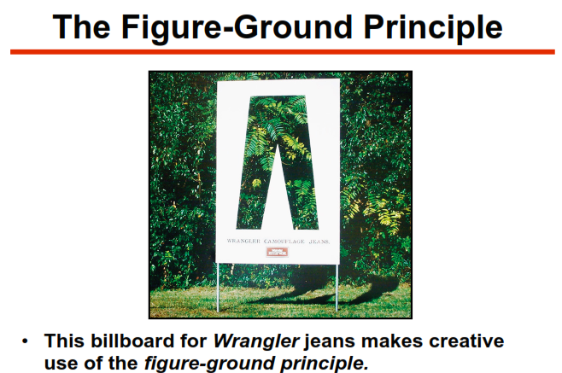

Slide 57
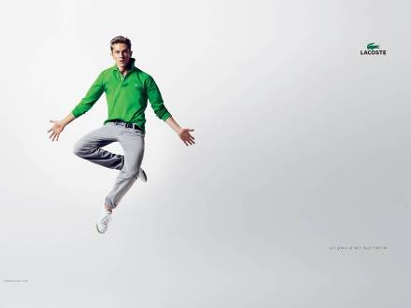

Lacoste’s campaign uses a very plain ground so the symbol really shows.

Slide 58
Organization
Principles
People group stimuli to form a unified impression or concept.
Grouping helps memory and recall.
  9919225050
  400101
Figure and ground
Grouping
Closure
Notes:
Grouping is common in perceptual organization. Whether it is numbers (phone numbers) that are grouped in 3 or 4 digits OR images in an ad, consumers will group stimuli together to organize them. This grouping helps memory and recall.

Slide 59
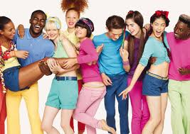
Grouping: United colour of Benetton

Slide 60
Organization
Principles
People have a need for closure and organize perceptions to form a complete picture.
Will often fill in missing pieces
Incomplete messages remembered more than complete
Figure and ground
Grouping
Closure
Notes:
Individuals organize their perceptions to form a complete picture. Our minds have a need for closure and we will work to fill in the missing information when we are presented incomplete stimuli.

Slide 61
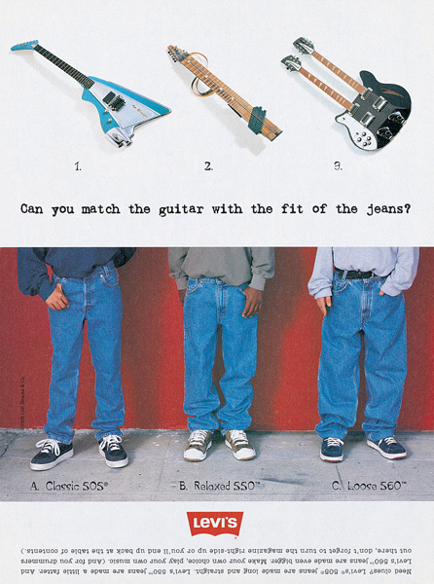
What Element of Perceptual Organization Is Featured in This Ad?

Slide 62
Closure

Slide 63
Discussion Question
Do you agree you remember more of what you have NOT completed?
How might a local bank use this in their advertising?
Notes:
When asked what you have done today, it is sometimes difficult to recall. When asked what you have to do, we often have a stronger memory of this information. A local bank could use this information to help their customers realize they have not yet set up an annual IRA account. They could show a picture of a teller with a blank square in their hand the size of a bank check. The consumer will use closure to fill in the image with a check.

Slide 64
3. Perceptual Interpretation
If the stimulus is ambiguous, more effort for interpretation is required.
Interpretation depends upon the clarity of the stimulus, the past experiences of the perceiver, motives and interests.

Slide 65
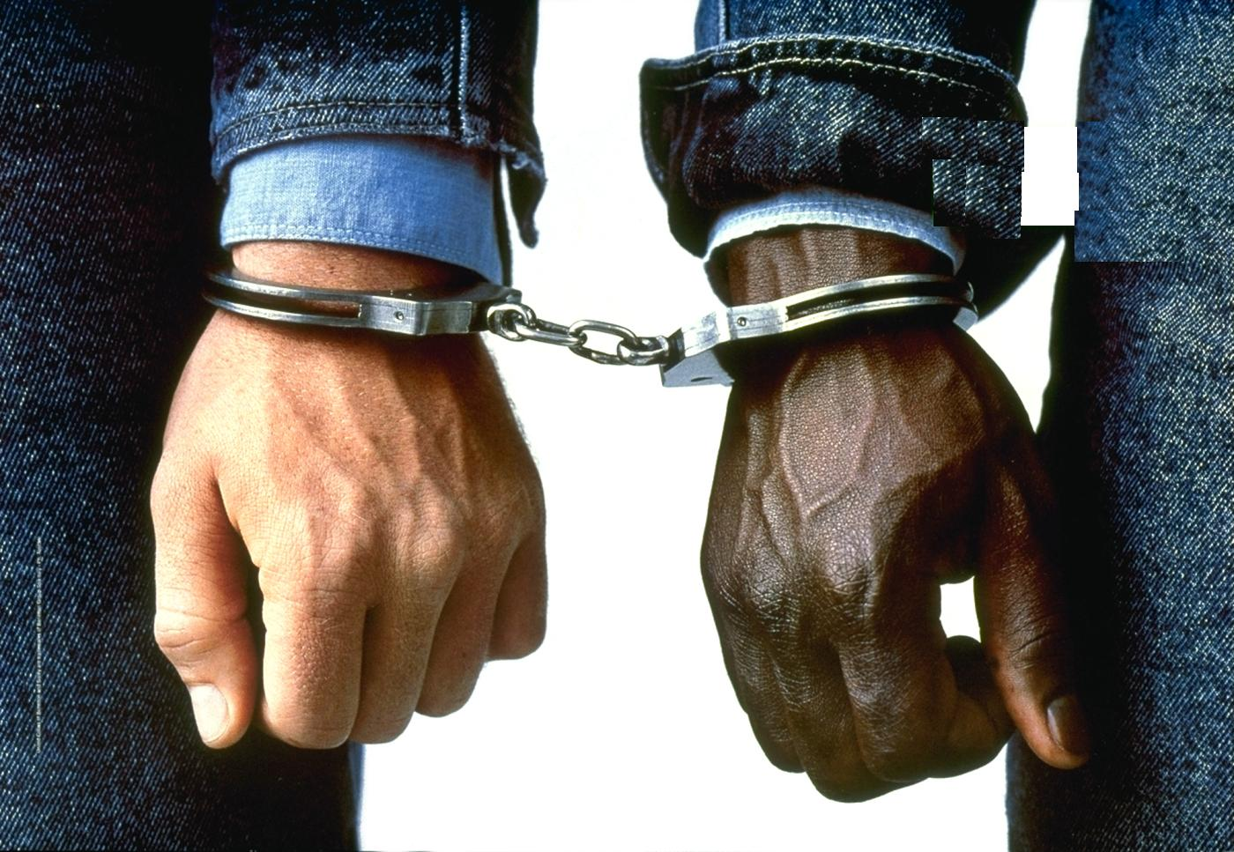


Slide 66
Interpretation
Stereotypes
First Impressions
Halo Effect
Physical Appearances
Descriptive Terms
People hold meanings related to stimuli
Stereotypes
First Impressions
Halo Effect
Physical Appearances
Descriptive Terms
Notes:
Perceptual interpretation occurs because consumers have unique motives, interests, and experiences. How people interpret often reveals a lot about themselves. For instance, individuals tend to have stereotypes due to physical appearances, descriptive terms, first impressions, and the halo effect. These will be examined in the next couple of slides.

Slide 67
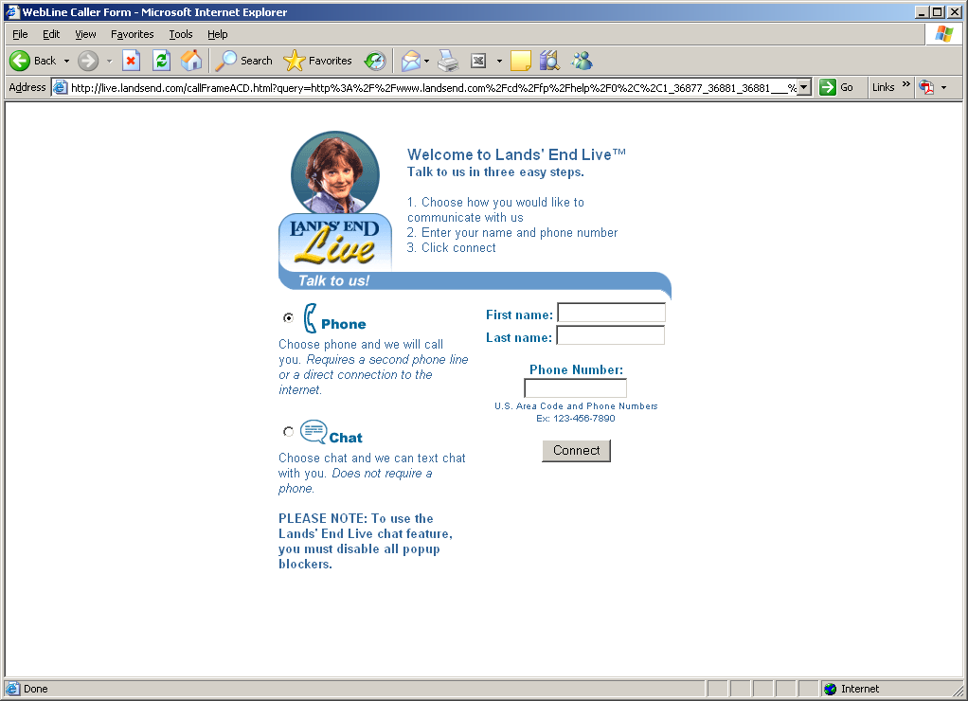
Putting a “Face” on Customer Service

Slide 68
Interpretation
Stereotypes
First Impressions
Halo Effect
Physical Appearances
Descriptive Terms
Stereotypes
First Impressions
Halo Effect
Physical Appearances
Descriptive Terms
Positive attributes of people they know to those who resemble them
Important for model selection
Attractive models are more persuasive for some products
Notes:
We often make decisions based on how people or products appear. A beautiful spokesperson might be perceived as possessing expertise for beauty products. A certain color to a food might make us think it is healthier. The web link is an example of a tool marketers can use on their website to give a “human” touch. There are many attractive hosts to choose from.

Slide 69
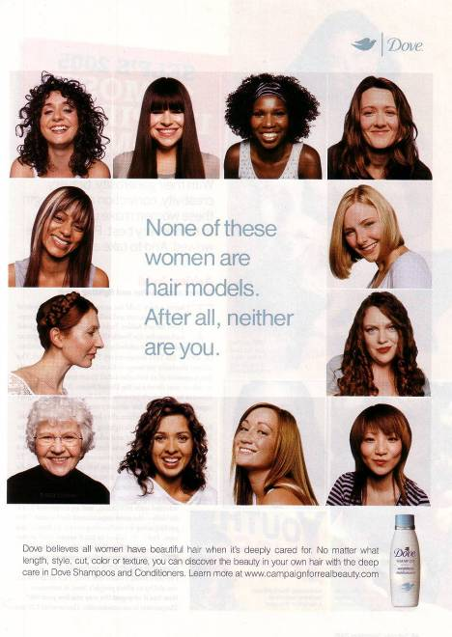
Dove’s campaign stresses the everyday woman.

Slide 70
Interpretation
Stereotypes
First Impressions
Halo Effect
Physical Appearances
Descriptive Terms
Verbal messages reflect stereotypes
Notes:
The choice of descriptive terms for names and advertisement in services are particularly important due to the intangible nature of services. In this ad, the marketer has stereotyped the person who eats a cheeseburger vs. tofu and applied them in a descriptive sense to their product.

Slide 71

How Does This Ad
Depict Perceptual Interpretation?

Slide 72
It Contrasts the Powerful Durango with Less Rugged Referred to in the Ad as the “Land Of Tofu.”

Slide 73
Interpretation
Stereotypes
First Impressions
Halo Effect
Physical Appearances
Descriptive Terms
Stereotypes
First Impressions
Halo Effect
Physical Appearances
Descriptive Terms
First impressions are lasting
The perceiver is trying to determine which stimuli are relevant, important, or predictive
Notes:
First impressions are lasting so a marketer should be careful how they advertise new products.

Slide 74
Interpretation
Stereotypes
First Impressions
Halo Effect
Physical Appearances
Descriptive Terms
Stereotypes
First Impressions
Halo Effect
Physical Appearances
Descriptive Terms
Consumers perceive and evaluate multiple objects based on just one dimension
Notes:
With the halo effect, a person uses just one dimension in evaluating a person, product, or service. For instance, a consumer might consider a clean waiting room as an indication of a good dentist. For this reason, marketers use the halo effect when licensing names of products or choosing spokespeople.

Slide 75

The halo effect helps Adidas break into new product categories.

Slide 76


Which Concepts of Perception Are
Applied in These Ads?

Slide 77
The Principle Of Contrast

Slide 78
Product Positioning
Establishing a specific image for a brand in the consumer’s mind in relation to competing brands
Conveys the product in terms of how it fulfills a need
Successful positioning creates a distinctive, positive brand image
Notes:
It is important to realize that good position defines the product in a unique place in the consumer’s mind when compared to competing products. This place is the result of the benefits that are offered by the product and how they are different or better than those of the competitor’s products.

Slide 79
Consumer Imagery
Product Positioning.
  Umbrella Positioning
  Positioning against the competition
  Positioning based on certain benefits
  Finding “Unowned” positioning
  Finding several positions
Product Repositioning
  Perceptual Mapping
Positioning of Services
Perceived Price
  Reference prices

Slide 80
Packaging as a Positioning Element
Packaging conveys the image that the brand communicates to the buyer
Color, weight, image, and shape are all important
Repositioning might be necessary because:
  Increased competition
  Changing consumer tastes
Notes:
A consumer often derives their understanding of a product and its benefits from the packaging. A good example would be shampoo. The shape of the bottle, the choice of colors and symbols, and even the cap can help the consumer position the product and determine if the product’s benefits are gentle, color safe, strong cleaning, or conditioning.
Many marketers will need to reposition their product over time due to either market changes or consumer preference changes. This is often challenging to marketers, especially if their product had been perceived negatively in the marketplace.

Slide 81

Umbrella Positioning- Nivea

Slide 82
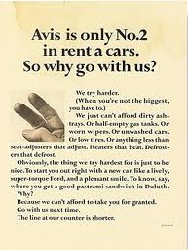
Avis :- Positioning against HERTZ

Slide 83
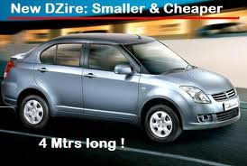
Benefit Positioning

Slide 84
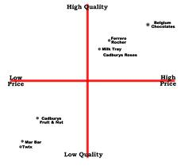
Perceptual Map

Slide 85
Consumer Imagery (Contd..)
Perceived Quality
  Perceived quality of products
  Perceived quality of services
  Price Quality Relationships
Retail Store Image
  Width and depth of product assortment
  Pricing strategies
  Positioning strategies
Manufacturers’ Image

Slide 86
Information Processing Model of CB
Individual
Consumer:
Personality (intro/extro)
Environmental
Characteristics:
Culture (color)
Selection
Interpretation
Attitudes:
Like/Dislike
Choice
information
beliefs
Stimuli
Memory/Prior Knowledge

Slide 87
Assume you are exposed to this magazine ad

Slide 88
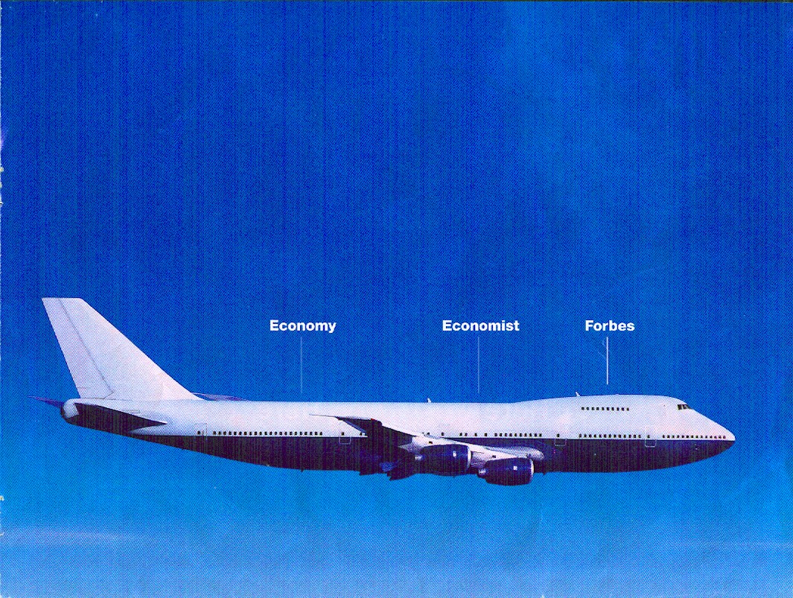

Slide 89
Information Processing at Work…
Select certain stimuli which stand out in the ad
  Plane
  Brand names: Forbes, Economist
Interpret: advertiser is trying to compare the brands
  (you know Economy class is cheaper; Business is more expensive; First class is most expensive – MEMORY)
Belief: Forbes is for the most up-market passengers
Attitude: Favorable attitude towards Forbes
  May buy the magazine (Choice…)
Individual differences: Expensive = good?
Environment: comparative ad: good?

Slide 90


Slide 91


Slide 92

Increased Sensory Input

Slide 93
Rin detergent – thundering light
Raymond’s – “feels like heaven” / “Complete man”
Some individuals may be very much receptive and can immediately sense the message that an ad is trying to convey, while others might not be quick enough to sense it.
E.g. Coco Cola ad – visual, verbally…

