Slide 1
Session 6
Consumer Learning

Slide 2
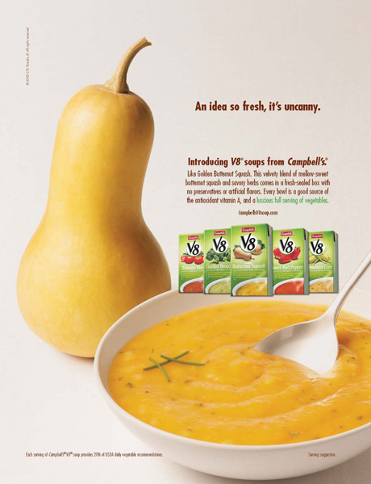

In Terms of Consumer Learning, Are These New Products Likely to Succeed?

Slide 3
These Ads Might Induce Learning Due to Familiar Names

Slide 4
Learning:
The process by which individuals acquire the purchase and consumption knowledge and experience that they apply to future related behavior
Marketers must teach consumers:
  where to buy
  how to use
  how to maintain
  how to dispose of products
Notes:
This definition of learning can be looked at more specifically. It is important to realize that it is a process, that it changes over time as new knowledge and experiences are gained by the consumer. New knowledge and experience serve as feedback to the consumer and will influence their future behavior.

Slide 5
Learning Processes
Intentional
  learning acquired as a result of a careful search for information
Incidental
  learning acquired by accident or without much effort

Slide 6
Two Major Learning Theories:
Behavioral Learning
Based on observable behaviors (responses) that occur as the result of exposure to stimuli
Cognitive Learning
Learning based on mental information processing
Often in response to problem solving
Also known as stimulus response theory.
Notes:
These are the two general categories of learning that will be discussed in this chapter. Each is covered in extensive detail on future slides.

Slide 7
Elements of Learning Theories:
Motivation
Cues
Response
Reinforcement
Unfulfilled needs lead to motivation
Stimuli that direct motives
Consumer reaction to a drive or cue
Increases the likelihood that a response will occur in the future as a result of a cue
Notes:
There are the four major elements of all learning theories. Motivation is important because it will differ from one consumer to the next. We may all have a need, but some are more motivated to fulfill the need versus another. Often, a consumer does not realize they have a need. A cue is the stimulus that helps direct a consumer’s motives. They include price, styling, packaging, advertising, and store displays. A consumer will have a response to a drive or a cue. The response is how the consumer behaves after being exposed to a cue or developing motivation. Finally, reinforcement is tied to the likelihood that the response will occur in the future.

Slide 8
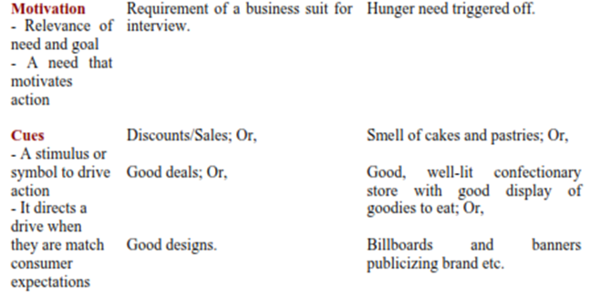
1.

Slide 9
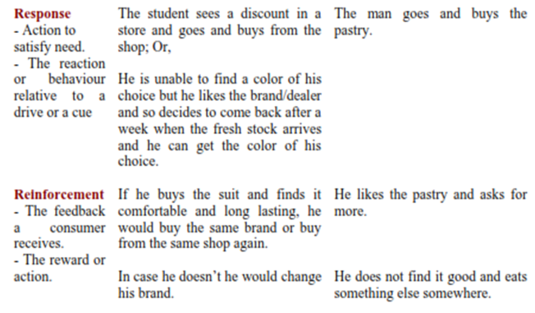
2.

Slide 10
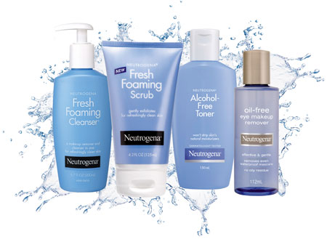

Slide 11

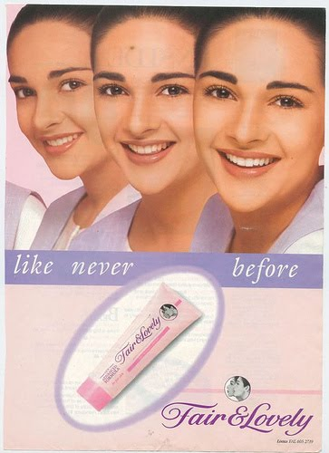
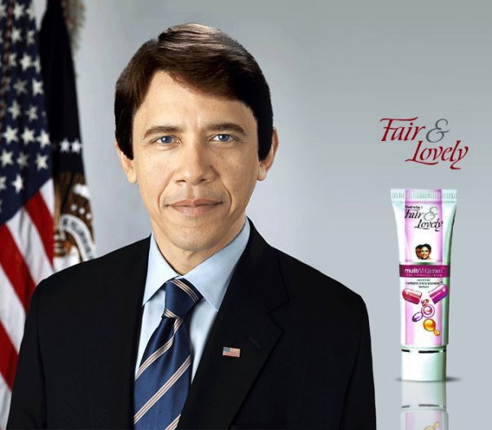

Slide 12
Behavioral Learning Theories
Classical Conditioning
Instrumental (Operant) Conditioning

Slide 13
Classical Conditioning
A behavioral learning theory according to which a stimulus is paired with another stimulus that elicits a known response that serves to produce the same response when used alone.
Notes:
Many of you may be familiar with Pavlov’s dog. In this situation, Pavlov sounded a bell, then applied meat paste to the dog’s tongue. Over time, the dog began to associate the bell with the meat paste. Eventually, when Pavlov rang the bell, the dog would salivate because he expected the meat paste to be applied. What happened was learning or conditioning. The dog learned that the meat paste, which is called the unconditioned stimulus, was associated with the bell, which is the conditioned stimulus. He began to have a conditioned response to the bell when he learned that the bell meant food. The experiment is provided in more detail on the following slide.

Slide 14
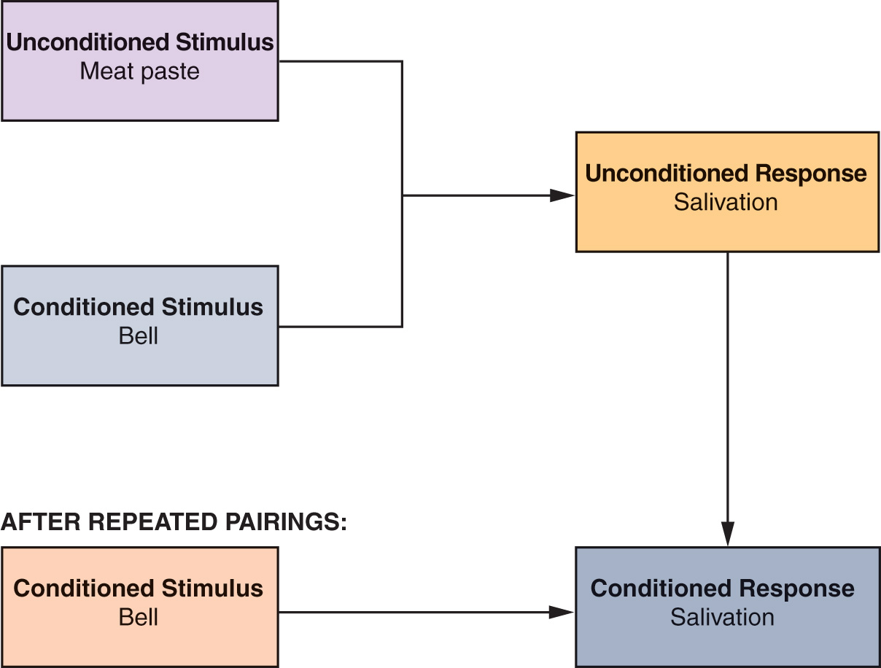
Models of Classical Conditioning:

Slide 15
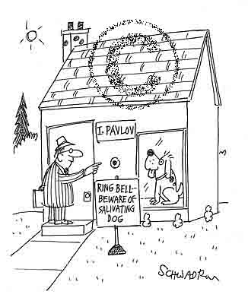

Slide 16
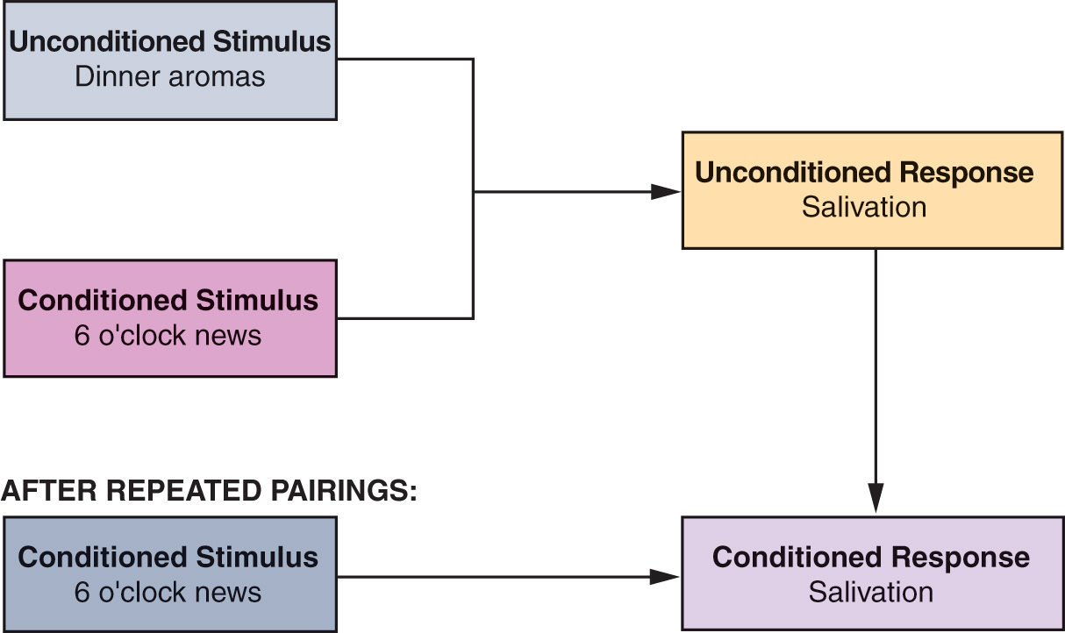
Example:

Slide 17
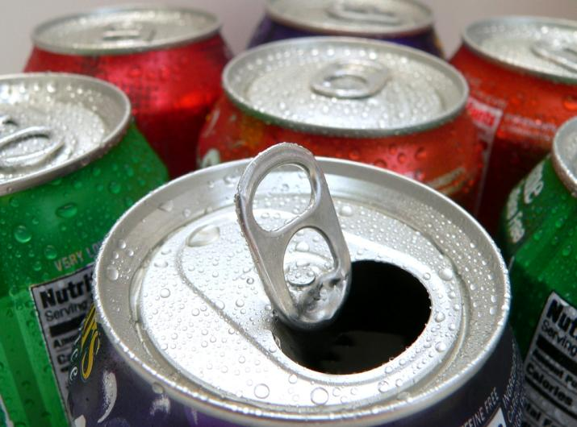
Discussion Questions
For Coca-Cola or another beverage company:
  How have they used classical conditioning in their marketing?
  Identify the unconditioned and conditioned stimuli, the conditioned and unconditioned response.
Notes:
Think about the advertisements for these ads. The smiling people and music.

Slide 18
Strategic Applications of Classical Conditioning
Basic Concepts
Repetition
Stimulus generalization
Stimulus discrimination
Increases the association between the conditioned and unconditioned stimulus
Slows the pace of forgetting
Advertising wearout is a problem
Notes:
For the association between the unconditioned and the conditioned stimuli to become strong, the exposure to the pairing must be repeated. In addition, the repetition is important so that the association is remembered by the subject. Of course, too much repetition can also be a problem. Think of the ad you have just seen so many times you feel like you can’t stand to see it again. This advertising wear out can be a big problem for advertisers, which is why they change their ads frequently. How are songs in ads an example of classical conditioning?

Slide 19


Why Did Gillette Use Two Different Ads to advertise the Same Product?

Slide 20
Repetition of the Message with Varied Ads Results in More Information Processing by the Consumer

Slide 21
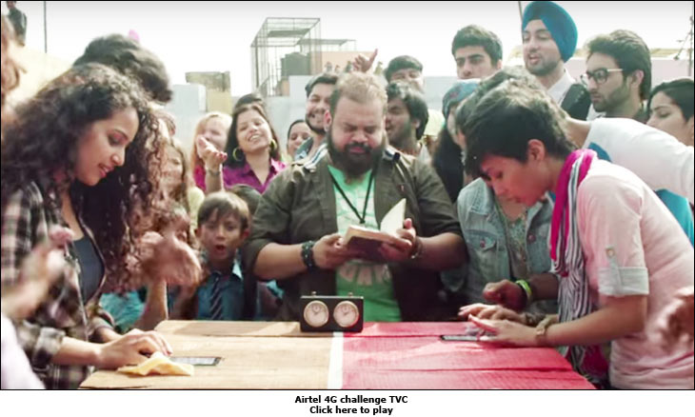

Slide 22
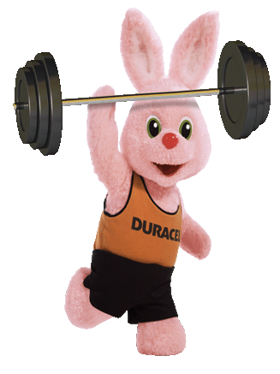

Strategic Applications of Classical Conditioning
Basic Concepts
Repetition
Stimulus generalization
Stimulus discrimination
Having the same response to slightly different stimuli
Helps “me-too” products to succeed
      Useful in product extensions
        Product Line, Form & Category Extensions., Family Branding
Notes:
Stimulus generalization is when a consumer applies a conditioned response to a stimulus that is not the same but is similar to a conditioned stimuli. An example you might recognize is when we react to someone in a certain way because they remind us of someone we know and have interacted with before. Stimulus generalization can be helpful as marketers extend their product line, product form, and product category. Example: Duracell and
Eveready played very similar advertisements, much to the confusion of consumers.

Slide 23


Discussion Question Stimulus Generalization
How does CVS Pharmacy use stimulus generalization for their private brands?
Do you think it is effective?
Should this be allowable?

Slide 24
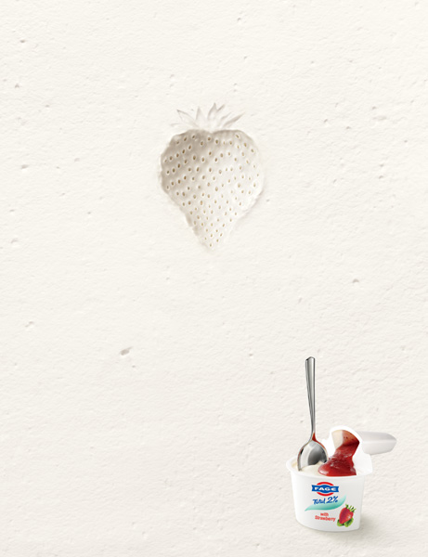
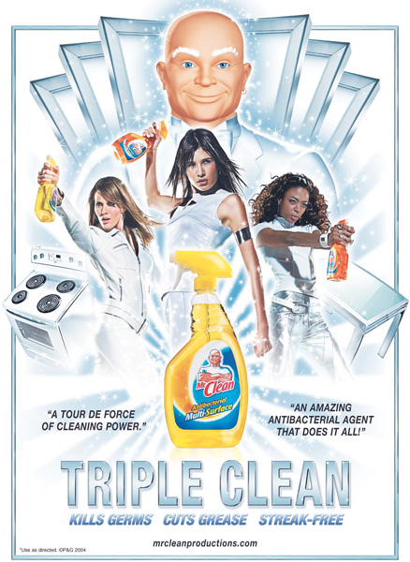
Which Concept of Behavioral Learning Applies to the Introduction of These Two Products?

Slide 25
Stimulus Generalization

Slide 26

What Is the Name of the Marketing Application Featured Here and Which Concept of Behavioral Learning Is It Based On?

Slide 27
Product Category Extension
Stimulus Generalization

Slide 28
Strategic Applications of Classical Conditioning
Basic Concepts
Repetition
Stimulus generalization
Stimulus discrimination
Selection of a specific stimulus from similar stimuli
This discrimination is the basis of positioning which looks for unique ways to fill needs
  Positioning
  Product Differentiation
Notes:
Stimulus discrimination is closely linked to the concept of positioning. Marketers want you to think of their product differently than the rest when you are looking at the shelf in the grocery store. Using the example of the brand Tylenol, the manufacturer would want you to know that it is superior to the store brand.

Slide 29
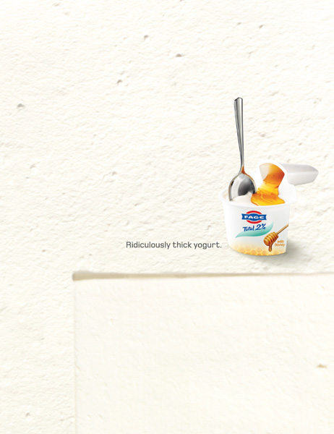
What is the Name of the Marketing Application & the Behavioral Learning Concept Featured Here?

Slide 30
Stimulus Discrimination -
Product Differentiation

Slide 31
Instrumental (Operant) Conditioning
A behavioral theory of learning based on a trial-and-error process, with habits forced as the result of positive experiences (reinforcement) resulting from certain responses or behaviors.
Notes:
Instrumental conditioning also requires a link between a stimulus and a response. The difference between this and classical conditioning is that the learned response is the one that is most satisfactory of responses. The famous psychologist B.F. Skinner is associated with this type of conditioning. He pointed out that learning occurs based on rewards. Through trial and error, consumers learn which behaviors lead to rewards and which do not.

Slide 32
Instrumental Conditioning:
Is the process in which the frequency of occurrence of a bit of behaviour is modified by consequences of the behaviour
If positively reinforced, the likelihood of the behaviour being repeated increases.
If punished, the likelihood of the behaviour being repeated decreases.
Notes:
The two types of reinforcement are positive and negative. It is important to realize that both of these influence responses. Positive reinforcement is a good thing that happens which rewards a behavior – going to the gym made you feel good so you go every other day. A negative outcome is a bad thing that happens which encourages a behavior. You ate a donut every morning for breakfast so gained a lot of weight over the past week. This causes you to go to the gym every other day and to stop eating donuts.

Slide 33
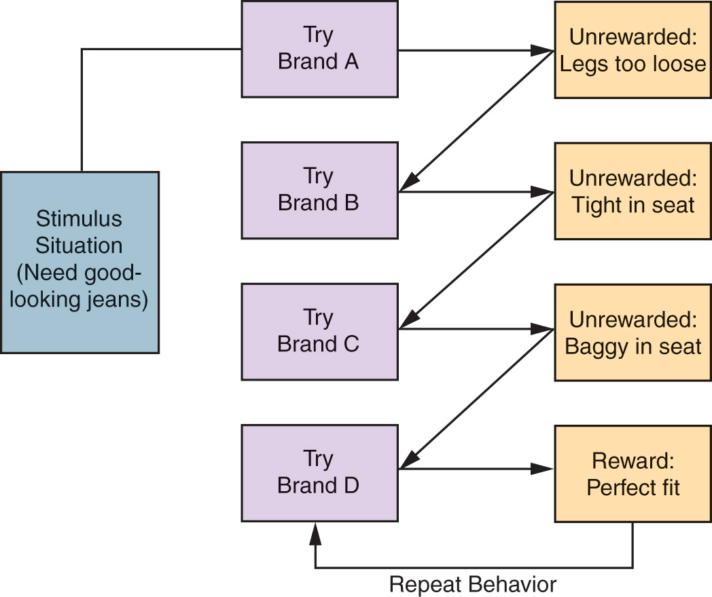
A Model of Instrumental Conditioning:
Notes:
Here is a model of instrumental conditioning. You can see this consumer tried on four brands. The first three brands ended with no rewards – they simply did not fit. The final brand, Brand D gave the consumer the reward of a perfect fit. The consumer has learned that these jeans are a good fit and will likely repeat this behavior the next time they are in the stimulus situation of needing good-looking jeans.

Slide 34
Instrumental Conditioning and Marketing
Customer Satisfaction (Reinforcement)
Reinforcement Schedules
  Continuous(Total)
  Systematic(Fixed)
  Variable/random
Shaping – by having the reinforcement BEFORE the behavior occurs.
  E.g. consumer can be given the offer of a reward before they actually make their decision & purchase a product
Notes:
These are four applications of instrumental conditioning that are used by marketers. Customer satisfaction means that each time the customer has an experience with the product or company, there has been positive reinforcement. This is the reason relationship marketing is so important.
Reinforcement schedules can vary. They can be total (or continuous) reinforcement, systemic (fixed ratio) reinforcement, or a random (variable ratio) reinforcement schedule. Marketers will often used random reinforcement as a bonus for the customer and fixed reinforcement as loyalty points or rewards. Shaping occurs by having the reinforcement BEFORE the behavior occurs. In this situation, the consumer can be given the offer of a reward before they actually make their decision and purchase a product.

Slide 35

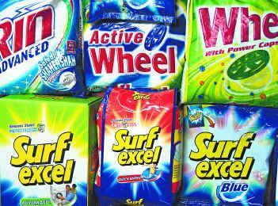
Example:
Notes:
In order to illustrate the two approaches in terms of consumer behavior, let us take an example. A new detergent + starch combination gel is launched by Hindustan Uniliver Ltd. It is specially developed for cotton clothes, and the USP of the product is that it does not only clean them but also applies starch on them, making them clean and crisp after application.
Classical Conditioning: A person who is loyal to HUL and buys many of their brands as he finds them to be of quality, would also buy this new product (stimulus generalization).
Operant Conditioning: HUL decides to give free samples in small 25 gm pouches, with products like Lux, Peposodent etc. The person who buy a Lux or a Pepsodent, would get a sachet of this new product free; he would try it and if he finds it satisfying, he would desire buying a larger quantity pack to be used regularly (positive reinforcement).

Slide 36
Observational Learning
A process by which individuals observe how others behave in response to certain stimuli and reinforcements. Also known as modeling or vicarious learning.

Slide 37

The consumer observes a positive response by two teens.

Slide 38

Cognitive Learning
Cognitive learning focuses on problem solving and consumer thinking. It is closely tied to information processing and how consumers store, retain, and retrieve information.
Notes:
This is a move away from the behavioral learning theories of classical and operant conditioning. Cognitive learning focuses on problem solving and consumer thinking. It is closely tied to information processing and how consumers store, retain, and retrieve information.

Slide 39
Discussion Question
How do advertisers drive consumers to rehearse information?
When does this work against the advertiser?
Can you think of examples of advertisements which drive you to rehearse?

Slide 40
Information Processing
Relates to cognitive ability and the complexity of the information
Individuals differ in imagery – their ability to form mental images which influences recall

Slide 41
Information Processing & Memory Stores:
STM
Rehearsal
LTM
DECAY
Notes:
The large blocks in this process are the three places where a consumer will store information before processing. The sensory store is very short term; it is where an image or sound will last for just a few minutes and then be forgotten. The short-term store is the stage where information is processed. Similarly to the sensory store, it is just held for a brief time. Information will move, through encoding, to the long-term store. Information here can last for relatively extended periods of time. Rehearsal, encoding, and retrieval move information from one place to the next. Rehearsal can be done either by repeating the information or relating it to other data. If held long enough, the information can be encoded, or given a word or visual image to represent the object. Retention, though not shown on this process chart, describes what happens with the information in long-term storage. As it is retained, it is constantly organized and reorganized. Finally, retrieval, the last stage of our process, describes how we recover information. Situational cues are the most common reason to retrieve information.
A person watches an advertisement for a brand (sensory memory). When he pays attention to the advertisement, it moves to his short-term memory. The inputs are processed here in the short-term memory, and if it is found to be of relevance and interest, it moves to the long-term memory. The inputs could relate to the brand name, sign or logo, symbol, features, attributes, price, celebrity endorsing it, the message content, the jingle and the music etc. On the other hand, if the consumer lacks relevance and interest for the product, the information input would be scrapped off and forgotten. Many a times, a consumer also faces a clutter, in terms of being exposed to too many stimuli at the same time. This amounts to an information overload, and here, a person uses his discretion as to whether to retain it or let it go. Once the person decides to retain it, he rehearses it within himself mentally, by forming images and associating the cues related to it (rehearsal); it is then that the information moves into long term memory. He may also evaluate the information for better comprehension (elaborative rehearsal).

Slide 42
Measures of Consumer Learning
Brand Loyalty
Recognition and Recall Measures
Brand Loyalty
Notes:
Recognition and recall tests determine whether consumers remember seeing an ad and the extent to which they can recall the ad. The researcher can use aided recall, which would rely on recognition as opposed to unaided recall. There are a number of services which conduct these tests, including Starch Research

Slide 43
Recognition v/s Recall
Recognition:
  Remembering with stimulus
Recall/Retrieve:
  Remembering without stimulus

Slide 44
Degree of personal relevance that the product or purchase holds for that customer.
Involvement
High involvement purchases are very important to the consumer
Low-involvement hold little relevance, have little perceived risk, and have limited information processing
Notes:
Involvement is focused on the personal relevance a product holds for an individual. Understanding whether a product is high or low involvement helps the marketer with all aspects of their planning and strategy.

Slide 45
Marketing Applications of Involvement:
Ads in video games
Avatars
Sensory appeals in ads to get more attention
Forging bonds and relationships with consumers
Notes:
Marketers want consumers to be involved with their brands and products. Advertisers are always searching for ways to do this, including the list on this slide. Product placement is also helpful in building involvement with a certain product.

Slide 46
Central and Peripheral Routes to Persuasion
Central route to persuasion
For high involvement purchases
Requires cognitive processing
Peripheral route to persuasion
Low involvement
Consumer less motivated to think
Learning through repetition, visual cues, and holistic perception
Notes:
When a product is of high importance, a consumer is likely to think through the advertising and examine details and information. This is the central route to persuasion. On the other hand, if the purchase is lower involvement, the consumer is more likely to be persuaded by music, pictures, and short slogans in the ads. This is the peripheral route to persuasion, which we often see for low-involvement products, especially on television advertising.

Slide 47
Hemispheral Lateralization and
Passive Learning
Hemispheral lateralization
  Also called split-brain theory
Left Brain
  Rational
  Active
  Realistic
Right Brain
  Emotional
  Metaphoric
  Impulsive
  Intuitive
Notes:
Most of you know whether you tend to be more right or left brain. The ad on the next slide pokes fun at hemispheral lateralization but makes the point that many products and services have to appeal to both sides of the brain. There are researchers who prove that learning occurs in a passive way from watching television. A consumer sees an ad and it is absorbed and processed by the right brain. Through repeated exposure, the consumer could in fact purchase the product without even having a change in their attitude. This contradicts the models we saw in an earlier slide where changes in affect preceded changes in behavior. If you think about it, this is consistent with classical conditioning.

Slide 48
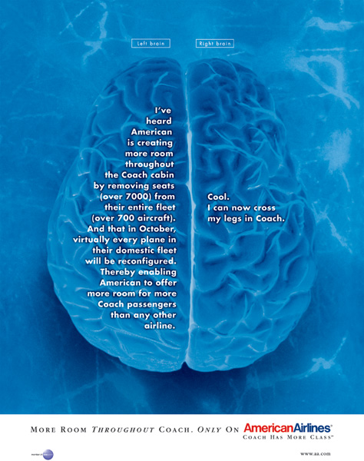
What Is the Name of the Learning Theory Concept Featured in This Ad and How Is It Applied to Air Travel?

Slide 49
Hemispheric Lateralization
Both Sides of the Brain are Involved in Decision

Slide 50

How Is Passive Learning Applied to the Promotional Appeal Featured in This Ad?

Slide 51
The Ad is Targeted to the Right Brain

Slide 52
High v/s Low Involvement
High involvement (looking at a car ad when you are in the market): more thought
  consumers evaluate ad and product carefully
  what the ad says about the product’s attributes
  non-product material such as music/endorser (peripheral cues) less important
Low involvement (just looking at a random car ad): less thought
  consumers do not evaluate ad carefully
  what the ad says about attributes not so important
  peripheral cues (e.g., music/endorser) quite important
So persuasion tactics have to be different for low vs. high involvement situations…advertisements use both types…

Slide 53
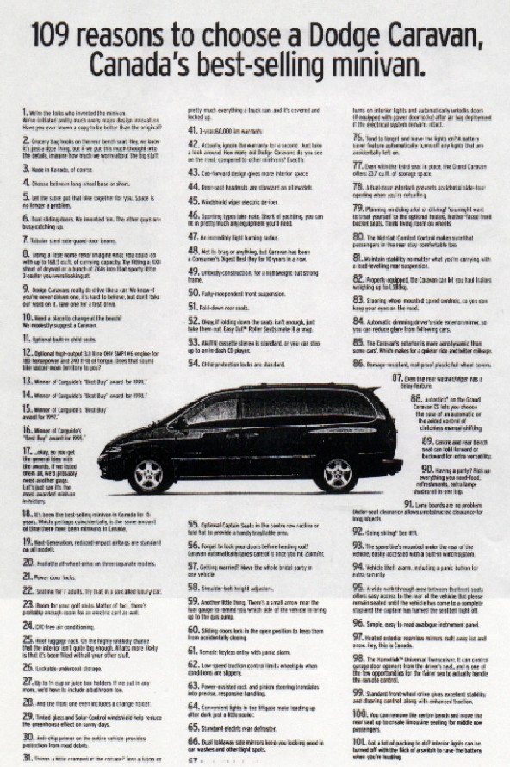

Slide 54
Low Involvement Persuasion Techniques:
Music
Sponsorships
Famous/Attractive Endorser
Advertising repetition (mere-exposure effect)
Many Arguments
Likable advertising
2 General points about these tactics
  Do not need consumers to make much effort…
  Don’t have to talk about product features

Slide 55
Very different if consumers are highly involved…!

Slide 56

automatic depth sensor.
Diving water alarm.
Depth alarm.
200 hours marine record.
Calculates oxygen left in body
alarm setting included
time all over the world
200m diving water resistant

Slide 57


Slide 58
High Involvement Persuasion Techniques:
Theory says: For high involvement, people really want to make the right judgment (e.g., “is this brand really good or not?)
Brand attitude will be based on how consumers evaluate the actual merits of the brand…
  (not irrelevant stuff like ad, or music…)

Slide 59
Difference with Low involvement
Low involvement persuasion: QUANTITY matters, not QUALITY
  so even if consumers don’t read the arguments/features carefully, they can develop a positive attitude
  In other words, you can get away with advertising unimportant attributes
High involvement persuasion: QUALITY matters more
  So consumers will read the arguments/features carefully
  In other words, you can’t get away with advertising unimportant attributes

Slide 60
Contd…
High Involvement Technique # 1:
  Use Strong, Convincing Arguments in the Ad
    Like “watch ad” earlier…
High Involvement Technique # 2:
  Actually demonstrate your product’s important features
    How did Pepsi use the demonstration technique…?
    Car Safety demonstrations
      Chrysler was the first to test out air bags with actual human drivers instead of mechanical dummies.

Slide 61
Contd…
High Involvement Technique # 3:
  Role of Endorsers in High involvement persuasion
For low involvement
  Attractive/likable endorser = good brand attitude

Slide 62
Assuming high involvement, which of the following endorsers are more likely to be effective?

Slide 63
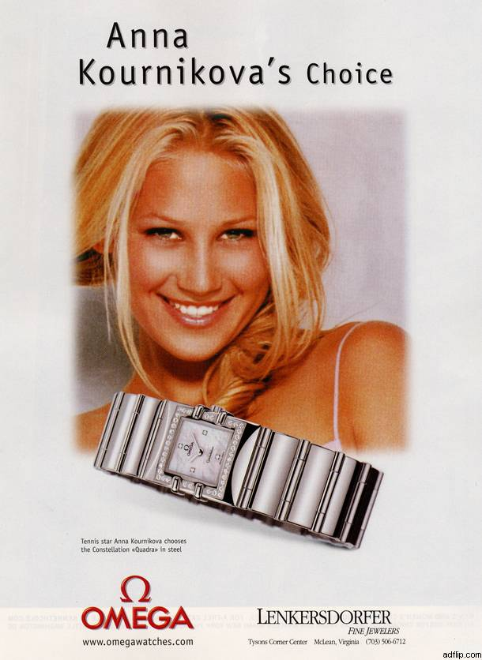

Slide 64
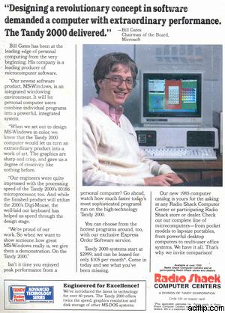

Slide 65
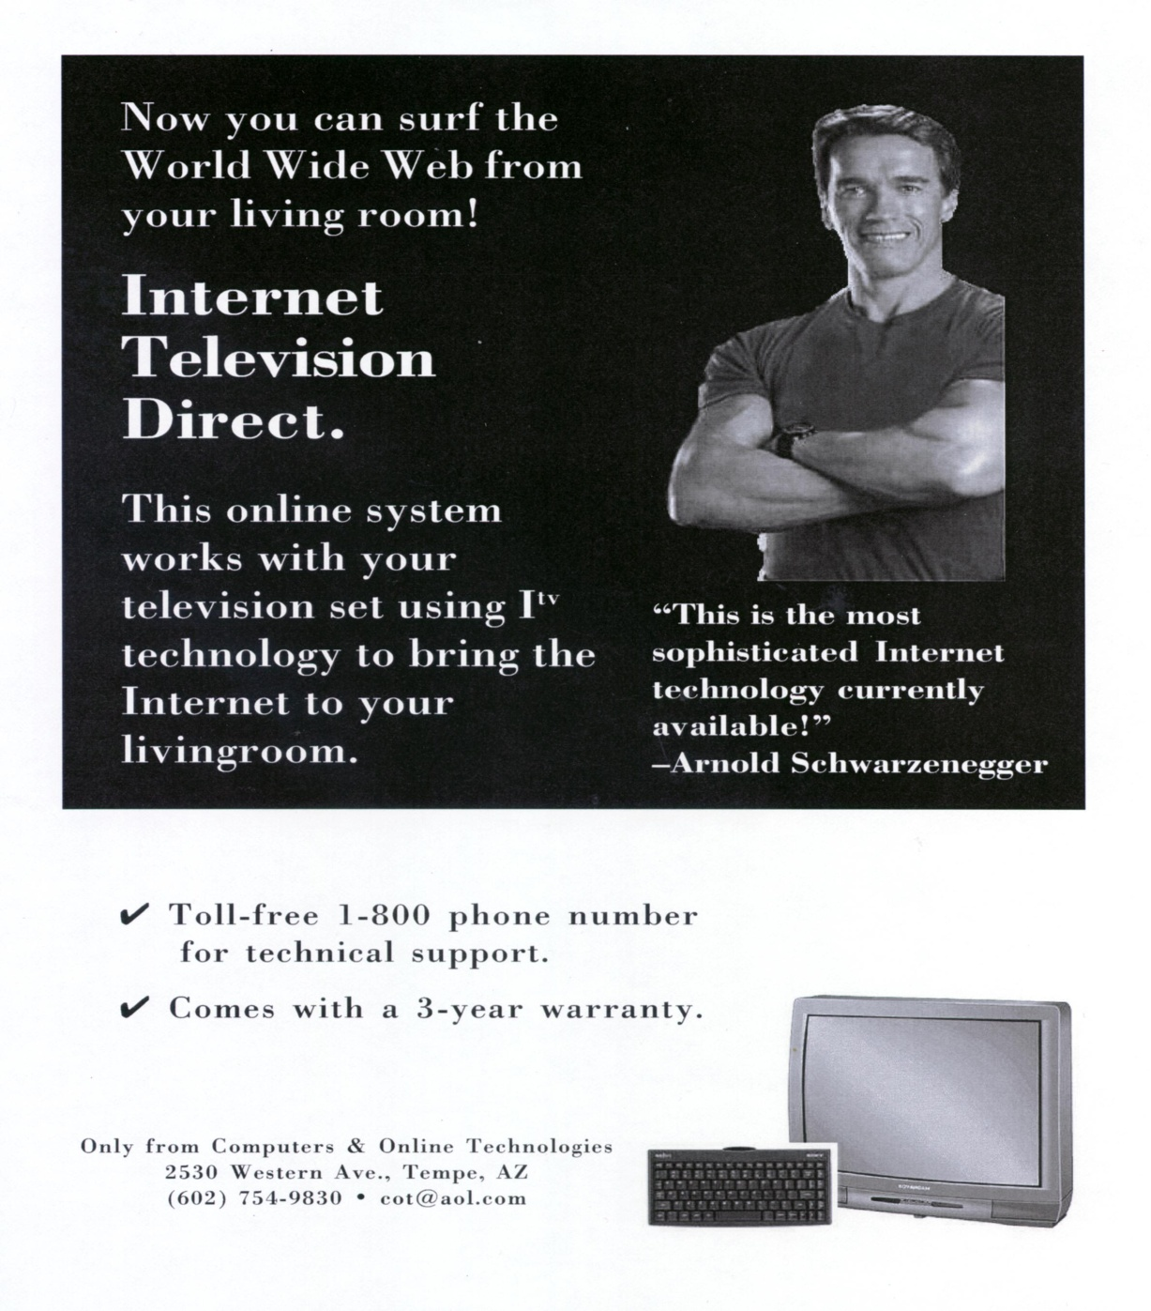

Slide 66


Slide 67
High Involvement Persuasion Techniques
Role of Endorser: Has to be Credible!!
Consumers must believe this person…
Not so necessary under low involvement (likability/attractiveness is enough)

Slide 68
Contd…
High Involvement Technique # 4:
  Fear Appeal: Scare the consumer!
    What happens if I don’t use this product?
    Or what happens if I engage in an unsafe behavior? (like smoking)
  Examples: Insurance

Slide 69
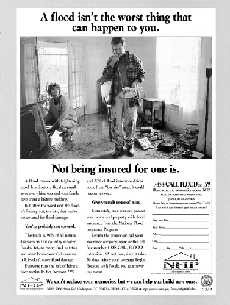
More Fear??

