Slide 1
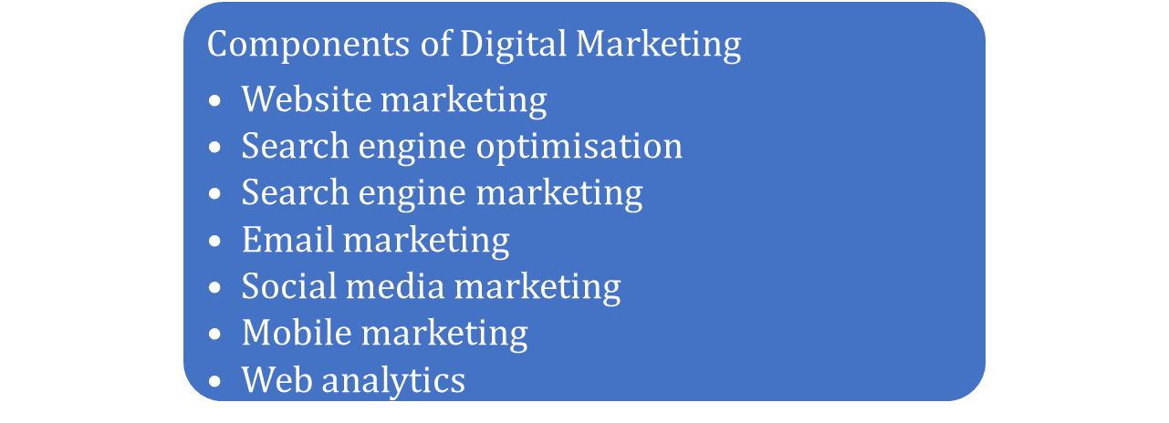
Digital Marketing
Digital marketing involves the use of various types of digital technologies such as social media, search engines and email, to promote products and services.
Digital marketing can be defined as a type of marketing practice that involves the employment of digital technology to promote and sell products/services.

Slide 2
Multichannel Marketing
Multichannel marketing can be defined as the practice of communicating with potential and existing customers through a variety of channels, such as retail stores, websites, mail order catalogues, emails and text messages.
Multichannel marketing is highly effective in increasing brand awareness by using various channels. It has been observed that multichannel customers spend more time and money on gathering information pertaining to a specific product or service in comparison to single channel customers.

Slide 3
A/B Testing Method
A/B testing, also known as split testing, is conducted in a controlled environment by inbound marketers to improve clicks and sales. Following are some important features that must be incorporated while creating an effective landing page.
In A/B testing, two versions of an online ad, email or even a landing page are examined to ascertain which version is effective in driving maximum conversions.

Slide 4
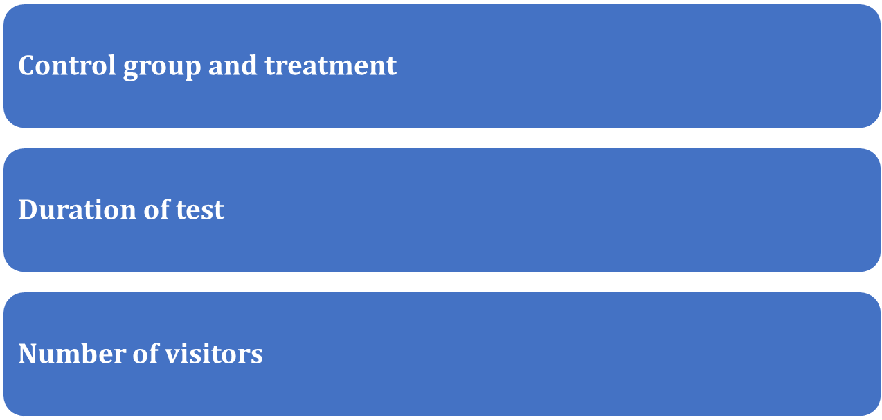
A/B Testing Method
To conduct A/B testing, an inbound marketer must determine:

Slide 5
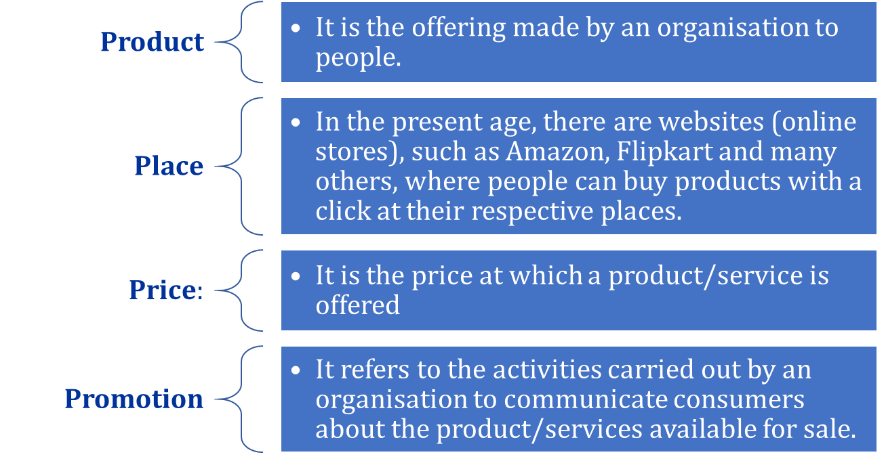
Digital Marketing Mix
Like marketing mix, digital marketing mix also comprise 4Ps, namely product, place, price and promotion

Slide 6
Digital Marketing vs Traditional Marketing
Traditional Marketing | Digital Marketing
It involves the use of conventional marketing channels for promoting products and services. The most common channels used in traditional marketing are newspapers, radio, television, flyers, billboards, magazines, etc. | It involves the use of digital channels such as emails, blogs, social media sites and paid pop-up ads.
Huge costs are involved in the development and implementation of marketing campaigns. | Relatively lesser costs are involved in the development and implementation of online marketing campaigns.

Slide 8
Digital Marketing vs Traditional Marketing
Traditional Marketing | Digital Marketing
There is no direct response from the viewers. | Viewers can respond immediately and directly after seeing an ad.
It helps in reaching out to an audience spread over a specific geographical region. | It helps a business organisation in developing a global presence and reaching out to its target audience located across different geographical regions.

