Slide 1
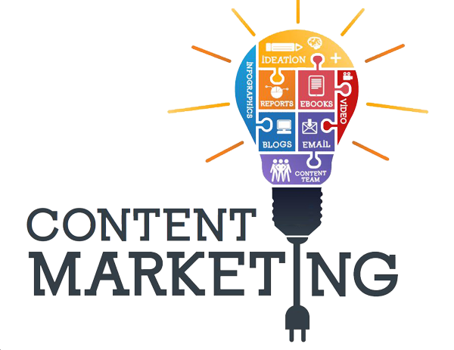

Slide 2

Introduction
Content marketing is a marketing strategy used to attract, engage, and retain an audience by creating and sharing relevant articles, videos, podcasts, and other media. This approach establishes expertise, promotes brand awareness, and keeps your business top of mind when it's time to buy what you sell.
Examples: E-books, Videos, Educational articles, Entertainments, and Webinars

Slide 3
Why do you need Content Marketing?
Basically it lubricates the process of your prospect going from discovering your brand all the way to him becoming a brand advocate i.e. customer.
Helps create a relationship with your audience , hence builds trust.

Slide 4
Origin of Content Marketing
1. 1895 - John Deere launches customer magazine called “The Furrow”
2. Michelin develops “The Michelin Guides”

Slide 5
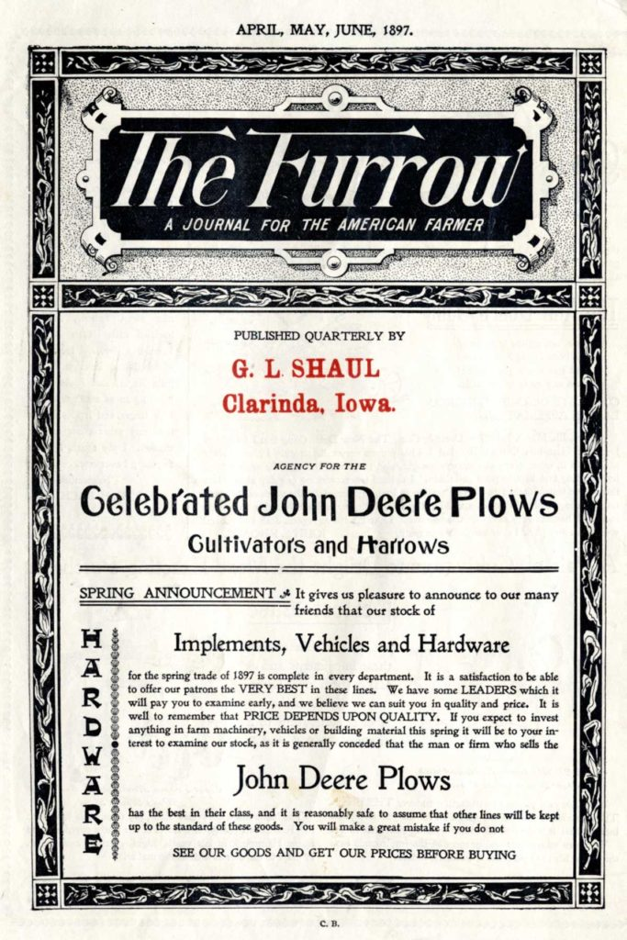
It provided valuable information and stories for consumers to enjoy.
The magazine forged a relationship of trust and dependence between the John Deere brand and its audience through the expert advice.
Results? - The Furrow became a Hit. By 1912 it reached 4 million readers. Today it has around 1.5 million circulation in 40 countries and 12 different languages.

Slide 6
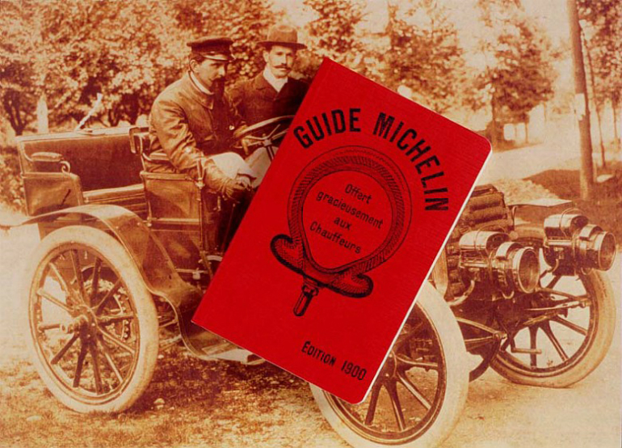
A 400-page guide helped drivers maintain their cars and find decent lodging.
Included tips on how to change your tire, and where to re-fuel your car.
List of places to eat & suggestions for hotels.
By today, the Michelin Guide has sold more than 30 million copies since it was first published

Slide 7
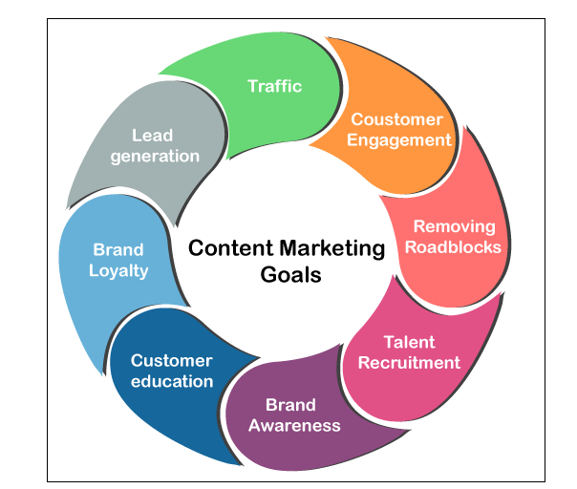
Content Marketing Goals

Slide 8
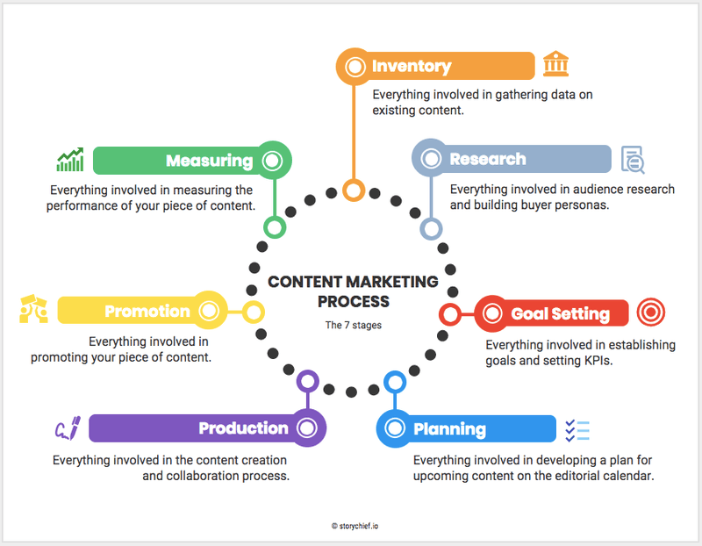
Content Marketing Process

Slide 9
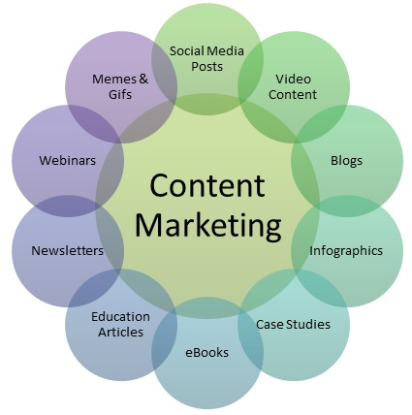
Types of Content Marketing

Slide 10
1. Blogs:
When writing blog posts, be sure to keep these things in mind:
Optimize your content for SEO
Use a pillar or cluster model to organize your blog topics
Keep your content focused and relevant to your product.

Slide 11
2. Videos
Videos engage an audience quickly. According to HubSpot research, 54% of audiences want to see videos from brands they support, which is more than any other type of content.
Videos are also a versatile medium; you can create a variety of content in your industry that engages your market and leaves them wanting more. In this post, we walk you through how to use video marketing to your advantage.

Slide 12
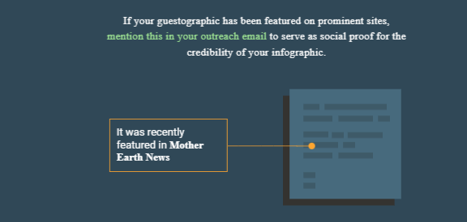
3. Infographics
Infographics are so fun and can wake up a marketing strategy with eye-catching content. They’re bright, visually captivating ways to present stats or processes. Infographics are quick and low-cost music to a marketer’s ears.

Slide 13
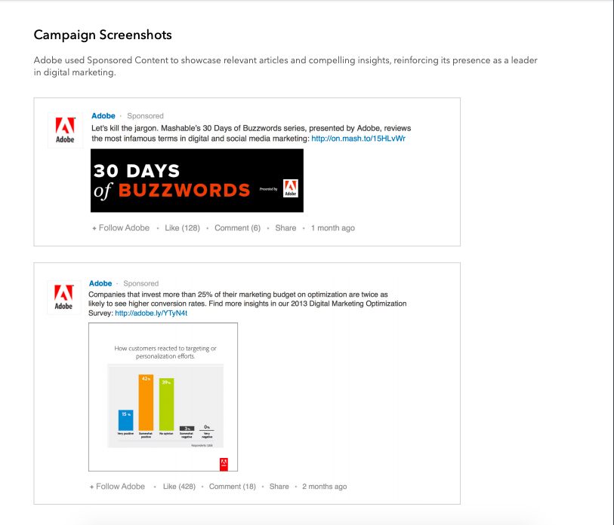
4. Case Studies
Case studies are effective for leads who want to learn more about your business from the customers themselves. With case studies, buyers see a customer’s journey from start to finish and see similar use cases in real life.

Slide 14
5. eBooks
If you’ve never created an eBook before, think of them as long-form blog content. They’re not a novel, they’re not a multiple-page ad for your business. Instead, they’re a way to give potential clients valuable information.
6. User-generated content
User-generated content is an amazing content marketing method because it gets customers involved. People respond to others like them, and it’s more likely to make them interested in your business.

Slide 15
7. Checklists
Checklists provide value to potential customers, especially for SMB customers. They show a step-by-step method for solving a problem and can be formatted to fit your social media pages.
8. Memes
A form of content marketing best described as, "Don’t knock it 'til you try it." Memes are a relatively new type of content marketing, but they work extremely well. A meme is an image set with culturally relevant text that is rapidly circulated online. If you can time a meme perfectly, and align it with your social aesthetic, it’s a savvy way to increase traffic.

Slide 16
9. Testimonials and customer reviews
Like user-generated content, testimonials and customer reviews are content generated straight from your audience. If you’re operating in a niche market, testimonials give a short synopsis of why your company stands out.

Slide 17
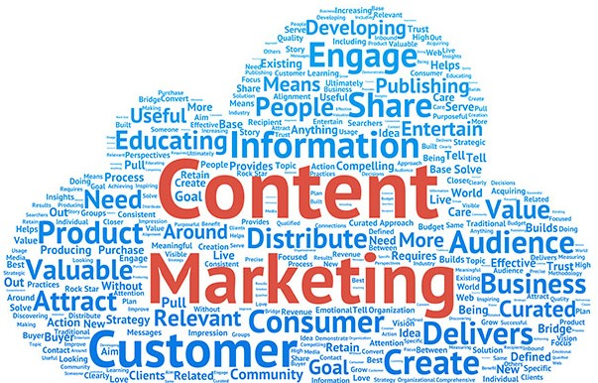
Effective v/s Ineffective
Effective:
The Content Marketing Institute helpfully defines content marketing as “a strategic marketing approach focused on creating and distributing valuable, relevant, and consistent content to attract and retain a clearly defined audience — and, ultimately, to drive profitable customer action.”
Ineffective:
Bad content is pretty much what it sounds like. Its typically content produced for its own sake, rather than to serve a specific purpose

Slide 18
Effective v/s Ineffective
Effective
Document Strategy
Valuable/Original Content
Leverage Multiple Channels
Content Calendar Posting
Data Driven Analytics
Build, Engage, Convert
Ineffective
Undocumented strategy
Copied Content
Limited Channels
Random Posting
Guess Work
Hard Selling

Slide 19
6 C’s of Effective CM Strategy
Conception
Compliance
Curate
Channels
Creation
Conversion

Slide 20

How to improve Ineffective Content?
Quality over Quantity
Reuse, Repurpose & Recycle
User Oriented Content
Less of “ME” & More of “YOU”
Map Content
Promote to targeted audience
Always Valuable & Beneficial

Slide 21
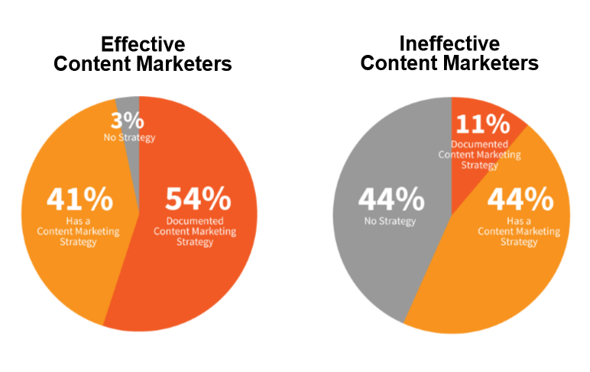
How many you have a Documented Content Marketing Strategy??

Slide 22
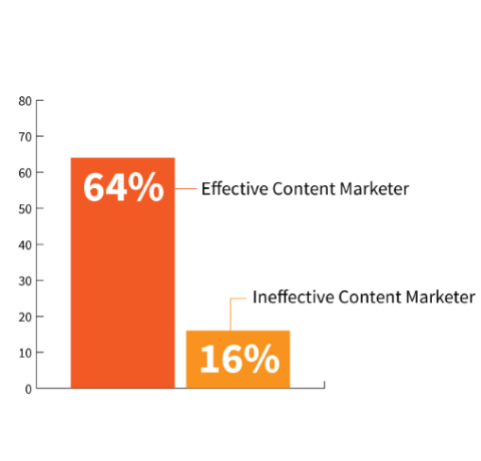
SUCCESS RATE

Slide 23
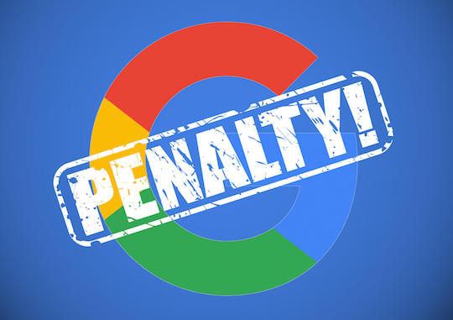
The No-Strategy Penalty

Slide 24

5 Ways to avoid Google Penalty
Know the rules & follow them
Avoid PBN and Low-Quality Link Exchange
Avoid Keyword Stuffing
Plagiarized content invites Google Penalty
No to Cloaking

