Slide 1
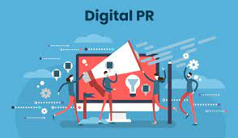
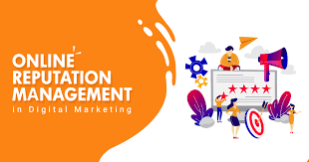
Digital PR and ORM

Slide 2
What is Public Relations
“Public Relations” is a strategic communication process that builds mutually beneficial relationships between organizations and their public.
According to Forbes “PR people are storytellers. They create narratives to advance their agenda.PR can be used to protect, enhance or build reputation thru media, social media, or self-produced communications
According to The Princeton Reviews “An image shaper, generate positive publicity for their client and enhance their reputation. They keep the people informed about the activities of government agencies, explain policy and manage the political campaign, may handle consumer relations and relations between employees and managers

Slide 3
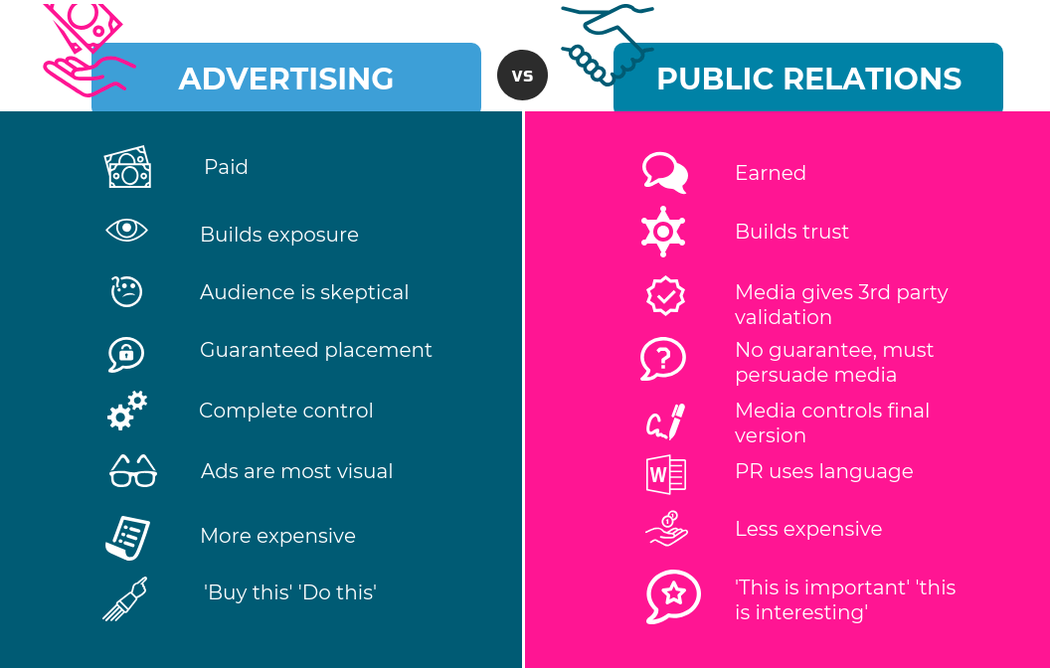
Difference between Advertising and PR

Slide 4
Objective
Boost website traffic
Improve Search Engine Optimization
Increase reputation and credibility
Generate sales and leads

Slide 5
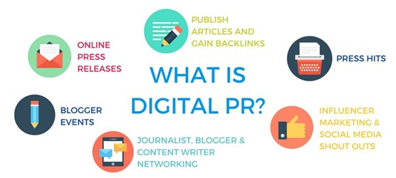
Preparing Online press release
Building relationships with online journalists and Bloggers to generate online press coverage
Arranging business profiling
Organize online interviews and reviews
Ensuring press releases are better optimized with relevant backlinks to your website.(E.g., of Blumart)

Slide 6
Various forms of the same content
An infographic
A guest blog post
An article in the local newspaper
An article in a trade publication
A LinkedIn news update
A short video

Slide 7
What is a Press Release
An effective Press Release helps you to boost your brand, and image and shape public perception through an informative official statement with facts to counter any negative publicity or make a new announcement.

Slide 8
Format of Press Release
Heading
Subheading
Images/ Audio/ Video
Links to further reading
Backlink to website
Easily accessible
Social Media Buttons

Slide 9
What is ORM
Stands for Online Reputation management
About improving your business or brand’s good standing
It’s not about what the company posts but also what others post about (Mention in a blog post or reply on social media post)
Understand what people think and say about you
Actively improve your online reputation

Slide 10
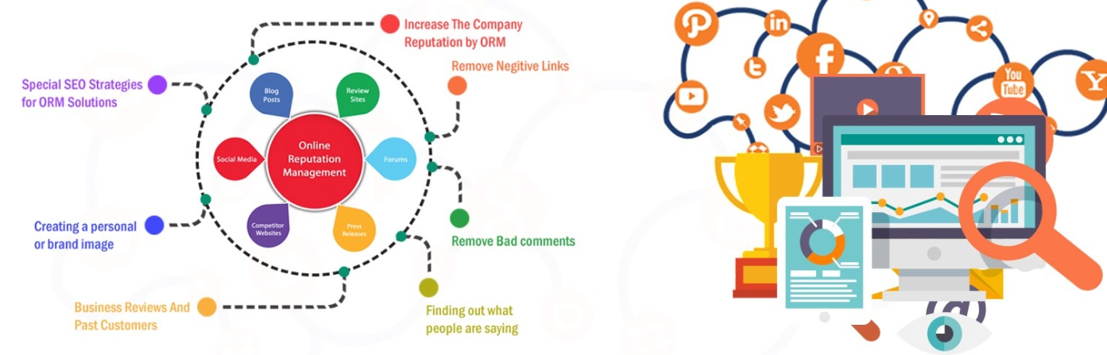
Why ORM is Important?

Slide 11
How to increase ORM
Google review
Social media presence
Blogging
Forums (Quora)
Press Release
Listening to and monitoring the comments of users
Taking action
Use review aggregators

Slide 12
Some examples of Review aggregator
Rotten Tomatoes for films/movies/TV series
Metacritic for video games
Yelp for local businesses
Glassdoor for employer reviews
Google Play Store for Android apps
App Store for Apple apps
G2 for software reviews

Slide 13
Tools
1-Reputology: to let you easily find and monitor brand reviews all over the web (https://www.youtube.com/embed/leq3iCiczoM)
2-Google alert
3-mention(https://www.youtube.com/embed/uns600UqniA)
4-Buzzsumo
5-Digimind
6-Review aggregator like Yelp, TripAdvisor
7- Social media monitoring and listening tools
Hootsuite
Sprout social
Buffer

