Slide 1
E-commerce, Marketplace Optimization & ASO

Slide 2
E-commerce
Ecommerce or electronic commerce is the trading of goods and services on the internet.
Companies like Amazon and Alibaba are examples of ecommerce websites.

Slide 3
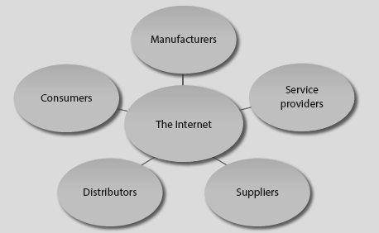
Online Distribution and Procurement

Slide 4
Types of E-commerce
Business-to-business (websites such as Shopify)
Business-to-consumer (websites such as Amazon)
Consumer-to-consumer (websites such as eBay).

Slide 5
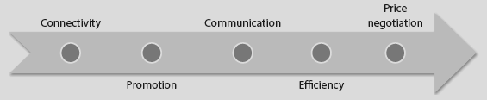
Advantages of the Internet

Slide 6
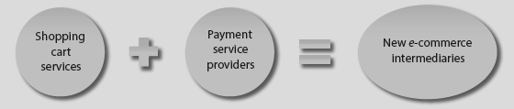
New Intermediaries
New intermediaries are also playing vital roles in two key areas
of the purchasing process:
Shopping cart services
Payment Service Providers

Slide 7
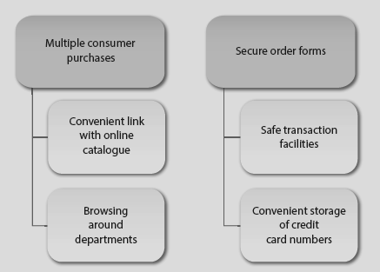
Functions of Shopping Carts

Slide 8
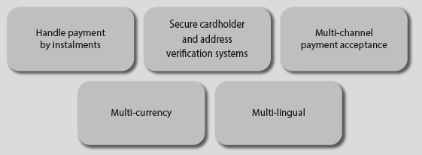
Payment Service Providers

Slide 9
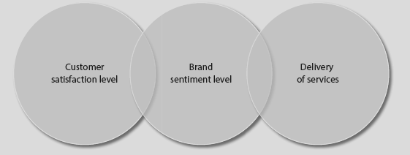
Monitoring Social Media Presence of E-commerce Brands

Slide 10
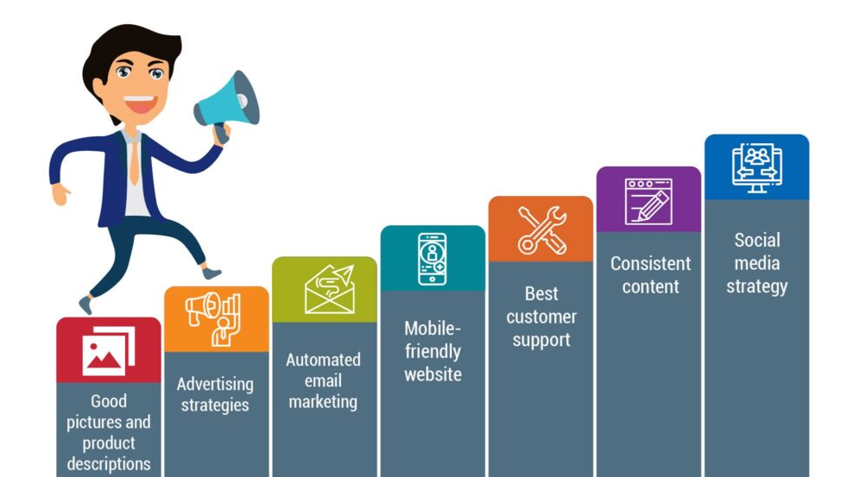
E-commerce Strategies

Slide 11
Marketplace Optimization

Slide 12
Marketplace Optimization
What is Marketplace Optimization (MPO)?
Marketplace Optimization (MPO) is similar to Search Engine Optimization (SEO), which uses a set of signals to rank sellers or their products to relevant buyers in marketplace searches. It is your product rankings on any website like the Facebook marketplace, Amazon, eBay, etc.

Slide 13
Ranking Signals on a Marketplace
Product Title
Product Description
Reviews & Ratings
Images & Videos
Product Features/Bullets
Search Keywords
Product Category
Seller’s Order Cancellation Rate
Seller’s History & Experience
Available Inventory for Purchase
Gross Sales
Total Number of Sales on the Marketplace
Order Defect Rate as a % of Gross Sales
Late Shipments as a % of Total Shipments

Slide 14
ASO ( App Store Optimization)

Slide 15
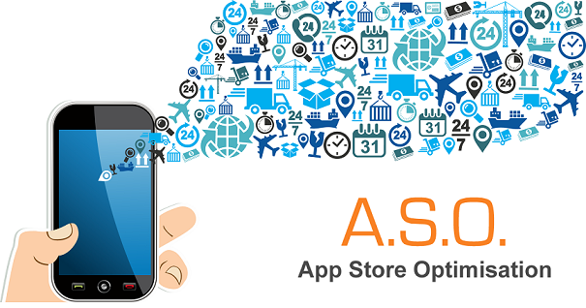
Introduction
App Store Optimization (ASO) is a tactic that improves an app's visibility in an app store. App stores rank each app based on a variety of factors. By successfully using optimal keywords, useful images, and localized descriptions, you can rank higher and drive more downloads due to that visibility.

Slide 16
What are the main ways you can improve ASO?
Using keywords in your app’s name
Including keywords in your app’s description
Localizing content
Using the right primary and secondary app categories
Screenshots and other useful images

Slide 17
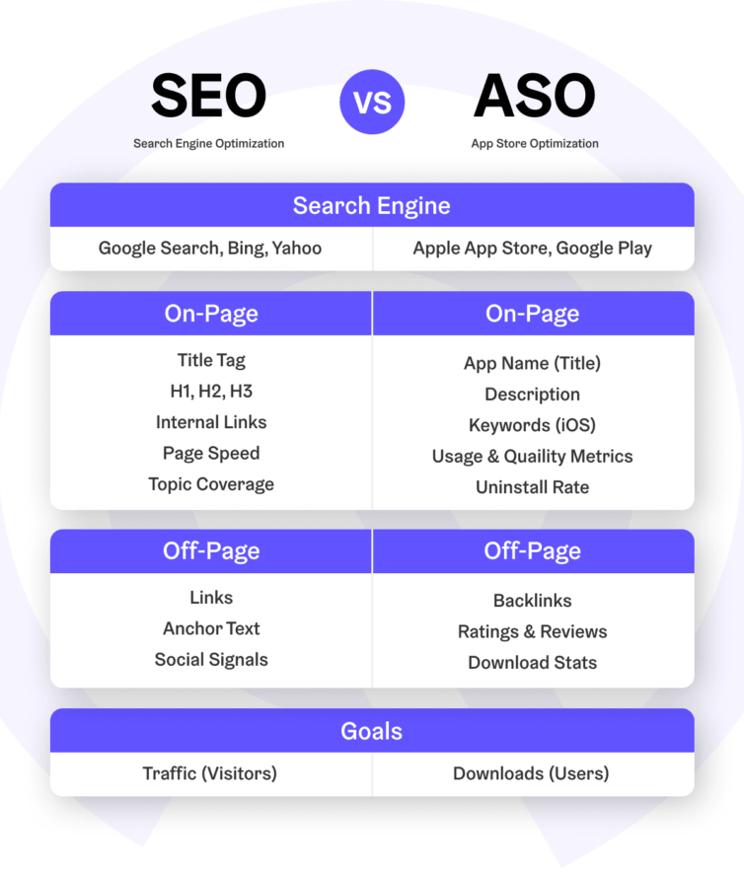
SEO Vs ASO

