Slide 1
Email Marketing

Slide 2
What is Email Marketing?
Is a form of direct marketing that uses email to promote your business's products or services. It can help make your customers aware of your latest items or offers.

Slide 3
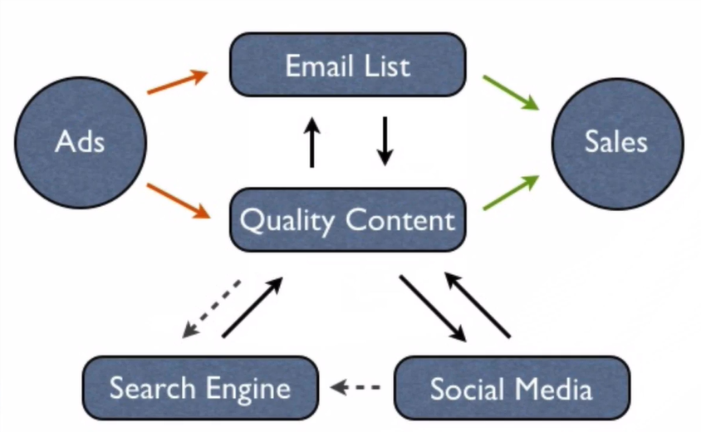
Email Marketing – Integral Part of Integrated Digital Marketing

Slide 4
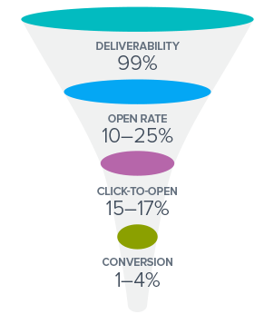
Email Marketing Funnel

Slide 5
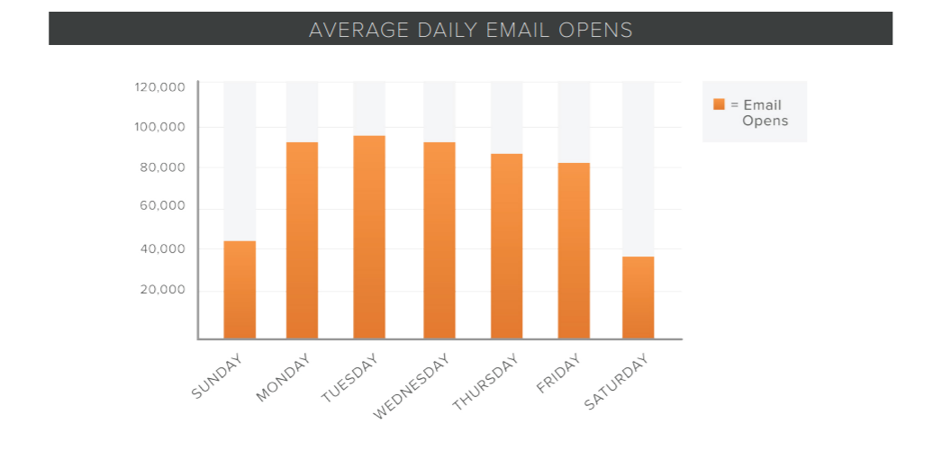

Slide 6
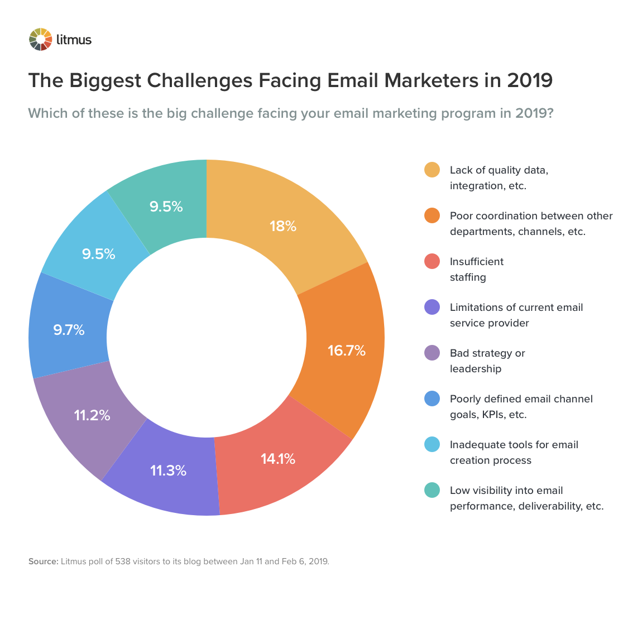

Slide 7
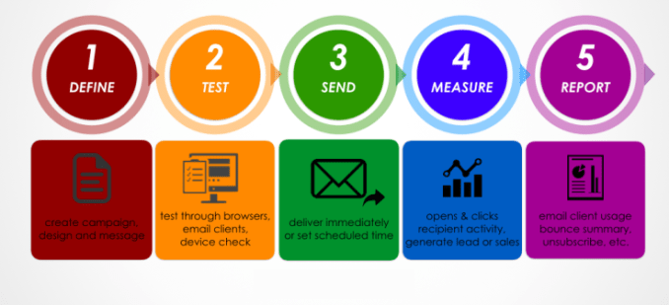
Email Marketing Process

Slide 8
To leverage e-mail marketing, the marketer needs to gain an understanding of following issues -
What is the significance of e-mail marketing for the consumer?
What are the steps that needs to be undertaken to ensure successful e-mail marketing?
What would the strategic approach be?

Slide 9
Consumers & Characteristics of E-mails
Ensure that e-mail is delivered to the user’s inbox
It is likely that user does not even open an email & deletes it, especially if the email is received from an unknown sender.
There is likely to be a substantial time gap between receiving & accessing an email.

Slide 10
THOUGHT ACTIVITY 1
What are the kinds of e-mails that you open?
Do you open e-mails from senders that you have not heard of?
Do you open e-mails from senders/companies that you have not subscribed to?

Slide 11

THE STRATEGY

Slide 12
1. OBJECTIVES
What are the objectives of using e-mail as a Marketing Tool?
What are the objectives of a specific campaign?
Acknowledgement for transactions, Promotional, Follow-up emails etc..
Leading Objectives – Customer Acquisition, Brand Awareness & Customer Retention

Slide 13
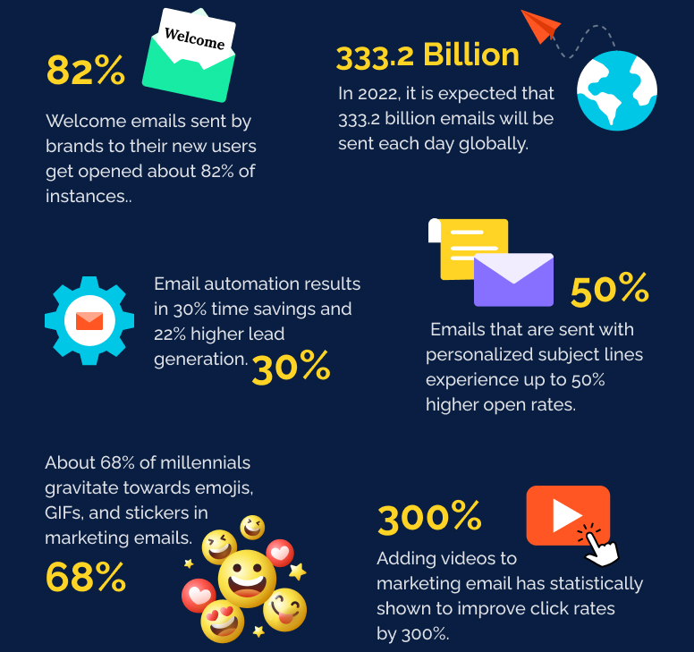
2. TARGET SEGMENT
Who is the Target Audience?
They would wish to receive communication from these brands/companies.

Slide 14
3. BENEFIT/VALUE OFFERED
What is the value obtained by the consumer through email?
Transactional Emails > Promotional Emails
Smart Marketers should be aware of this consumer behaviour

Slide 15
STRATEGY
Emails are information intensive
The Newsletters & Communications sent to users are meant to allow the user to make an informed choice, instead of acting immediately.
MEASURING OUTCOMES
Final Step – Involves determining the extent to which the objectives of the campaign have been achieved.
For e.g. Acquisition of Leads is a step that ensures that individuals are signing up for the company /brand newsletter.
Further steps are – Delivery of email in the user’s inbox, opening of the email, click-through by the user and then arrival of user on the landing page.
Each of these above steps provides an indication of the extent to which the email campaign has been successful or not.
Stop the engagement or Re-engage.

Slide 16
EXECUTING EMAIL MARKETING

Slide 17
1. List Building & Maintenance
Drive Growth Constantly
Maintain the List
Minimize Churn Rate
Segment for Greater Relevance

Slide 18
Drive Growth Constantly
List needs to grow & consist of potential customers
Target & get permission from each user
Opt-in : Ensure that it does not spam the inboxes
What can a Marketer do? How can a marketer go about building an opt-in list?
1. Provide a compelling reason to customer 2. Find out where consumers spend most time on the web 3. Provide various ways of engaging with the customer so that they want to hear from you constantly. (Touch points like – Webinars, Landing pages of contests, social media etc.) 4. Provide subscription forms on your website. 5. Offline efforts
Once signed up for the newsletter, marketer needs to maintain that.
This process is called as – “Single Opt-In”
“Double Opt-in” – Consumer’s confirmation of registration through instructions in the inbox.
Time consuming but reduces the churn rate.
Notes:
According to Merkle Interactive, the average churn rate on email lists is 25-30% per year mainly because of changing email addresses. The Churn rate is about 30% on consumer goods, and about 25% on B2B lists.

Slide 19
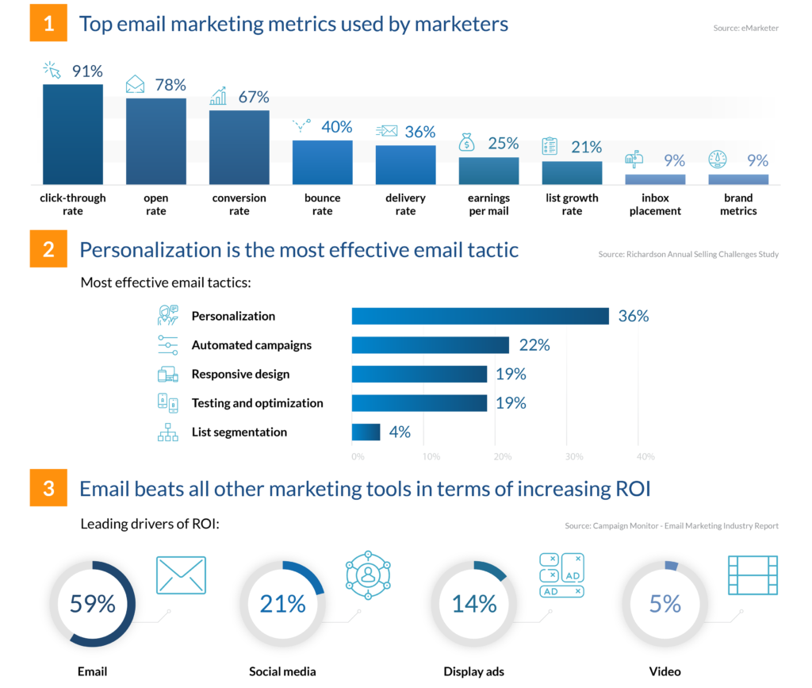
3 Key Email Marketing Statistics

Slide 20
THOUGHT ACTIVITY – 02
Think of the kinds of messages that you have recently received in your inbox. What are some of those e-mails that you have clicked on? What are some of the emails that you have deleted?
Now think of reasons that will explain why you clicked on some of the emails and deleted others.
One of the golden rules of email marketing is that the marketer or the ESP should never buy e-mail lists from any third party data vendor. Purchasing such lists does not give the marketer any control over the kinds of email ids that are there on the list.
For e.g. many of them may be invalid. Using such lists can depress the overall campaign results and lead to low sender reputation.

Slide 21
Maintain the List
Clean the list and check whether the email IDs on the list are current ones.
Bad List – Depresses campaign results, sully the brand’s online reputation and waste company’s time, effort & money.
Minimize Churn Rate
Ensure that there is minimum churn from the list.
Reducing churn, is building trust, empowering the consumer and respecting user’s privacy.
Double opt-in mechanism helps to build trust by asking for permission – which minimizes the risk of leaving.
Set expectations – What is the newsletter going to be about? Are there any specific topics that consumer can choose from? How often can the user expect the newsletter?
At last, provide control to the subscribers. Like – forward/share, interact, contact the brand and opting out at any point of time.

Slide 22
Segment for Greater Relevance
Email messages should speak directly to customer needs & expectations.
How do consumers interact with opt-in email messages that they receive?
Personalize the content more than just putting the recipient’s name on top of the email. Based on the recipient’s behaviour.
Providing recommendations to keep the engagement going.
Speak with the customers at regular intervals, helps to know about the changing needs of the user.
Hire a professional agency or an in-house team to handle e-mail marketing.
Monitor the CTR on every campaign. Can be between 5-18% depending on the industries
Notes:
A Merkle Interactive study suggests that the total no. of emails received by users, the majority belongs to promotional offers & newsletters. However, users are usually more interested in reading those emails that are confirmations of transactions, account summaries etc.

Slide 23
2. Messaging & Campaign Design
Design for the In-box
Confirm proper rendering on All email Platforms
When customers might be using mobile devices

Slide 24
3. Deliverability
Managing Online & Sender Reputation
Pay attention to legal requirements
Measure Success

Slide 25
EMAIL MARKETING ANALYTICS
How to Measure and Report on the Most Important Metrics

Slide 26
How to choose which email metrics matter most for your business.
How to calculate and measure those data points (and understand what they mean).
How to develop a simple email marketing analysis and reporting process.

Slide 27
Most Important Email Marketing Metrics Every Business Should Monitor?

Slide 28
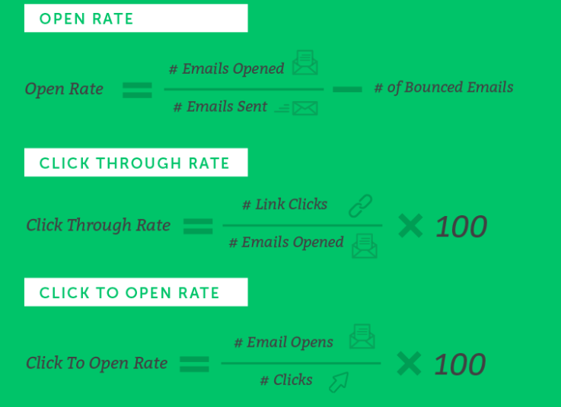

Slide 29
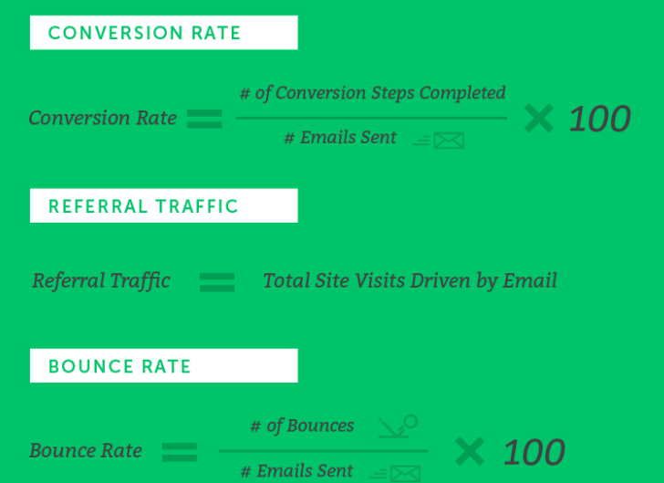

Slide 30
