Slide 1
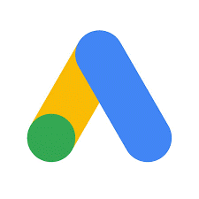
GOOGLE ADWORDS

Slide 2
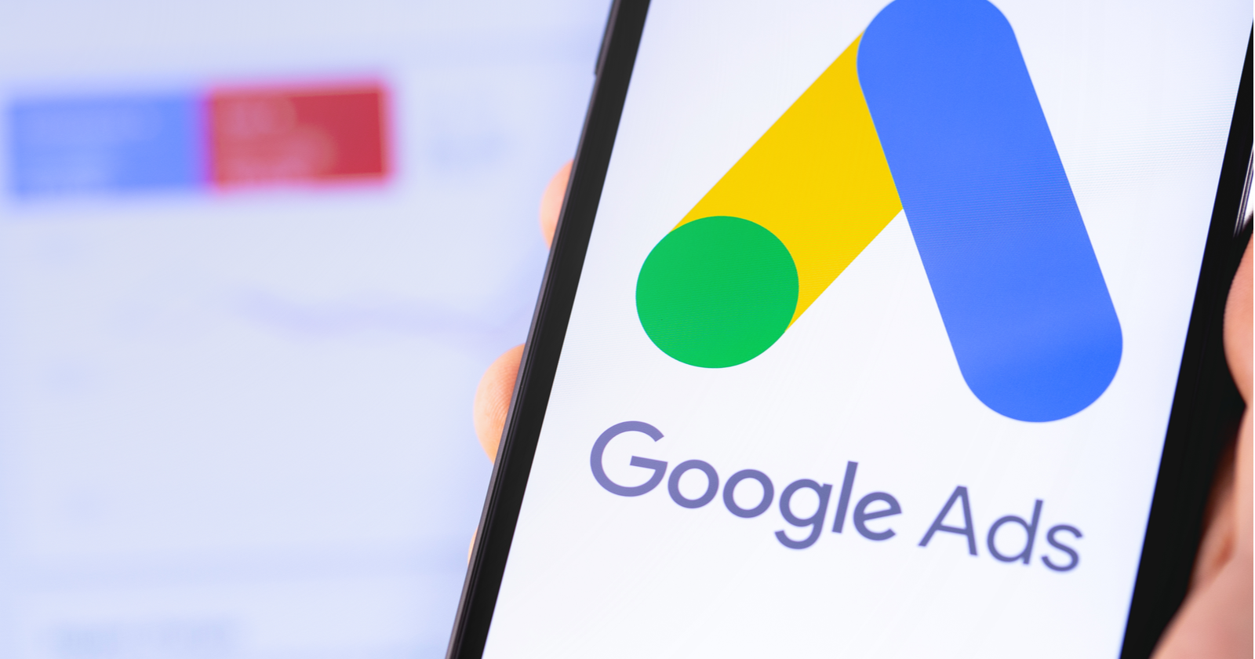
CONTENTS
Introduction
Campaign Types
Advantages
Google AdWords Layers
Google AdWords Groups
Ad Types
Keywords Match Types
Bidding
Ad Rank
Quality Score
Ad Extensions
Practical's

Slide 3
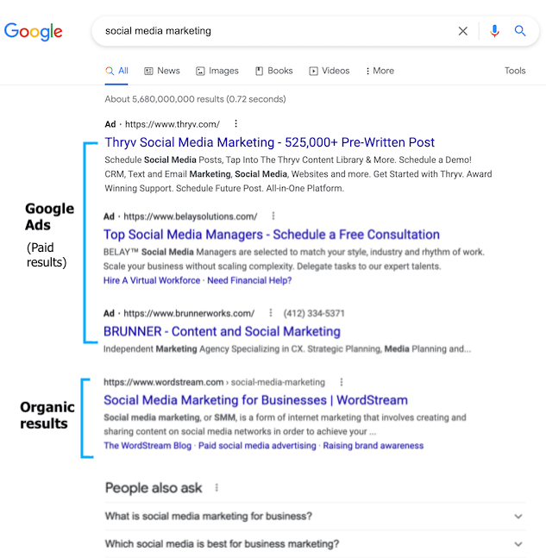
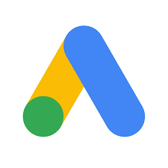
INTRODUCTION
Google AdWords is Google’s online advertising program.
Google Ads is a product that you can use to promote your business, help sell products or services, raise awareness, and increase traffic to your website.

Slide 4
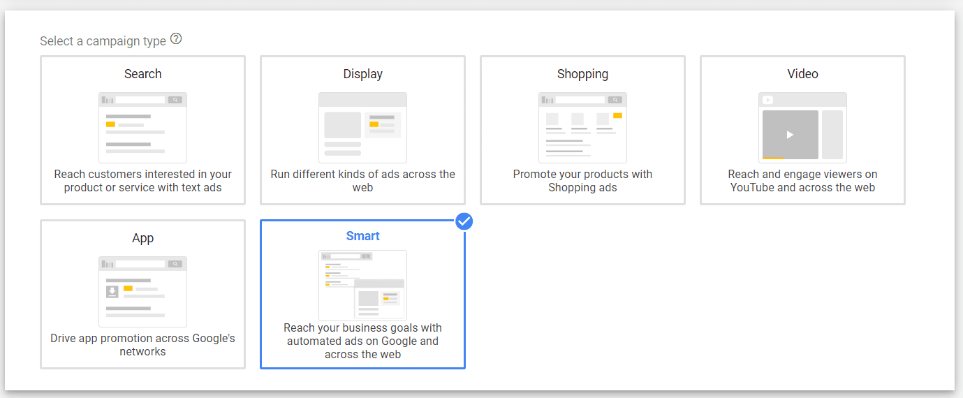
GOOGLE ADWORDS – CAMPAIGN TYPES
There are Five Types of Campaigns. They are:

Slide 5
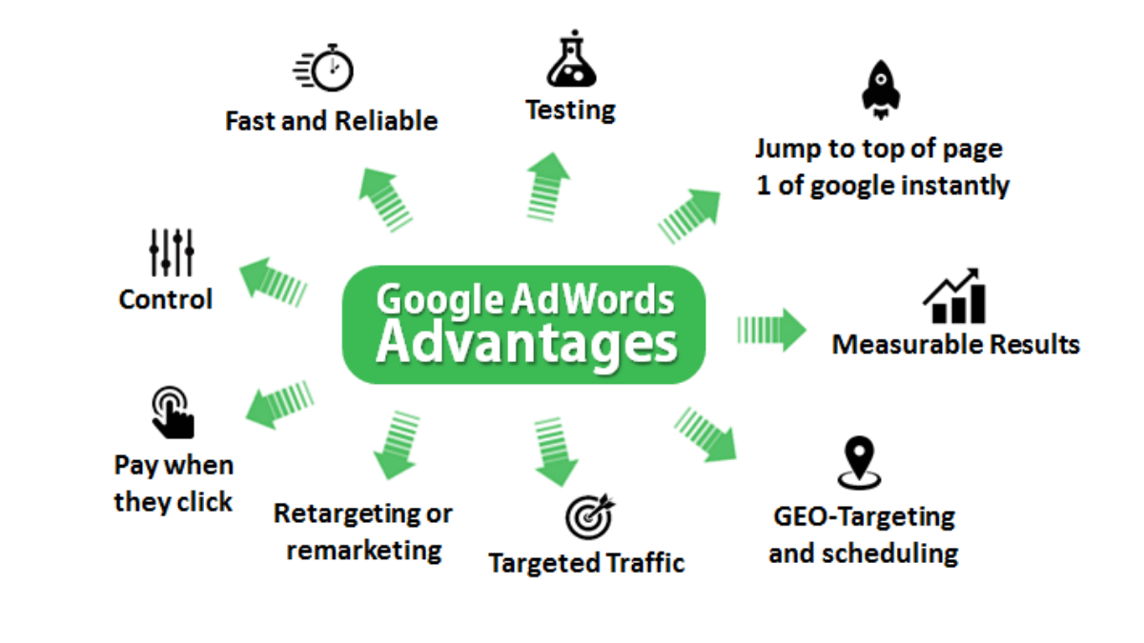
GOOGLE ADWORDS ADVANTAGES

Slide 6
GOOGLE ADWORDS LAYERS
AdWords is Organized into three Layers:
Account
Campaigns
Ad Groups
Your account is associated with a unique email address, password, and billing information. Your campaigns have their own budget and settings that determine where your ads appear.

Slide 7
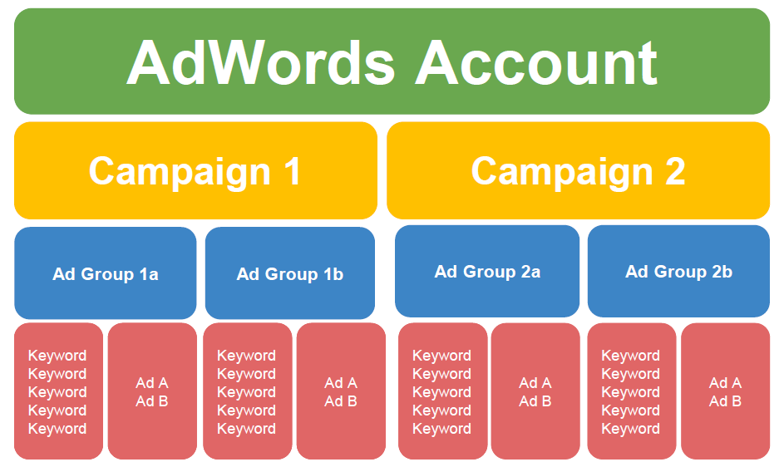

Slide 8
GOOGLE ADWORDS GROUP
Your Ad group contains a set of similar ads and the words and phrases, Known as Keywords.
An Ad group contains one or more ads which target a shared set of Keywords.
Each of your campaigns is made up of one or more ad groups
Use ad groups to Organize your Ads by a common theme.

Slide 9
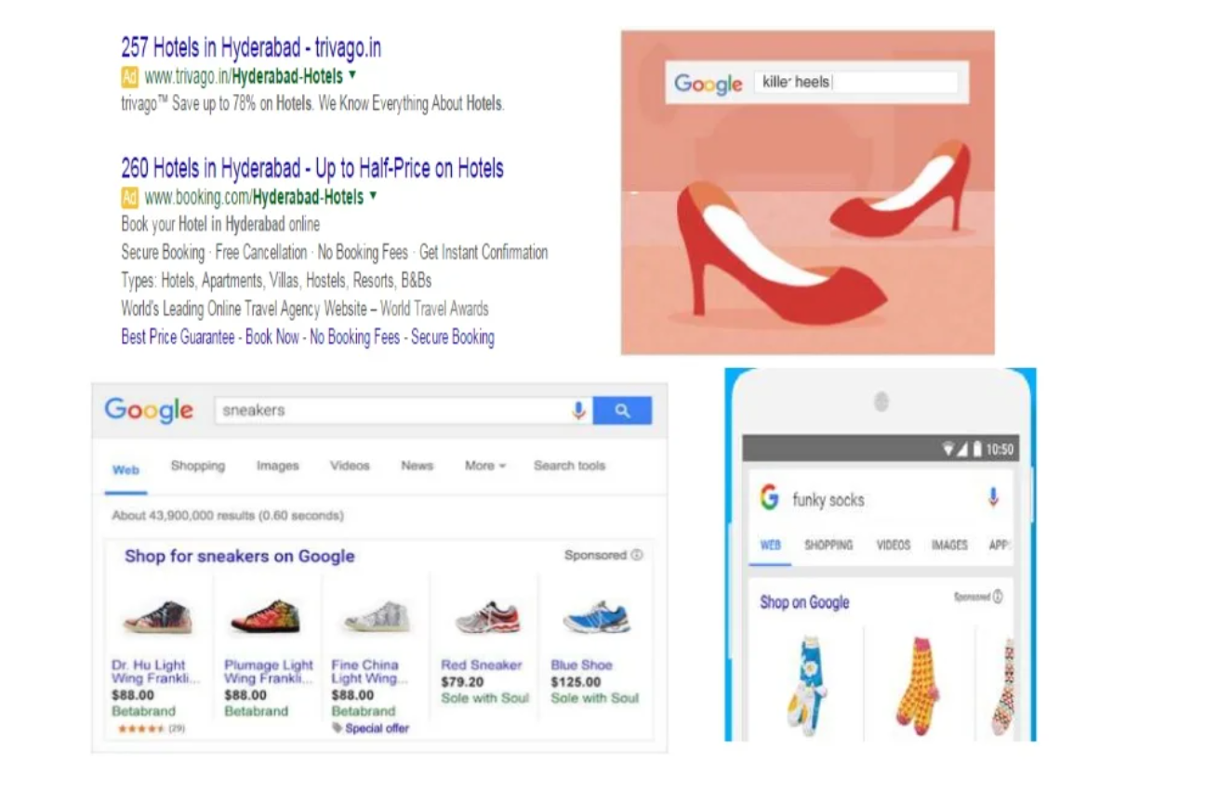
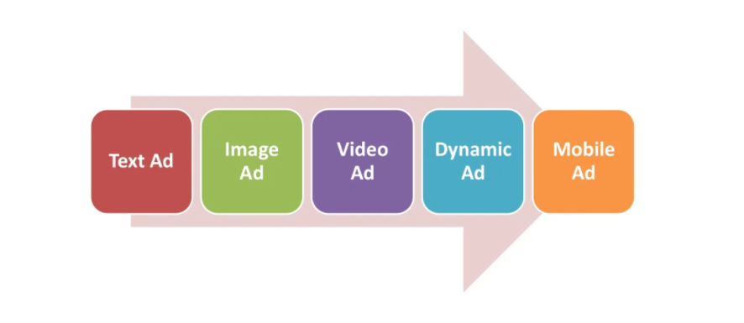
GOOGLE ADWORDS – AD TYPES

Slide 10
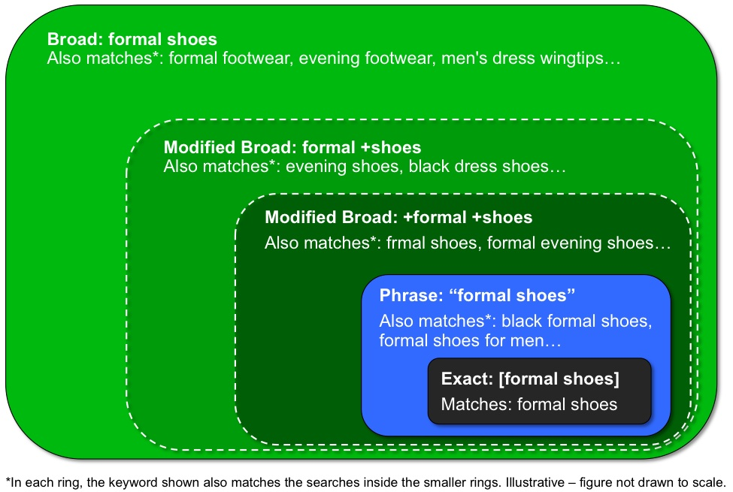
GOOGLE ADWORDS – KEYWORDS MATCH TYPES

Slide 11
GOOGLE ADWORDS – BIDDING
Bidding is an offer to set a price tag by an individual or business for a product or service or a demand that something be done.
Mainly Three Kinds of Bidding Types:
CPM (Cost–Per Thousand Impressions): A way to bid where you pay per one thousand views (impressions) on the Google Display Network. Viewable CPM (vCPM) bidding ensures that you only pay when your ads can be seen.

Slide 12
2. CPC (Cost-Per Click): Cost-per-click (CPC) bidding means that you pay for each click on your ads. For CPC bidding campaigns, you set a maximum cost-per-click bid - or simply "max. CP
3. CPA (Cost-Per Action): It is a metric that measures how much your business pays in order to attain a conversion. Average cost per action (CPA) is calculated by dividing the total cost of conversions by the total number of conversions.

Slide 13
GOOGLE ADWORDS – AD RANK
Ad Rank determines your Ad Position where your ad shows on the page in relation to other ads and whether your ads are eligible to show at all.
The main components of your Ad Rank are your bids and the quality of your ads and website.
AdRank = Max. CPC * Quality Score (QS)

Slide 14
Max. CPC –
A bid that you set to determine the highest amount that you were willing to pay for a click on your Ad.
Quality Score –
Quality score is metric calculated AdWords based on various factors of quality and relevancy.

Slide 15
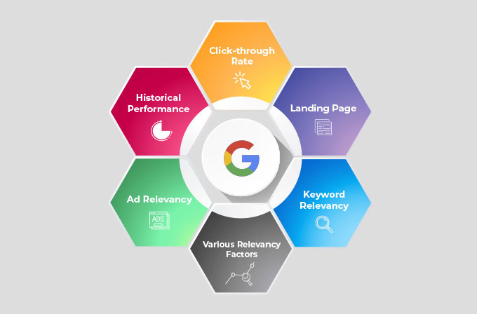
QUALITY SCORE FACTORS

Slide 16
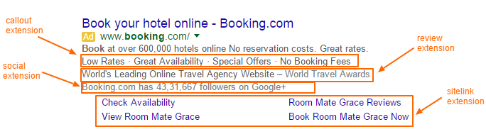
GOOGLE ADWORDS – AD EXTENSIONS
Ad Extensions are a type of ad format that show extra information about your business. Some can be added manually, and others are automated.

Slide 17
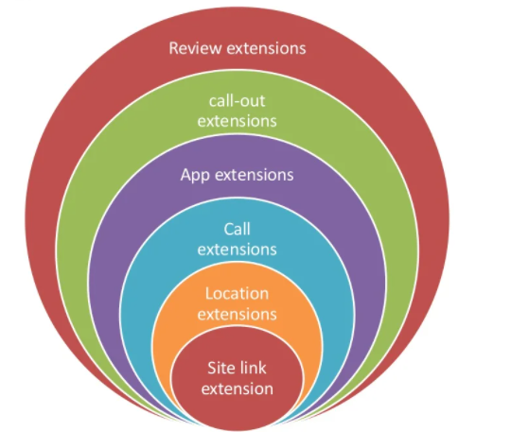

Slide 18
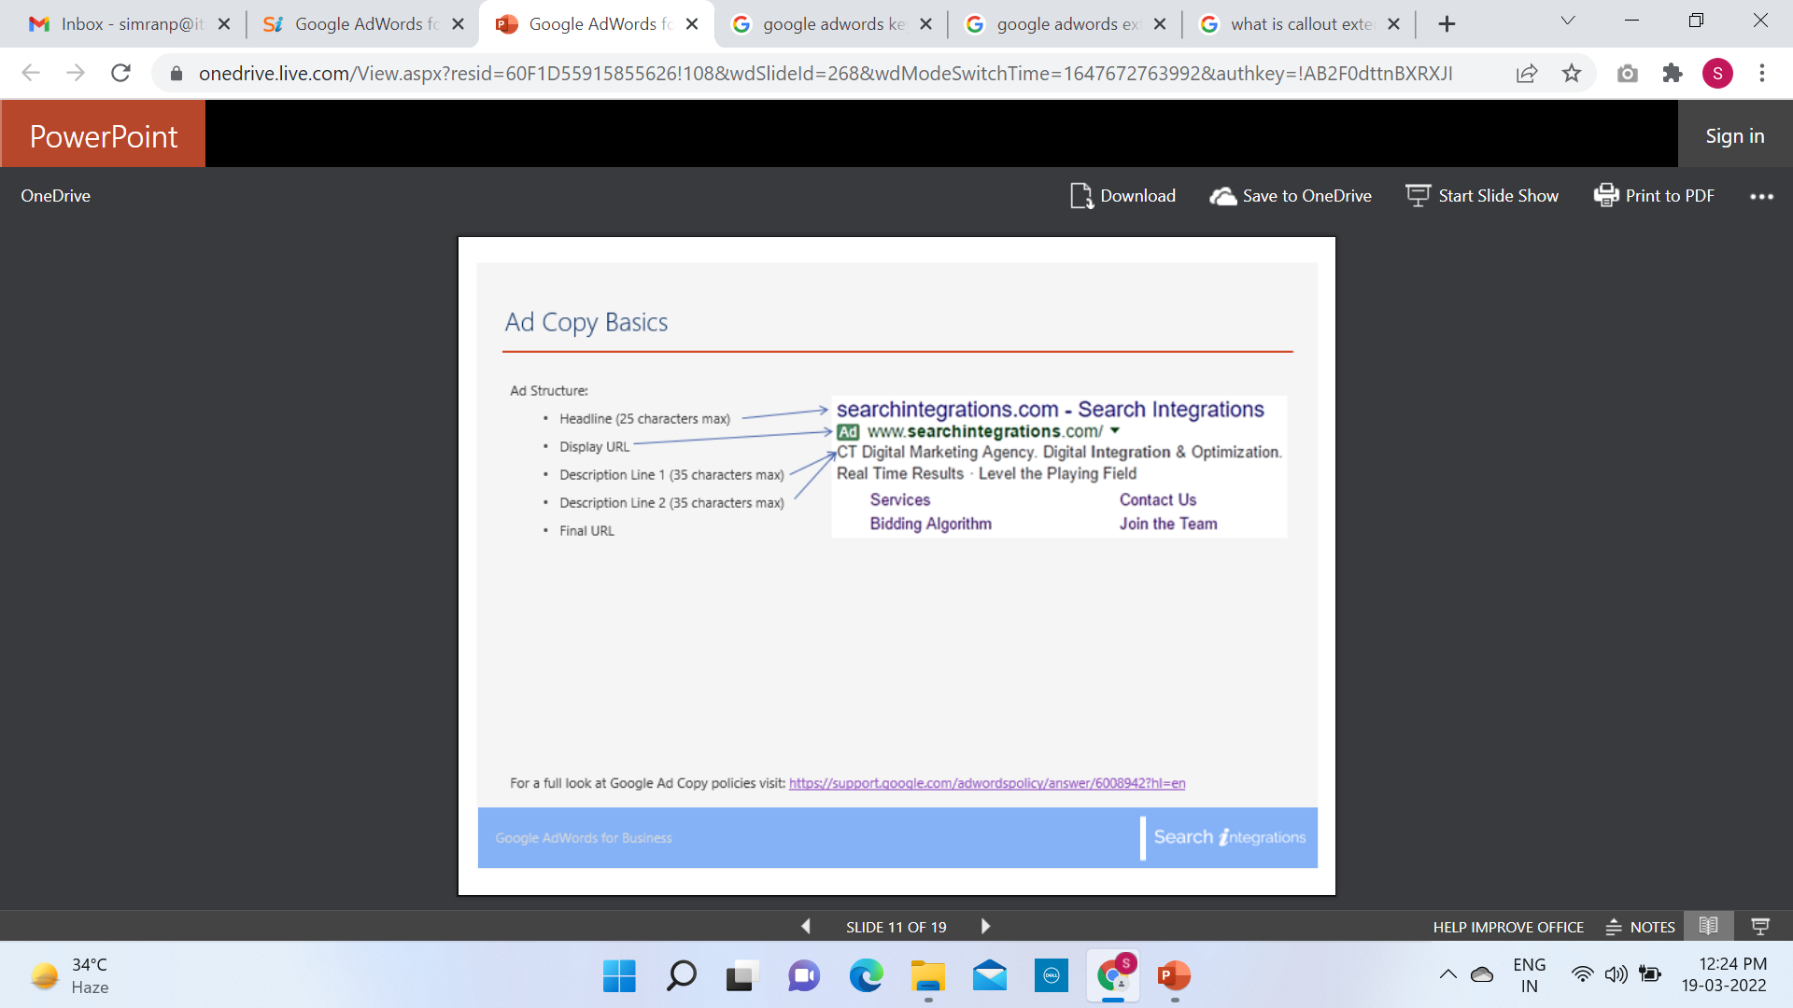
BASIC INFORMATION BEFORE DOING PRACTICALS

Slide 19
LETS UNDERSTAND BY DOING PRACTICALLY
Google AdWords –
https://ads.google.com/

