Slide 1
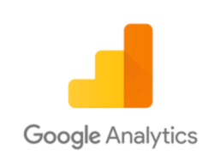
Google Analytics

Slide 2

CONTENTS
INTRODUCTION
KEY ELEMENTS
HOW GOOGLE ANALYTICS WORKS
DO’S & DON’T
WHY USE GOOGLE ANALYTICS
PRACTICAL'S

Slide 3
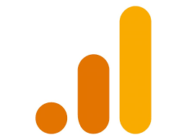
INTRODUCTION
Google Analytics is a web analytics service offered by Google that tracks and reports website traffic, currently as a platform inside the Google Marketing Platform brand.
At a Glance dashboard view as well as detailed reports.
Most Widely used website statistics service.

Slide 4
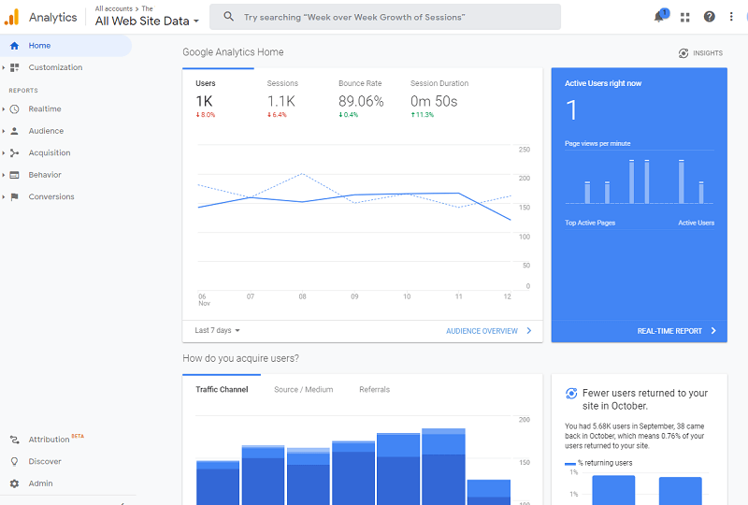
DASHBOARD

Slide 5
BASIC UNDERSTANDING
In marketing, we have the concept of a purchase funnel. There are different stages within the funnel that describe customer interactions. A basic purchase funnel includes the following steps:
✔Acquisition - involves building awareness and acquiring user interest
✔Behavior - is when users engage with your business
✔Conversion - is when a user becomes a customer and transacts with your business

Slide 6
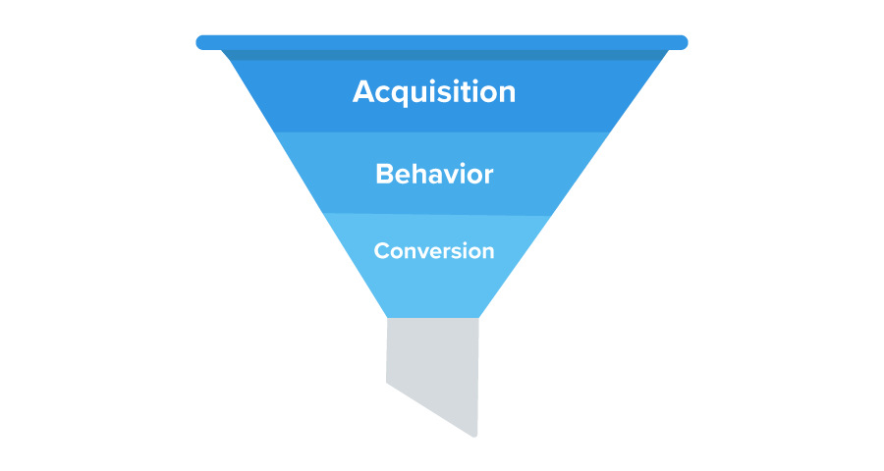
We can track what online behavior led to purchases and use that data to make informed decisions about how to reach new and existing customers.

Slide 7
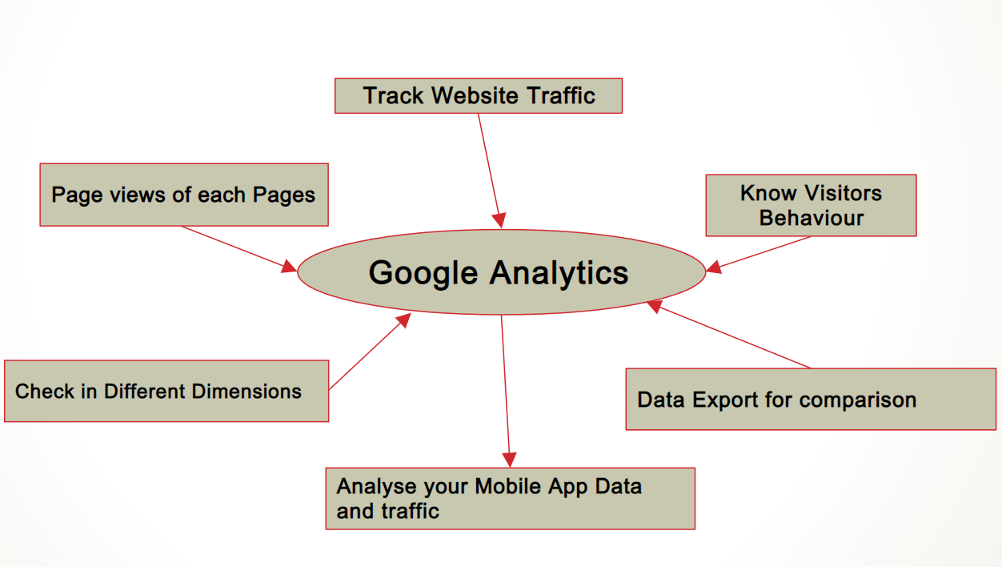
KEY ELEMENTS

Slide 8
HOW GOOGLE ANALYTICS WORKS?
TRACKING A WEBSITE
To track a website, you first have to create a Google Analytics account. Then you need to add a small piece of Javascript tracking code to each page on your site.
Every time a user visits a web page, the tracking code will collect anonymous information about how that user interacted with the page.
The tracking code could show how many users visited a page or how many users bought an item by tracking whether they made it to the purchase confirmation page.

Slide 9
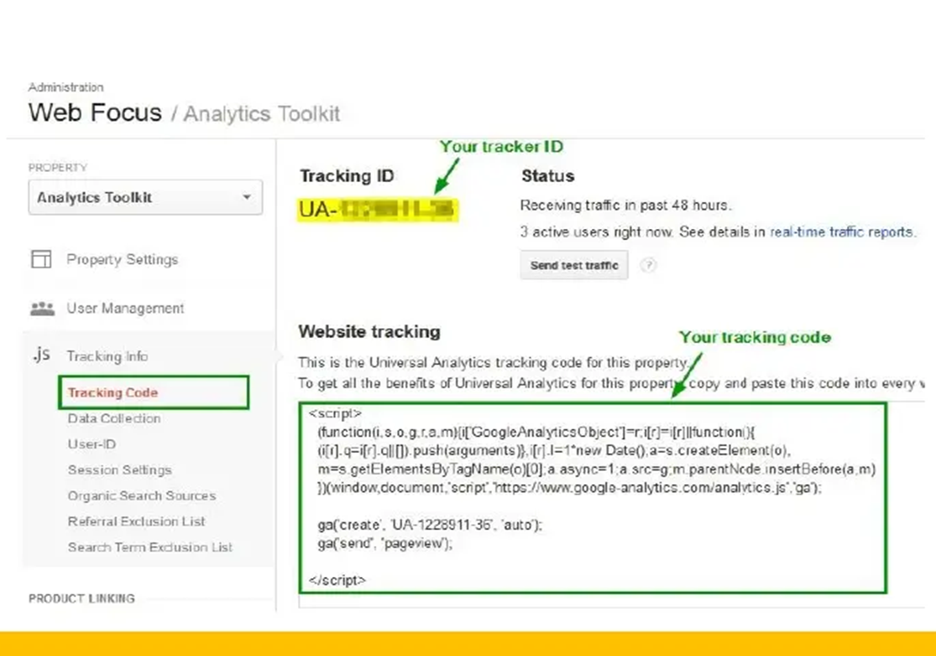
Javascript Tracking Code
The tracking code will also collect information from the browser like:
Language: the browser is set to.
Type of Browser: like chrome, explorer, etc.
Device
Traffic Source: what brought users to the site in the first place This might be a search engine, an advertisement they clicked on, or an email marketing campaign.

Slide 10
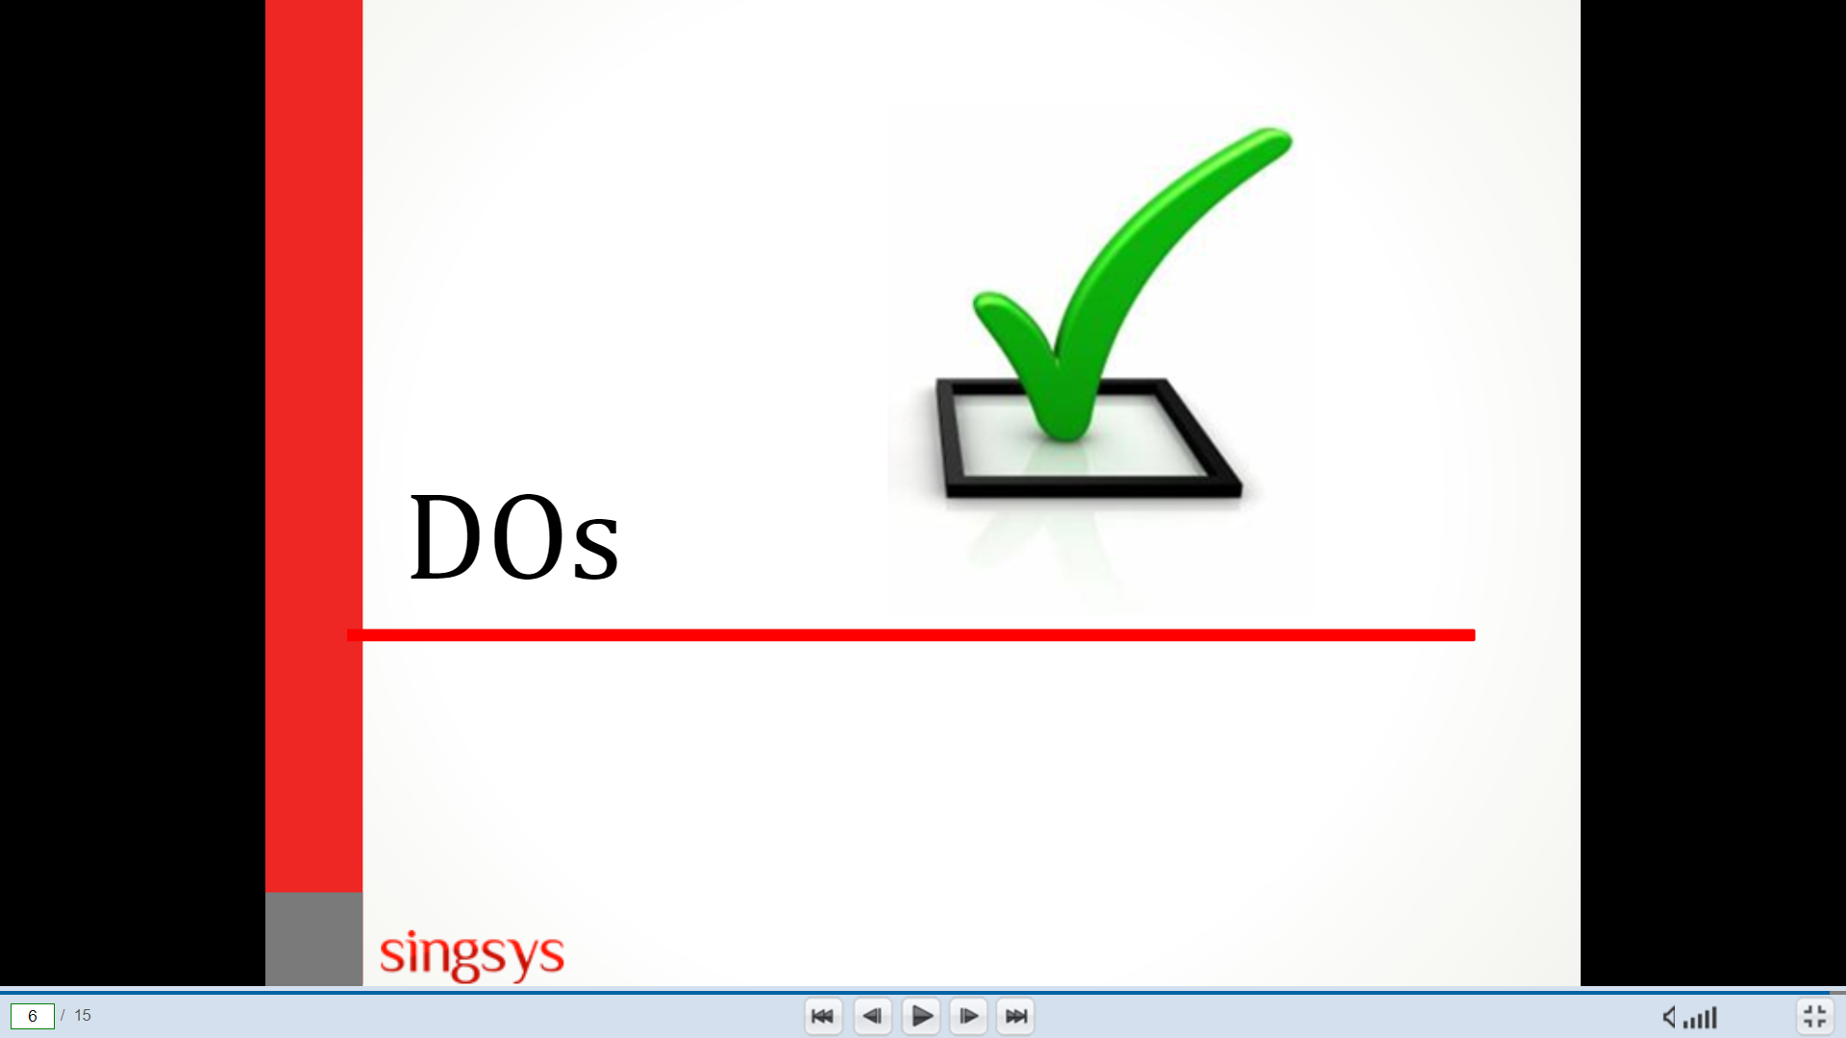
DOs AND DON’T
Dos:
Keep check of Analytic Data Daily
Take action on Suggestions

Slide 11
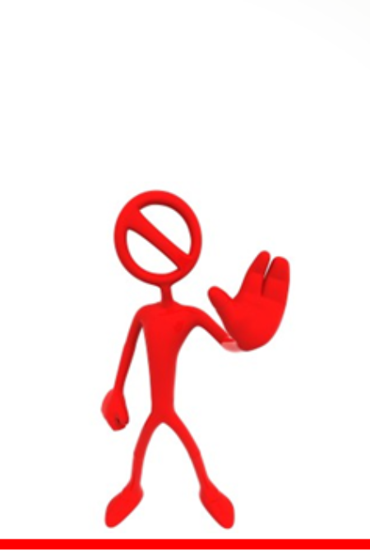
Don’t:
Website without google analytics code.
Increase unauthentic links.
Link spamming it will impact your Google Analytics data.
Add any out of Google Analytics Data.
Avoid to link so many tools with Google Analytics.

Slide 12
WHY USE GOOGLE ANALYTICS?
Why should you be looking at Analytics regularly?
Who is visiting your site
What do people do on your site
When do they visit your site
How did they get to your site

Slide 13
LET’S UNDERSTAND BY DOING PRACTICALS
Google Analytics:
https://analytics.google.com/analytics/web/
GA4 Demo Account Link-
https://analytics.google.com/analytics/web/?utm_source=demoaccount&utm_medium=demoaccount&utm_campaign=demoaccount#/p213025502/reports/intelligenthome
Google Analytics Universal Demo Account-
https://analytics.google.com/analytics/web/?utm_source=demoaccount&utm_medium=demoaccount&utm_campaign=demoaccount#/report/visitors-overview/a54516992w87479473p92320289/

