Slide 1

MOBILE MARKETING

Slide 2
What is Mobile Marketing?
Mobile marketing is a way to promote products or services through mobile devices. With this strategy, target consumers access location and time-sensitive customized content that promotes certain products, services, or ideas.

Slide 3
Why is Mobile Marketing important?
89% of consumer media time in mobile apps, 11% in mobile web according to latest statistics by Nielsen, making mobile devices dominate communication.
The overall view and amount of content on mobile devices are simplified due to their smaller size. As mobile devices are smaller and lighter than computers, users can easily carry them everywhere and make purchases at any time they want.
50% of smartphone users expect to buy something immediately while using their devices.
91% of smartphone users plan purchases after seeing relevant ads.
2/3 of customers who use smartphones are likely to purchase from businesses that have apps or mobile websites with content customized to their location.
40% of online transactions occur on mobile devices.

Slide 4
Benefits of Mobile Marketing
Compared to other forms of marketing, mobile marketing has several significant benefits.
Text messaging is easy and comparatively cheap.
SMS has a high CTR
Especially useful for local businesses.

Slide 5
Types of Mobile Marketing
There is a variety of mobile marketing techniques to try for a business. Factors like your budget, specific industry, and customer segment determine the success of the strategy.
Mobile app marketing
In-game advertisements
Quick-response barcode
Mobile banner ads
Proximity or Bluetooth marketing
Voice marketing
SMS

Slide 6
THOUGHT ACTIVITY – 01
Over the last few days, check the messages that you have received on your mobile phone. Make a note of the messages that you have received from vendors blocked by you. Keep a track.
Why are you receiving such messages?
Does it have anything to do with the location where you are at? For what kind of products/ services are you receiving messages that are based on your location?
Do you think it is effective targeting?

Slide 7
Product Type as a Moderator of Extent of Consumer Activity on Mobile Phone
www.bookmyshow.com
www.pepperfry.com
www.policybazaar.com
Visit the above mentioned websites via laptop/desktop and via smartphone. Consider –
What are some differences in your experience across the 2 screens?
Do you like some activity better on one of the channels as compared to the other? Why do you think that is the case?

Slide 8
MOBILE MARKETING STRATEGY

Slide 9
OBJECTIVES – Making a user Call back / sending the user to a specific webpage / download their mobile app
TARGET SEGMENT – Understand media consumption, Know the apps that target audience uses etc
BENEFIT/VALUE OFFERED –
Why will the target audience be interested in responding to the mobile marketing campaign?
What is in it for the user?
What is the benefit that the user is likely to obtain by clicking on a link?
STRATEGY
Geo-targeting – Location based targeting of mobile devices
A strong CTA to reach the desired target audience
Engage continuously with the customer & deliver personalized content
Often used tool – QR codes
Common Short Codes(CSC)
Measuring Outcomes

Slide 10
Forms of Mobile Marketing
Voice based Communication Services
Short Messaging Services (SMS)
Mobile Websites
Mobile SEO
Optimising the website for Mobile
Mobile Apps
What is in it for the Company?
What is in it for the Customer?
Points to consider for App Development
App Store Optimization (ASO)
Digital Wallet

Slide 11
MOBILE ADVERTISING
Banner Ads
Most commonly used mobile advertisement format.
A strip of information text/graphic at the top or bottom of the screen
Usually used for the purpose of branding
Strong brands use this as there is little space for detailed information
Native Ads
Appear to be a part of the content of the page that the user is browsing.
Attempt to integrate with the publisher website/app.
Require a substantial budget, but offers a high level of user engagement
Interstitial Ads
Interactive ads that ‘take-over’ the entire screen of the mobile device, often while a website is loading or after it is closed.
Offers high level engagement
Rich media Ads – Interactivity built into the advertisement to creatively engage the users to generate high CTR & Conversions.

Slide 12
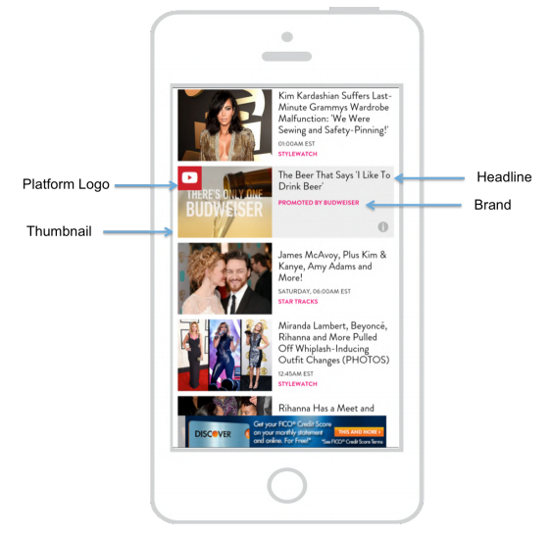
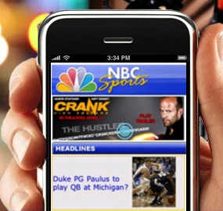

Slide 13
M-COMMERCE
Refers to pairing of mobile devices with commercial transactions, providing consumers with the ability to carry out transactions through wireless internet-enabled devices.

Slide 14
Let’s Think…..
Why do you think that e-commerce companies in India are investing more in developing mobile phone applications over the open net?
Comment on the state of m-commerce in the India. Specifically, think of the infrastructure as well as consumer-related issues that are affecting m-commerce in India.

Slide 15
NATIVE MOBILE AD FORMATS
In-Feed (Social)
In-Feed (Content)
In-Feed (Commerce)
In-Map
In-Game
Paid Search
Recommendation Widgets
Custom

Slide 16
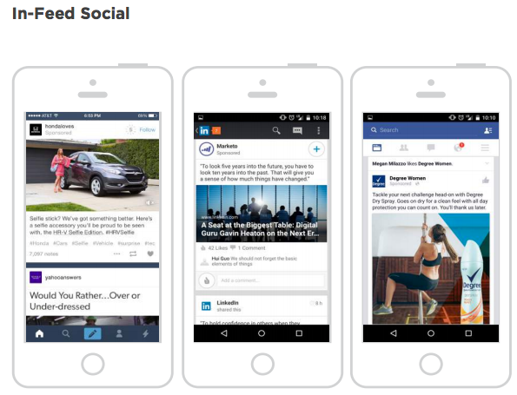
1. In-Feed (Social)
Social feeds include users’ posts to social networks and sponsored content from advertisers. Social network data pulled into the native ad, such as friends who like the brand and likes or comments, provide social proof to consumers.
• Form: Ad blends in to each social network, i.e. Facebook Post, LinkedIn Update, Promoted Pin, and Sponsored Post (Tumblr)
• Function: The social network capabilities are available for the ad, i.e. Pin, Like, Tweet, Follow, Repost, etc.
• Examples: Tumblr, Pinterest, Twitter
• Advertiser Objective: Awareness or content engagement

Slide 17
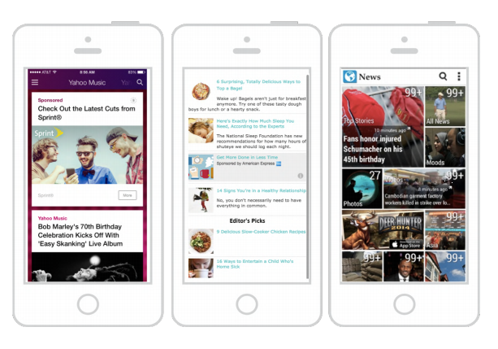
In-Feed (Content)
Editorial feeds, streams, and walls include both paid and unpaid content in various forms, including written stories, music, games, videos and inboxes.
• Form: Ad will match site layout, including fonts, graphics, etc.
• Function: Ads have the same user experience as unpaid content, including flipping, swiping, and viewing in-feed
• Examples: Yahoo, News Apps, SoundCloud, Sharethrough
• Advertiser Objective: Drive engagement with content such as read, view, watch or listen

Slide 18
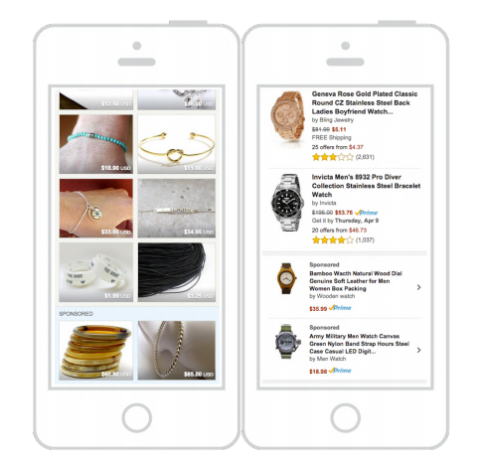
Feed-in(Commerce)
Commerce feeds contain product listings and promoted products are integrated within. This is a big retail opportunity to connect with users near the store or in store with NFC, iBeacons, GPS, and payments.
• Form: Ad blends in to site or app. includes same details as organic products such as price, reviews, product details, etc
• Function: Ad has same functionality as organic products such as buy, like, wish list
• Examples: Amazon, Etsy, Shopkick, App Store
• Advertiser Objective: Sell physical or digital products and services

Slide 19
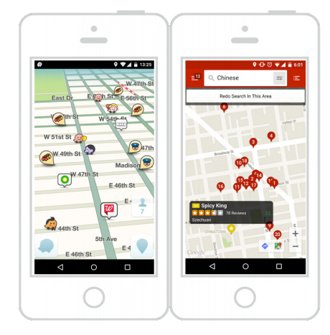
In-Map
Mobile maps provide location and navigation information. In addition to map data and organically generated business listings, maps also provide native ads in-maps.
• Function: Ads appears on map with location context
• Form: Ads can show distance to location, navigation, directions, click to call, hours, etc
• Examples: Waze, FourSquare, Google Maps
• Advertiser Objective: Drive foot traffic

Slide 20
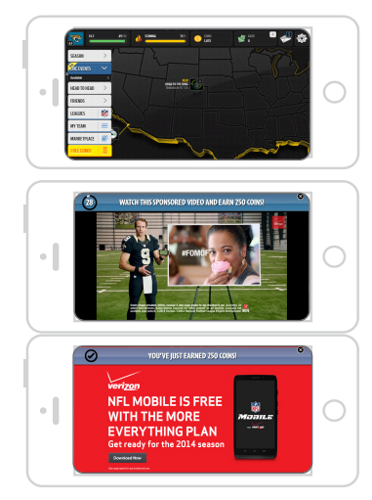
In Game
Ads are opt-in where players are invited to watch a video and earn a reward. The reward is a digital currency or feature that adds value to the player experience.
• Form: Video runs in ad container that matches the look/feel of the game. The video is not seen unless a player clicks on an icon that offers a reward for watching a video
• Function: Ad provides value exchange for players to engage with brands
• Examples: Verizon ran a video in Madden 15 where when a player watched the :30 second video, they are rewarded with 250 coins to improve the gameplay experience
• Advertiser Objective: Increase brand awareness, better advertising performance, higher engagement

Slide 21
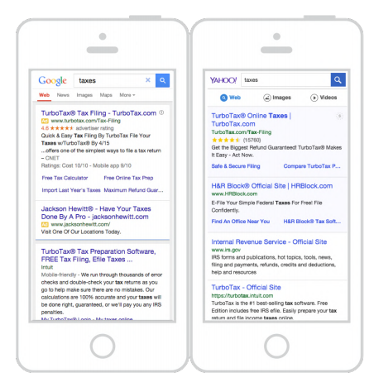
Paid Search
Ads appear on mobile search sites and apps integrated with organic search results. Mobile features such as click to call, nearest location, driving directions, hours of operation.
• Form: Ads appear on search results page above and below organic search results
• Function: Same functions as organic listings including click, call, etc
• Examples: Google, Yahoo
• Advertiser Objective: Drive site visits, calls or foot traffic

Slide 22
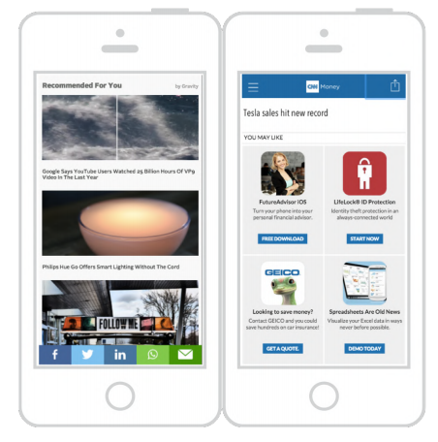
Recommendations Widgets
Recommendation widgets feature sponsored links and often appear at the end of a feed or when a user is finished reading an article.
• Form: Image and texts match the editorial site
• Function: User behavior is same as organic content, click out to full article
• Examples: Gravity, Taboola, Outbrain, and Yahoo Recommends
• Advertiser Objective: Drive traffic to content

Slide 23
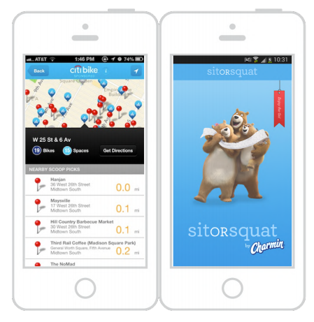
CUSTOM
Content that is built by a brand. For mobile, it can be editorial, music, apps, games or videos. Custom mobile native ads are great for offline integrations with location data and augmented reality.
• Form: Custom sponsorship must match site or app look and feel. Bring in elements from publisher to ad
• Function: Ad functionality should match organic app or site functionality
• Examples: Sit Or Squat app sponsored by Charmin, Pandora sponsored station, Citibike sponsored app
• Advertiser Objective: Increase brand awareness

