Slide 1
TWITTER & BLOGGING

Slide 2
Twitter & Its Role in Business
Twitter is a microblogging news & social media service that enables users to publicly post short messages which are known as tweets.
Originally tweets were restricted to 140 characters, but the limit has been increased to 280 characters.
Registered users can tweet or reply to the tweet using desktop applications or mobile applications .

Slide 3
From Business Perspective, Twitter can be used for –
Establishing a Community
Finding Customers
Interacting with people
Asking Questions
Providing Customer Support
Finding what people think about you
Promoting your content
Enhancing Brand Visibility

Slide 4
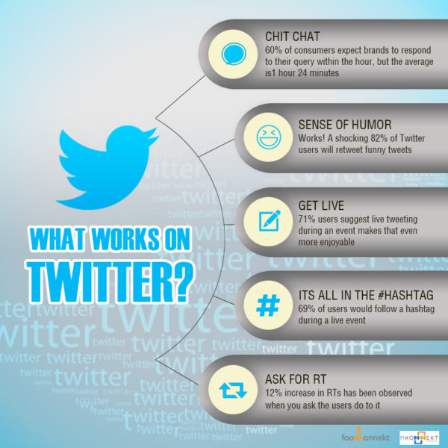
What works on twitter?

Slide 5
TWITTER’S ALGORITHM
Some key factors, that regulate the ranking of tweets:
Interaction
Timing
Media
To increase your reach on twitter organically,
Use appropriate hashtags
Use pictures & videos in your tweets
Constantly examine your twitter analytics & redesign your strategies accordingly
Notes:
At the beginning, Twitter displayed tweets of people in the reverse chronological order.
However, with time, Twitter’s ranking algorithms have changed & become more complex.

Slide 6
Twitter Moments:
A content curation tool that enables Twitter users to collect and showcase a set of tweets on a particular topic.
Moment illustrates the “very best of what’s happening on Twitter”
Used as a tool for storytelling through a collection of tweets.
To create successful Twitter Moment as a sure tool to drive traffic & engage your target audience, ask these to yourself:
Is the topic timely enough to arouse interest?
Which keywords can I use to improve the visibility?
What kind of hashtags can I use to ensure that my story is discoverable?
Do the tweets contain illustrative pictures and descriptive videos?

Slide 7
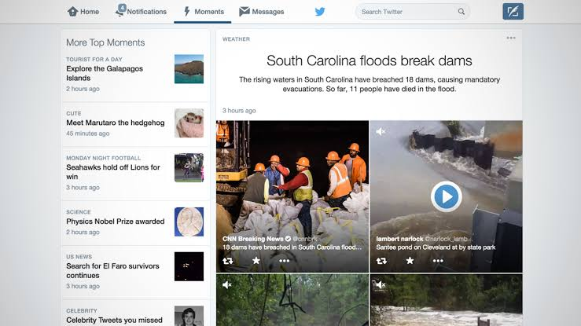

Slide 8
TWITTER ADS

Slide 9
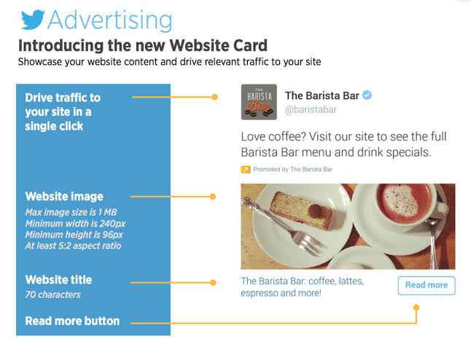
CAMPAIGN TYPES
Website Click Campaigns -
Follower Campaigns
Engagement Campaigns
App Campaigns
Quick Promote
Notes:
85% users say that they feel more connected to a brand after following it on twitter
72% of twitter users say that they are more likely to purchase from a brand they follow on twitter.

Slide 10
BLOGGING

Slide 11
Blogging as a Communication Channel
Blogging happens to be one of the easiest and simplest methods of establishing rapport with your prospective and existing customer base.
It includes several categories including personal blogs, Company Blogs, Micro blogging, Photo/Video Sharing and Podcasts.
Blogging is not only about you talking about yourself and your product. You will get to listen and understand all about your customers too.
Blogging is not Advertising - It works different when compared to the other mediums that you use for advertising.
You can use this medium to enhance the value that you provide to your customers.
Using this medium involves listening and engaging customers in conversation as against direct advertising.
Notes:
Refer Link - https://www.managementstudyguide.com/blogging-as-marketing-communication-channel.htm

Slide 12
Blogger Outreach Programs
A company, in seeking exposure for a product or service, leverages influencers who have established a substantial following, asking them to write about it in exchange for free access to the product or service.
To develop a solid blog outreach strategy, includes a five step process:
Understand the Need for Bloggers
Set Goals
Find Relevant Bloggers
Collaborate with Bloggers
Measure Results
Notes:
Refer - https://marketingland.com/blogger-outreach-119253
Site: .com inurl fashion bloggers

Slide 13
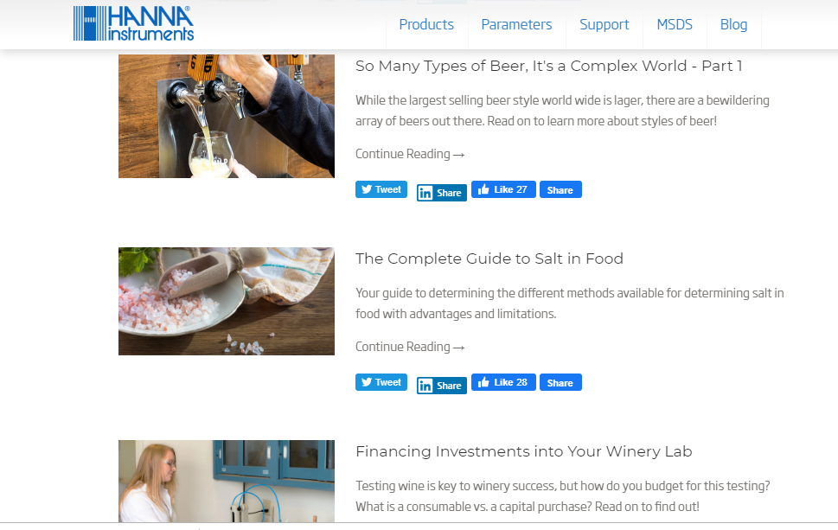

Slide 14
List of 5 blogger outreach tools that can help you achieve greater success.
BuzzSumo
Traackr
Tomoson
PitchBox
BuzzStream

Slide 15
LINKEDIN as a Social media marketing tool

Slide 16
ROLE OF LINKEDIN IN B2B
For Selling & Generating Leads
For Establishing Thought Leadership
For Attracting New Business Opportunities
For Networking
Notes:
For Selling & Generating Leads – One of the most effective platforms for lead generation. It has a unique way of identifying potential leads, engaging and converting them into customers. It allows businesses to listen, share, participate, network, analyse and then respond to increase opportunities for sale.
For establishing thought leadership – LinkedIn is not only a channel to distribute professional content but also as an effective platform to establish a business as a leader in the industry. By providing high quality and relevant content, optimising your company profile and participating in company groups, businesses can become trusted advisors and influencers. Being a trusted source, you can get a lot more recommendations from other references that will help to build your reputation.
For attracting new business opportunities – Linkedin can act as a a fastest path to acquire a new client. It provides an opportunity to receive recommendations from past employees and clients. You can request recommendations from people with whom you have done business, on basis of which you can attract new businesses.
For Networking – A platform to connect with people or companies with same interest. With Linkedin, a business can find its potential vendors, suppliers, manufacturers and other 3rd parties whose services they need. By going through the profiles of these parties, marketers can have a complete picture of the company, on the basis of which they can decide whom to partner with. s

Slide 17
Advertising on LinkedIn
Getting started with Campaign Manager
Choose your LinkedIn Ad Format
Create an Ad
Target your Ads
Set your budget & schedule
Measure and refine your Campaign
1
4
2
5
3
6
Notes:
Campaign Manager – Ad Format
3 Common types of Ad formats are –
Sponsored Content
Text Ads
Sponsored InMail

Slide 18
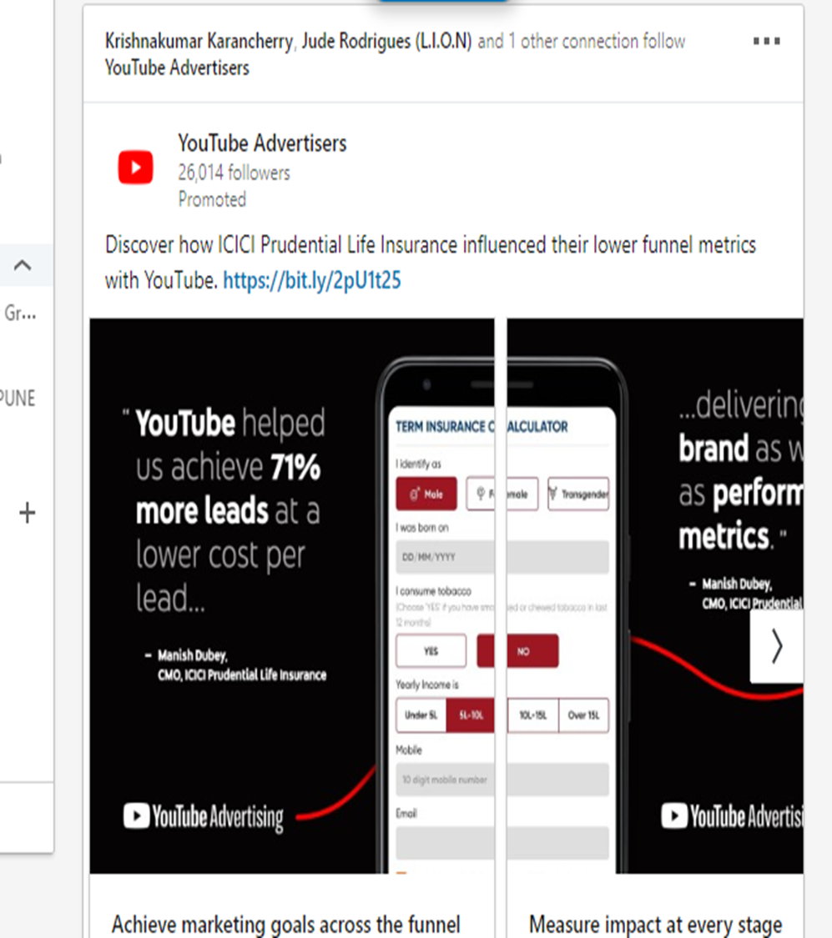
Sponsored content ads

Slide 19
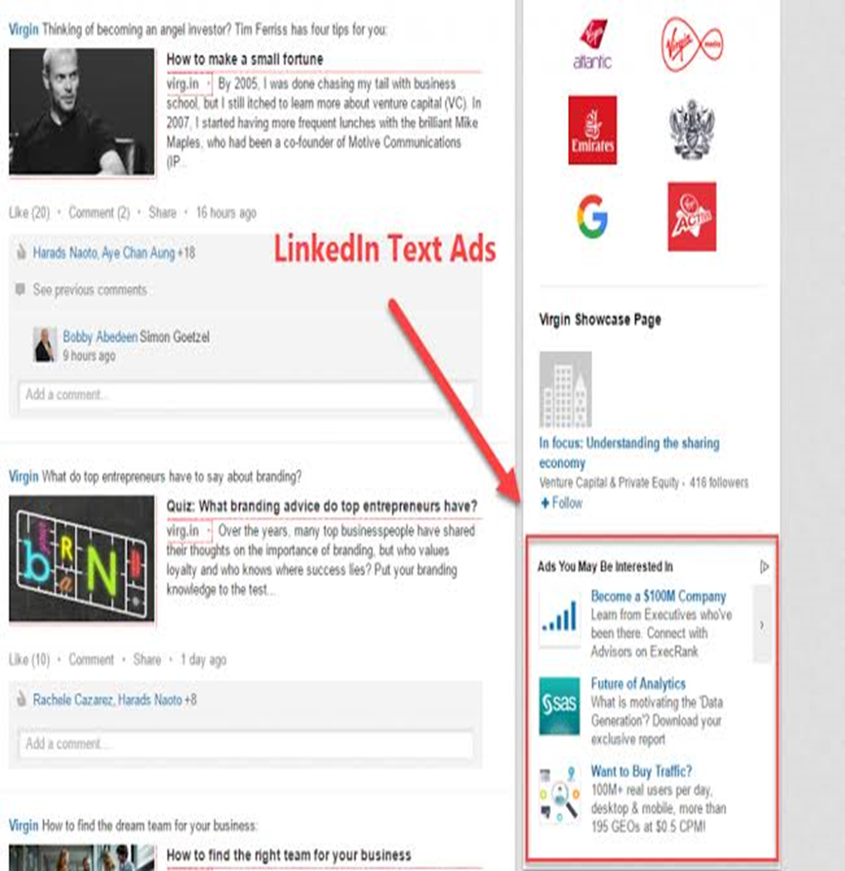
TEXT ADS

Slide 20
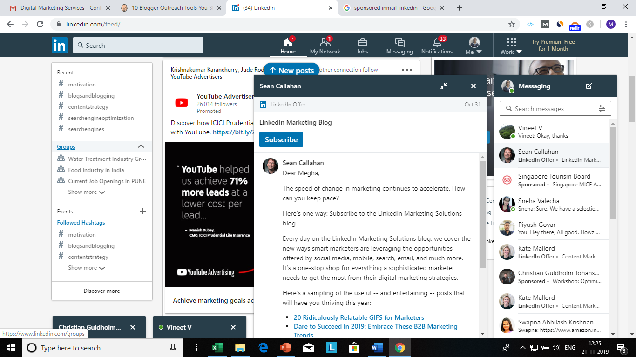
Notes:
Sponsored InMail Ads

Slide 21
INSTAGRAM MARKETING
OBJECTIVES
CONTENT STRATEGY
STYLE GUIDELINES
HASGTAGS
VIDEOS
SPONSORED ADS
GENERATE LEADS

