Slide 1
BLOGGING
A blog (shortening of “weblog”) is an online journal or informational website displaying information in the reverse chronological order, with latest posts appearing first. It is a platform where a writer or even a group of writers share their views on an individual subject.
The main purpose of a blog is to connect you to the relevant audience. Another one is to boost your traffic and send quality leads to your website.
When you use your niche knowledge for creating informative and engaging posts, it builds trust with your audience. Great blogging makes your business looks more credible, which is especially important if your brand is still young and fairly unknown. It ensures presence and authority at the same time.

Slide 2
BLOG VS WEBSITE
BLOGS
Blogs need frequent updates. A good example can be a food company sharing meal recipes to attract customers.
Perfect Reader engagement through comments and posts.
Know your author, date , research etc.
WEBSITES
Websites present the content on the static pages and does not gets updated frequently or on daily basis.
Readers can only read. Very less websites have an option for comments.
The author, research and publication dates are less known in website.

Slide 3
PURPOSE OF BLOGGING
In the early stages, blogs became mainstream, as news services began using them as tools for outreach and opinion forming. It became a new source of information.
Blogging is the set of many skills that one needs to run and control a blog. Equipping web page with tools to make the process of writing, posting, linking, and sharing content easier on the internet.
It became the mainstream source of information.
It keeps the clients and the customer up to date with all the information.
Through a blog people can comment or interact with your brand.
People can make money by blogging.

Slide 4
HISTORY OF BLOGGING
Blogs started out as a natural extension of the increased use of computers and the creation of the earliest forms of the Internet as government military, scientific and academic networks.
Before the World Wide Web, communities of people interacted on these networks. Individuals created content for themselves or others and stored that content on computers that were connected to the networks.
Before blogs became popular, these communities often communicated and shared frequently-updated content through community message boards. The term “newsgroups” became coined to describe many of these discussion and information-sharing areas.
The exact date and year of the first use of the term “blog” is still debated by scholars. Most believe that it happened in 1999 as the natural truncation of a particular description of this type of content, “web log” or “weblog,” into the shortened form.

Slide 5
MICRO BLOGGING
Microblogging is a combination of blogging and instant messaging that allows users to create short messages to be posted and shared with an audience online.
Social platforms like Twitter have become extremely popular forms of this new type of blogging, especially on the mobile web — making it much more convenient to communicate with people compared to the days when desktop web browsing and interaction was the norm.
These short messages can come in the form of a variety of content formats including text, images, video, audio, and hyperlinks. The trend evolved around the later end of the Web 2.0 era after social media and traditional blogging merged to create a way that was easier and faster to communicate with people online and keep them informed about relevant, shareable information at the same time.
You may be using a microblogging website already without even knowing it. As it turns out, short but frequent social posting online is exactly what most people want, given that so many of us browse the web from our mobile devices when we're out on the go and our attention spans are shorter than ever.

Slide 6
EXAMPLES OF MICRO BLOGGING
TWITTER
Twitter is one of the oldest and most well-known social platforms to be put under the "microblogging" category. While the 280-character limit still exists today, you can now also share videos, articles links, photos, GIFs, sound clips, and more through Twitter Cards in addition to regular text.
TUMBLR
Tumblr takes inspiration from Twitter but has fewer limitations and more features. You can certainly post a lengthy blog post if you want, but most users enjoy posting lots and lots of individual posts of visual content like photosets and GIFs.
INSTAGRAM
Instagram is like a photo journal for wherever you go. Rather than uploading multiple photos to an album the way we used to do via the desktop web on Facebook or Flickr, Instagram lets you post one photo at a time to show where you are and what you're doing.

Slide 7
CUSTOMER PERSONA
A customer persona (also known as a buyer persona) is a semi-fictional archetype that represents the key traits of a large segment of your audience, based on the data you’ve collected from user research and web analytics.
It gives you insight into what your prospective customers are thinking and doing as they weigh potential options that address the problem they want to solve.
“Actionable buyer personas reveal insights about your buyers’ decisions—the specific attitudes, concerns and criteria that drive prospective customers to choose you, your competitor or the status quo.”
In order to create a representative sample of an audience, personas are based on the analysis and research of real customers. This helps to build a much more detailed picture of the (hypothetical) customer, including far more emotive information such as personal motivations, what they value in a brand, what kind of communication they prefer, etc.

Slide 8
WHY CUSTOMER PERSONA ??
Customer personas can provide tremendous value and insight to your organization. For example, they can help everyone on your team:
Develop a deeper understanding of customer needs and how to solve for them
Guide product development by creating features that help them achieve their desired outcomes
Prioritize which projects, campaigns, and initiatives to invest time and resources in
Create alignment across the organization and rally other teams around a customer-centric vision.
Brands are then able to take this insight and use it to deliver a much more relevant and less one-dimensional experience.

Slide 9
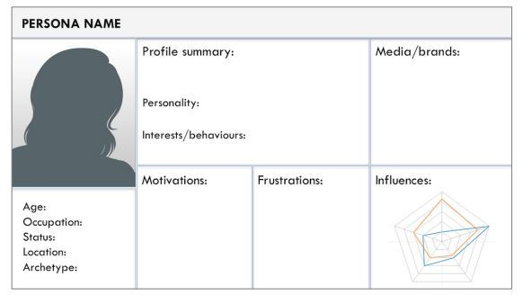
TEMPLATE OF CUSTOMER PERSONA

Slide 10
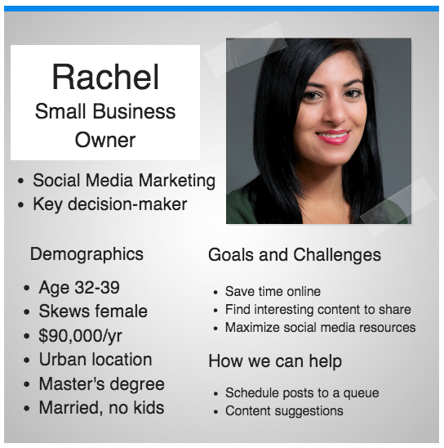
EXAMPLE OF CUSTOMER PERSONA

Slide 11
HOW TO CREATE CUSTOMER PERSONA
Keyword research is one effective tool for generating data, allowing brands to discover exactly what customers are searching for in relation to their product or website. For example, if a retailer discovers that a popular search term is its brand-name alongside the word ‘discount’ or ‘offer’, it could be the case that customers value price over other factors like entertaining content or fast delivery – informing the ‘motivations’ part of a persona.
Social media is another important tool for establishing personas, with most platforms already having in-built analytics that can offer key data sets.
Facebook Insights, for example, allows brands to tap into how users are responding to ads, as well as what kind of content is generating the most engagement. By comparing this to specific user data, such as gender, relationship status and so on, brands are able to flesh out personas even more.
Finally, alongside data-driven tools, customer personas can also be largely influenced by surveys, feedback, and one-to-one interviews

Slide 12
NEGATIVE CUSTOMER PERSONA
Whereas a buyer persona is a representation of an ideal customer, a negative -- or “exclusionary” -- persona is a representation of who you don’t want as a customer.
This could include, for example, professionals who are too advanced for your product or service, students who are only engaging with your content for research/knowledge, or potential customers who are just too expensive to acquire (because of a low average sale price, their propensity to churn, or their unlikeliness to purchase again from your company.)
Characteristics of a negative persona could involve someone who is overly negative or unrealistic in their expectations, someone who typically abandons purchases, or who has a high acquisition cost.
Recognising these types of customers early on can allow marketers to hone their communication and marketing messages accordingly, and instead target the most worthwhile.

Slide 13
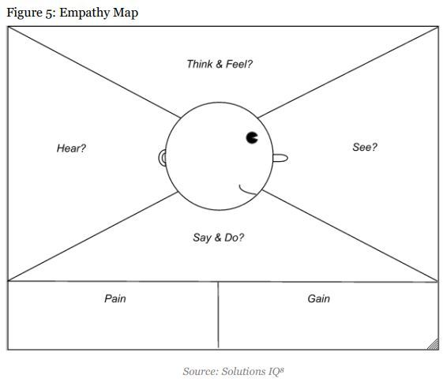
EMPATHY BETWEEN MARKETERS AND PERSONA

