Slide 1

SELLING SKILLS
SALES & ETHICS

Slide 2
Vision
Mission
Core Values

Slide 3

Agenda
Pillars of professional selling
Ethical selling
Ethical dilemmas
Consequences of mis-selling
Appropriate behaviour
Anger management

Slide 4
Ethical Selling
Sales ethics is when you use trustworthy sales practices, accurate information, and honest concern for customers' needs when selling your product.
Unlike a “sell-at-all-costs” mentality, ethical selling involves your sales representatives maintaining their professional integrity in every interaction.

Slide 5
Pillars of Ethics
The five pillars are
veracity (to tell the truth),
non-maleficence (to do no harm),
beneficence (to do good),
confidentiality (to respect privacy),
fairness (to be fair and socially responsible)

Slide 6
Pillars of professional Selling
There are 4 pillars to What to Sell:
Industry,
Customer Personas,
Product and
Competitive Analysis
These pillars support the articulation of the Value Proposition and stand on a firm foundation of case studies and success stories.

Slide 7
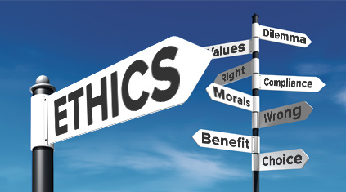
Benefits of Practicing Ethics in Selling
Business meets its ethical selling obligations
Trust and loyalty of your customers
Strengthens your reputation
Notes:
Helps your business meet its ethical selling obligations
Helps earn the trust and loyalty of your customers
Strengthens your reputation

Slide 8






Exaggeration
False promises
Waivers
Rebates
Incorrect Actions
Misrepresentation
Notes:
The slide is displayed, and the participants have to guess the inappropriate practice
After the text is displayed, the facilitator makes the participants share some examples of inappropriate practices group wise
Explain
Exaggeration is a statement that represents something as better or worse than it really is.
False promise is a promise that is made with no intention of carrying it out and especially with intent to deceive or defraud. — gratuitous promise. : a promise that is made without consideration and is usually unenforceable. — called also naked promise.
Waiver is an act or instance of waiving a right or claim
Rebate is a partial refund to someone who has paid for availing the products or services of the bank
Incorrect Actions refers to morally bad or wrong behavior
Misrepresentation is an untrue or misleading statement of fact made during negotiations by one party to another, the statement then inducing that other party to enter into a contract.

Slide 9
Ethical Dilemmas
The use of company assets
Customer relationships
Competitor relationships
Relationships with peers and supervisors
Conflicts of interest
Gifts and entertainment
Bribery and facilitation
Notes:
The use of company assets, including abuses of equipment such as cars and computers, and expense reports;
Customer relationships, which includes such abuses as overstocking, overselling, overpromising, overtelling, and underinforming ;
Competitor relationships, including disparagement, tampering and spying;
Relationships with peers and supervisors, including such abuses as territory poaching and false reporting;
Conflicts of interest, including improper disclosure;
Gifts and entertainment in excess of corporate and customer policies; and
Bribery and facilitation, specifically in countries in which they are accepted practices and not illegal.

Slide 10
Mis-selling
  A common example of mis selling can be found in the life insurance industry. Consider an investor who has a large amount of savings and investments but no dependent children and a deceased spouse.
  This investor would arguably have little need for whole life insurance or an annuity with an expensive survivor benefit and, therefore, an insurance salesperson describing the product as something the investor urgently needed to protect their assets or income stream in the event of death could be considered a case of mis selling.
Notes:
A sales practice in which a product or service is deliberately misrepresented or a customer is misled about its suitability
May involve the deliberate omission of key information, the communication of misleading advice, or the sale of an unsuitable product based on the customer's expressed needs and preferences
It is both negligent and unethical
An example of mis-selling include:
A common example of misselling can be found in the life insurance industry. Consider an investor who has a large amount of savings and investments but no dependent children and a deceased spouse. This investor would arguably have little need for whole life insurance or an annuity with an expensive survivor benefit and, therefore, an insurance salesperson describing the product as something the investor urgently needed to protect their assets or income stream in the event of death could be considered a case of misselling.

Slide 11

Do’s of Selling
Do’s and Don’ts of the Role
Features & Charges
Documents
Transparency
Treatment
Customer requirements
Capturing correct details
Punctual
Notes:
DOs
Should explain all features and charges in detail
Should give thorough details of documents which are collected
Should inform rates and charges effectively and transparently
Should not force the customer into taking the loan.
Should be gentle and nice in treatment towards the customers
Pay attention to the customer demands and requirement
Ensure the details like mobile number are correctly captured
Visiting the customer at committed time
OSV is mandatory on KYC, OVD collected
Any referral that customer is willing to provide

Slide 12

Don'ts of Selling
Do’s and Don’ts of the Role
Force
Wrong Commitment
Follow up Time
Incomplete information
Notes:
DON’T
Never to Force any customer into buying the loan
Never to take cash from the customer at any time.
Never to give wrong commitment to the customer
Never to follow with customer before 8 AM and after 7 PM
Don’t mention incomplete information in any document
Don’t force the customer for any other product apart from Vehicle Finance.

Slide 13

Moments of Truth
Customers interact with the members of the organization
Create an impression about the organization
Moments of truth can be neutral, positive or negative
Notes:
Those moments when the customers interact with the members of the organization
In those moments they create an impression about the organization
On the basis of the experience, the moments of truth can be neutral, positive or negative

Slide 14
Moments of Truth – Its Importance
 | Customer A | Customer B | Customer C
Equation | Service=Expectations | Service<Expectations | Service>Expectations
Experience | Neutral | Negative | Positive
Type of Customer | Satisfied | Dissatisfied | Delighted
Word of Mouth | Neutral | Negative | Positive
Change in customer base | NIL | -10x | +x

Slide 15
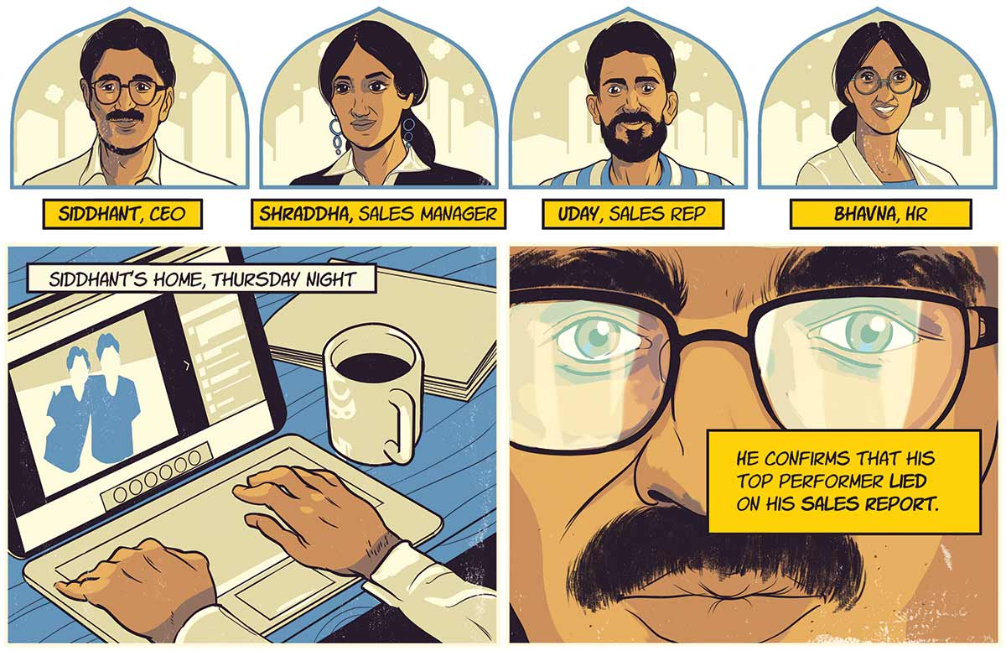

Case Study:
Your Star Salesperson Lied. Should He Get a Second Chance?

Slide 16

Common Ethical Issues for Salespeople
What are the most common ethical issues facing salespeople? Many of the most common situations you could face as a salesperson involve issues such as the following:
A customer asking for information about one of their competitors, who happens to be one of your customers
Deciding how much to spend on holiday season gifts for your customers
A buyer asking for something special, which you could easily provide, but aren’t supposed to give away
Deciding to play golf on a nice day, since no one knows if you are actually at work or not

Slide 17
In the first issue, a customer owns the information about their business. The salesperson may hold that information, such as how many cases of the product they purchase or who their customers are, but that salesperson does not have the right to share that information with the customer’s competitor.
In many instances, a buyer may ask the seller to sign a nondisclosure agreement because, in order to serve the buyer, the seller will gain access to important private information about that buyer.
But even if there is no nondisclosure agreement, courts are likely to agree with the buyer that the seller has an obligation to protect the buyer’s information.

Slide 18
In the second issue, the concern is whether the gift is so extravagant that it is considered a bribe. In some companies, such as IBM and Walmart, buyers are not allowed to accept so much as a free cup of coffee from a seller.
These companies do not allow their buyers to receive promotional items such as a pen or coffee cup with the seller’s logo on it because they want every vendor to have free access to sales opportunities and earn the business on their merits, not their freebies. Many buyers would question the motives of a salesperson giving too large a gift.
Most salespeople agree that lavish entertainment and gifts are becoming less important in business because decision makers know these add to the costs of doing business and they’d rather get a better price than be entertained.

Slide 19
The third issue is tough for salespeople because there are two factors involved: a possible violation of company policy and providing an unfair advantage to one customer. Customers may not know that their special request could get the salesperson in trouble and the request may be reasonable, just against company policy. In that instance, the salesperson should not follow through on the request, though it might make sense to see if the policy can be changed.
The second factor, though, is a bit more difficult because the request can be unfair to other customers and may cause legal problems. As long as the special request can be provided to anyone who asks for it, no law is broken. What if the special request is for a discount? Pricing discrimination laws could come into play if such a discount is not made available to all who ask. What if the request isn’t illegal, but other customers find out and get upset that they weren’t offered the same benefit? Then the salesperson may get a reputation for being untrustworthy.

Slide 20
In the final issue, the question is whether the salesperson is cheating the company out of time and effort. Some argue that a salesperson who is paid straight commission (paid by the sale) is not stealing anything from the company, but others argue that even in that instance, the company is being deprived of possible sales that would be gained if the salesperson was working.

Slide 21

Summarize

Slide 22
Thank You

Slide 23

Managing Anger

Slide 24
5 Types of
Difficult Customers
Irate
Talkative
Mistaken
Elitist
Positive
Notes:
Here are the five different types of customers you might encounter
1. The irate customer
Known for their anger that explodes as soon as you pick up the phone, irate customers are among the most common callers you'll encounter. Some of them may be fuming even before they begin their interaction with your call center. Others, on the other hand, were only annoyed at the start of the call but got increasingly aggravated with every unanswered inquiry, unnecessarily long hold times, and call transfers.
2. The talkative customer
Talkative customers are the bane of a call center's productivity, as they can slow transactions down. These customers tend to drone on about topics unrelated to the issue they're discussing with agents. Because conversations with them take too long, you may have to put other queued customers on hold. This means you'll be losing the opportunity to help other customers.
3. The mistaken customer
This type of customer insists that they know more than you do, but in fact, they may be misinformed. So when given a solution, they might not believe you immediately. This makes it hard for agents to deal with them.
4. The elitist customer
Elitist customers don't like dealing with frontline agents, as they think that the problem they're facing are too special or too complex for employees to handle. Thus, after explaining things to them, you may hear them say, "I want to talk to your supervisor" instead of giving your recommended solutions a shot.
5. The positive customer
This type of customer is the best one there is. They are friendly customers who just want to get their problems fixed. Customers with a positive mindset can be beneficial for your company. They can provide you insights regarding your products, services, or business, which can help your company grow. They can be your brand's promoters as well. Just continue giving the best service to them and they'll likely to stick to your brand.

Slide 25

Notes:
Tips to communicate with them
1. The irate customer
The key to interacting with this kind of customer is to be calm throughout the call. The trouble will only escalate if you let your own irritation and impatience take over the conversation. Instead, assure the customer you know how to solve the problem, and then provide a solution as soon as you can.
2. The talkative customer
To maintain control over the conversation with a chatty caller, focus on the reason why the customers called. Should the conversation digress from the topic, politely redirect the discussion back to the main issue.
3. The mistaken customer
Telling them outright that they're wrong can easily anger them, so it's best to make them feel that you're their ally in uncovering the answer they need. Be careful not to come off as high and mighty. Be polite as you explain to customers how the solutions you recommend can help them better.
4. The elitist customer
When handling this type of customer, assert that you are qualified to fix their issues, but do so in a polite manner. If the problem can be solved without a manager's intervention, inform them that it's not advisable to escalate the call to a supervisor. Make sure, however, that you can thoroughly address their issues.
5. The positive customer
It's important for call center reps to know how to handle customers with varying personalities in order to ensure that interactions will go smoothly. Be intuitive and adapt an effective strategy in handling different types of customers. That way, you can keep all clients happy and loyal to your brand.

