Slide 1

SELLING SKILLS
Proposing a Solution & Eliminating Doubts through the Art of Story-Telling

Slide 2
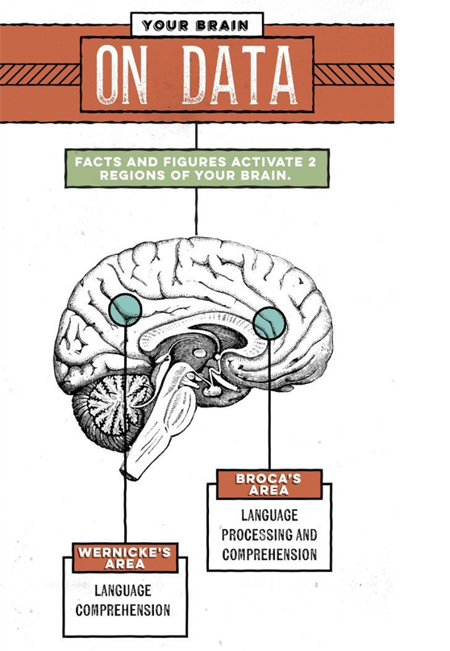
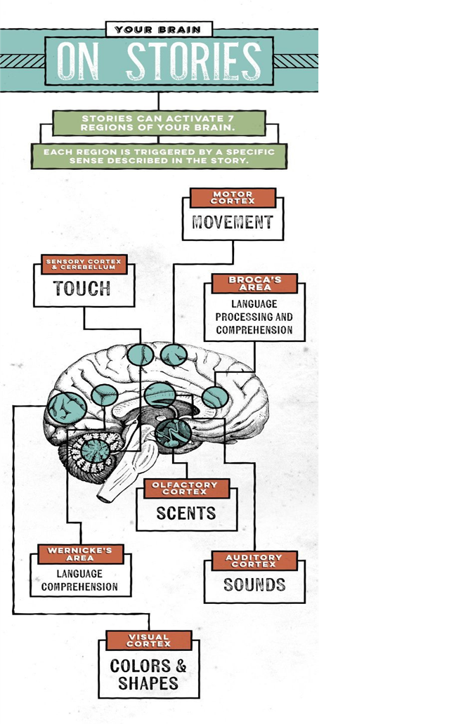
“Stories are up to 22 times more memorable than facts and figures alone.”

Slide 3
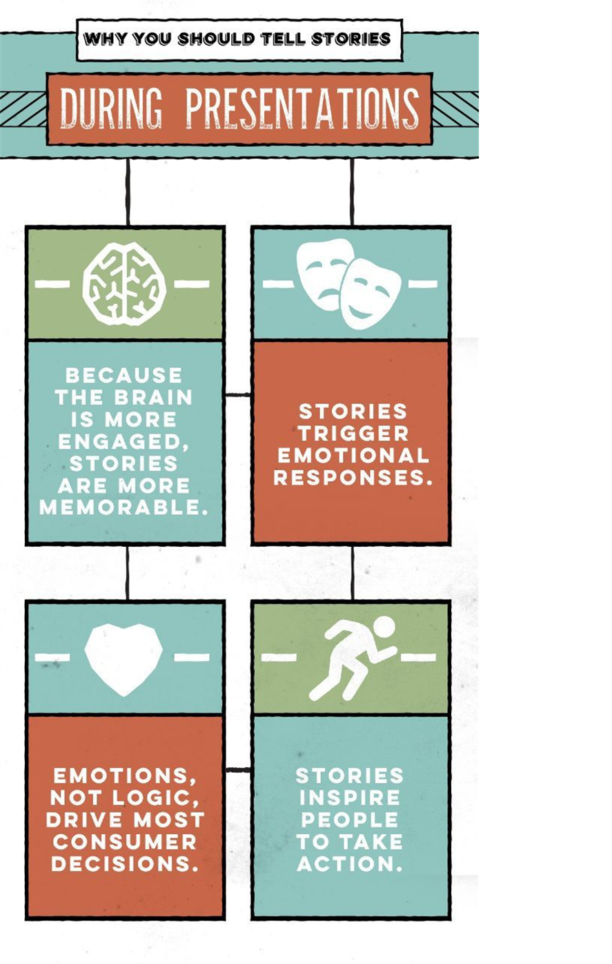
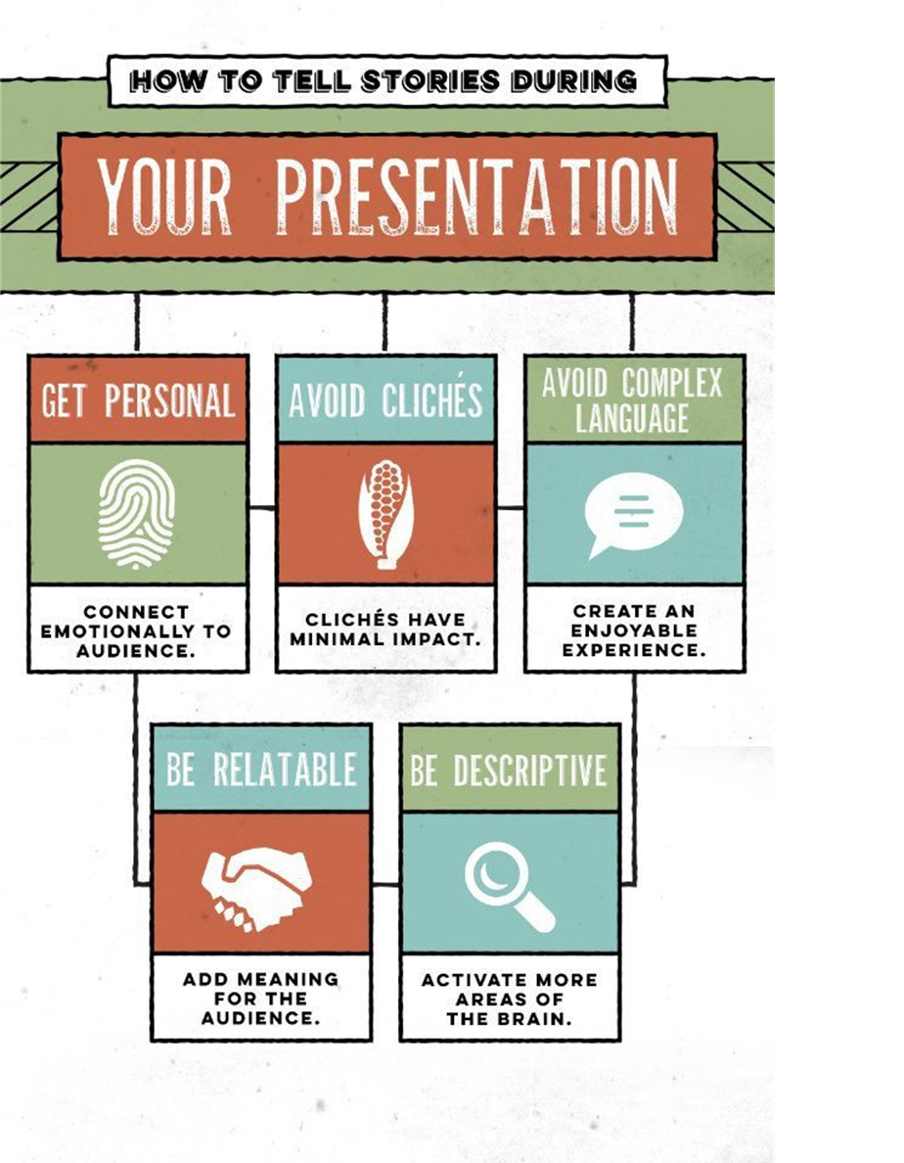

Slide 4
“Metaphors like “The singer had a velvet voice” and “He had leathery hands” roused the sensory cortex. […] Then, the brains of participants were scanned as they read sentences like “John grasped the object” and “Pablo kicked the ball.” The scans revealed activity in the motor cortex, which coordinates the body’s movements.”

Slide 5

Agenda
Proposing a Solution & Eliminating Doubts through the Art of Story-Telling

Slide 6
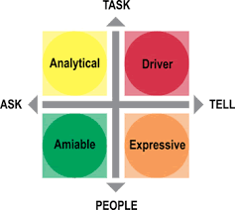
Tackling 4 Key Customer Social Styles
An essential criterion to attain success in business is to possess the ability to be flexible while dealing with different kinds of customers. Anyone who has ever dealt with customers knows that one cannot apply the same technique to deal with different customers.
This is because customers differ in personality, style of communication, thought process, behavior, and method of making decisions. It is imperative for you to recognize the characteristic social style of individual customers and approach them accordingly.

Slide 7
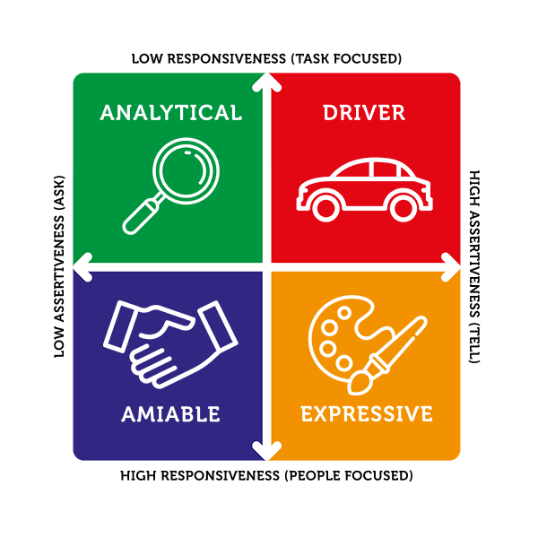
What is customer social style?
Customer social style is the approach followed by customers in their interactions. It is their most natural and comfortable way of dealing with people.
Customers can be divided into four personality types: Amiable, Expressive, Analytical, and Driver. Though a customer may display traits of more than one type, eventually it is just one personality style type that dominantly defines his/her behavior. Each style can be recognized by its unique characteristics involving language, thought process, and approach to business.

Slide 8
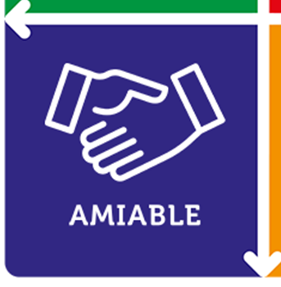
Amiable Social Style
These customers are agreeable, supportive, responsive, friendly, soft-spoken, and people-oriented by nature.
For such people – teamwork, co-operation, acceptance, and respect of other’s opinion matter a lot.
Amiable customers may need time to build rapport, but they are quick decision makers. Such customers conduct business with people whom they consider to be trustworthy.

Slide 9
How to tackle amiable customers?
The best way to deal with customers having an amiable personality is to establish a personal relationship with them.
Engage them in a lively chat before getting down to business. If you are providing customer support to an amiable customer, emphasize on why your solution or product will meet their requirements.
Being agreeable and pointing out low-risk solutions is a good approach to win over such customers.

Slide 10
Expressive Social Style
A stereotypical expressive social style customer displays enthusiasm, assertion, spontaneity, responsiveness, and creativity.
Such customers are charismatic, confident, and engaging.
They love to talk a lot and possess strong persuasive skills.
For an expressive customer, building relationships is a means to gain power or recognition.
They are impatient with details but are happy to focus on the big picture.

Slide 11
How to tackle expressive customers?
People with an expressive personality tend to be slow in making decisions.
It is best to deal with them patiently and discuss all aspects of the product/service without going into much detail.
Ensure to summarize the main points and present them concisely to draw the complete picture.
Also, remember that such people tend to buy products based on the recommendations of people they know. Therefore, keep your best testimonials at hand while dealing with expressive customers.

Slide 12
Analytical Social Style
Individuals with analytical social style are cautious, rational, thoughtful, and serious.
They focus on facts, statistics, and detailed information. Such customers tend to ask many questions but remain reserved in their interactions.
They like to follow standard operational procedures and conventional methods of doing things.
When making decisions, analytical customers prefer to make informed decisions based on their own judgment and hard facts.

Slide 13
How to tackle analytical customers?
In order to deal with analytical customers, you need to be ready to provide clear and detailed answers.
They prefer data, information, or instruction to be presented in an organized manner.
A good way to impress such customers is to use specific examples to explain your point.
Allow facts to speak for themselves, even as you explain the pros and cons of anything in a systematic manner.
Do not forget to offer background data that might help them in making their decision.

Slide 14
Driver Social Style
People having the driver social style are smart, determined, focused, direct, and action-oriented.
They prefer things to happen at a fast pace and lose patience with too much detail or a longwinded answer.
Drivers are independent and assertive and do not take much time to make decisions.
For them, getting a brief overview of any product or matter is enough to make up their mind.
They love to be in control and do things their own way.

Slide 15
How to tackle driver customers?
While dealing with drivers, always be professional and efficient.
Since they value time and are task-oriented, try to identify their objective and provide to the point solutions.
Steer clear of making small talk with them or providing irrelevant details. Instead, try to convince them with facts and logic.
Be concise and relevant in order to appease such customers.

Slide 16
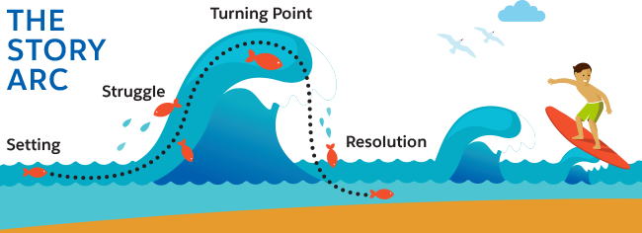
The Story Arc
You can use something called a story arc to structure your stories. A “story arc” is the chronological way the events unfold in a story. The arc gives the listener the opportunity to travel through the story like it’s an adventure!
The basic story arc has four parts:

Slide 17
What it is | What it does | For example,
Setting The setting is where and/or when the story occurs | Helps the customer imagine the scene as if they were there in the moment. | The meeting room was stuffy and warm. It smelled like a mix between paint fumes, freshly pressed dry-cleaning, and leftover catered lunch. There were no windows or artwork—just a larger-than-life screen for presentations, a stage, and a room full of people.
Struggle The struggle is the character’s pain point, challenge, or conflict | Builds tension, adds just enough anxiety to keep the story interesting, and helps your customer empathize with the story’s main character. | I could not get in touch with my manager. She was supposed to present. I knew the presentation but had never spoken in front of a crowd before. I waited. I waited some more. I called. I was worried… what would happen if she didn’t arrive? More time passed. I called and called. No answer. The presentation was due to start in 2 minutes. My heart raced. The event’s organizer approached and said: “What would you like to do?”

Slide 18
What it is | What it does | For example,
Turning point The turning point is the defining moment. It’s when the main character has no choice but to take action | Makes your customer feel so engaged that they want to shout, “Do this” or “Don’t do that!” | “I’ll give the presentation,” I replied. I gulped some water and walked on stage. I could feel my heart racing. The lights were so bright on stage that I couldn’t see the audience.
Resolution The resolution is the ending and what happens after the turning point | Inspires your customer. | I did the best I could. I tried my best to remember the speaking points, but it was agonizing - I read from the speaker notes for entire chunks of the presentation. My voice was shaky. But I stuck it out. I stayed with it. I learned more about presenting in those 30 minutes than I ever did from months of watching my manager present the same speech.

Slide 19

What is the typical storyline that each of the customer types would like to listen to?

Slide 20
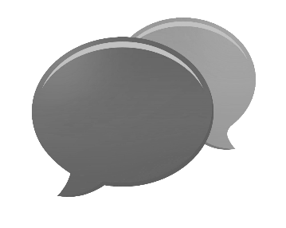
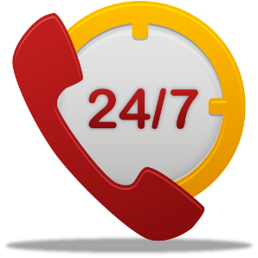




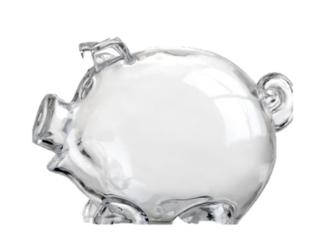

Building Relationships
Further grows when you wish on special occasions
Becomes stronger for lifelong if you are there, whenever they need you
Relationship account opens when you meet for the first time
Grows when you start interacting & understand their interests

Slide 21

Relationships are Fragile
…as relationships take years to build but a moment to end.
When you stop keeping in touch
When you do not keep your promises

Slide 22

Take a Pause to Check
Feedback
Follow Up
Answer Queries
Handle Complaints

Slide 23
Feedback Questionnaire
How would you rate your experience at Magma HDI with respect to the following (Poor, Average & Good)
Your current Insurer
Product Offerings & Add-ons offered
Experience with Agent Portal
Frequency and Timely Commission Payouts
Communication & Engagement Initiatives ( Club memberships, R&R)
Frequency and Quality of organized Training
Support from the Internal Team
Renewal Support & Renewal Protection
Turn Around Time for Policy Issuance & Service Requests
Claims Servicing

Slide 24

Feedback Analysis
A score of Poor represents an unhappy partner
Average refers to a partner who if not attended to immediately, may get unhappy soon
A score of Good shows that partners are happy associating with you

Slide 25

Follow Up Action Plan
What would you do, if your partner is happy being associated with Magma HDI?
Continue to build Trust
What would you do, if your partner is unhappy being associated with Magma HDI?
Rebuild Trust

Slide 26

LEAP Technique
Building the Dependability Level of Trust
L
isten Actively
E
mpathise
A
ccept Responsibility
P
rovide Solution

Slide 27


Listen
To understand what is making your prospect/customer happy or unhappy
Repeating
Eye Contact
Mirroring
Clarification

Slide 28

Empathize
“Let the prospects /customers know that you are keen to understand their concerns”
Eg – Even I would be disappointed if something similar would have happened to me…
Eg – Even I would react in the same way if…
Eg – Even I would be angry if…

Slide 29

Accept Responsibility
To build trust with prospects/customers and convert them into your partners
Eg – Now that I am here, I assure you that..
Eg – Trust me sir, I will help you to…
Eg – I take the full responsibility to guide you in…

Slide 30

Provide Solutions
If prospects/customers are unhappy with their current insurer:
Build Trust by highlighting USPs of Magma HDI Offerings to counter the low rating
If prospects are happy with their current insurer:
Build Trust by highlighting USPs of Magma HDI Offerings

Slide 31
Let’s do a quick Recap
Building Relationships
Dependability Level of Trust
Feedback
Listen actively
Follow Up
Empathize
Answering Questions
Accept Responsibility
Handle Complaints
Providing Solutions

Slide 32

Summarize

Slide 33
Thank You

