Slide 1
Selling Skills in Financial Services
SESSION 1-INTRODUCTION TO SALES
Prof:Sharlot Bency

Slide 2

What will you do if u won a million dollars in lottery?
This Photo by Unknown Author is licensed under CC BY-SA

Slide 3
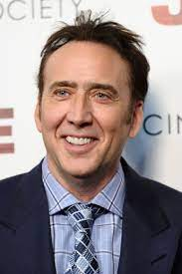
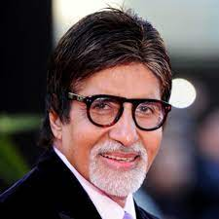
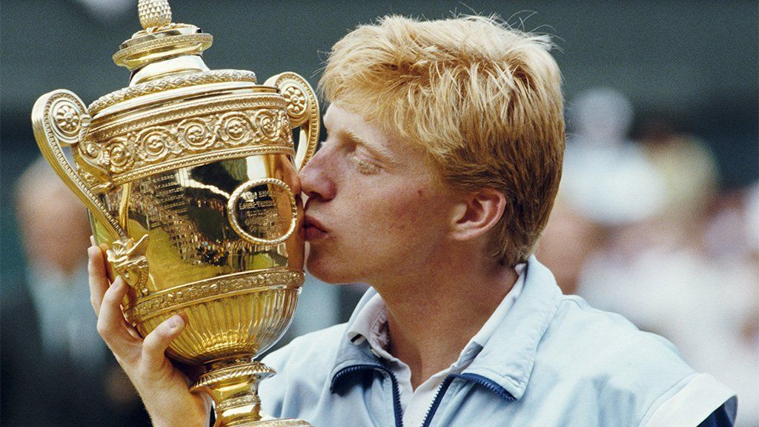
Guess these Super stars!!

Slide 4
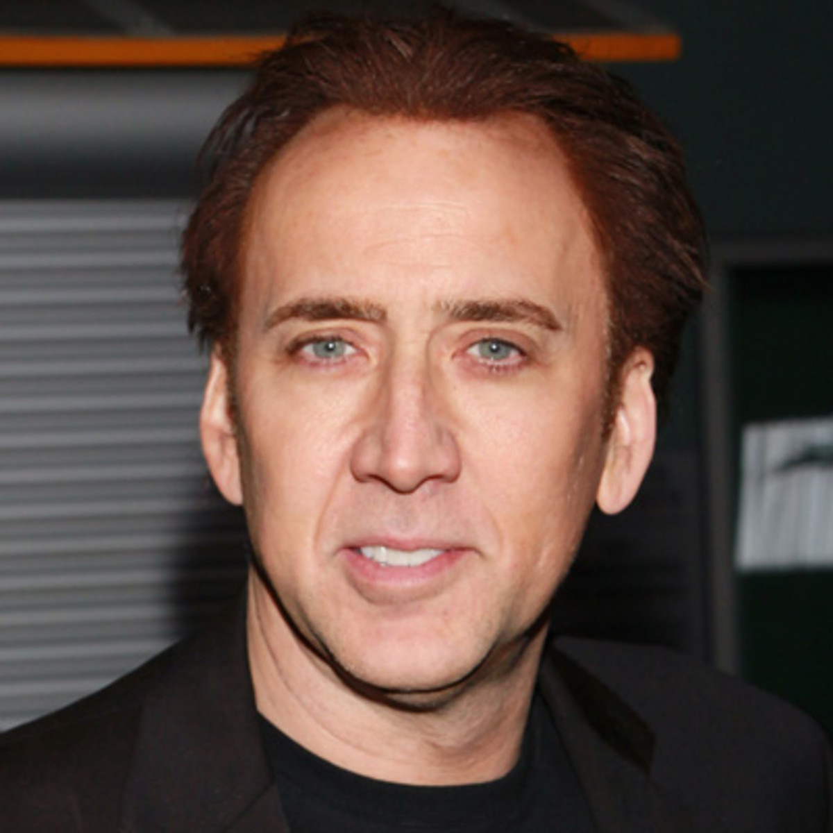
Nicholas Cage
Between 1996 and 2011 he made an estimated $150 million in his acting career.
Some of his blockbluster movies are Gone in Sixty Seconds ($20 million), National Treasure ($20 million), Snake Eyes ($16 million) and Windtalkers ($20 million).
Notes:
Nicholas Cage-150 million in his acting career.Hugely successful Oscar winning actor..2009 Forbes-highest paid actor.Fun was short live as he went broke.As income incsd so dis his insane buying habits.

Slide 5
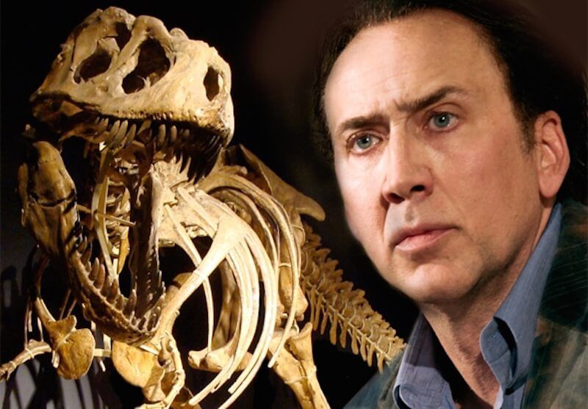
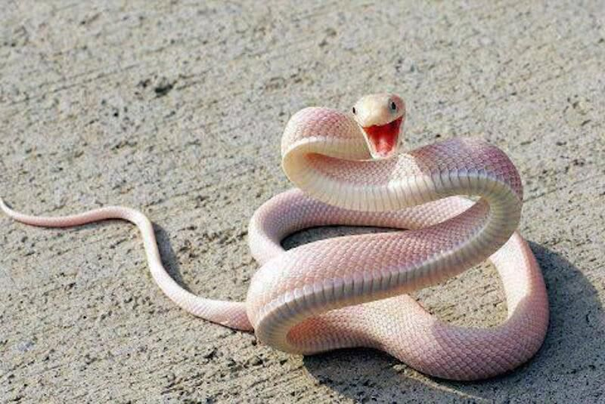


Notes:
Where did all the money go? Dinosaur skulls-He was a self proclaimed history buff.Two Albino King s,A crocodile,an Octopus ,a pet whale,Luxury yachts,Exotic cars and motor bikes,Shah odf irans Lamborgini,15 estate homes around the world,two European castles, A famous haunted house.First Superman comin,A pyramid tombstone,Art Expensive Jewellery.He also has a collection of shrunken pygmy heads.The IRS people put a tax lien on Cage worth 6.8 million.And he was in debt..Mothers medical bills.Accepted all kinds of acting offers and slowly offloaded his assets.Sued his money manager and his money manager countersued him which ended ina settlement.Now Case has cleared his debts

Slide 6
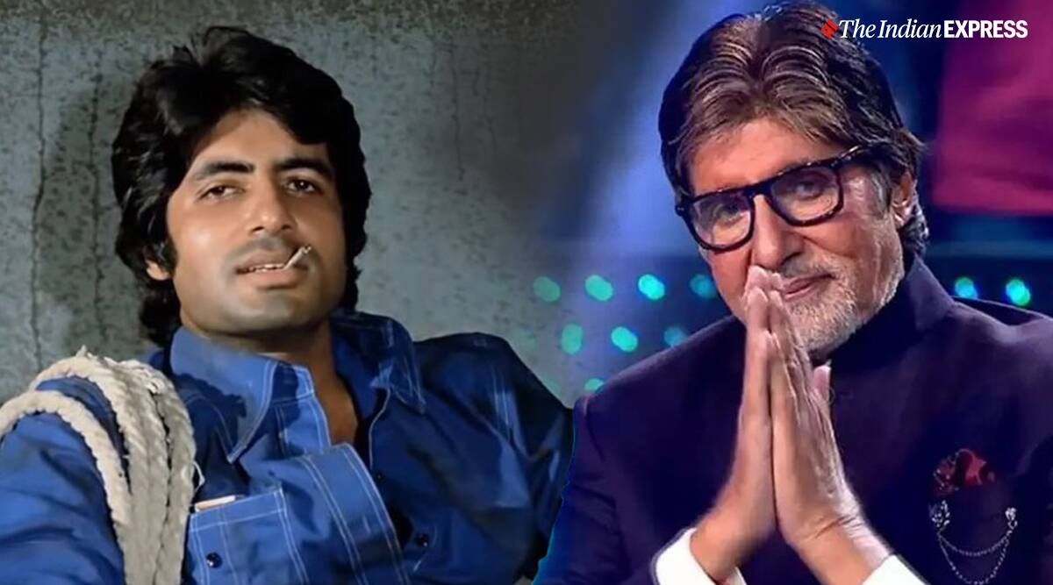
Amitabh Bachan
Notes:
Big B-One of the busiest actors in the country.80 th birthday.In 1990s Big Bs career was suffering a set back.Many of his films were not doing well.So he started ABCL-India’s first Entertainment firm and got into film production,distribution,event management,talent management,and television marketing..Though initially very popular soon went into bankruptcy.In 1999 Big Bs debts were -90 crs ,and personal assets-60 crs.Creditors turning up in his bunglow Pratiksha to collec money.Dark phase.Kaun Banega Carorepati series-2000.Roaring success .Yash Chopra –asked for work.Mohabattein.Dhirubhai Ambai offered help.

Slide 7
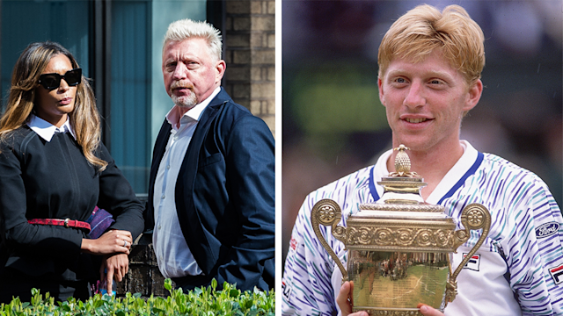
Boris Becker
Notes:
1985-Wibledon Championship.-He won it 17 years –the youngest ever to win Wimbledon mens title.At 37 years he wasjailed for 2 ½ years for breaking insolvency laws after he was declared bankrupt in 2017 owing creditors 50 M pounds.He also spent his wealth wildly and faced financial difficulties.Boris becker coached Nadal Djokovic for three years starting 2013.

Slide 8
Lessons learnt
Don’t be materialistic
Learn about money
Don’t assume that success lasts forever
“The philosophy of the rich and the poor is this: the rich invest their money and spend what is left. The poor spend their money and invest what is left.” Rich Dad Poor Dad
Warren Buffet & Mark Zukerburg-Bllionaires who don’t spend money like they are rich.

Slide 9

Join the dots game..
Connect all the dots with no more than four straight lines without lifting your hand from the paper.

Slide 10
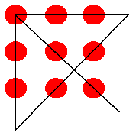
Solution

Slide 11
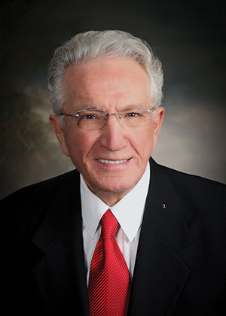
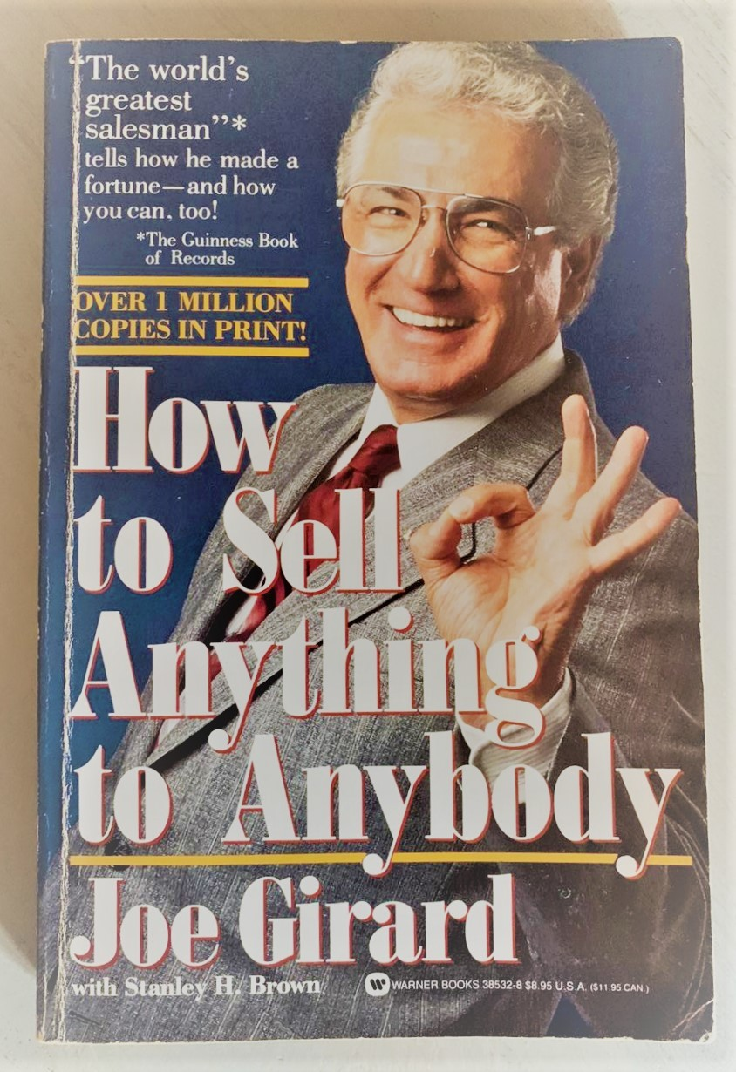

Slide 12
Mr. Joe GiRARD
The World’s Best Salesman(1968-1978)
Guiness Book of World Records-12 times
1425 cars in a year(1973)

Slide 13
Discuss
The difference between Marketing and Sales.
Notes:
Where does marketing begin in a company that makes products or services?
Co-pdt-customer
Is it something that you do when the product is made?Marketing starts even before the pdt or service is made. Who's going to buy this? What do they look like? What do they want? What's their pain point? What problem can you solve.
Idea-Fine tune-prototype-test marketed-refined-sell/promote-ongoing refinement.

Slide 14
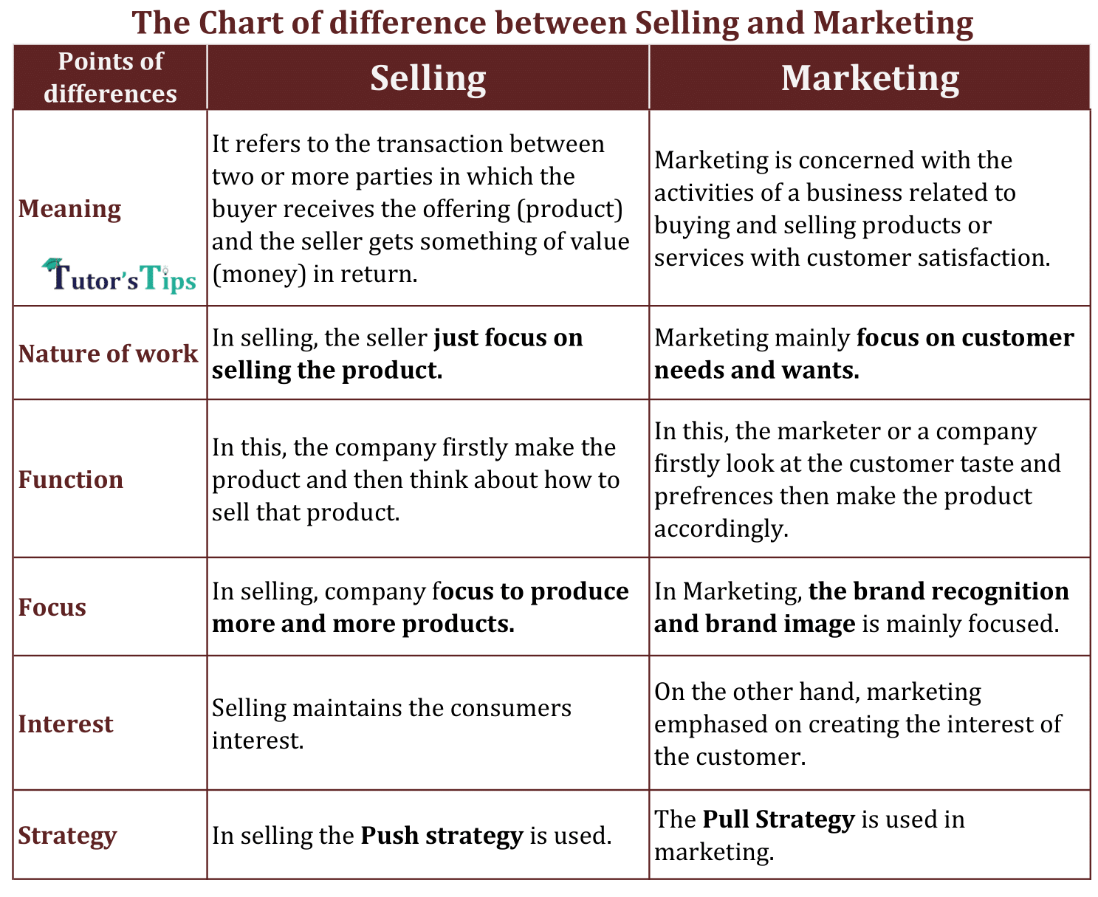
Difference between marketing and sales

Slide 15
Marketing
Marketing is one-to-many.
Marketing tells the stories (of the company, product, etc.) To many people.
Marketing looks after the brand’s reputation
Marketing needs to keep the stories circulating and resonating with the target markets .

Slide 16
Sales
One-to-one Interaction.
Brand Comes to life in sales
Relationship-driven.
Analyses the behavior of the prospects and customers on an individual basis.
Notes:
Sales is about one-to-one.
Sales is where our business becomes real for the client. It is where the stories and brand come to life.
Sales develops relationships and is relationship-driven.
Sales analyses the behavior of the prospects and customers whom they deal with on an individual basis. Sales professionals talk to their customers about the joys of risk free offerings that help them realise their goals and objectives. They tap into their buyers’ facebook, linkedin and other digital pages to gain a deeper understanding of what experiences each individual customers want.

Slide 17
Selling Process
The selling process is the series of steps followed by a salesperson while selling a product.
Selling process is a complete cycle which starts from identifying the customers to closing the deal with them.
It is more relevant is b2b business sales where the sales cycle is not short and might take a longer duration to close. In B2C the selling process may be transient and shorter.

Slide 18
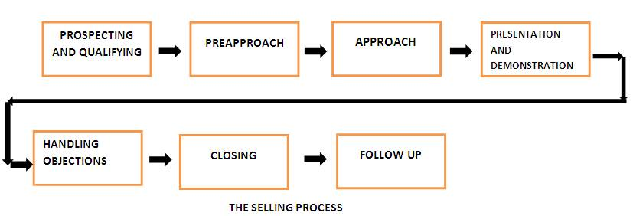
Steps of a Sales process

Slide 19
1. Prospecting: The first step in selling process in which potential customers are identified by the salesperson is called prospecting.
2. Pre-approach:The stage where the salesperson collects information about the potential customers and understands them before making the sales call is called pre-approach.
3. Approach: Approach is the step where the salesperson actually meets the customer for the first time.
4. Presentation: The step wherein the salesperson talks about how the product will satisfy the customer’s needs and add value to his/her life is called presentation.
5. Handling Objections: In this step, the salesperson clarifies all the doubts and questions that the customer has and eliminates all his objections to buying the product.
6. Closing:The step in which the customer is asked to place and order for the product is called closing.
7. Follow-Up: This is the final step in the selling process where the salesperson follows up with the customers to ensure satisfaction and builds the relationship in order to repeat business with them.

Slide 20
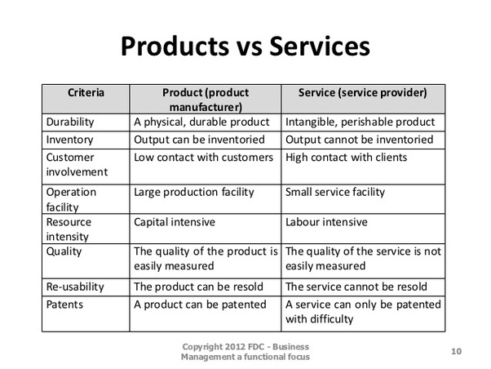

Slide 21
Knowing your products and services
Product knowledge is an essential sales skill. Understanding your products' features allows you to present their benefits accurately and persuasively. Customers respond to enthusiastic sales staff who are passionate about their products and eager to share the benefits with them.
Get to know your products or services
Customers are more likely to trust sales people who show confidence in themselves and what they are selling. You can build this confidence by increasing your knowledge of your products or services.
Notes:
Use conventional and creative sources of information to learn about your products or services, including:
your own experiences using the products
product literature such as brochures and catalogues
online forums
feedback from customers
trade and industry publications
internal sales records
your team members
visits to manufacturers
sales training programs
competitor information

Slide 22
Be honest about shortcomings
If your product or service has some shortcomings in certain situations, be honest about them with your customers. Let them know early on if you don’t think your product or service is right for them and they will be more inclined to trust you when they need something in the future.
Turn product features into benefits
As you engage customers, you can use your knowledge to lead your customer through the sales process, and make their experience an enjoyable one that they'll want to revisit.
Successful salespeople know all of their products' features and skilfully turn these features into benefits for their customers.
To practice this skill, list your product's features, potential benefits, and all information up front for your customers. Consider how you can communicate the potential benefits, for example.

Slide 23
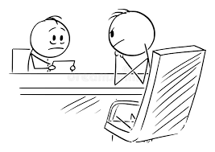
Importance of product knowledge
Imagine you are searching for a product or Sevivce.You found it but you have some questions and you find the sales representative and pose your queries.
What if his reaction is like this?
Most of the time the reason for such reaction is lack of product knowledge.
So what is product knowledge and why is it important in selling?

Slide 24
Imporatnce of product Information
Consumers today
Digitally connected,socially networked.
Try to gather all required information before speaking to the product
Today’s consumers are digitally connected, socially networked and prefer to have gathered all the required information on the product that is to be purchased, before they even speak with your sales team. However, an intelligent consumer may approach your salesperson with a difficult question—one without an answer on your website, white paper, social media posts and so on. Is your staff adequately equipped to make that personal connection, provide a trustworthy experience for your prospective customer and tip the scale toward a win situation for your organization?

Slide 25
Benefits
1. Answering difficult questions-
Prepared ahead and educated about these questions, the answer received will be very powerful and concise.
If caught off guard-defensive response, stumble upon the answers or completely ignore the ignore the question resulting in faith being lost
2. Knowledge is power
Product knowledge can lead to increased business.
Better communication skills-different techniques and methods of presenting a product
Boosts enthusiasm- armed with deep product knowledge, a display of enthusiasm and belief in the product may generate excitement among your customers and alleviate uncertainty about the solution that the product provides for the customer

Slide 26
3.Grows Confidence – If a customer isn’t fully committed to completing a sale, the difference may simply be the presence (or lack) of credibility or confidence a salesperson has towards the product. Becoming educated in the product and its uses will help cement that confidence.
4.Assists in Overcoming Objections – Factual information gained from product knowledge, may be used to strike down objections voiced by customers. Solid knowledge about your product coupled with parallel information about similar products sold by your competitors—gives you that added advantage to easily counter objections.
An investment in knowledge pays the best interest. -Benjamin Franklin
Notes:
Answering Difficult Questions:
Many customers will have answered just about every question on your product or service before they even call you. But, there are usually a couple questions which don’t have answers online, and normally they are difficult questions like: “I have read some mixed reviews on your customer service. Can you tell me what I can expect if I have problems down the road?” This is where product knowledge training is crucial. If your team is educated on these negative perceptions ahead of time and have prepared responses for them, the answer the customer receives will be very powerful and concise. If they are caught off guard, they might become defensive, stumble over their response, or completely ignore the question, which will result in all faith being lost with the customer because the one question they couldn’t find an answer for ahead of time, was answered insufficiently.
Benefits of Product Knowledge
Knowledge is power and for your sales force, product knowledge can be the vehicle to increased sales. We have already discussed the reasons why product knowledge is important to your business, but the list below highlights the benefits of product knowledge—as they directly relate to your sale team.
Strengthen Communication Skills – A thorough and wider understanding of a product enables a salesperson to use different techniques and methods of presenting a product to various types of customers. Stronger communication skills empower a salesperson to suitably adapt a sales presentation for greater impact.
Boosts Enthusiasm – Armed with deep product knowledge, a display of enthusiasm and belief in the product may generate excitement among your customers and alleviate uncertainty about the solution that the product provides for the customer.
Grows Confidence – If a customer isn’t fully committed to completing a sale, the difference may simply be the presence (or lack) of credibility or confidence a salesperson has towards the product. Becoming educated in the product and its uses will help cement that confidence.
Assists in Overcoming Objections – Factual information gained from product knowledge, may be used to strike down objections voiced by customers. Solid knowledge about your product coupled with parallel information about similar products sold by your competitors—gives you that added advantage to easily counter objections.
Product training with emphasis toward product knowledge will be more effective in helping you deliver customer experiences that “Wow” before your competitors do. In closing and to reiterate the importance of product knowledge, here’s a quote:
An investment in knowledge pays the best interest.
-Benjamin Franklin

Slide 27
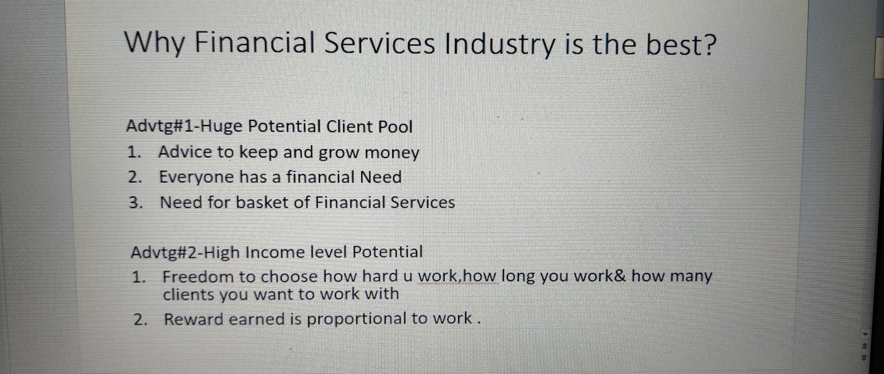
Finance Industry –Career in Sales

Slide 28
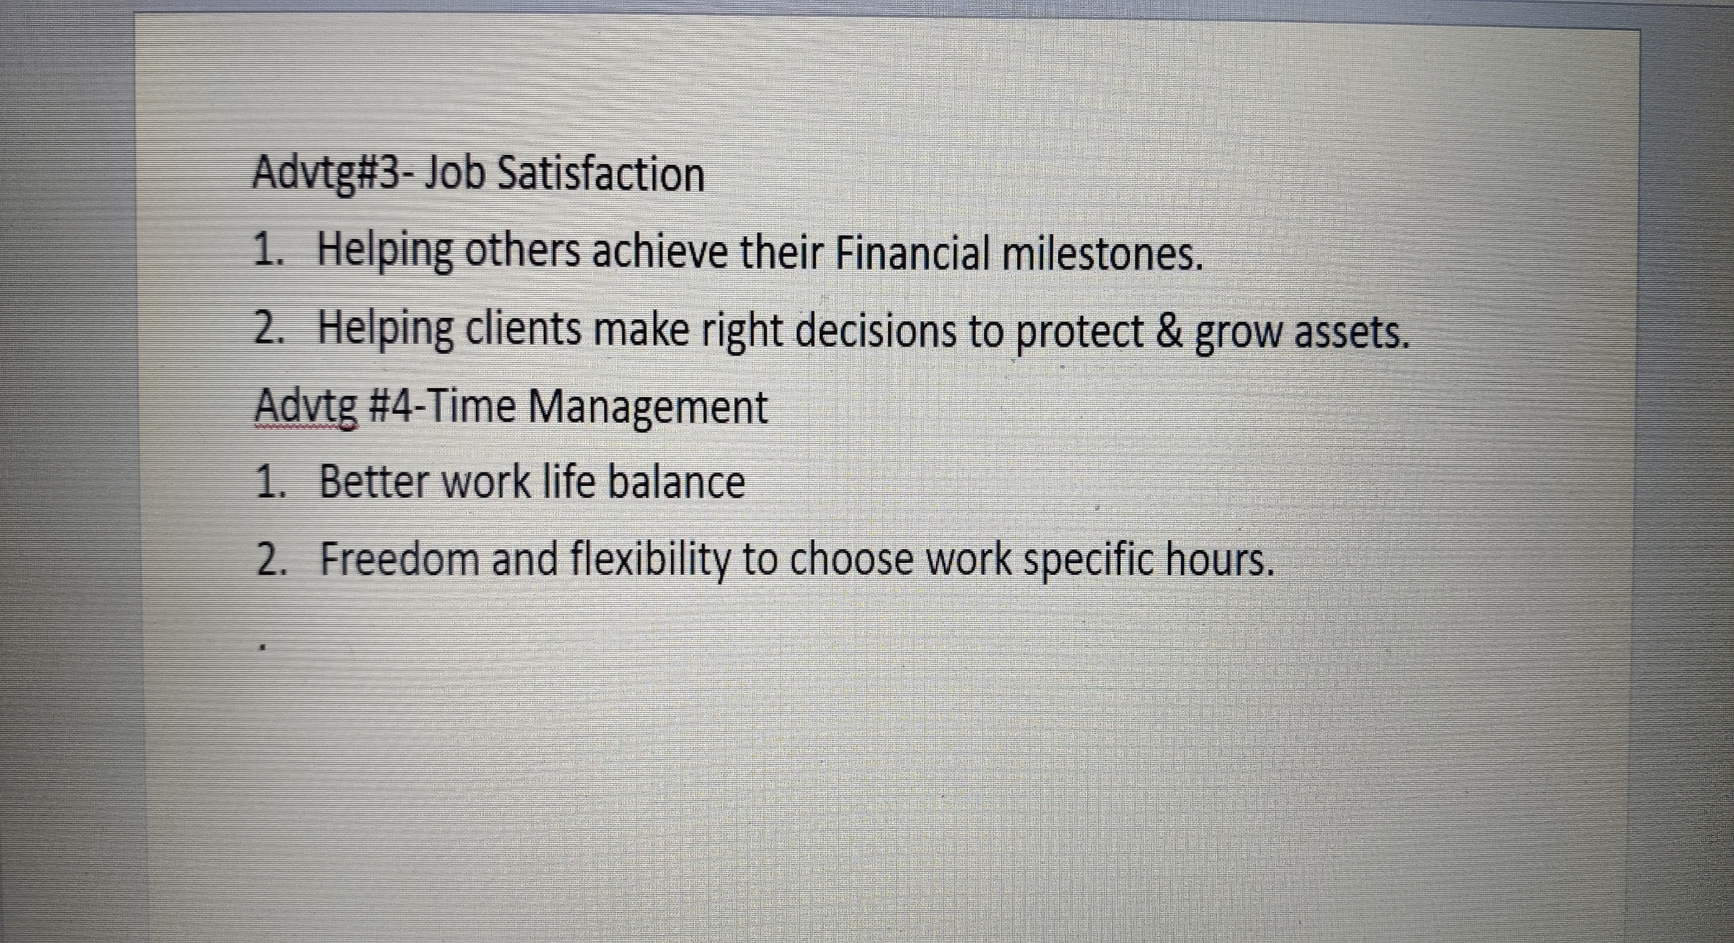

Slide 29
End of Slide
        Thank You!

