Slide 1
Current Financial Products and Competitor Analysis
Prof :Sharlot Bency

Slide 2
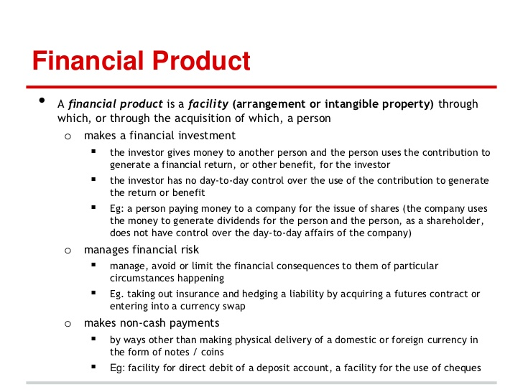

Slide 3
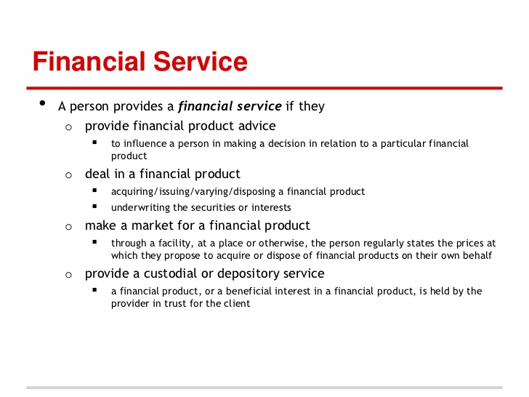

Slide 4
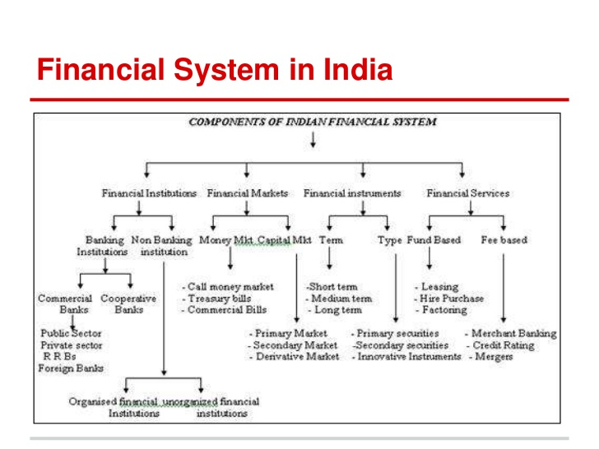

Slide 5
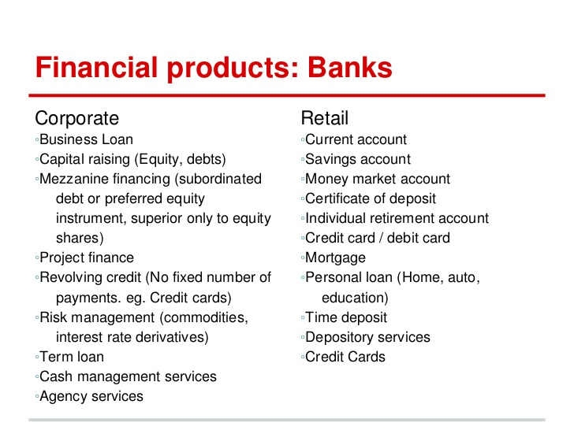

Slide 6
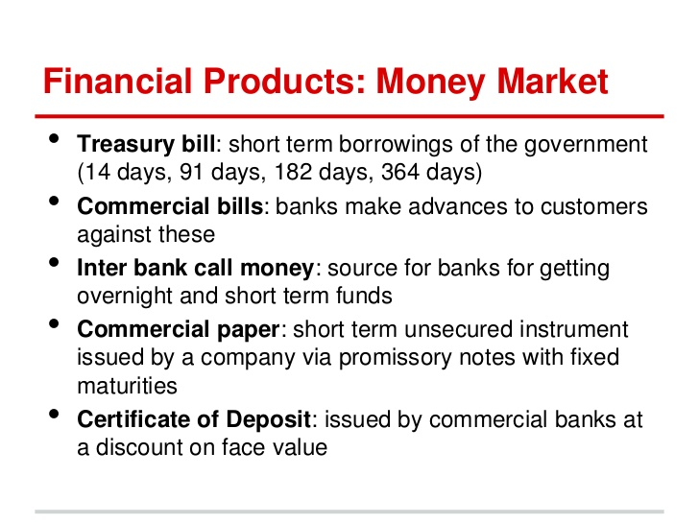

Slide 7
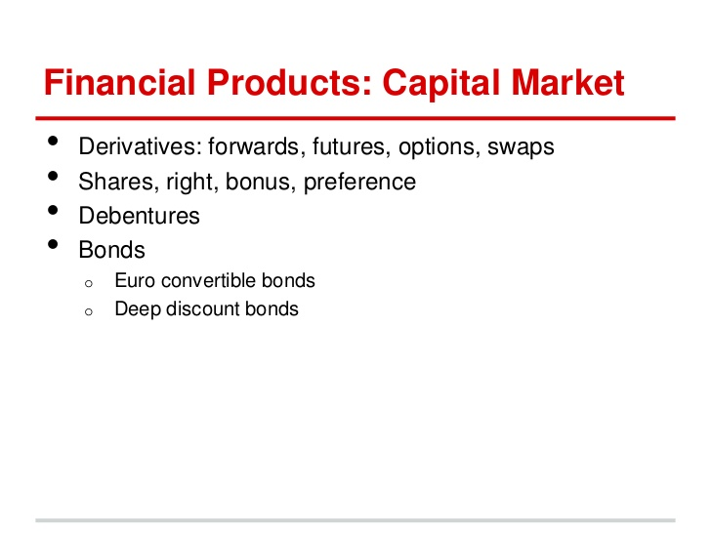

Slide 8
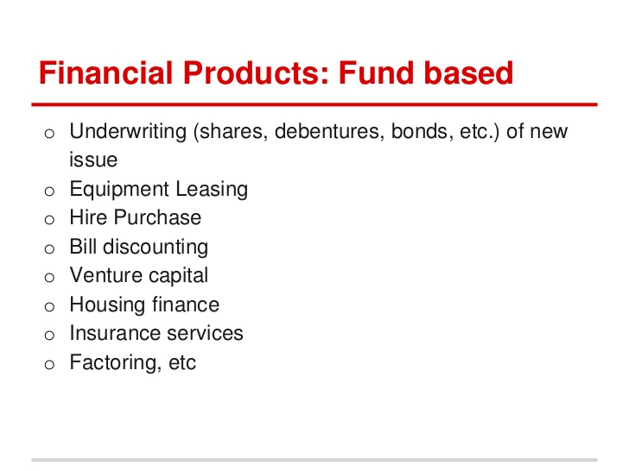

Slide 9
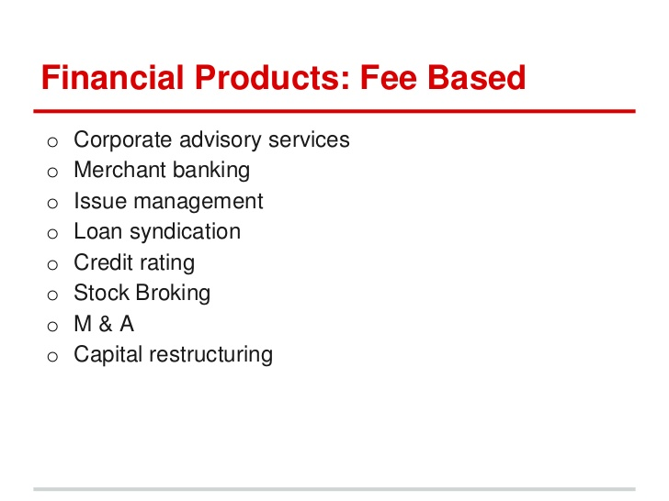

Slide 10
Competitor Analysis
In sales and marketing competitor analysis is an assessment of the strengths and weaknesses of current and potential customers.
A strategy to identify major competitors and research their products, sales and marketing strategies. Solid business strategies can then be developed to counter your competitors.
Every brand can benefit from regular competitor analysis. By performing a competitor analysis, you'll be able to:
Identify gaps in the market
Develop new products and services
Uncover market trends
Market and sell more effectively

Slide 11
How to Perform a Competitive Analysis
Determine who your competitors are.
  Divide your “competitors” into two categories: direct and indirect.
  Direct competitors are businesses that offer a product or service that could pass as a similar substitute for yours, and that operate in your same geographic area.
  An indirect competitor is one that provides products that are not the same but could satisfy the same customer need or solve the same problem.
  The focus should be on the Direct competitor only.

Slide 12
2. Determine what products your competitors offer.
Are they a low-cost or high-cost provider?
Are they working mainly volume sales or one-o purchases?
What is their market share?
What are characteristics and needs of their ideal customers?
How does the company differentiate itself from its competitors?
How do they distribute their products/services?

Slide 13
3.Research your competitors sales tactics and results.
What does the sales process look like?
What channels are they selling through?
Do they have multiple locations and how does this give them an advantage?
Are they expanding? Scaling down?
Do they have partner reselling programs?
What are their customers reasons for not buying? For ending their relationship with the company?
What are their revenues each year? What about total sales volume?
Do they regularly discount their products or services?
How involved is a salesperson in the process.

Slide 14
4.Analyze how your competitors market their products.
Do they have a blog?
Are they creating whitepapers or ebooks?
Do they post videos or webinars?
Do they have a podcast?
Are they using static visual content such as infographics and cartoons?
Do they have a FAQs section?
Are there featured articles?
Do you see press releases?
Do they have a media kit?
What about case studies?
Do they publish buying guides and data sheets?
What online and offine advertising campaigns are they running?

Slide 15
5.Take note of the Competition's content strategy.
Evaluate the quantity and quality of the content published by the competitors.
Look at the frequency, accuracy and readability of the content.
Is the content available for free to anone or do the readers have to sign in?
Pay attention to the photos ,imagery and tone used.Is there any call of action that is specific to the business.
Analyse the level of engagement of the content.Ceck how the target audience responds to the content.

Slide 16
6.Observe how they promote marketing content.
1.What keywords are the marketers focusing on that we have missed?
2.What content of competitors is highly shared and looked into?
3.Which social media platform is the target audience using the most?
4. Look at their social media presence, strategies, and go-to platforms

Slide 17
7.Perform a SWOT Analysis to learn their strengths, weaknesses, opportunities, and threats.
Where does your competitor have the advantage over your brand?
What is the weakest area for your competitor?
Where does your brand have the advantage over your competitor?
What could they do better with?
In what areas would you consider this competitor as a threat?
Are there opportunities in the market that your competitor has identified?

Slide 18
Thank You!

