Slide 1
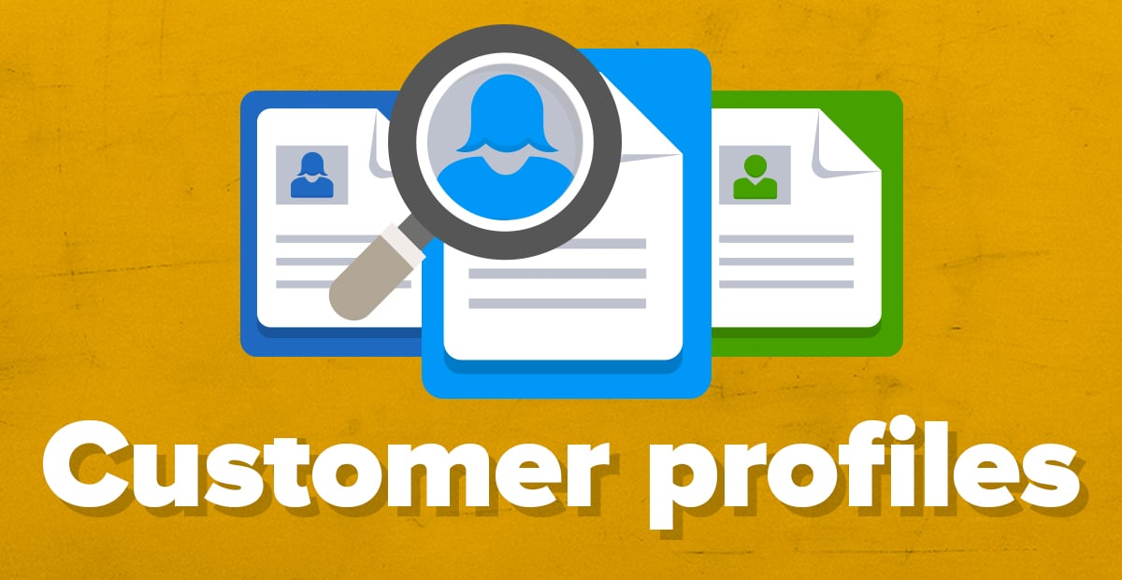
Customer Profiling
Sharlot Bency
Notes:
Understanding the customers your business intends to target is an essential step in figuring out your brand’s identity. Who are you hoping to reach? How are you going to reach them? What is the value you intend to provide them? Knowing exactly who your business is trying to sell to is a vital step, and developing ideal customer profiles and buyer personas makes this happen.
A sports car supplier looks to target an affluent market.His product is not for everyone.You have to understand how to recognize your prospects,only then can you market the product to them.You are not for everybody.You have to use specific language for the target customers.Being specific makes selling simpler.

Slide 2
Ideal Customer Profiles(ICP)
An ideal customer profile, or ICP, is a breakdown of the type of customer that would receive the most value from your product or service while providing your business with the best possible return.
A technique by which customers are grouped according to geography, demographics, behaviours, needs and wants
Profiling allows key customer groups to be targeted based on their engagement with services
Customers are targeted using communications channels that are most likely to be received by the customers you are trying to reach

Slide 3
Build a great ICP
https://youtu.be/2_FS5w7LIHo
https://youtu.be/4duQSBRRNvw
https://youtu.be/o9ema2yJvxs
https://youtu.be/9EboPhgFhD0

Slide 4
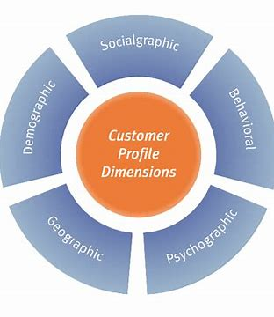
Elements of a Customer Profile
Demographic-Name ,age, gender,ethinicity
Geographic-Where do they stay
Psychographic-Behaviours,beliefs,personality,hobbies.
Behavioural-Factors influencing buyer behaviour.
Sociographic-Education,occupation,income level,household structure.
Notes:
Demographics: First begin with describing the name, age, gender, race/ethnicity of your customer.It tells you who your customer is.
Socio-economics: This includes your customer’s highest level of education, their current occupation, income range per month and household structure. The household description should consist of the family makeup, whether they are single, married, have kids, single with kids or living with a partner, etc.
Geographic: The geographic location should encompass your customer’s hometown, their current residential location and what characterizes the neighbourhood, town or area they live in.
Psychographic: Once the demographics are clear, identify the psychographics, that is your customer’s behaviours and beliefs, including their personality, hobbies, interests, lifestyle, values. This can also include their worries, fears, hopes and dreams, which will assist you in understanding how your business can help with that.It tells you why they buy.
Behavioural: Define what influences your customer’s buying decisions, in terms of their product choice, price factor or promotions; whether the influence is external or internal; what motivates them to make the purchase and why.Some of the ads use celebrities .Their personality lends a certain character to the brand as well.
(Note: Every customer profile does not necessarily have all of the above information. You may use what is required depending on your company type or marketing objectives.

Slide 5
Customer Profiling Strategies
1. The Psychographic Strategy
Demographics: This aspect of a customer profile covers their age, region, gender, stage in life and occupation
Activities: Psychographic customer profiles use feedback and buying habits to predict customer hobbies, interests and leisure activities
Opinions: This part of a customer profile includes customer beliefs and values, which can affect how a customer spends money and what they choose to purchase. For example, a customer interested in dispelling climate change might choose a product packaged with recycled paper.
Income level: A customer's monthly income often affects their buying power, which can influence what they choose to buy and when they choose to buy it. For example, a business selling necessities may increase its revenue by offering a sale price on a local payday.
Notes:
Psychographic data can include a person's status, characteristics from birth and aspects of their personality. This profiling method also takes a customer's lifestyle into account to determine customer categories. An analysis of a customer's psychographic information might include: Demographics,activities,opnions and income level
1.Demographics-people between the age range of 25-35 years are generally high risk takers and would be more interested in purchasing stocks and mutual funds.
2.

Slide 6
2.The Consumer Typology Method
Loyalty-driven customers: These customers typically favor a product from a particular company or brand and may also encourage friends and family to buy it.
Discount-loving customers: These customers strive to find the best deals and usually have no particular brand preference.
Impulse-driven customers: This type of customer searches for what they want during a specific moment rather than looking for a brand or price point. Impulse-driven customers may make unplanned purchases based on how they feel.
Needs-based customers: These customers frequently limit their purchases to the necessities. They're rarely loyal to a brand, though they may search for discounts.
Notes:
This style of consumer profiling organizes customer types based on their interests and desires. Using consumer typology profiling, you can uncover the buying habits of top customers and adapt products and services to support that kind of customer. There are four types of customers this method identifies:

Slide 7
3. The Consumer Characteristics Tactic
Convenience-motivated: These customers may be busy or have limited time. They often want something that can quickly serve their needs, such as stores with multiple services.
Community-oriented: This type of customer often listens to word-of-mouth advertising, such as recommendations from friends, family or social media influencers, which may influence them to purchase a product they were considering. Community-oriented customers may also prefer shopping within their area, preferring locally made products and regional businesses.
Customization-driven: Customers who fit this category are typically interested in how a company's products and services can meet their distinct needs. They may want the option to select the appearance of a product or receive a service based on their unique specifications.
Notes:
Conenience motivated-Convenience of Malls.Everything under one roof. Banks are financial super markets.
Amex card lets you chose custom designs.
Wells fargo lets customers personalise their credit cards.

Slide 8
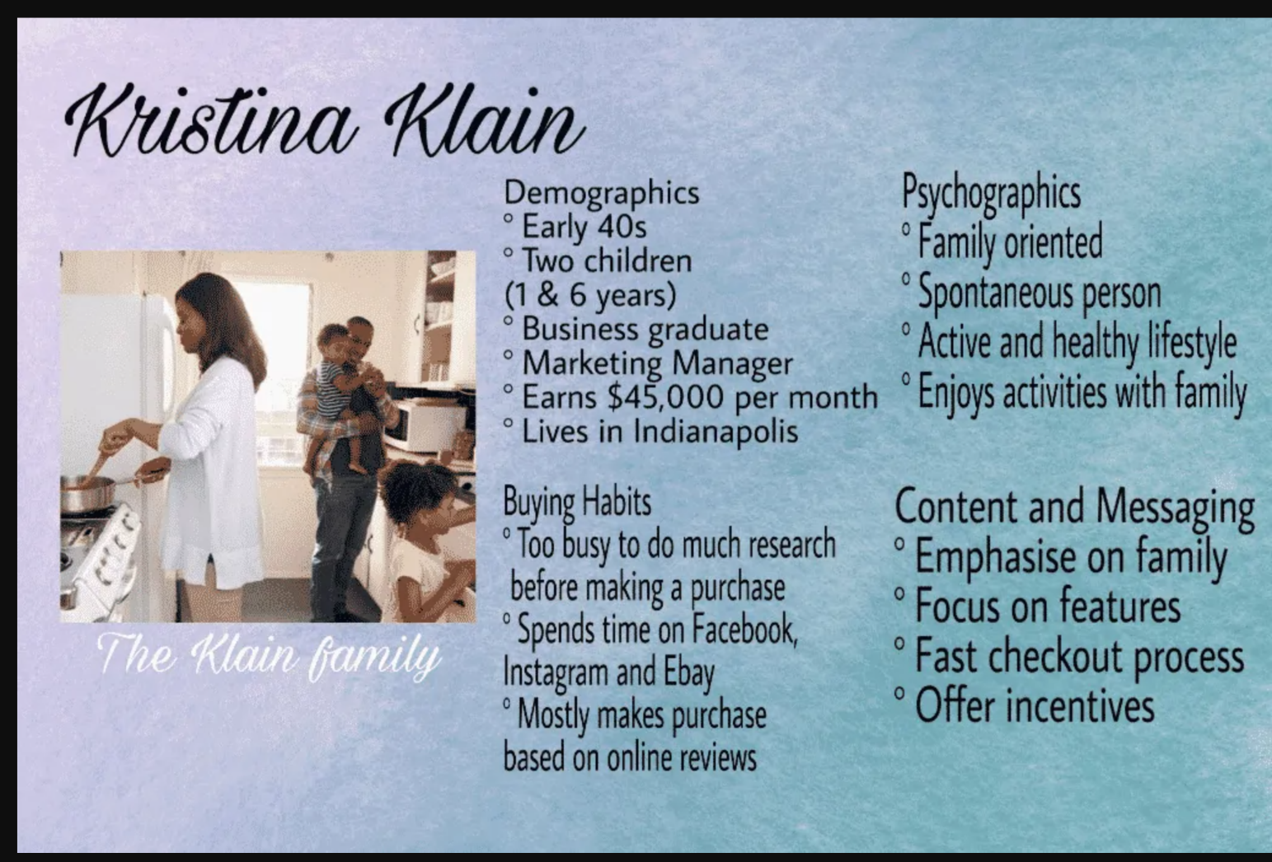
Customer Profile for a home/kitchen appliances company
Notes:
Here are some customer profiling examples to help you create your own.
In this buyer persona example, you can get a good idea of who Kristina is by learning about her background, buying habits and her priorities. Accordingly, you can draft your communication message that will reach her more efficiently.

Slide 9
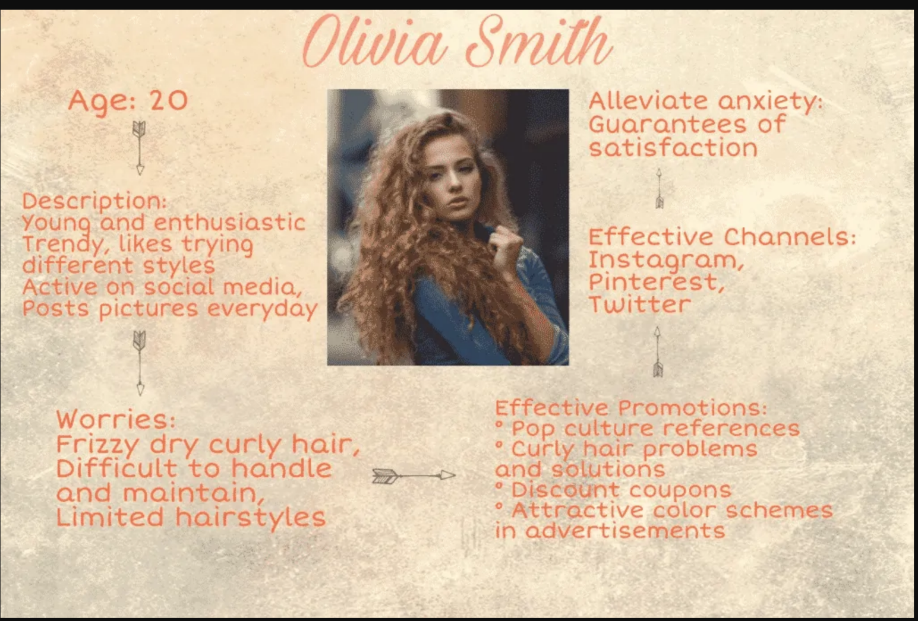
Customer Profile for Salon/Hair products
Notes:
Your persona can be short and sweet as long as it includes the essential information. This example has the basic description of the kind of person Olivia is, what her pain points are, hence how you can promote your service effectively and through what channels will your get through the right way, thus solving her problem message get through the right way, thus solving her problem.

Slide 10
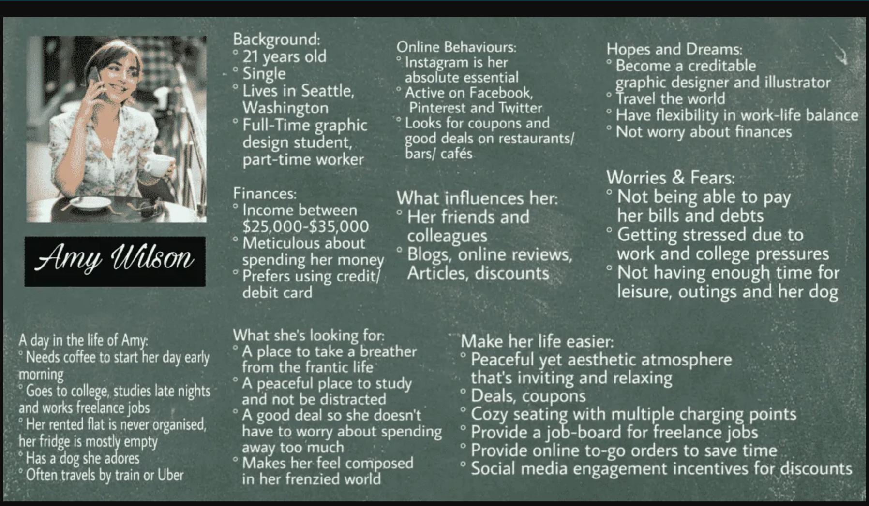
Customer Profile for a Coffee shop/ Restaurant/ Café

Slide 11
Benefits of Customer Profiling
Improving the company's reputation for being customer-driven
Simplifying product planning
Predicting which merchandise may produce the most sales
Revealing how customers make decisions about purchases
Uncovering when consumers may be most likely to take action
Showing which products or services aren't available yet in the industry
Clarifying which aspects of a product or service to modify

Slide 12
Bottom Line
Customer Profiling is a tool for
Understanding your audience accurately
Increase performance and efficiency of advertisements and promotional activities.
Activity-Assignment for internals.
Customer profile for a private portfolio management company that caters to HNI clients.
Notes:
Customers are your greatest asset. It is crucial to enhance their experience and boost the relevancy of your message. Insights gained from doing customer profiling exercises will yield product upgrades and maximum customer satisfaction.
So try creating your own customer profile for your brand and look for any empty spaces your company can fill in. It might even help you come up with new promotional ideas which will be more target-oriented.

