Slide 1
BPR- Process Mapping
Definition, Tools, Symbols, Examples

Slide 2
Process Mapping
Process mapping is a method to graphically describe the steps that make up a process.
It consists of a set of tools that enable us to systematically document, analyze, improve, and redesign a process.
It is the first step of Business process Reengineering.

Slide 3
Process Flowcharting -- Defined
Process flowcharting is the use of a diagram to present the major elements of a process. The basic elements can include tasks or operations, flows of materials or customers, decision points, and storage areas or queues.
It is an ideal methodology by which to begin analysing a process.
Notes:
4

Slide 4
Learning Mate -JD
2018-20 batch – campus recruiter

Slide 5
Process View
Input Output
Raw materials, components, Info products, services
PROCESS

Slide 6
Operations as a Transformation Process
Operations
Management
Feedback
for control
Transformation:
Network of activities
Inputs
Outputs
Flow Units
(Material, Information,
Knowledge, etc.)
Goods
Services
Labor & Capital
Resources

Slide 7
Other Types of Processes
Make-to-order
  Only activated in response to an actual order.
  Both work-in-process and finished goods inventory kept to a minimum.
Make-to-stock
  Process activated to meet expected or forecast demand.
  Customer orders are served from target stocking level.
Notes:
4

Slide 8
Defining a Process (S-I-P-O-C)
Suppliers
Inputs : resources allocated to activities, flow units
Process : net-work of activities and buffers, information structure.
Outputs
Customers

Slide 9
Major Steps of Process Mapping
Process Identification
Information gathering/Documentation
Interviewing and map generation
Map Analysis

Slide 10
Activity Flow Diagram for Process Mapping
Symbols Used
Operation
Storage
Movement
Delay
Inspection
Decision
Origination/Termination

Slide 11
Flowchart Symbols
Tasks or operations
Examples: Giving an admission ticket to a customer, installing a engine in a car, etc.
Decision Points
Examples: How much change should be given to a customer, which wrench should be used, etc.
Notes:
4

Slide 12
Flowchart Symbols (Continued)‏
Storage areas or queues
Examples: Sheds, lines of people waiting for a service, etc.
Flows of materials or customers
Examples: Customers moving to the a seat, mechanic getting a tool, etc.
Notes:
4

Slide 13
Multistage Process
Stage 1
Stage 2
Stage 3
Notes:
4

Slide 14
Multistage Process with Buffer
Buffer
Stage 1
Stage 2
Notes:
4

Slide 15
Other Types of Processes
Make-to-order
  Only activated in response to an actual order.
  Both work-in-process and finished goods inventory kept to a minimum.
Make-to-stock
  Process activated to meet expected or forecast demand.
  Customer orders are served from target stocking level.
Notes:
4

Slide 16
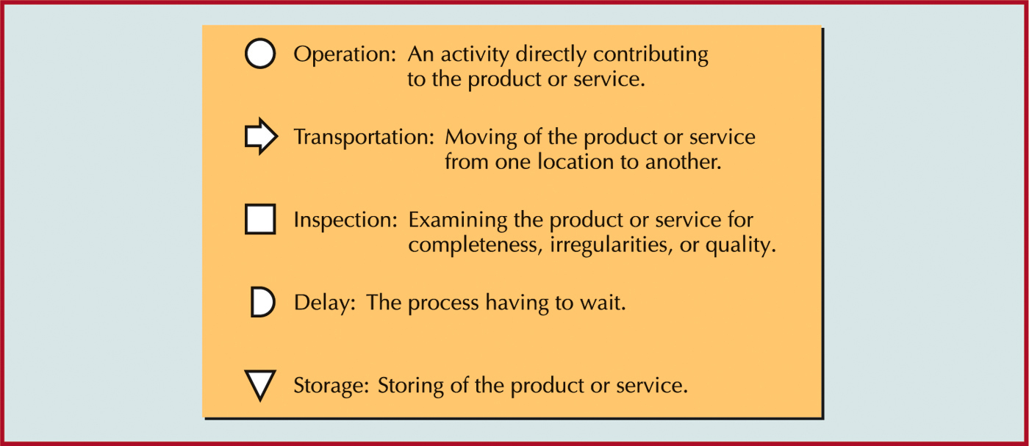
fig_08_01
Process Mapping Symbols

Slide 17
Process Mapping
Video- 3 minutes -3.2

Slide 18
Example: Flowchart of Student Going to College
Notes:
4

Slide 19
Example: Flowchart of Student Going to College
Go to college today?
Yes
Drive to college
Walk to class
No
Day- off
Notes:
4

Slide 20
Operations Mgnt
New product Design & development cycle
Market
research
Basic
research
Prototype
shop
feedback
Work
order
needs
customer
Sales &
Mktg.
Product
design
Tool Design changes
Product
specs
Tool design
& tool mfg.
specs
Mfg
shops
Process
planning
PL,AIS
samples
Field test
&approval
feedback
Testing
sample
Approved
products
Product dev
committee

Slide 21
POM
New product development cycle
Market
research
Basic
research
Prototype
shop
feedback
Work
order
needs
Customer
reqmts
customer
Sales &
Mktg.
Product
design
Tool Design changes
Product
specs
Tool design
& tool mfg.
specs
Mfg
shops
Process
planning
PL,AIS
samples
Field test
&approval
feedback
Testing
sample
Approved
products
Product dev
committee

Slide 22
Product Development Process
Sequential Decision Points

Slide 23
Organisation for Product Development Process: Traditional Approach
Customers
Suppliers
Marketing
Design
Planning
Procurement
Production
Finance

Slide 24
Organisation for Product Development Process: Concurrent Engineering
Planning
Customers
Procurement
Concurrent Engineering
Team Structure
Marketing
Production
Design
Finance
Suppliers

Slide 25
Map Analysis –
Elimination of Waste
Delays
Duplication
Approvals
Hand-offs
Errors
Uncertainties

Slide 26
Process Improvement-Methods
Perform activities in parallel.
Change the sequence of activities.
Reduce interruptions.
Eliminate inspections
Reduce batch size
Minimise movement of material, product
Multifunctional teams
Notes:
20

Slide 27
Potential Pitfalls of
Process Mapping
Mapping without a clear purpose
Lost in the details
Failure to finalize mapping
Not verifying the facts
Hidden bias or agenda
Not focusing on customers’ needs

Slide 28
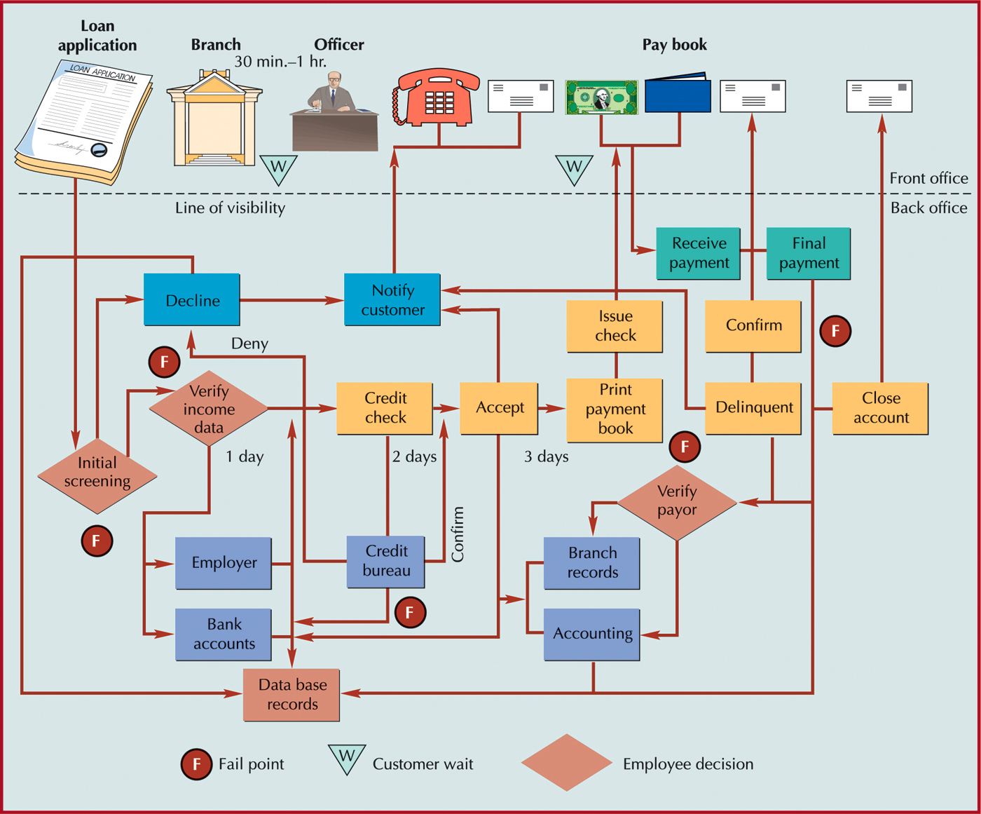
fig_05_06
Bank Loan Processing

Slide 29
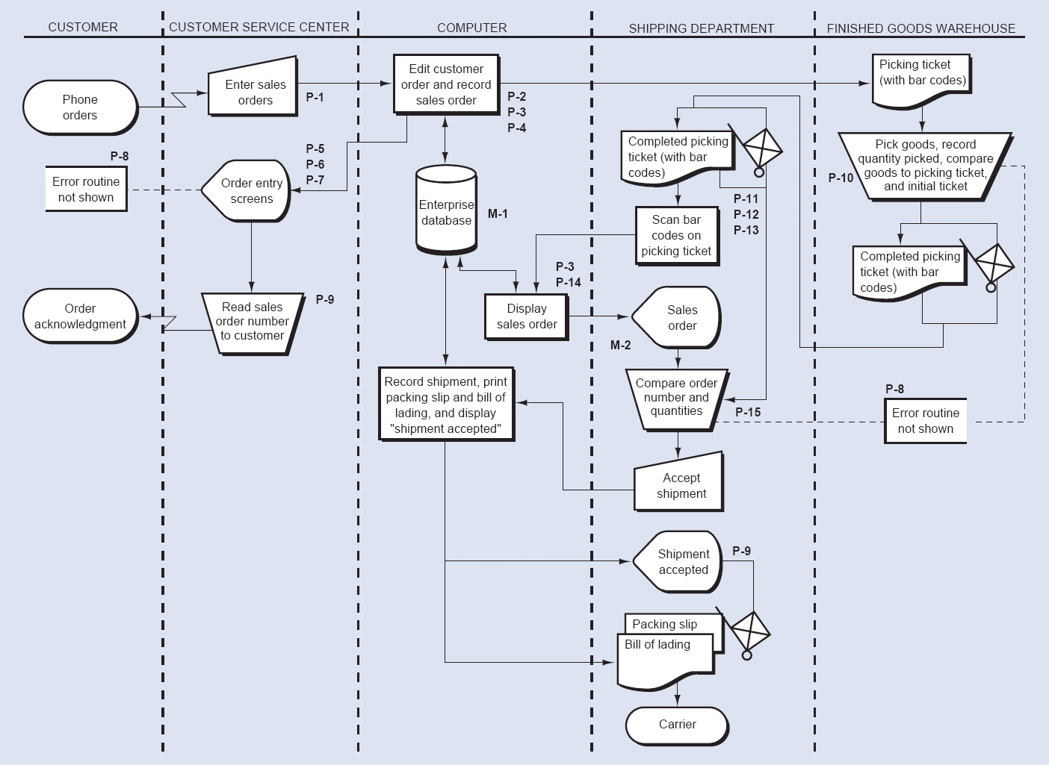
The Sales Order Execution Process Flowchart

Slide 30
Value Stream Mapping
1 Value stream mapping – 3.1 pdf – page 5
2 Video -Value stream map? What is it?
How we use it? 5 minutes.
https://www.youtube.com/watch?v=MVbZkRjNO4Q

