Slide 1

Project
Management
Session -2
Review Session 1
Learning PM
Project Management Framework
What is Strategic Management?
Strategic Management & Project
Project Management Maturity
Project Management Maturity Model
Project Selection
Project Selection Model

Slide 2
Review Session 1
A project is “a temporary endeavor undertaken to create a unique product, service, or result”
Application of knowledge, skills, tools, and techniques to project activities to meet the project requirements
Project-
  Characteristics
  Life Cycle
  Determinants of success
  Types

Slide 3
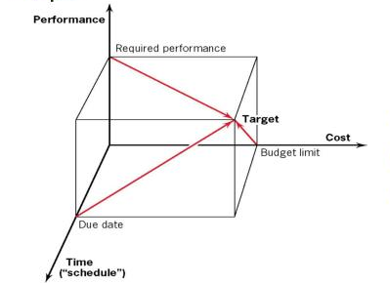
Project Success

Slide 4
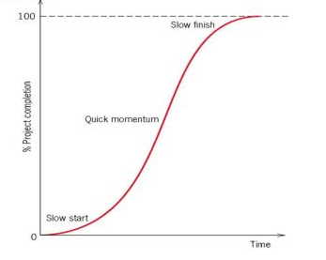
Project

Slide 5
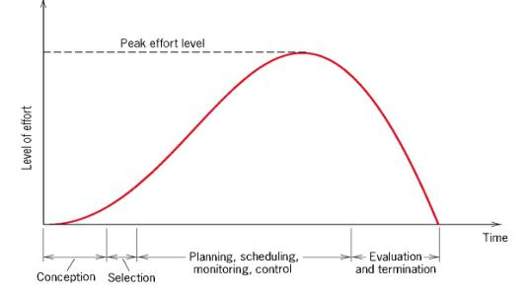
Project Life Cycle

Slide 6
Learning-Project Management
Termination
Today’s Organization- Management by Projects
Control
Auditing, Information System
Scheduling
Resource allocation CPM, PERT
Budgeting
Estimates, Cost, Risk
Project Manager
Activities, PMO, Conflicts, Negotiation, Risk
Project Selection
Strategy
Project Definition

Slide 7
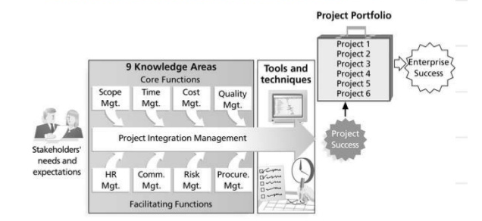
Project Management Framework

Slide 8
What is Strategic Management?
Strategic management is the management of an organization’s resources to achieve its goals and objectives.
Challenges facing the contemporary organization are-
How to make sure that projects are closely tied to the organization’s goals and strategy

Slide 9
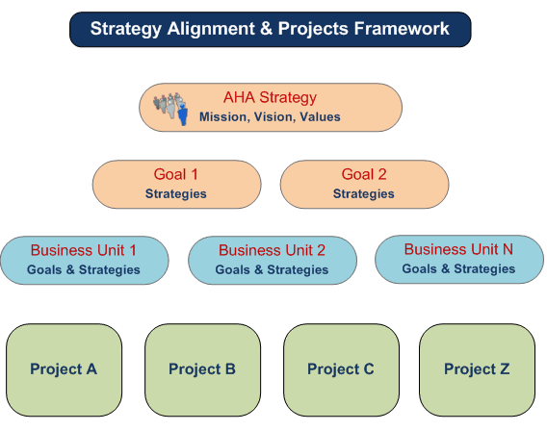
Strategic Management & Project

Slide 10
Project Management Maturity
Refers to the progressive development of an organization for project management
  Approach
  Methodology
  Strategy
  Decision Making

Slide 11
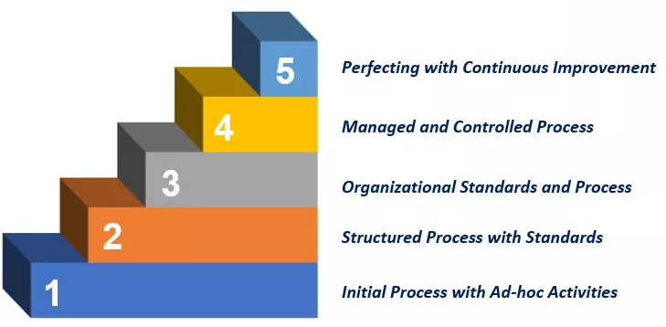
Project Management Maturity Models
Maturity Models are frameworks for helping organization to improve their processes and systems.
Integrated
Planned
Ad-hoc

Slide 12
Benefits of Project Maturity Model
Provide a roadmap for strategic improvement
Allow to look into the organization’s strength and weakness
Helps organizations get answers to strategically important questions like:
  How effective are PM efforts in our organization?
  How well has PM been integrated into our business?
  Is PM a competitive strategy for higher quality & greater customer satisfaction?
  Are we using the right methods, tools and technologies?
  What are our competitors doing?

Slide 13
How to do P M Maturity Assessments?
Staff face-to-face interviews
Business and Technical project fact evaluation
Surveys
Benchmarking (vs. industry standards)

Slide 14

Project Selection
Process of evaluating proposed projects or groups of projects, and then choosing to implement some set of them so that the objectives of the parent organization will be achieved
Hospital can find the best mix of psychiatric, orthopedic, obstetric, and other beds for a new wing.

Slide 15
Souder Project Selection Model
Realism- Firm’s facilities, capital, personnel
Capability – Internal & External
Flexibility - It should be easy to modify in response to changes in the firm’s environment
Ease of use -Reasonably convenient, not take a long time to execute
Cost - All costs should be considered
Easy computerization
Models represent the problem structure & can be useful in selecting & evaluating projects

Slide 16
PMMM- Skill Development
P3M3 (Portfolio, Program & Project Management Maturity Model) is the newest model
Capability Maturity Model® Integration (CMMI®) – developed by the SEI to assist organizations to improve their processes for developing and maintaining the products and services of the organization
Organizational Project Management Maturity Model (OPM3®) – Developed by the PMI to assist organizations to improve their capabilities for managing projects, programs and portfolios, leading to business improvement

Slide 17
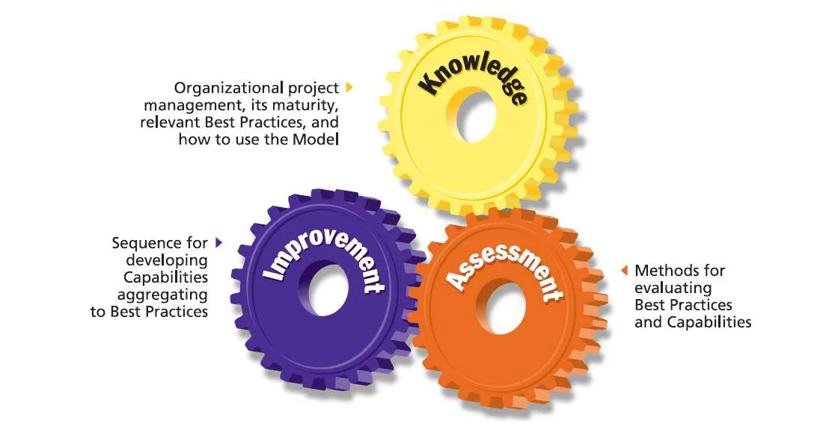
PMMM- Skill Development

Slide 18
Review Questions
What is strategic management?
Define project management maturity
Explain project management maturity model
List benefits of project management maturity model
How to do Project management maturity assessment?
Discuss project selection
Explain Souder project selection model

Slide 19


