Slide 1
Collection Services and Loans and Advances
Dr.Rajashree Yalgi

Slide 2
Bank’s role as a Financial Intermediaries
They mitigate the default risk of deficit units when surplus units lend to them.
They ensure liquidity of savings by surplus units.
They lower information costs.

Slide 3

Who needs Credit?
Both the demand and supply side of the economy need bank credit.
Financing demand side of the economy , the large class of consumers, is called retail banking.
Financing supply side of the economy , which is more customized in nature and calls for specialized skills, is called wholesale banking or corporate banking.
This Photo by Unknown Author is licensed under CC BY

Slide 4
Types of Lending
Fund Based Lending
Non Fund Based Lending
Asset Based Lending

Slide 5
ECS – Electronic Retail Payment System
Bulk and repetitive payments like interest / dividend are mostly paper based involving printing of warrants (in costly MICR format) dispatching them by post and reconciliation thereof after payment by agency bank.
Difficulties –
Expensive administrative machinery – printing, dispatching and reconciliation system
Operational bottlenecks and pressure on the cheque processing system

Slide 6
Contd….
3. Chances of loss of instrument or fraudulent encashment.
4. Customer needs to keep track of receipt or nonreceipt.
5. Error prone, monotonous and strain.

Slide 7
ECS System
ECS
Credit (Ex. Dividend payment)
Debit (Ex. MSEB bill settlement)
Centralized (NECS)

Slide 8
Working of ECS
USER- Payment data on Magnetic media and submit to Sponsor Bank
Sponsor bank presents to local banker’s clearing house
After authorization C.H. process data interbank fund settlement
C.H. – furnish to service branches – branch wise credit report
Service branch – pass on the advices to concerned branches

Slide 9

Benefits of ECS to the Organization
Saving in administrative cost
Loss of instrument in transit or fraudulent encashment totally eliminated
Automatic Reconciliation of transactions
Cash management becomes easier
Better customer / investor service
Paying in best way

Slide 10

1. Paying on due date
2. Effortless receipt
3. Probability of loss of instrument in transit or fraudulent encashment thereof are completely eliminated
Notes:
Video - ECS

Slide 11
NEFT
Electronic Funds transfer system was introduced by RBI in 1997 as an intercity, intra city and interbank, intra bank fund transfer mechanism by which funds can be transferred by any bank branch to any other bank branch from one city to another.
EFT’s process pre authorized debits or credits from one bank account to another within a 48 hour period.
It is similar to standing instructions maintained in customer’s accounts, which are carried out automatically at pre appointed dates.

Slide 12

1.Small fee per transaction, eliminate the need to print, process and send monthly bill, lower labor cost reduces late payments
2. Increase customer retention, Ex. Newspaper, security co. pest control etc.
3.Saves on billing and admin.cost

Slide 13
NEFT uses the INFINET to connect bank branches for EFT.
The Indian Financial Network (INFINET) is the communication backbone of the Indian Banking and Financial Sector. All banks in the public, private and cooperative sectors as well as premier financial institutions in the country are members of INFINET. INFINET is a Closed User Group Network for the exclusive use of its member banks and financial institutions. It is network platform for the National Payments System, which caters mainly to inter-bank applications like RTGS, Delivery Vs Payment, Government Transactions, Automatic Clearing House, etc.

Slide 14
Main participants in the Clearing and Settlement Process
Clearing corporation – Post trade activities, risk management, confirmation etc.
Clearing members – setting obligation determined by clearing house
Custodian – confirms to settle the trade
Clearing Bank – Key link between clearing member / clearing house
Depositories – Holds securities in dematerialized form
Professional clearing member – clearing and settlement responsibilities

Slide 15
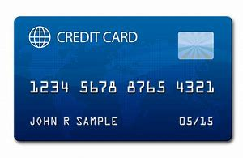
Plastic Money
Credit Card
Bank Cards
Travel & Entertainment
Co./ Retail Store

Slide 16
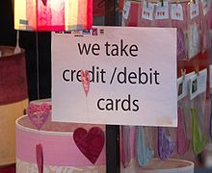
Benefits to customers:
1.Deferred payment of bills
2. Revolving Credit
3. Reward from card issuers
Benefits to merchants:
1. Immediate payment
2. Assured Payment
3. Increased customer spending
This Photo by Unknown Author is licensed under CC BY-SA

Slide 17
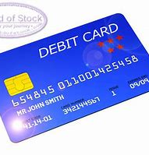
Benefits to Customers:
1. Payment convenience safety
2. Wide Acceptance
3. Easier Qualification
Benefits to Merchants:
Fast Approval
Fraud Prevention
Increased sale
Minimum Investment and Charges
Security

Slide 18
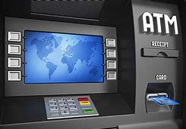

Other Payment Channels:
(a) Automated Teller Machine

Slide 19
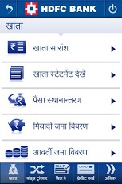

(b) Mobile Banking
This Photo by Unknown Author is licensed under CC BY-SA-NC
This Photo by Unknown Author is licensed under CC BY-SA

Slide 20
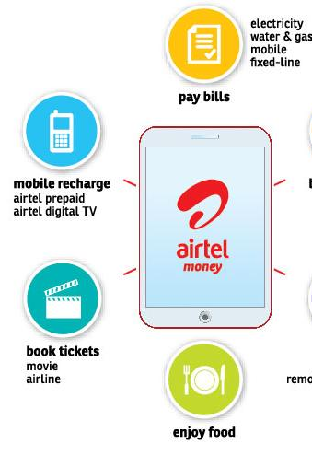
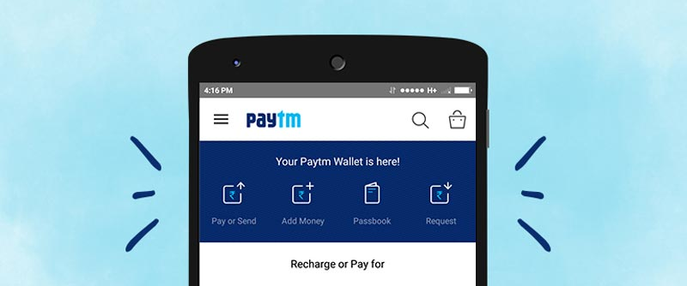
(c)Prepaid Payment Instruments
This Photo by Unknown Author is licensed under CC BY-SA
This Photo by Unknown Author is licensed under CC BY-SA-NC

Slide 21


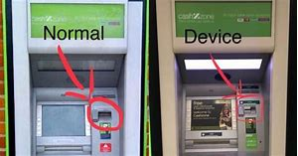

Security Issues

Slide 22
Real time Example (Security Issue)
Nordea lost more than $10,00,000 in aggregate due to a sophisticated malware attack, which recorded user’s account details and sent them to fraudsters. These transfers were made in several small amounts between 2005 to 2007, in order to circumvent the bank’s fraud detection mechanisms.
Often inadequately protected, personal computers are the first point of attack for cyber criminals. Users are attracted to various offers that seem to be coming in from their banks and fall prey to internet fraud.

Slide 23
Features of Bank Credit
Good Loans (Profitable)
Credit Risk
Interest rate risk, loan maturity, principle repayment

Slide 24
Financial Appraisal and Credit Creation
Though several qualitative factors play a role in a credit decision, a major influencing factor is the financial health of the borrower as brought out by the financial appraisal.

Slide 25
1. Financial Ratio Analysis
Liquidity
Profitability
Leverage
Operating ratios
Valuation

Slide 26
2. Common Size Ratio Comparisons
Many banks may additionally use common size ratio comparisons. Such comparisons are valuable since they are independent of firm size, thus facilitating inter firm comparisons in the same industry or line of business. However, the analysis should be able to spot the outliners, such as firms whose financial structure is vastly different from the typical firm in the industry.
Example – a firm with leased asset would show a different asset ratio in an industry in which firms typically own substantial fixed assets. Hence, common size analysis is generally used along with ratio analysis as described above, to lead to better insights about the borrowing firm’s financial strength.

Slide 27
3. Cash Flow Statement
Cash from Operating Activities
Cash from Investing Activities
Cash from Financing Activities
Cash

