Slide 1
CREDIT RISK MODELLING
By Prof. Samie

Slide 2
WHAT IS CREDIT RISK?
Credit risk is a risk of a loss resulting from the fact that a borrower or counterparty fails to fulfil its obligations under the agreed terms.
In terms of RBI Guidelines 'Credit Risk is defined as the possibility of losses associated with diminution in the credit quality of borrowers or counterparties.
In a bank's portfolio, losses stem from outright default due to inability or unwillingness of a borrower.

Slide 3
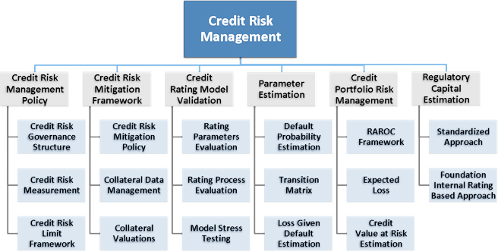
CREDIT RISK MANAGEMENT

Slide 4
Credit risk estimation

Slide 5
Non-performing asset ratio for u.s. commercial banks

Slide 6
RAROC
Risk Adjusted Return On Capital (RAROC) is an adjustment to the return on an investment that accounts for the element of risk.
It acts as a validation tool to decide whether to go ahead with a transaction, lending or project or not.
RAROC also gives decision makers the ability to compare the returns on several different projects with varying risk levels.

Slide 7
RAROC Estimation

Slide 8
Merton model
The Merton model is an analysis model used to assess the credit risk of a company's debt.
Analysts and investors utilize the Merton model to understand how capable a company is at meeting financial obligations, servicing its debt, and weighing the general possibility that it will go into credit default.
In 1974, Robert Merton proposed a model for assessing the credit risk of a company by modeling the company's equity as a call option on its assets

Slide 9
Kmv model
The KMV approach follows the same logic as the structural approach to a point, ie, the firm defaults when the value of assets falls below a certain level.
But as an end product, it comes up with the expected default frequency (EDF) (ie the probability of default).
Three steps to KMV model:
  Determine value of assets
  Calculate distance to default
  Determination of EDF

