Slide 1
VISUAL REASONING

Slide 2
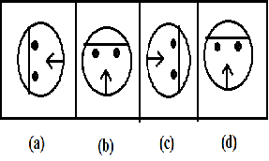
EXAMPLE 1. Choose the figure which is different from the others.

Slide 3
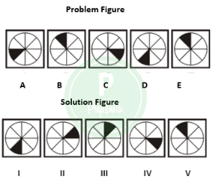
Out of the Problem Figure find out the right solution from the five choices given in the solution figure.
A. I
B. II
C. III
D. IV
E. V

