Slide 1

Cover letter

Slide 2
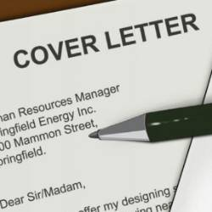
By the end of the session
You will be able to:-
Understand the concept of cover letter.
Analyze the need of writing a cover letter.
Create an effective cover letter.

Slide 3

You will never get a second chance to make a
First Impression

Slide 4

A cover letter is a quick way for you to summarize
who you are,
what position you are applying for and
what skills and knowledge you have.

Slide 5
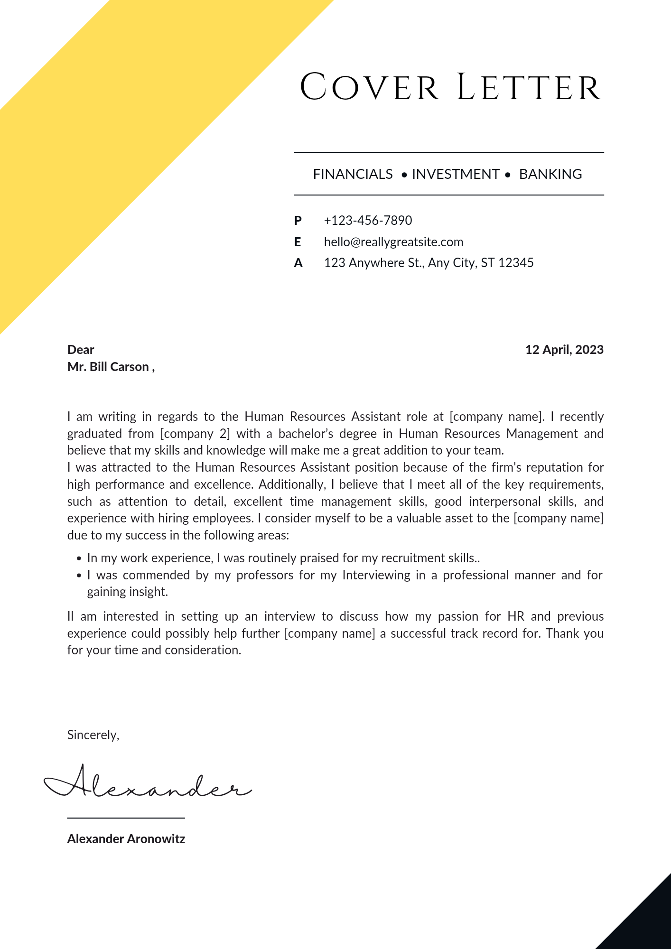
A cover letter is also
A huge opportunity to engage a potential employer as well as showcase other skills or outside experiences that might not be on their resume but which are perfect for the position.

Slide 6
Think of your cover letter as the “laser pointer” highlighting exactly why you’re the Perfect Candidate.
So how long should my cover letter be?
A well written cover letter should never be longer than a single page.

Slide 7
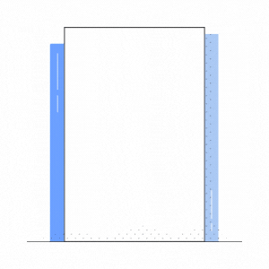
Cover letter
Cover Letter is a document sent with your resume to provide additional information about your skills and experience
It is to be written with 200 – 250 words ideally.
It has a layout of a letter.
Notes:
For reference - https://in.indeed.com/career-advice/resumes-cover-letters/how-to-format-a-cover-letter-example

Slide 8

Do’s:
Have a strong opening statement that makes clear why you want the job and what you bring to the table.
Be succinct — a hiring manager should be able to read your letter at a glance.
Share an accomplishment that shows you can address the challenges the employer is facing.
Personally sign the letter, preferably in blue ink.

Slide 9

Don’ts:
Send a generic cover letter — customize each one for the specific job.
Go overboard with flattery — be professional and mature.
Repeat information from your resume.
Write more than a page.

Slide 10
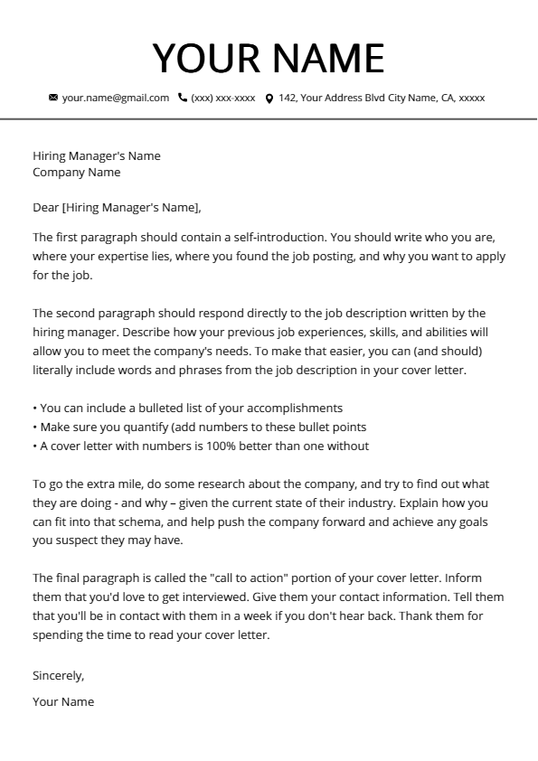
Format

Slide 11
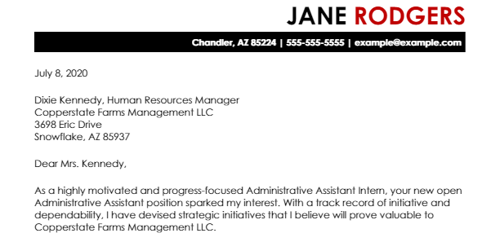
1st Paragraph - Example

Slide 12
2nd paragraph - Format

Slide 13
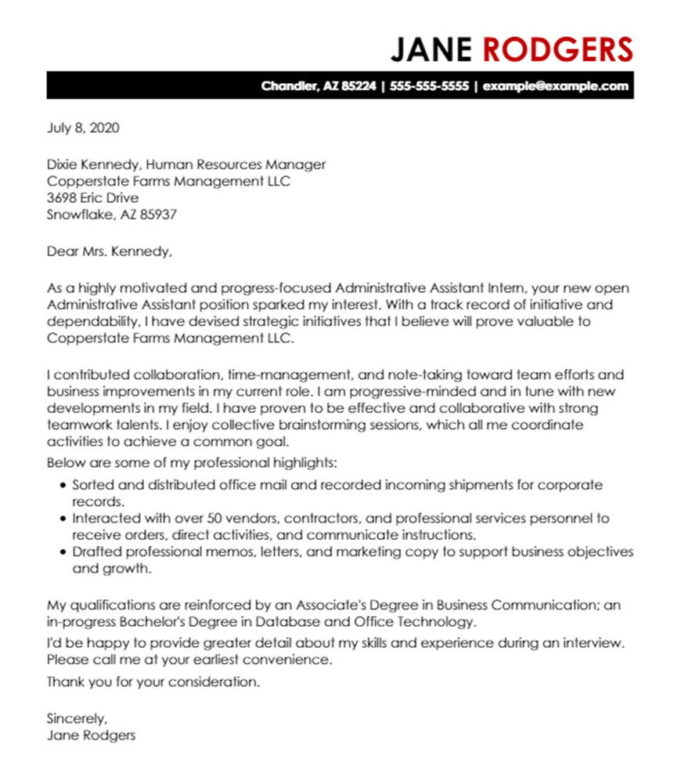
2nd paragraph - Example

Slide 14
3rd paragraph - Format

Slide 15
3rd paragraph - Example

Slide 16
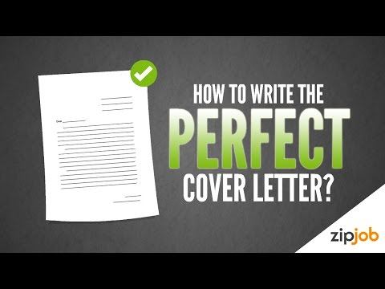
Notes:
Revision
video :- https://youtu.be/jHg0b7Nai6c

Slide 17
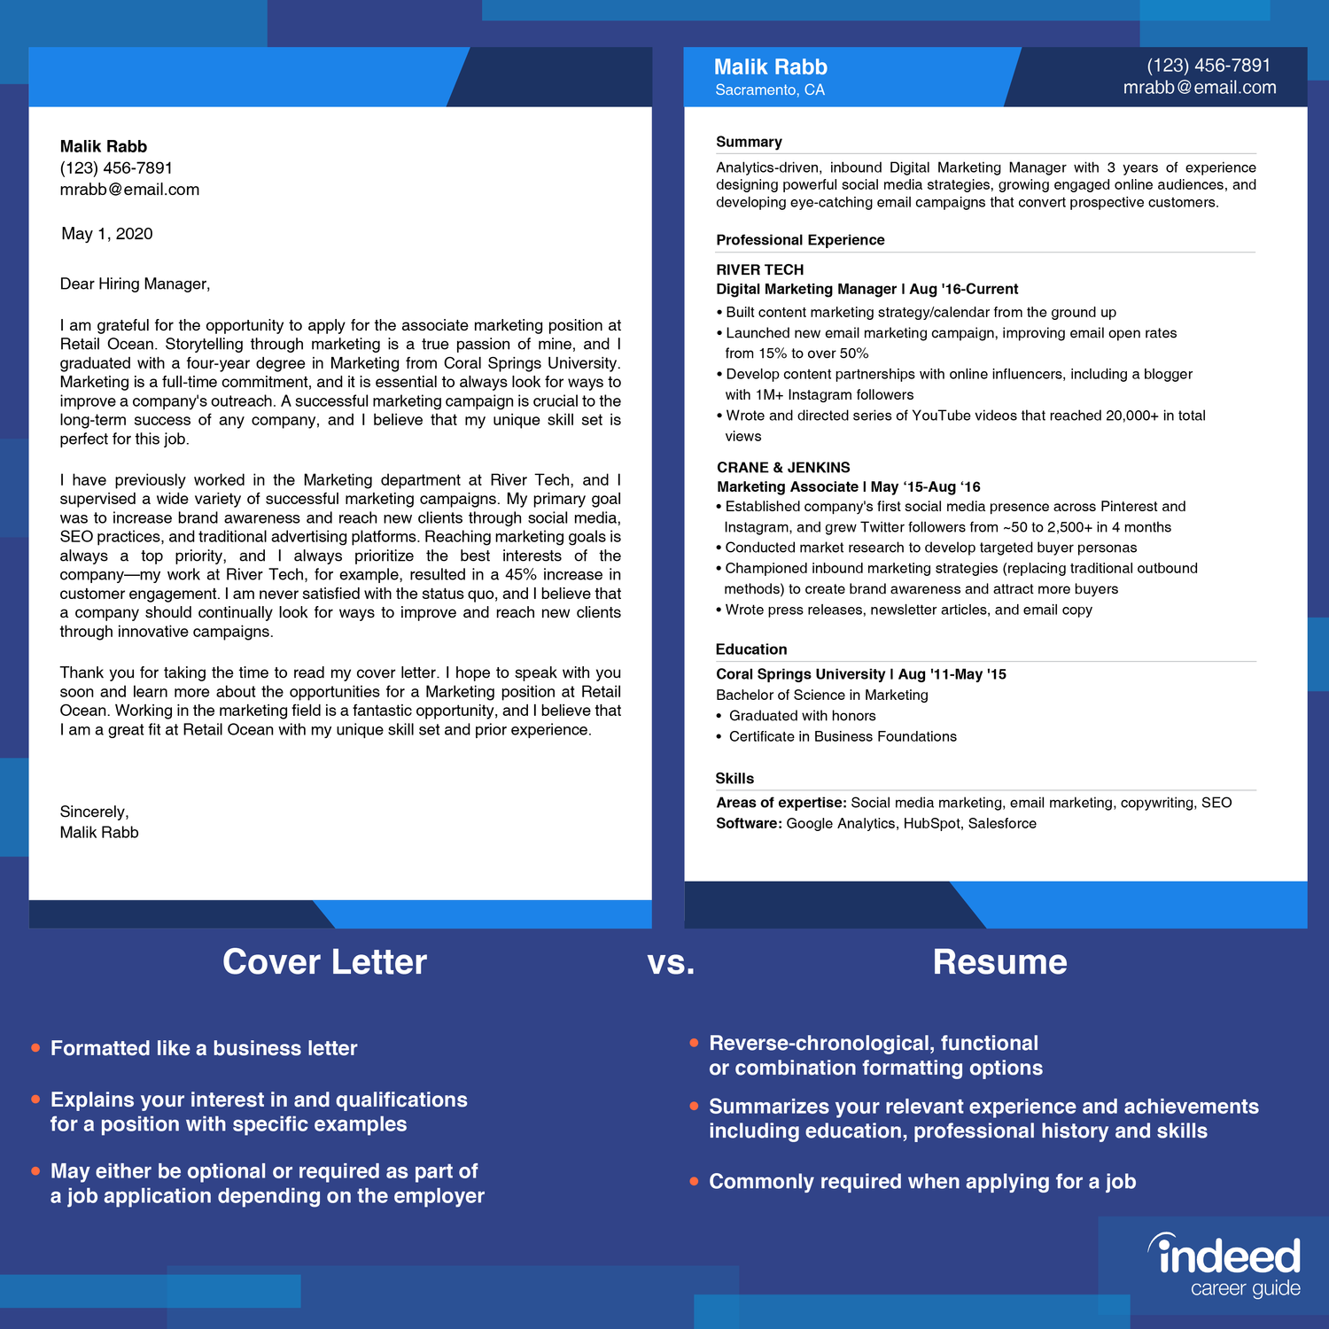
Notes:
A resume is made up of six parts:
Contact details
Introduction
Educational background
Work history
Relevant skills
Awards
A cover letter is made up of six parts:
Header
Salutation
Introduction Paragraph
Body Paragraph/s
Conclusion Paragraph
Sign-off

Slide 18
Hiring an Administrative officer
Job brief
We are looking for an Administrative Officer to join our team and support our daily office procedures.
A successful Administrative Officer will act as the point of contact for all employees, providing administrative support and managing their queries. Main duties include managing office stock, preparing regular reports.
Responsibilities
Manage office supplies stock and place orders
Prepare regular reports on expenses and office budgets
Maintain and update company databases
Organize a filing system for important and confidential company documents
.
Answer queries by employees and clients
Requirements
Proven work experience as an Administrative Officer, Administrator or similar role
Solid knowledge of office procedures
Experience with office management software like MS Office (MS Excel and MS Word, specifically)
Strong organization skills with a problem-solving attitude
Excellent written and verbal communication skills
Notes:
Practice – Write a cover letter for the above job description

Slide 19
Thank you

