Slide 1



Slide 2

After fulfilment, the degree

Slide 3
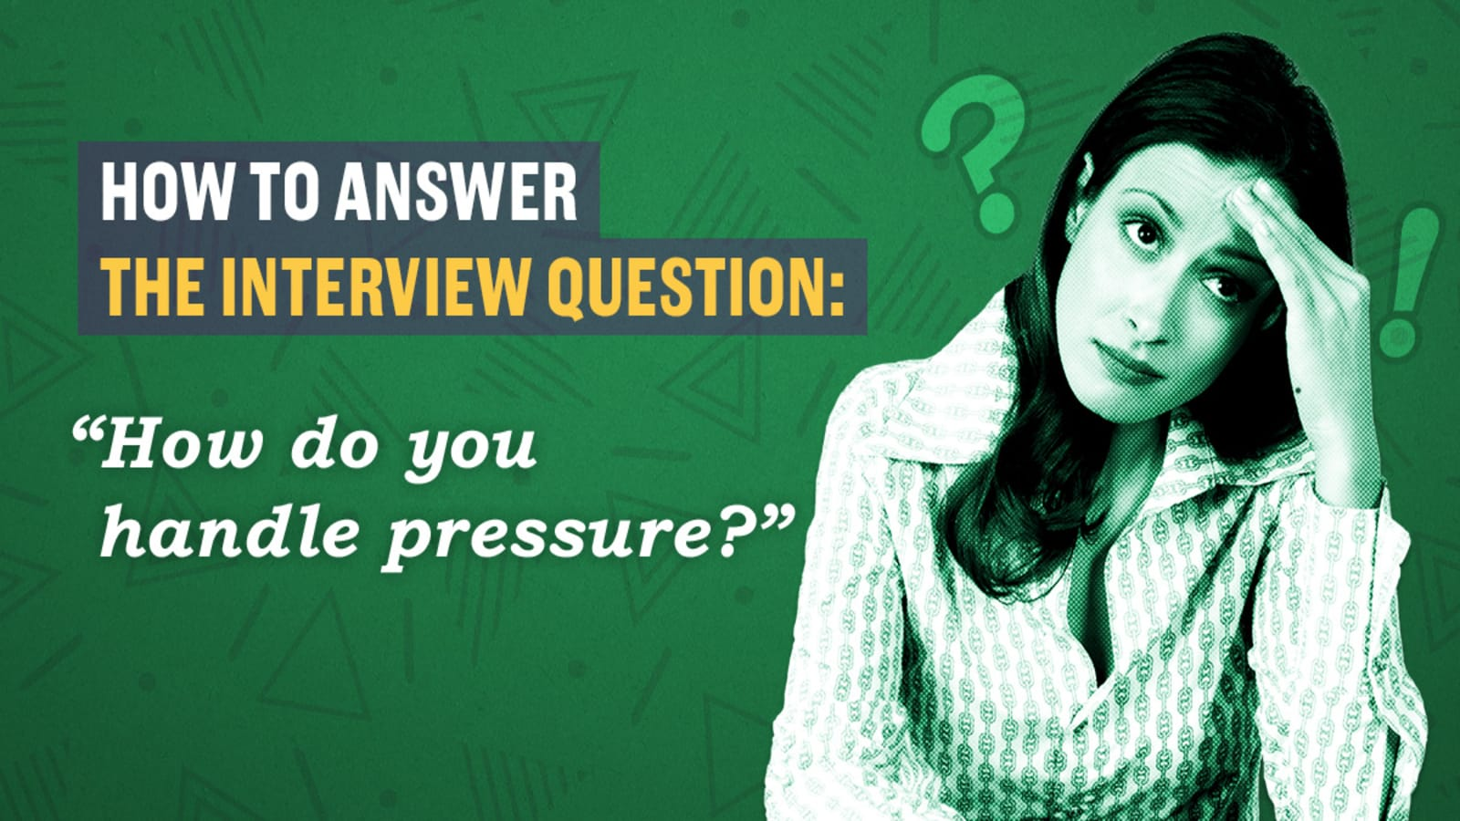

Slide 4

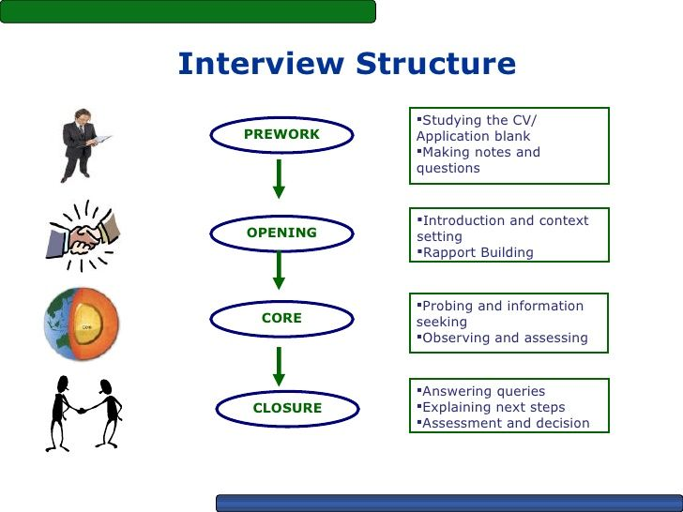

Slide 5

Prework
PLAN
P – Prepare
L – Learn
A – And
N - Note

Slide 6

Interview Question

Slide 7

W.A.P
W – Work
A – Academic
P - Personal

Slide 8
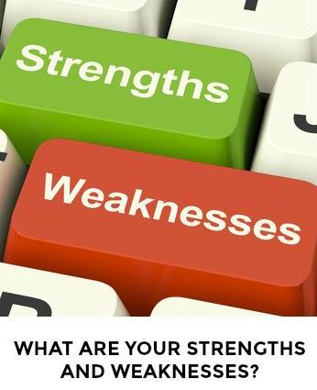
Strengths
2 A’s
Awards
Anecdotes

Slide 9
Weakness
Be authentic
Acceptable
Relatively Minor and Fixable
Concise & Neutral way

Slide 10

Interest in the Job
Core Strengths
Professional Goals

Slide 11
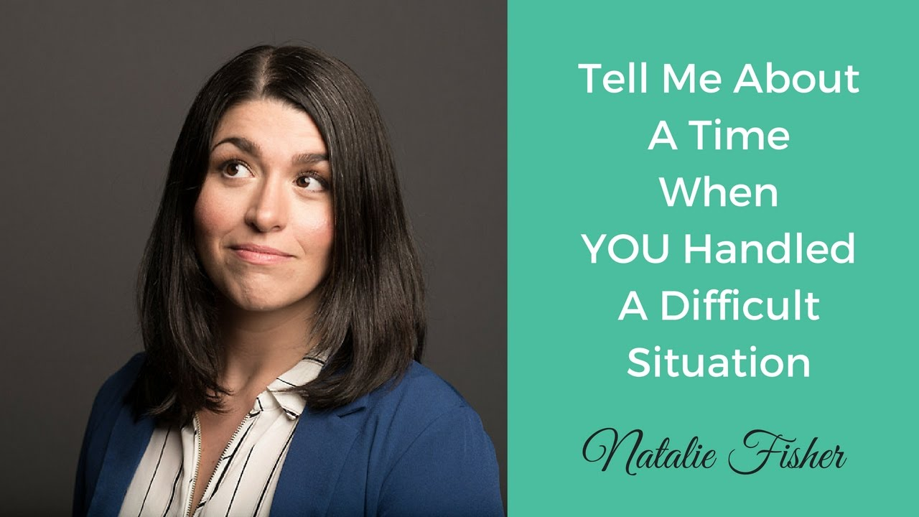
C.A.R.L
C – Context
A – Action
R- Result
L- Learning

Slide 12

FAB
Feature
Advantage
Benefit

Slide 13

Authentic
Brief Context
Example

Slide 14
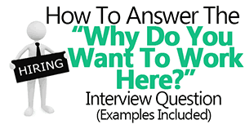
Make it about them first.
Share what you want, and how they uniquely offer it
Speak from the heart.

Slide 15

SWOT

Slide 16
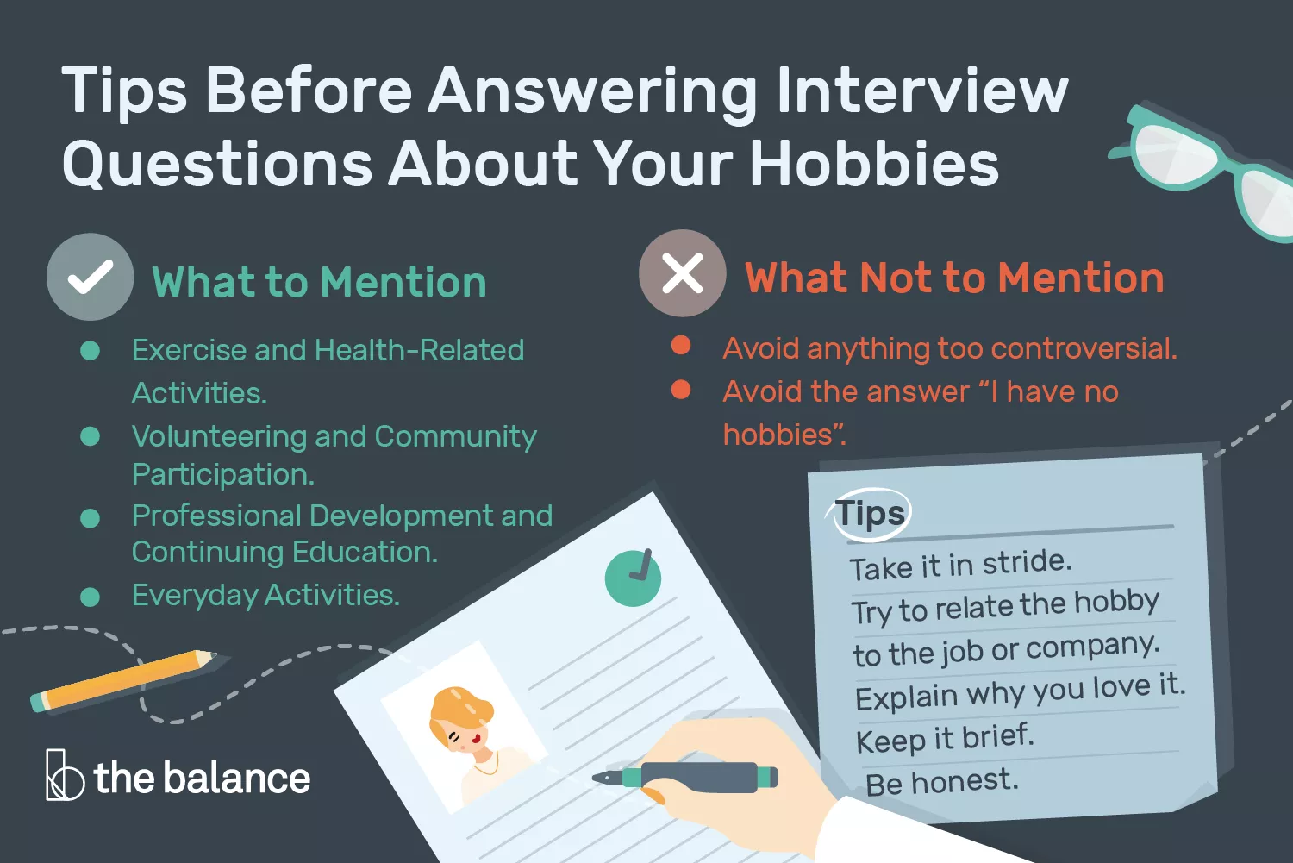

Slide 17
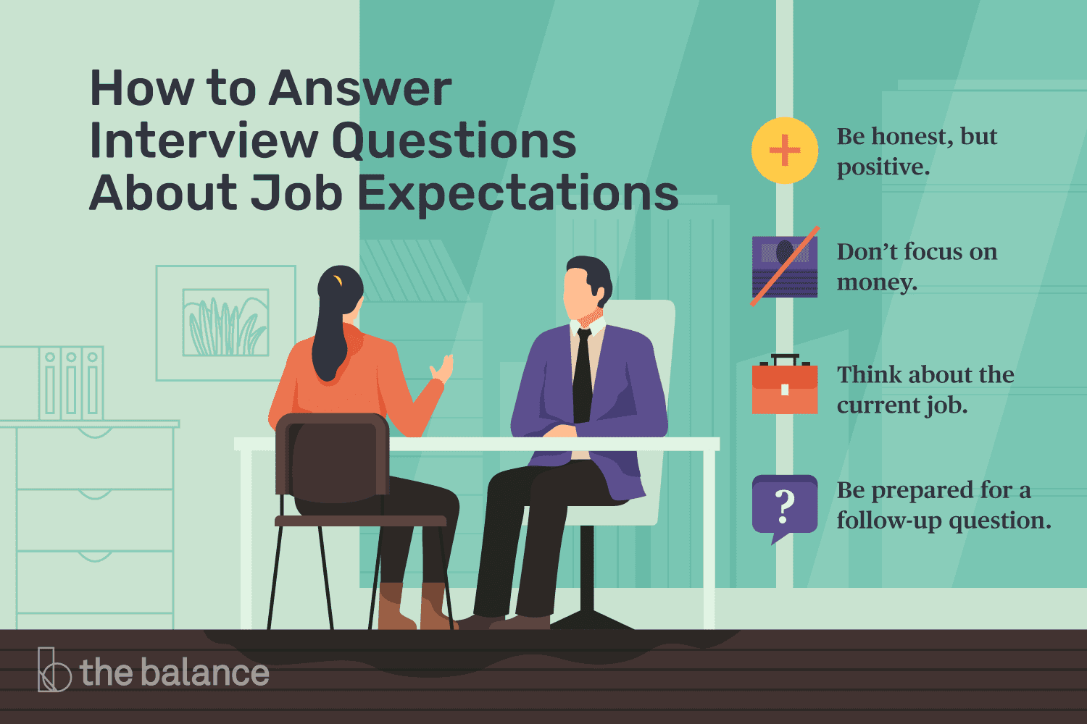

Slide 18


Slide 19
Preparation is the key to Success

Slide 20
Day 2

Slide 21
Quiz

Slide 22
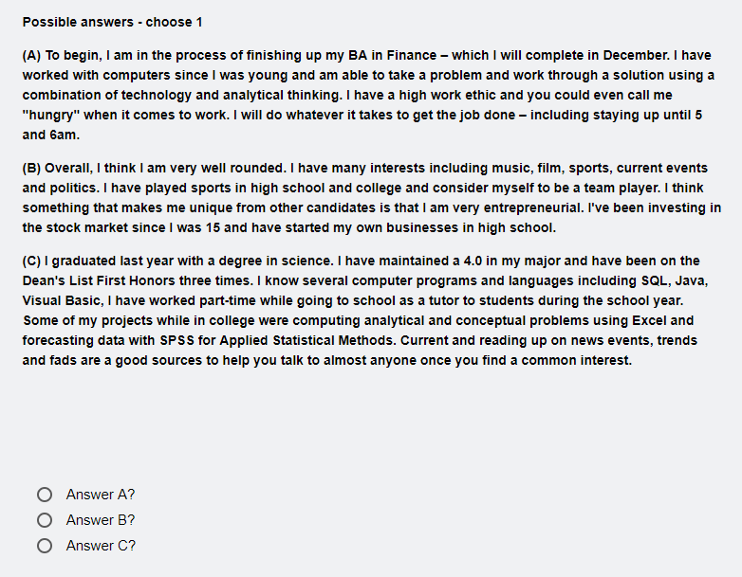
Tell me about yourself?

Slide 23
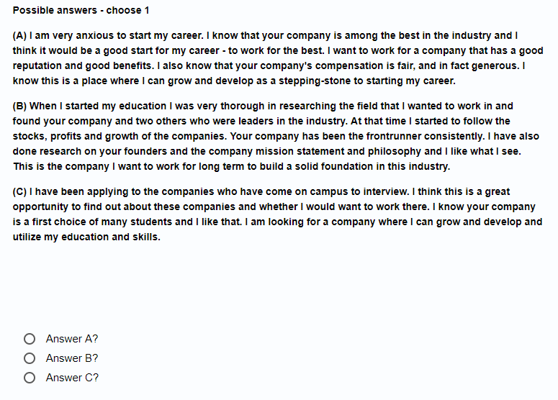
Why do you want to work in this company?

Slide 24
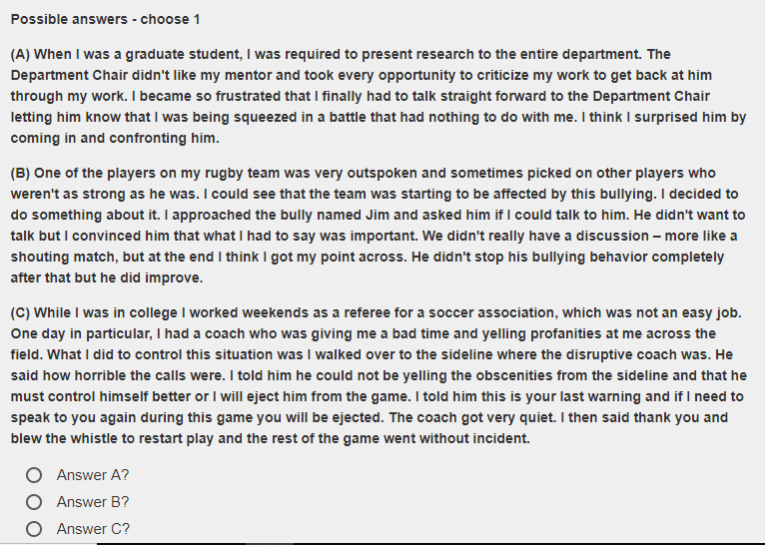
Tell me about the time when you had to deal with difficult person?

Slide 25
Tell me about the time when you had to dealt with many projects at same deadline?

Slide 26
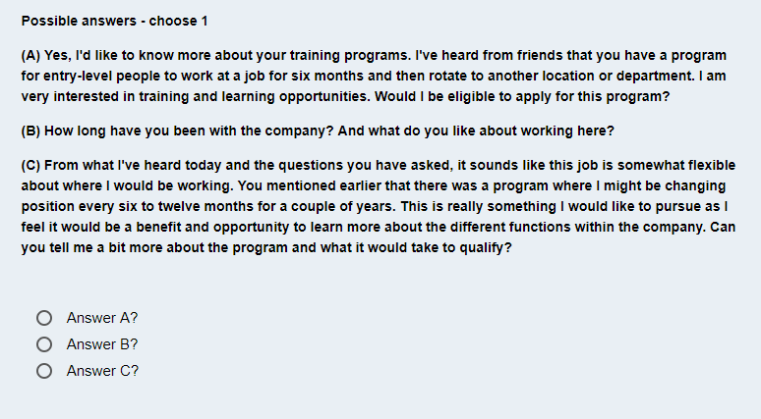
Do you have any question?

Slide 27
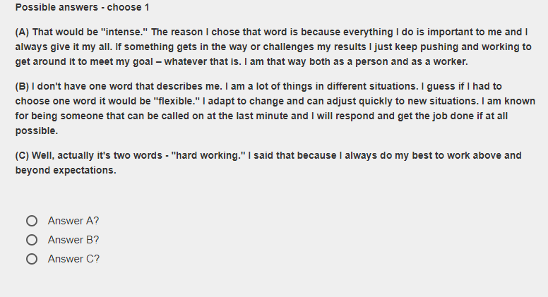
Describe yourself in one word and why did you pick up that?

Slide 28



Slide 29
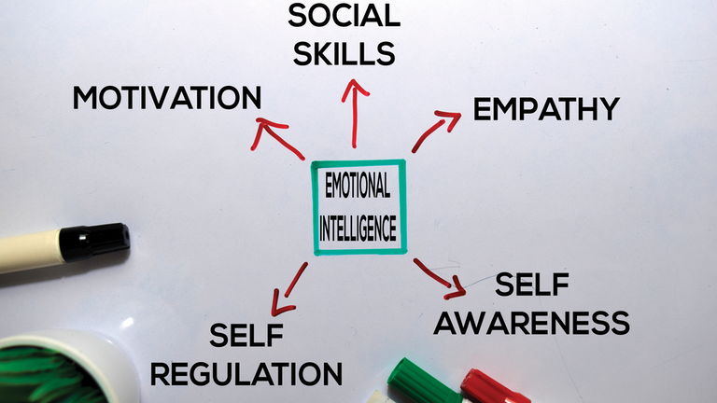
What have you learned about yourself during the pandemic?

Slide 30


Can you do the job while working from home?

Slide 31
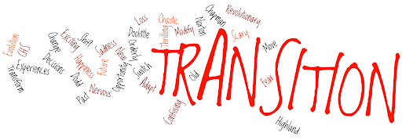
Are you willing to work from an office when the pandemic is over?

Slide 32
How have you been spending your time during Lockdown?
Proactive
Stress Handling
Add Value

Slide 33
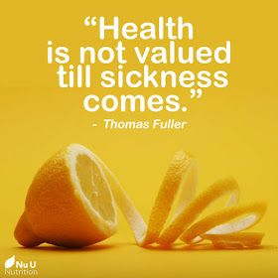
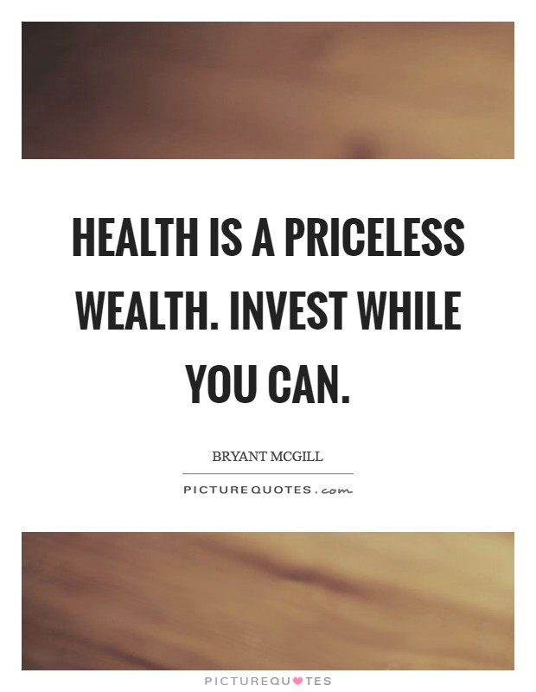
What is your biggest learning from the lockdown?

Slide 34
How has the lockdown changed you as a person?
Adaptability
Habit
Strength

Slide 35
What is one thing you miss the most at this time?
Face to Face to Communication

Slide 36
What is one thing you realize you need to change?
Habit
Weakness
Self regulation

Slide 37
Key to ace an interview
Start Strong
Finish Stronger

Slide 38
Thank you

