Slide 1


Slide 2
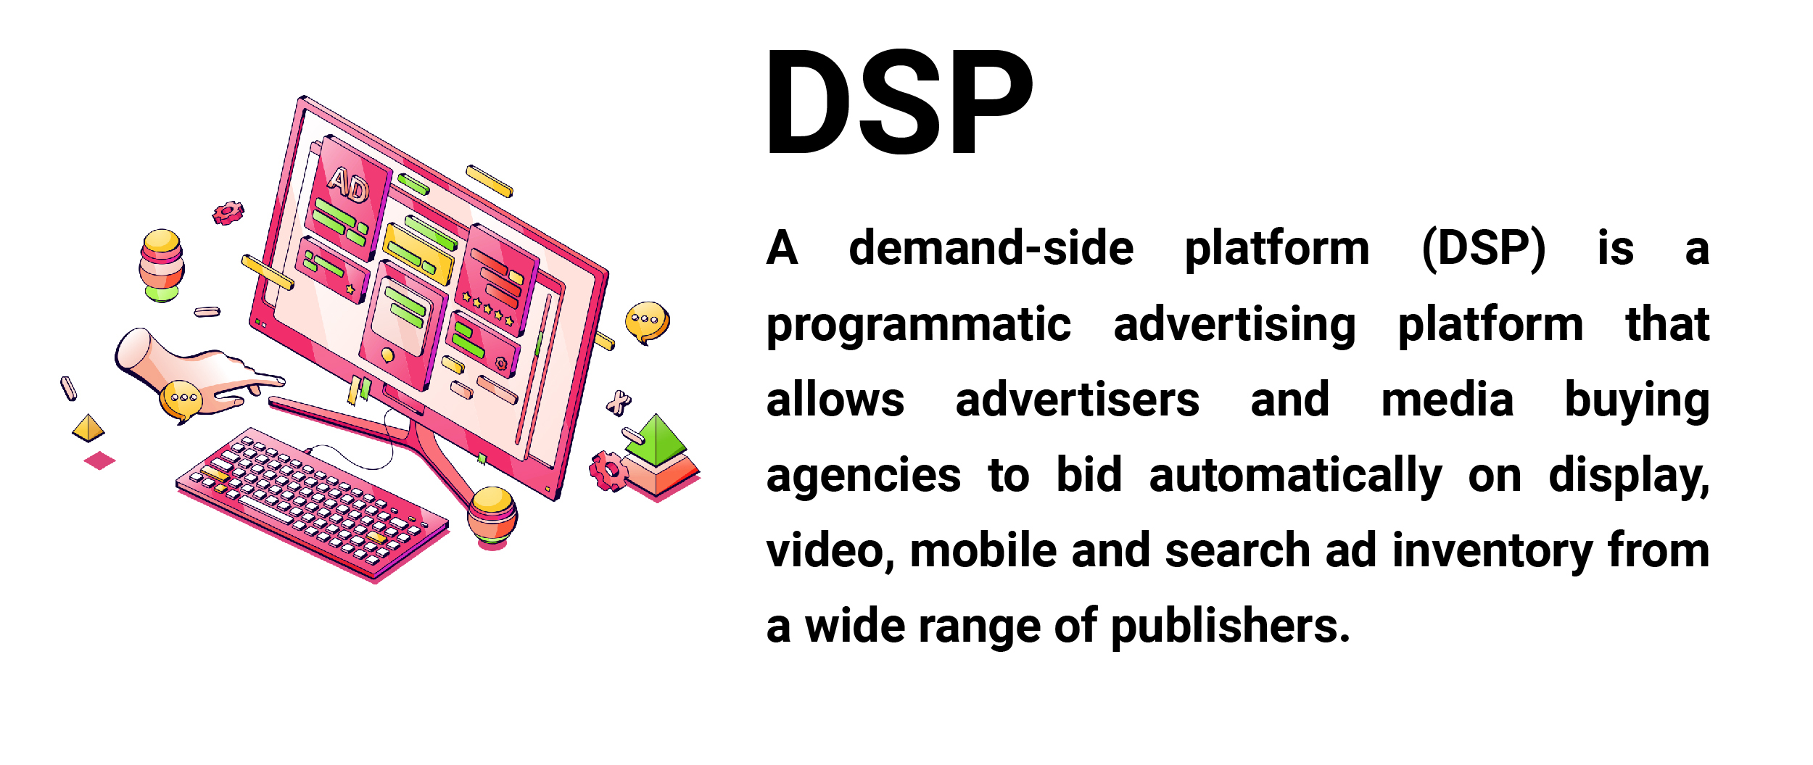
Introduction

Slide 3
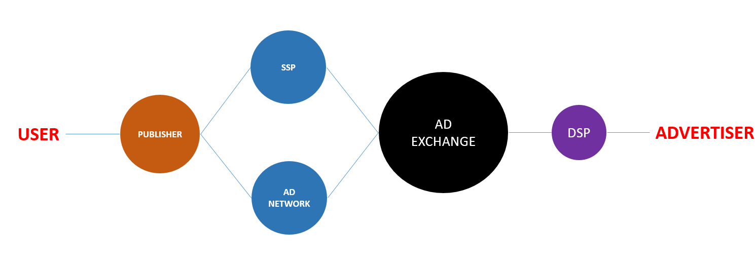
How do DSP Work?

Slide 4
What Are the Main Components of a DSP?
Bidder
Ad Server
Campaign Tracker and Reporting
User Profiling
Budget Manager
Integrations

Slide 5
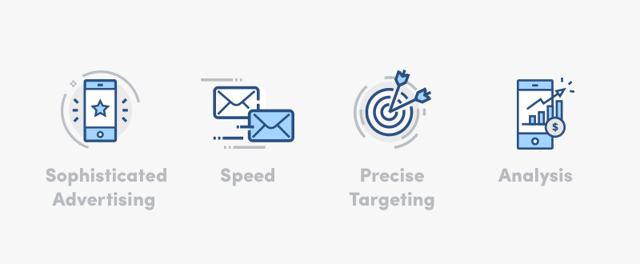
Benefits of a DSP

Slide 6
Trading Desk
A trading desk is a physical location where transactions for buying and selling securities occur. Depending on the type of financial institution, the trading desk may be filled by traders trading for their own proprietary account, brokers who act as agents matching buyers and sellers, or some mixture of both.

Slide 7
Programmatic Advertising Platform
A programmatic advertising platform enables marketers and advertisers to automate the purchase and management of their digital ad campaigns. This includes media buying, ad placement, performance tracking, and campaign optimization. Many platforms also offer an editing tool to design campaign creatives.

Slide 8
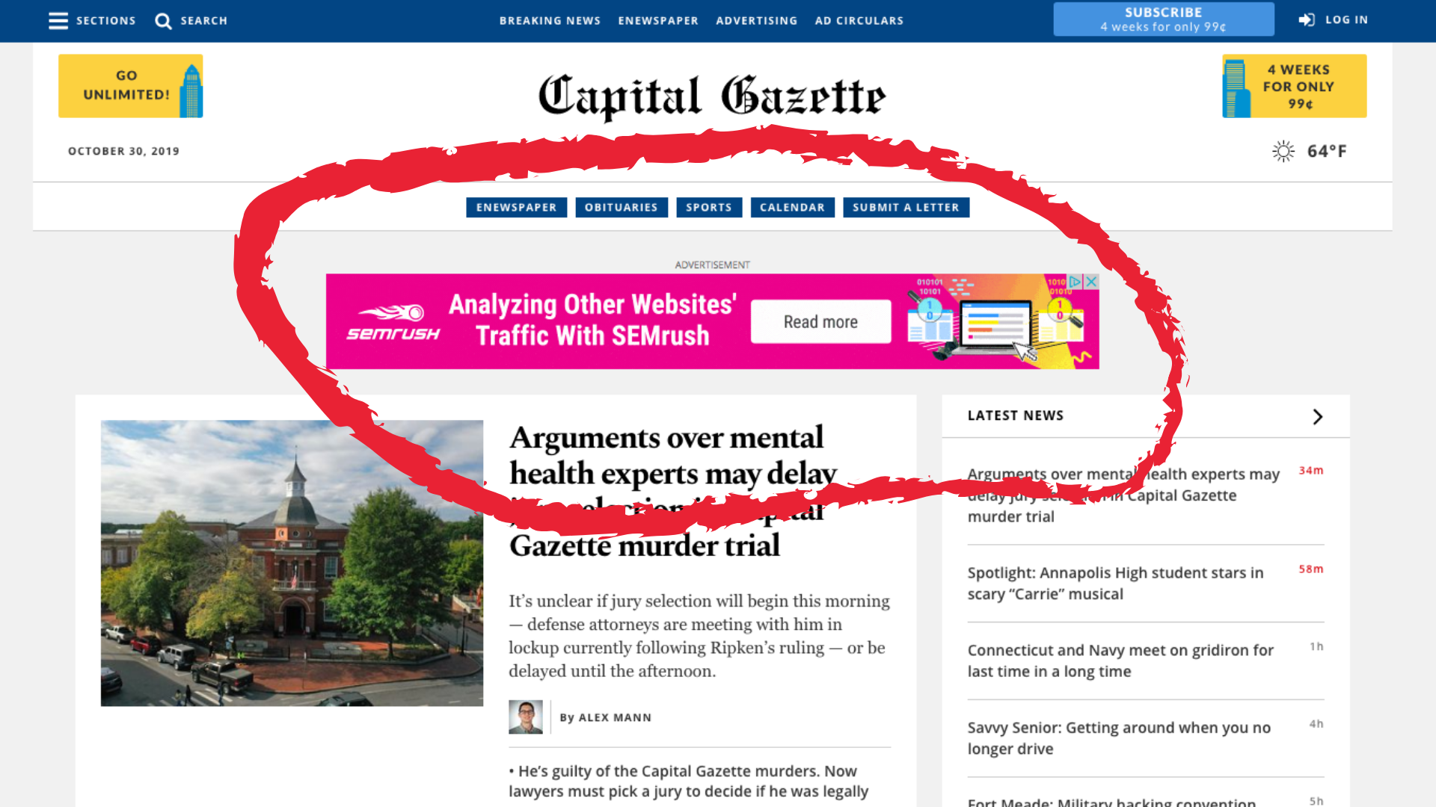
Types of Programmatic Ads
Display Ads

Slide 9

Video Ads

Slide 10
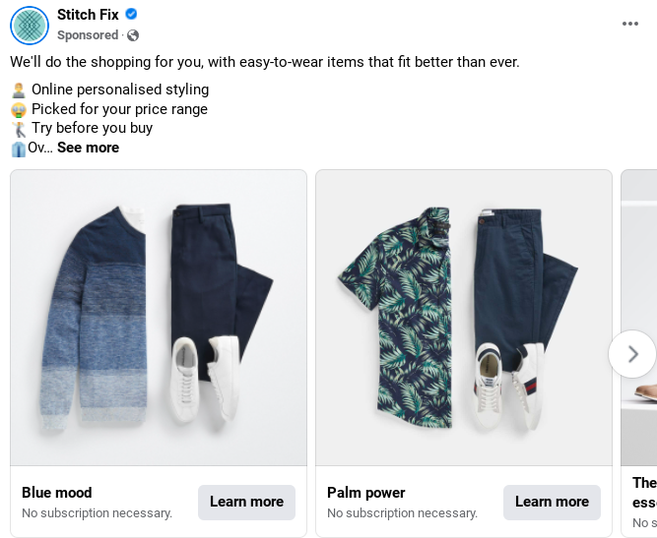
Social Ads

Slide 11
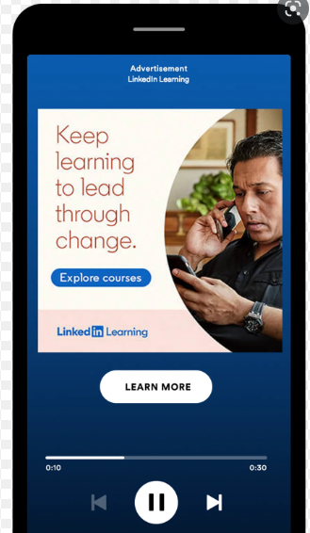
Audio Ads:
Ads served in audio content such as podcasts.

Slide 12
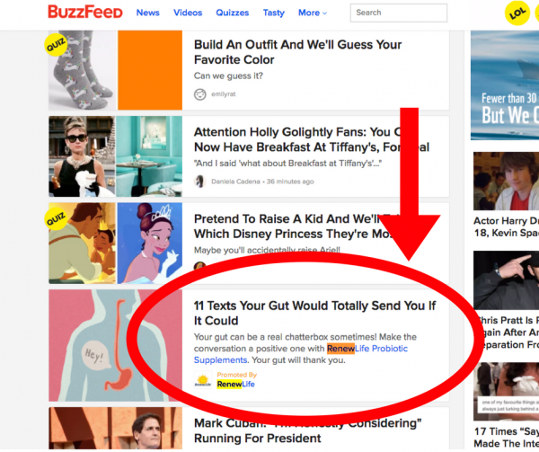
Native Ads

Slide 13
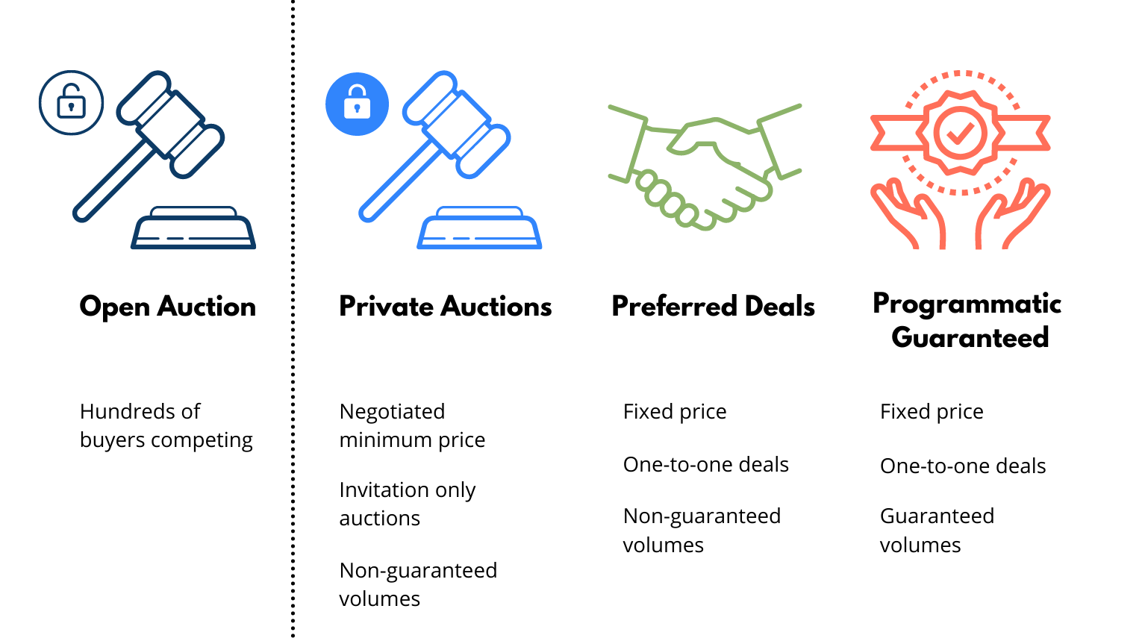
Types of Programmatic Deals to buy inventory

Slide 14
1. Open Auction
Also known as: Open exchange, open market-place, real-time bidding
Who can buy: All eligible buyers on a platform
Pros
Open market and can get more scale
Readily available in DSPs for targeting
Control for publishers
Cons
No guarantee you can buy the placement you want
Lower ROI for publishers in general

Slide 15
2. Private Auction
Also known as: Closed auction, private auction, invitation-only auction
Who can buy: Only invited buyers are allowed
Pros
Smaller pool of brands competing for a placement
Transparency on what you are buying
Cons
CPMs tend to be higher
Still not guaranteed to win the placement

Slide 16
3. Preferred Deal
Also known as: Spot buying, private access, unreserved fixed rate
Who can buy: One buyer
Pros
Guaranteed inventory if floor price is met
Transparency on what you are buying
Fixed pricing
Cons
CPMs tend to be higher
Inventory volume is not guaranteed

Slide 17
4. Programmatic Guaranteed
Also known as: Programmatic Guaranteed/Direct/ Premium/ Reserved
Who can buy: One buyer
Pros
Exclusive inventory
Transparency and control
Guaranteed volumes to buyer and seller
Cons
High CPMs
Minimum budgets and commitment terms
Increased resources required to set up

Slide 18
Real – Time Bidding (RTB) Auction
Real-time bidding ( RTB) is a subcategory of programmatic media buying. It refers to the practice of buying and selling ads in real time on a per-impression basis in an instant auction. This is usually facilitated by a supply-side platform (SSP) or an ad exchange.

Slide 19
Why is real-time bidding important?
RTB is effective for advertisers and publishers. Let’s look at how RTB is useful for each:
For advertisers: RTB means more streamlined, efficient and targeted buying. It provides them with the ability to fine-tune targeting and focus on the most relevant inventory results in higher ROI. Ultimately, users see more relevant ads.
For publishers: RTB increases revenue and fill rates by opening inventory to a wider variety of buyers in a competitive auction. Finally, publishers gain visibility of who is buying which inventory and can leverage this knowledge to charge more for their premium placements.

Slide 20
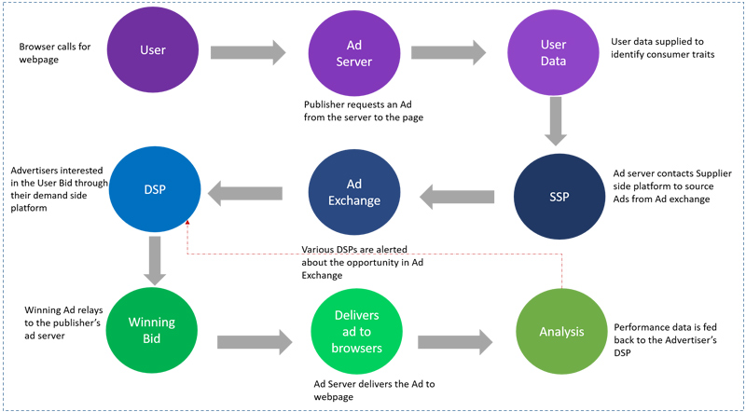
Programmatic Ecosystem Structure

Slide 21
The demand side includes all kinds of media-buyers, i.e., advertisers and marketing agencies, ad networks, demand side platforms (DSP), small businesses, and virtually anyone interested in purchasing digital ads.
The supply side includes direct publishers and inventory vendors, such as publishers' networks, supply side platforms (SSP), or any other authorized seller of the given display ads inventory.
The marketplace stands for all kinds of platforms and environments that host the whole media buying process. It can occur in the form of direct sales or programmatic auctions, such as real time bidding. It can also differ in terms of availability - one can find both closed auctions, that can be general or niche-oriented.
The data overlays both demand and supply sides, as well as third-party tools and ad tech vendors that help to enrich and categorize collected data. These can be customer data platforms, data management platforms, various plug-ins, data collection companies. This segment also partly includes various legal regulators of data collection and usage, such as privacy policy, data protection laws, and many others.
Finally, the user is basically any consumer of the content whose attention the four sides are trying to get.

Slide 22
Bidding System
What is Bidding?
The definition of bidding means a command, or a set of attempts to buy something at auction. An example of bidding is a wealthy businessman telling his butler to take care of errands. An example of bidding is trying to buy a ring on eBay.
A bidding system in contract bridge is the set of agreements and understandings assigned to calls and sequences of calls used by a partnership and includes a full description of the meaning of each treatment and convention.

Slide 23
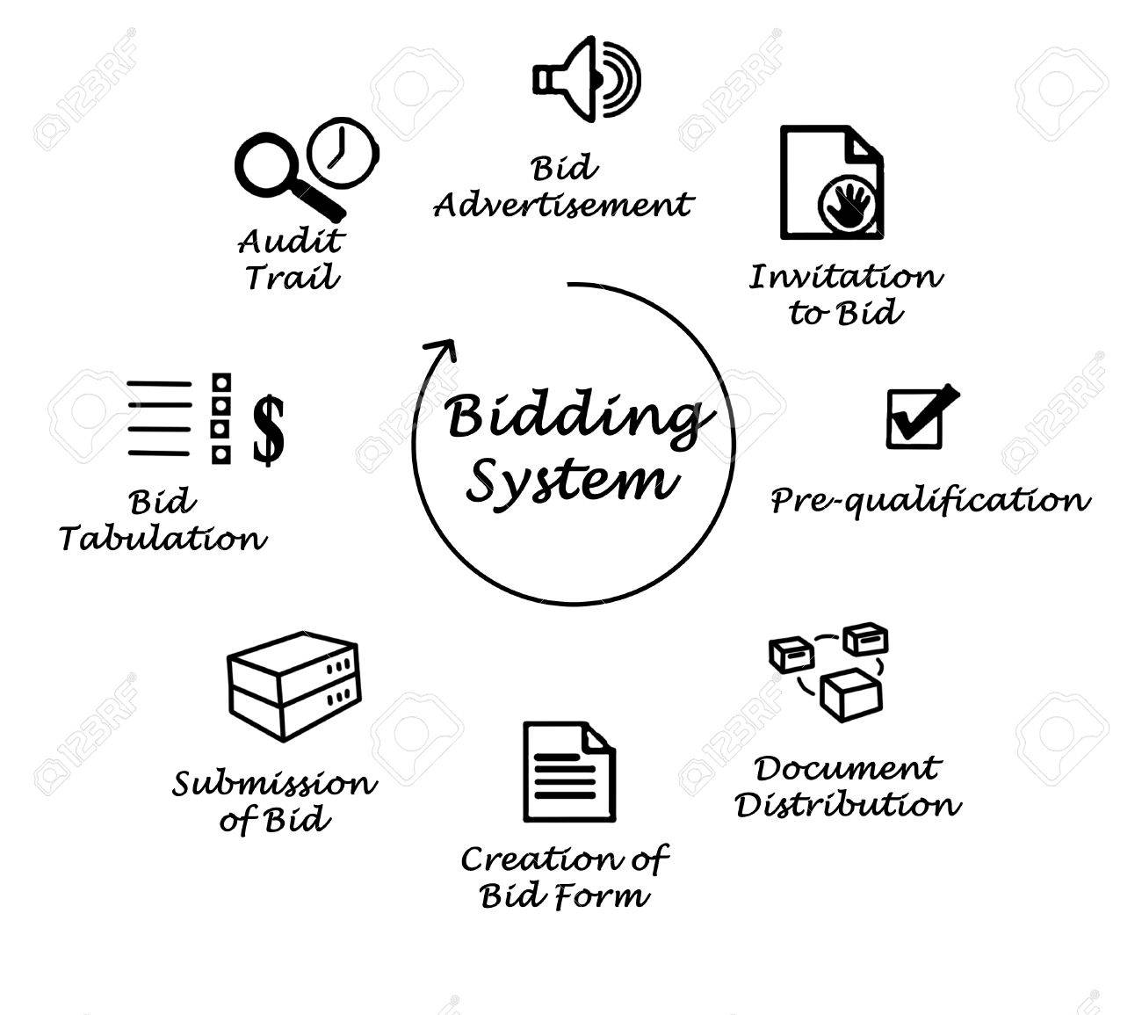

Slide 24
Data Management Platforms
A data management platform (DMP) collects, organizes, and activates first-, second-, and third-party audience data from various online, offline, and mobile sources. It then uses that data to build detailed customer profiles that drive targeted advertising and personalization initiatives.
Examples: HubSpot

Slide 25
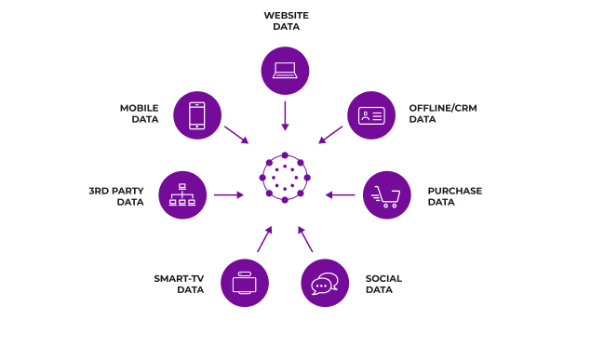

Slide 26
DMPs and Data
First-party data | Data collected from website visits, CRM systems, social media, subscriptions, mobile, and apps.
Second-party data | Someone else’s first-party data. It is derived from a mutually beneficial relationship with another company (a partner, supplier, etc.) with whom you share data.
Third-party data | This data comes from websites and social media platforms other than your own and can be used to reach a wider audience. It’s needed to augment first-party data so that marketers can increase scale and reach and improve personalization.

Slide 27
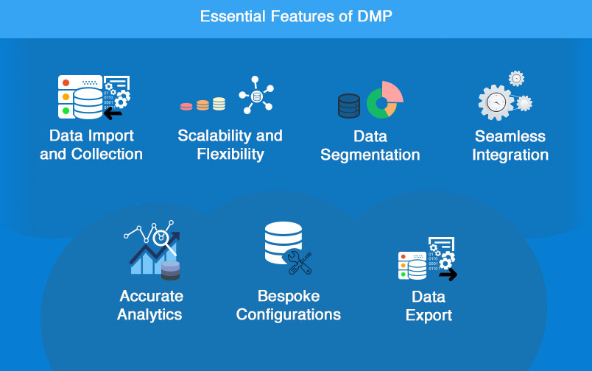
Features of DMP

Slide 28
Data Collection Process
Step 1: Identify issues and/or opportunities for collecting data
The first step is to identify issues and/or opportunities for collecting data and to decide what next steps to take. To do this, it may be helpful to conduct an internal and external assessment to understand what is happening inside and outside of your organization.
Step 2: Select issues and/or opportunities and set goals
The focus of Step 2 is choosing a priority issues and/or opportunities for collecting data, and then setting goals and objectives.

Slide 29
Step 3: Plan an approach and methods
In Step 3, organizations will make decisions about who will be surveyed, how data will be collected, the sources of data that will be used, and the duration of the data collection project, among other questions. These decisions may be made in consultation with an expert.
Who will the data be collected about?
Who will the group of interest be compared to?
What locations or geographical areas will the data be gathered from?
What categories will be used to identify the group of interest and comparator group?
How should data be collected?
Qualitative Data
Quantitative Data
What sources of data should be used to collect information?
Pre-existing or official data
Survey data
Interviews and focus groups
Observed data
How long will the data be collected (the scope of data collection)

Slide 30
Step 4: Collect data
When planning on how best to collect data in Step 4, it is important to be aware of the practical considerations and best practices for addressing logistical challenges organizations often face at this stage of the process.
Step 5: Analyze and interpret data
Step 5 involves analyzing and interpreting the data collected. Whether quantitative and/or qualitative methods of gathering data are used, the analysis can be complex, or less so, depending on the methods used and the amount of data collected.

Slide 31
Step 6: Act on results
Once an organization has analyzed and interpreted the results of the data collected, it may decide to act on the data, collect more of the same type of data or modify its approach.

Slide 32
Cookie Syncing Process
Cookie-syncing is a process that enables the ad-tech partners (SSPs, DMPs, CDPs, and DSPs) to synchronize their cookies and share the incorporated user's data from different websites with each other. As a result, the DSPs can know about the user (interests, demographics, location, etc.)
For Example, when a user visits different web pages, the publisher can collect terms or keywords that the user searched for.

Slide 33
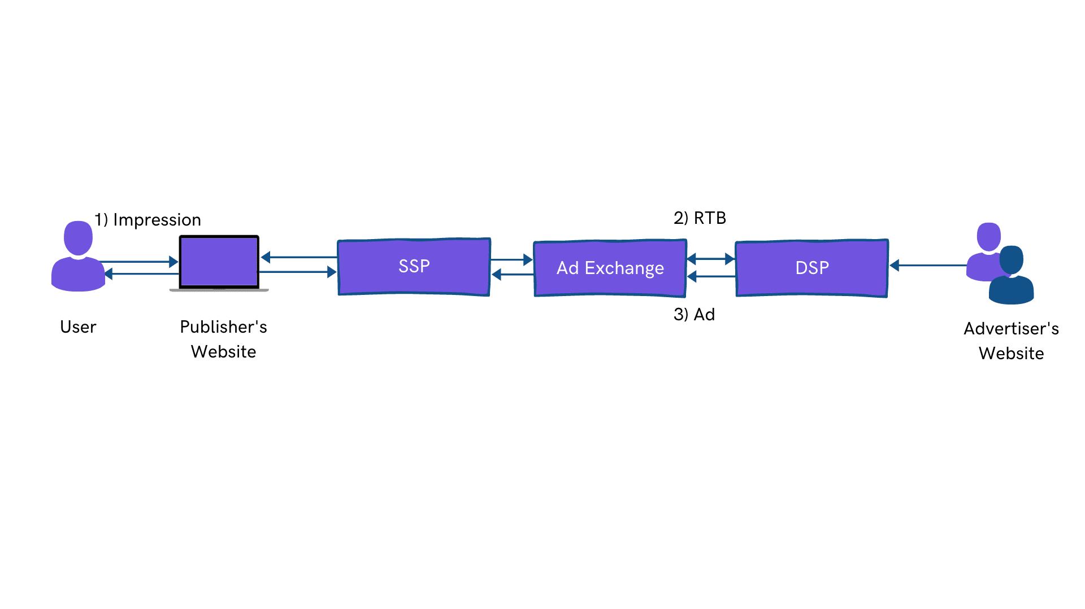

Slide 34
Benefits of Cookie Syncing
There are several benefits of cookie syncing:
Re-targeting
Exclusion of converted users
Interest-based and demographics targeting

Slide 35
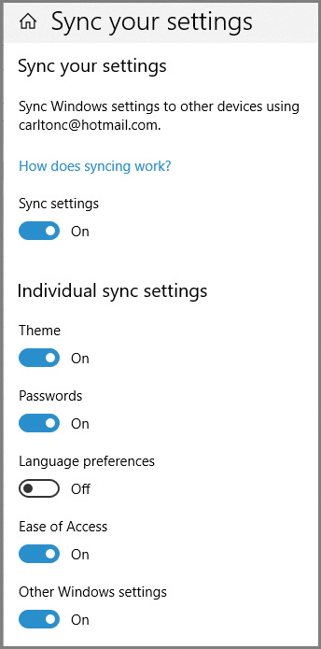
Device ID Syncing
A device ID (device identification) is a distinctive number associated with a smartphone or similar handheld device. Device IDs are among one of the easiest ways to identify mobile users.
What happens when you sync devices?
When you sync a device with your computer, the syncing process results in both the device and the computer being updated with the most up-to-date files. Another example is when you sync iTunes with your iPhone or iPod, the music then exists on the computer and device.

Slide 36
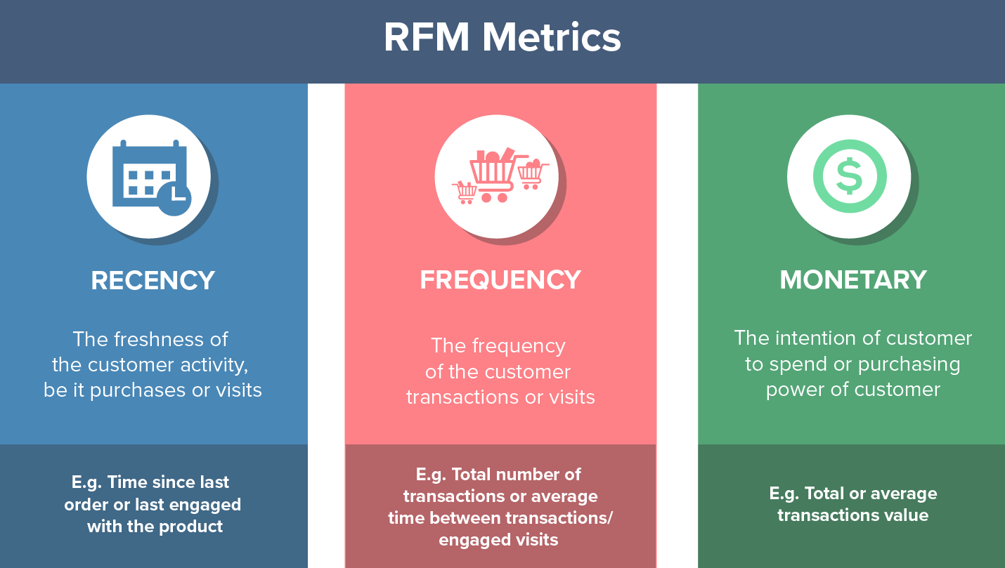
What does RFM mean in marketing?
(recency, frequency, monetary)
RFM analysis is a marketing technique used to quantitatively rank and group customers based on the recency, frequency and monetary total of their recent transactions to identify the best customers and perform targeted marketing campaigns

Slide 37
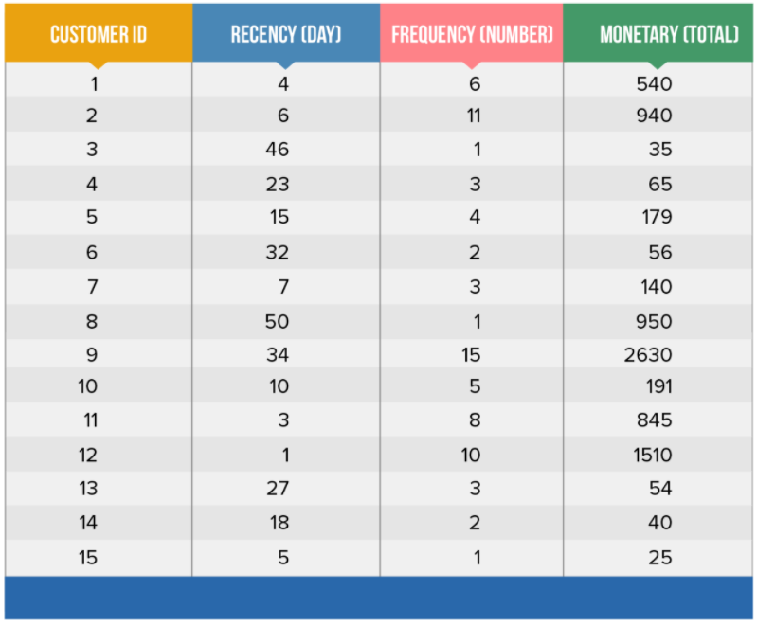
5-Step Approach to RFM Analysis
Step 1: Relevant Data Assembly

Slide 38
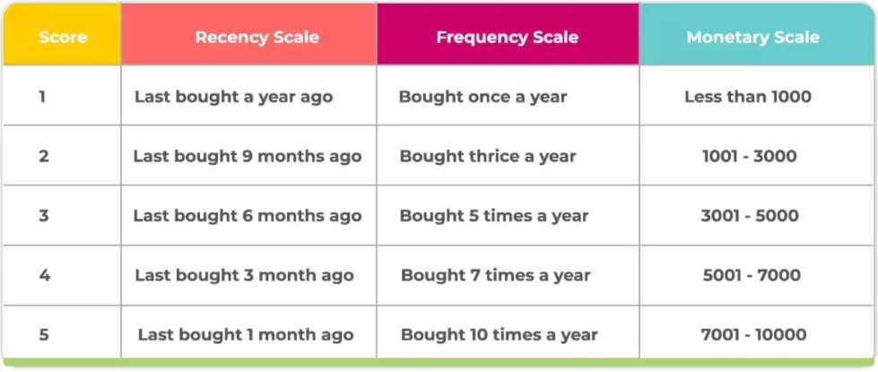
Step 2: Setting Up RFM Scales

Slide 39
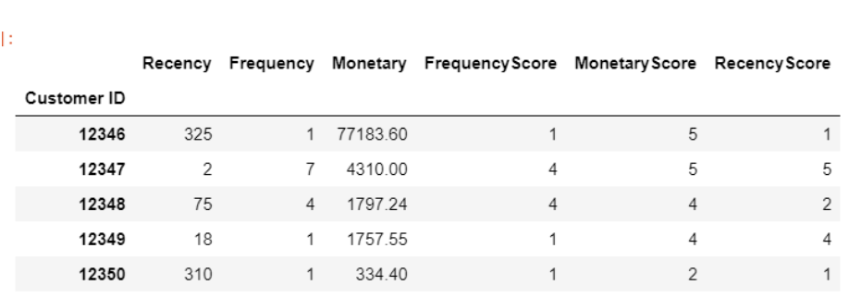
Step 3: Score Designation

Slide 40
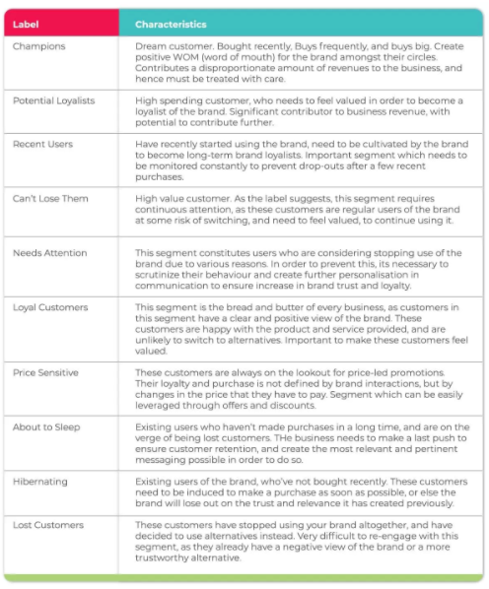
Step 4: Segment Classification

Slide 41
Step 5: Personalization of Strategies for Relevant Segments
Once you are done with the segmentation part, you can move on to developing personalized campaigns for each customer segment.
Champion customers: They are given greater access to products and act as the first point of contact for feedback before launching it for the rest of the customer base.
Loyal customers: They can be offered a higher level of service to ensure they feel more valued and continue their customer journey with your brand.
Recent customers: They can be filled in on the other products that they might want to try out based on their preferences so far, to convert them into loyal customers.
At-risk customers: They can be offered freebies, offers, and discounts to ensure they don’t end up becoming a part of the Customer Churn statistic. This can be done simultaneously by the business.

Slide 42
Data Segments
Data Segmentation is the process of taking the data you hold and dividing it up and grouping similar data together based on the chosen parameters so that you can use it more efficiently within marketing and operations.
Examples of Data Segmentation could be Gender.

Slide 43
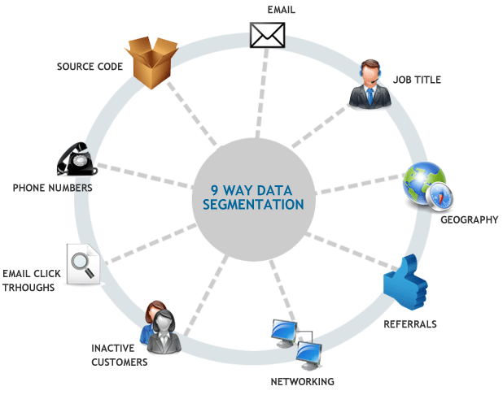
9 Way Data Segmentation

Slide 44

Types of Data Segment

Slide 45
1. Data Area
It is the permanent memory area. All static and external variables are stored in the data area. The variables which are stored in the data area exist until the program exits.
2. Code Area
It is the memory area which can only be accessed by the function pointers. The size of the code area is fixed.

Slide 46
3. Heap Area
As we know that C supports dynamic memory allocation. C provides the functions like malloc and calloc which are used to allocate the memory dynamically. Therefore, the heap area is used to store the data structures which are created by using dynamic memory allocation. The size of the heap area is variable and depends upon the free space in the memory.
4. Stack Area
Stack area is divided into two parts namely: initialize and non-initialize. Initialize variables are given priority than non-initialize variables.
All the automatic variables get memory into stack area.
Constants in c get stored in the stack area.
All the local variables of the default storage class get stored in the stack area.
Function parameters and return value get stored in the stack area.
Stack area is the temporary memory area as the variables stored in the stack area are deleted whenever the program reaches out of scope.

Slide 47
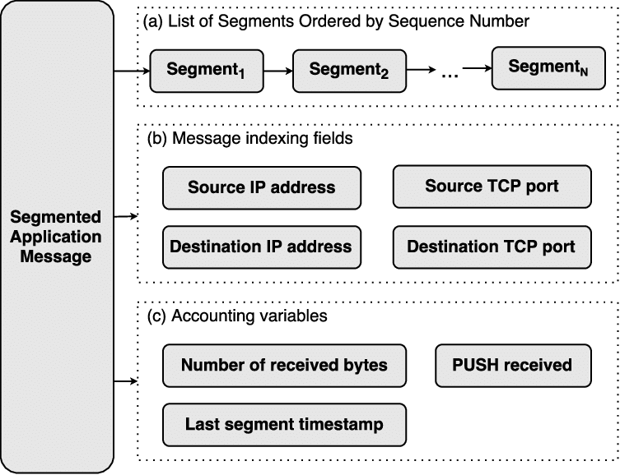
Account Structure in Data Segment

Slide 48
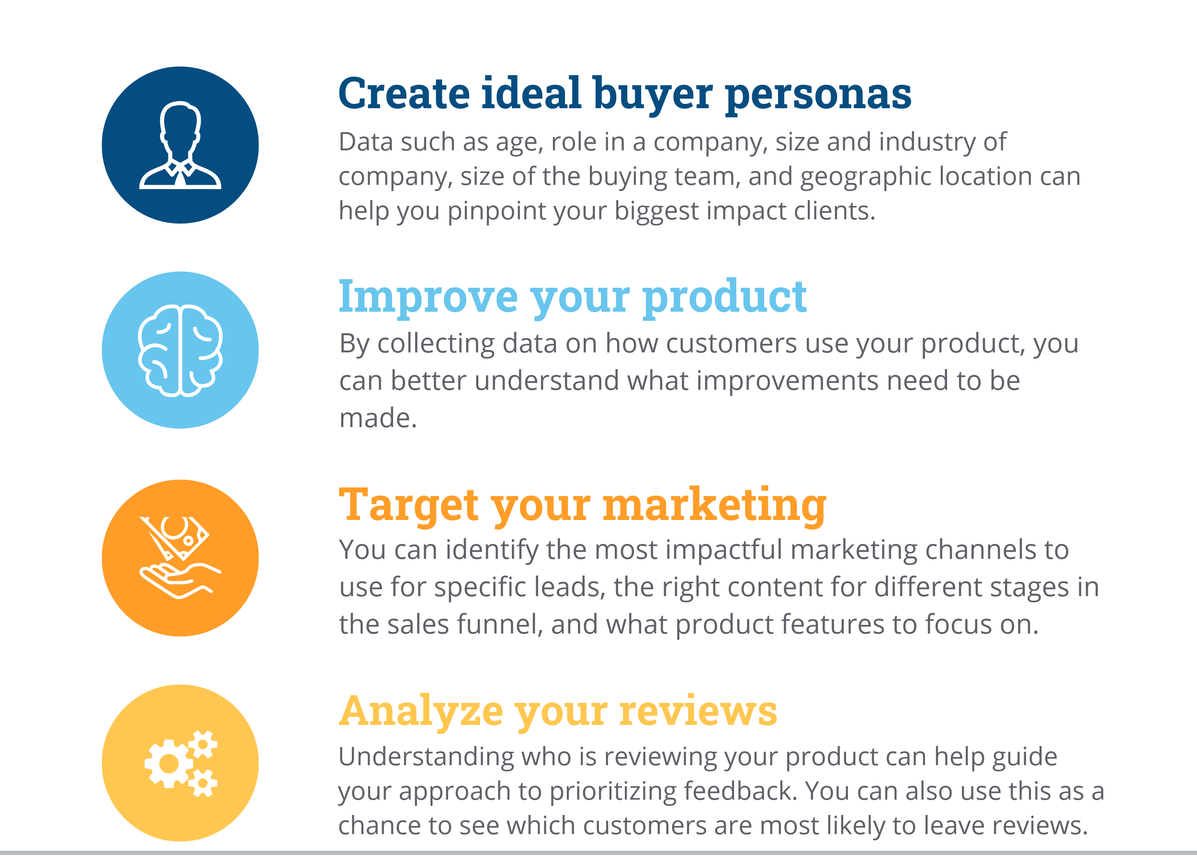
What Can You Do With Data Segmentation?

