Slide 1
Dear Diary,
My heart is racing to buy a car.
☹ ☹ ☹

Slide 2
1. Honda CRV
Functional and convenient
Budget – 22.5 lacs to 27.5 lacs
Promotion is due, so would need a car – for work purposes
Car with plenty of seats as have 6 siblings
SUV – Honda CRV with 12 kmpl mileage.
Price – 27.5 lacs
Insurance premium also not bad
Gas consumption since large space but benefits outweigh those negative points.

Slide 3
2. Red Audi A4
Fav red color & big fan of Audi
Everything made me fall in love with it.
31.65 lacs – but sales person told me that he would bring it to 30.5 lacs.
Also insurance premium was more or less the same.
Fuel consumption will be more
But cant use Audi for job purpose neither for family as less seats.
In total it wasn’t functional car.

Slide 4
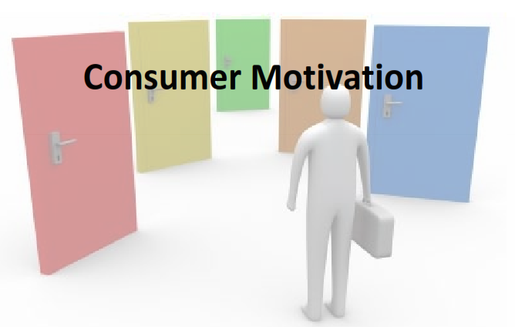

Slide 5

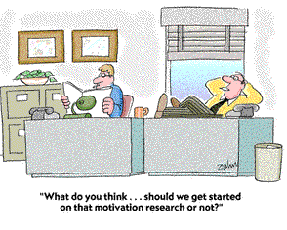
What is a motive?
from the Latin motus - to move
A motive is something that causes a person to act (or move). It answers the question Why?
Motivation?
An inner drive or process that causes a person to act to fulfil a want or need.

Slide 6
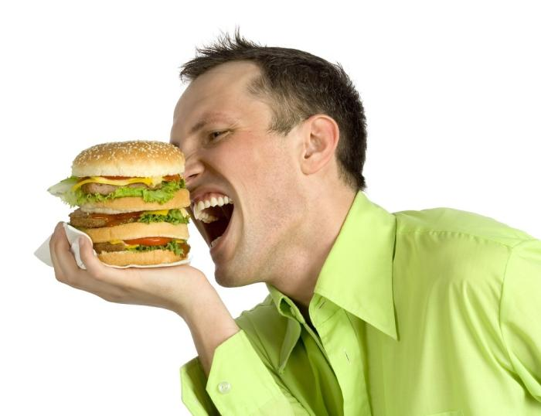
Motivation as a Psychological Force
Motivation is the driving force within individuals that impels them to take an action.
Needs are the essence of the marketing concept. Marketers do not create needs but can make consumers aware of needs.
Notes:
Motivation is produced by a state of tension, by having a need which is unfulfilled. Consumers want to fulfill these needs and reduce the state of tension. For example, when you are very hungry, you are extremely motivated to find food. Perhaps when you need a new pair of pants, you are a bit less motivated to fulfill this need as compared to your need for food. In the case of needing pants, it is important for marketers to help increase your motivation and/or specify your need for their products - perhaps Diesel Jeans.

Slide 7
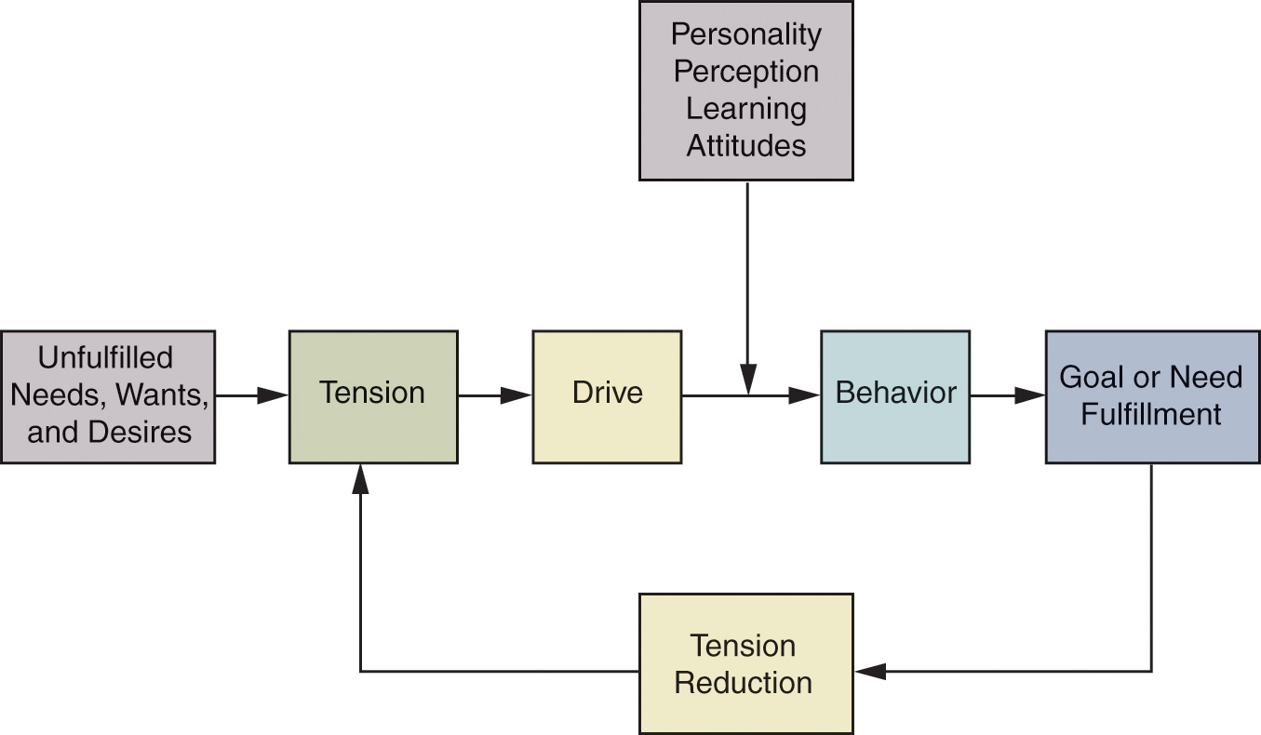
Model of the Motivation Process
Figure 4.2
Notes:
This model highlights the motivation process. We can see that the “drive” toward behavior will often end in the fulfillment of the need. The processes and effects of previous learning tie strongly into choices made when the behavior is defined.

Slide 8
Types of Needs
Innate Needs
  Physiological needs that are considered primary needs or motives
  Examples are shelter, food, water, clothing
Acquired Needs
  Needs based on personal preference and personal experiences. Are generally psychological and considered secondary needs. Eg. Jeans, Cars, Jewellry
Notes:
The example of the need for food compared to a new pair of jeans can be further described by understanding types of needs. The need for food is more of an innate need and is considered a primary need. The need for a pair of jeans would be considered acquired. The need for clothing could be considered primary, but the need specifically for a pair of jeans is acquired, especially when they are a certain brand or designer jean.
Needs may have a positive or negative direction. There are in fact some products we are NOT drawn to. For example, when people shop for funeral services, this is not something they are usually drawn to but rather must pursue and purchase.

Slide 9
Goals
The sought-after results of motivated behavior
Generic goals are general categories of goals that consumers see as a way to fulfill their needs
Product-specific goals are specifically branded products or services that consumers select as their goals
Any drink.. Any cold drink… any carbonated drink… Bisleri
mineral water
Notes:
Continuing with our example of jeans, we can understand the types of goals that exist. When a consumer states they want a pair of jeans, they have stated a generic goal. When they announce they really want a pair of Calvin Klein jeans, then they have stated product-specific goals.

Slide 10
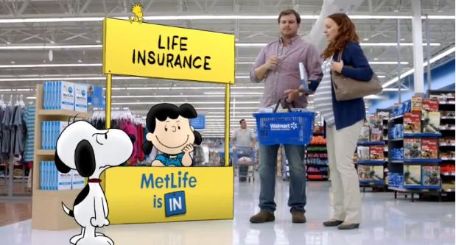
How Does this Ad Appeal to
One’s Goals?

Slide 11
It Appeals to satisfying security needs

Slide 12
The Dynamics of Motivation
Needs are never fully satisfied
New needs emerge as old needs are satisfied
People who achieve their goals set new and higher goals for themselves
Notes:
Motivation is highly dynamic and constantly changes in response to life experiences. Motivations change as we age, interact with others, change careers, acquire wealth, become ill, marry or divorce, or pursue education.
Humans constantly have needs. This is due in part to the fact that our needs are never fully satisfied, or once satisfied, reappear. Hunger is a good example of a need that is often not satisfied and reappears. As humans, we also develop new needs as we satisfy existing needs. The hierarch of effects model shows how we meet our lower-level needs first and then move up the hierarchy. Finally, our needs are based on the goals that we set for ourselves. If one sets a goal to enter politics, they may feel they need a law degree. However, if they are unsuccessful in getting accepted at law school, their needs may change and they may want to pursue a few years of work experience first and need to find a job.

Slide 13
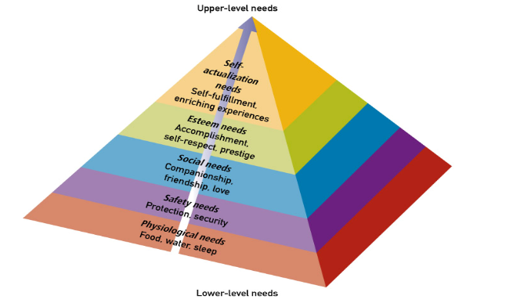
Maslow’s Hierarchy of Needs
Notes:
Dr. Abraham Maslow is well known for his hierarchy of needs. The web link on this page will bring you to www.maslow.com which reports on other publications by Dr. Maslow. The hierarchy presents five basic levels of human needs which rank in order of importance from lower-level needs to higher-level needs. The theory says that consumers will fill lower-level needs before the higher-level needs – they will eat before they enroll in a Master’s program.

Slide 14
Contd..
Physiological — housing, food, water, clothing.
Safety — insurance, burglar alarm, fire alarms, cars with air bags.
Self-esteem — high status brands, goods or services like owning luxury homes, branded cars etc.
Social — greeting cards, holiday packages, sports equipment, gift items
Self actualization — Trust organizations, mountaineering etc.

Slide 15
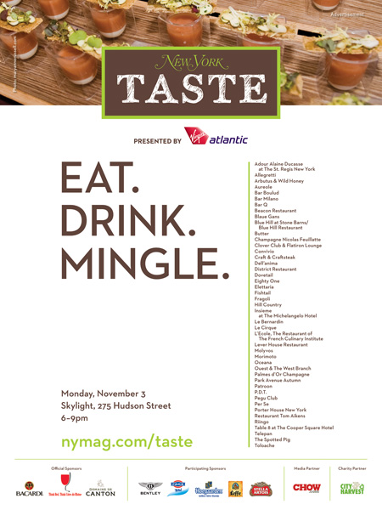
To Which of Maslow’s
Needs Does This Ad Appeal?

Slide 16
Both Physiological and Social Needs

Slide 17

To Which of Maslow’s
Needs Does This Ad Appeal?

Slide 18
Esteem Needs

Slide 19

To Which of Maslow’s
Needs Does This Ad Appeal?

Slide 20
Self-Actualization

Slide 21
Discussion Questions
For each type of product, consider two brands. How do marketers attempt to differentiate their product from the competition?
Notes:
To answer this question, think of products that provide safety and shelter but may also vary in price.
For the second part of this question, you might want to consider companies that market coats and jackets. Some will emphasize different needs than the coat will meet and these unmet needs will exist in several layers of the hierarchy.

Slide 22









Slide 23
The Trio of Needs / McClelland’s Theory of Need Achievement
Power
  Individual’s desire to control the physical environment
Affiliation
  Need for friendship, acceptance, and belonging
Achievement
  Need for personal accomplishment
  Closely related to egoistic and self-actualization needs
Notes:
Some psychologists believe that this trio of needs exists for most consumers and that marketers can find a tie to motivation. Power refers to the individual’s desire to control other people and objects – it is tied to a type of ego needs. Affiliation is similar to Maslow’s social need and suggests that behavior is influenced by the desire for social ties. Finally, the need for achievement, like the other needs, will vary from individual to individual.

Slide 24

Which need advertisement is focusing on?

Slide 25
It reflects the achievement need.

Slide 26
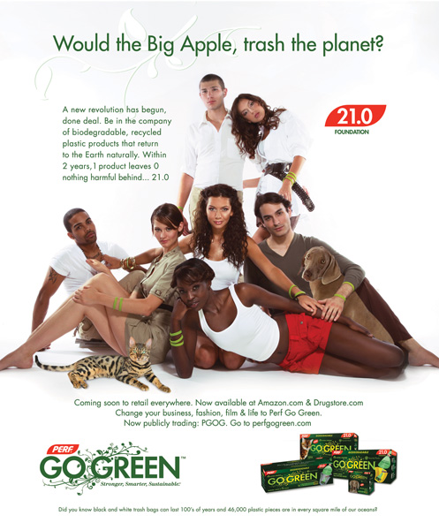
To Which of the Trio of Needs Does This Ad Appeal?

Slide 27
The Affiliation Needs Of Young, Environmentally Concerned Adults

Slide 28
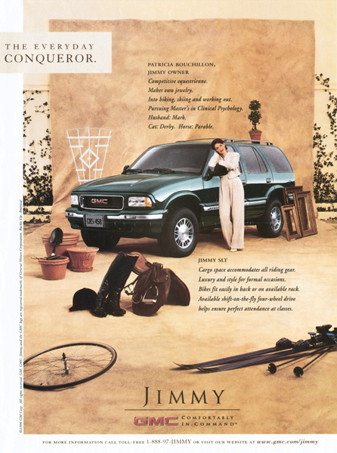
Power And Achievement Needs

Slide 29
Motivational conflict
Satisfying a need often comes at the expense of another need – these trade-offs cause motivational conflict

Slide 30
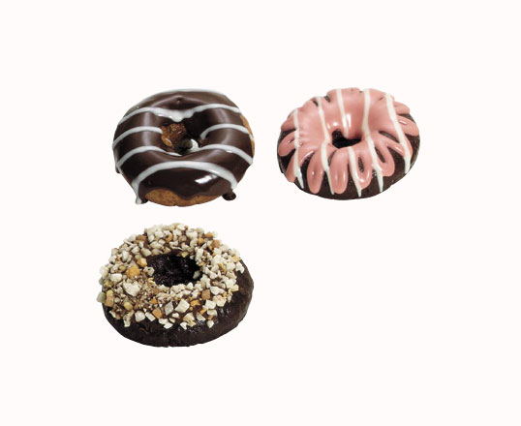
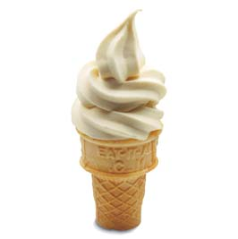
Deciding between two or more desirable options
Approach Approach

Slide 31
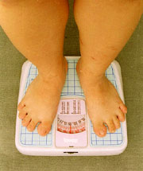
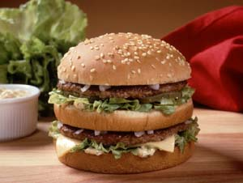
Behaviour has both positive and negative consequences
Approach Avoidance

Slide 32

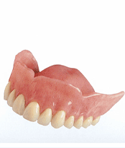
Deciding between two or more undesirable options
Avoidance Avoidance

Slide 33
Cognitive Dissonance
Inconsistency between beliefs one holds or between one’s beliefs and actions.
Consumers are motivated to reduce dissonance or tension by either changing their actions or their beliefs.
Almost all major purchases result in cognitive dissonance, also known as buyer's remorse.
Often consumers are faced with two or more alternatives. Choosing one may leave us wondering if we should have purchased the other.

Slide 34
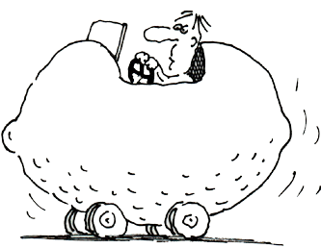
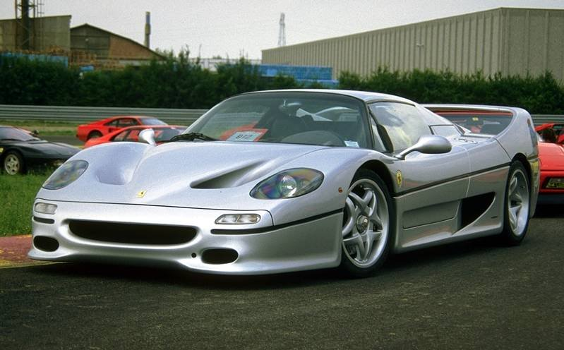
You've spent months shopping for a new car, comparing features and narrowing down the alternatives. Finally, you make your decision and purchase one that's just the right car for you. But now you’re feeling anxious about the decision, second-guessing the wisdom of your choice., i.e. you’re experiencing cognitive dissonance.
What could a marketer do to make you feel better about your purchase?

Slide 35
Strategies to Increase Involvement
Build a Bond
With the
Consumer
Appeal to
Hedonic Needs
Increasing Consumers’ Attention
Use Novel
Stimuli
Include Celebrity Endorsers
Use Prominent
Stimuli

Slide 36
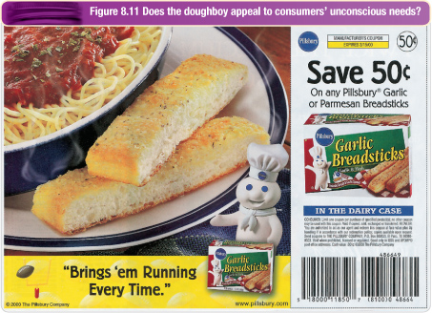
Unconscious motivation

Slide 37
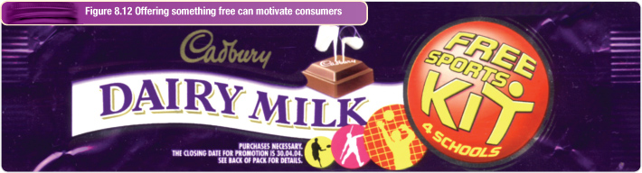
Motivating consumers
Motivating with Money
  Price cuts, specials, rebates and coupons motivate purchase
  Resulting sales may increase, but profits may not
  Attracts consumers less likely to repeat
  Price reductions may increase price sensitivity

Slide 38
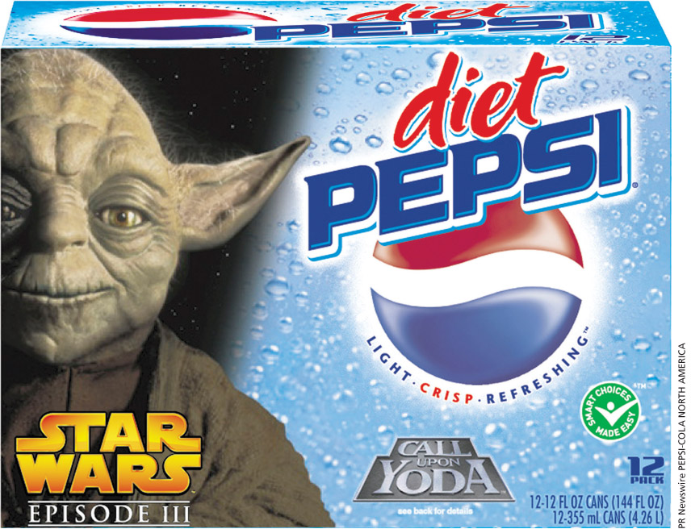
Motivating consumers
Provide other incentives:
Premiums, free products, contests and sweepstakes are designed to motivate consumers to purchase
There are limitations and shortcomings for this strategy in addition to the products offered as a premium being valued less (value-discounting hypothesis)

Slide 39
Motivating consumers
Implement a loyalty program
  Motivate repeat buying by providing rewards to customers based on how much business they do with the company
  Tracks consumer purchases and provides estimates of Customer Lifetime Value

