Slide 1
COMMUNICATION & CONSUMERS

Slide 2
Communication Process
Sender (Source)
Message
Channel (Medium)
Receiver (Consumer)
Feedback

Slide 3
Selective Exposure
Refers to consumers selectivity in paying attention to advertising messages.
Consumers can control their exposure to mass media and avoid commercials while watching TV
Psychological Noise
Repeated exposure to an advertising message surmounts psychological noise facilitates message reception.
Copywriters often use contrast to breakthrough the psychological noise & advertising clutter to get customer attraction
Digital technologies allow marketers to monitor the consumer’s visits to websites and send customised promotional messages to that person.

Slide 4
Designing Persuasive Messages
Images & Texts
Message Framing
One-Sided versus Two-Sided Messages
Order Effects

Slide 5
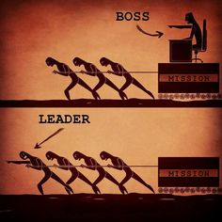


Slide 6


Slide 7
Persuasive Advertising Appeals
Comparative Appeals
Fear Appeals
Humorous Appeals
Sexual Appeals
Timeliness Appeal
Notes:
Comparative Advertising is a widely used marketing strategy in which a marketer claims product superiority for its brand over one or more explicitly named or implicitly identified competitors.
Fear Appeals are often employed to discourage distracted driving caused by using mobile phones and texting, as well as drunk driving.

Slide 8

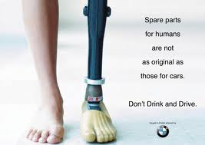

Slide 9
Consumers & Social Media

Slide 10
Impression-based Targeting V/S Segment-Based Targeting
IBT is implemented through real-time bidding, which is a technique that allows advertisers to reach the right user, in right place, at right time and also sets price
SBT occurs when advertisers pre-negotiate prices for advertising space in media whose audiences largely (but not completely) match the profiles of the consumers, advertisers wish to target.

Slide 11
Advantages of Impression-based Targeting
Impression based targeting enables marketers to identify which “halves” of their advertising expenditures are wasted & design messages that reach primarily those who are likely to become customers.
In contrast to messages of “one-size-fits-all” traditional messages, receivers of impression based ads can view and rotate images, click on the links for detailed information.
Feedback can be determined immediately by observing the elements they click on within the ads, how long they stay at the website, how often they return etc.

Slide 12
Permissions to collect Personal & Social Information
Social Media Marketing is enabled by the information consumers provide about themselves and their social contacts, mostly via “Apps”
Users are asked to provide 4 kinds of information:
Basic Permissions – Name, Gender, Photo, Demographics etc
User Permissions – To allow the installation of the applications on user’s computer or smartphone
Friends Permissions – Requests to share info the users have about friends using the same app
Sensitive information requests – Highly personal lives and opinions

Slide 13
Social Media Communication Channels
Owned Social Media
Paid Social Media
Earned Social Media

Slide 14
Google’s Consumer Tracking & Targeting
Types of ads through which Google reaches consumers and how to track the visitors.

