Slide 1

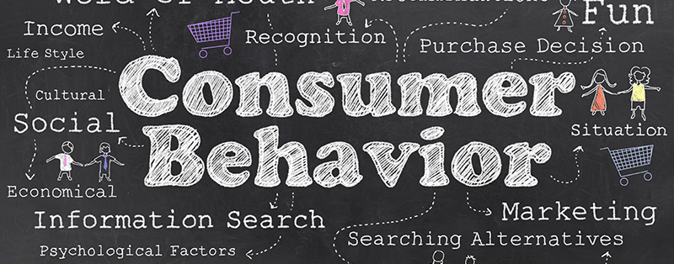
The Consumer for Digital Marketing

Slide 2
The Impact of Digital Technology on Buying Behaviour
Consumers set their own benchmarks
Word of Mouth
Reduced Customer Tolerance
Consumers are always experimenting
Consumers becoming Switchers
Social Media Platforms
Notes:
What looks good to them is what really convinces them to go ahead with the purchase. They will make comparisons of your brand with your competitors and will go for the one that suits them the best in terms of all the elements. To match the consumer-set standards, every brand has to make sure to be on their toes and everyone has maintained its presence on the social media platforms.
In digital marketing, word of mouth is done in terms of reviews of experts and users, ratings, testimonials etc. To make a decision about a particular product or service, they will first do a research on Google, will review the sites and give a read about the brand.

Slide 3
Reduced Customer Tolerance –
Consumers expect an immediate reaction to their actions. They want a response to their queries clear and fast. It takes just a single viral post or tweet for a consumer to build or destroy a company’s or brand’s rapport.
Platforms in Digital Marketing that consumers use to share their experiences with the brand
Human Psychology - Consumers are more attracted towards the negative news/reviews and there are very few consumers who actually share positive reviews/posts.
This issue of negative feedback is many times even misused by the competitors. To handle this situation, every brand should follow Online Reputation Management (ORM) Strategy, where you make interactions with the consumers to convert their negative image to the positive.
Notes:
Platforms are – Quora, Facebook, Twitter etc

Slide 4
Consumers keep Experimenting –
In the past era, consumers had trust issues before going for any new product or service and would trust only on the feedback provided by the experienced consumers.
With the changing era, Consumers are now welcoming new products with fresh and good quality features with applause.
This experimenting behaviour of the consumers made way for many start-up companies like Uber, Oyo, Ola, UrbanClab, Olx etc.
Consumers are Switchers –
Consumers in the past era trusted one particular brand in a particular industry.
What make consumers switch for a new product?
Notes:
Consumers in the past era trusted one particular brand in a particular industry. For example, in the mobile industry, Nokia was the only brand consumers always trusted, but now, it is nowhere seen.
What make consumers switch for a new product? - It is when the product competitors come out with better product features and better marketing strategies. With so many options available in the market, it becomes difficult for the consumers to become loyal and switching becomes easy.

Slide 5
Social Media Platforms –
It is the consumers that decide which social media platform the brand must use to expand its business.
If the mass consumers are on Facebook, Snapchat, Twitter, Instagram, LinkedIn etc., it becomes mandatory for the brands to have their presence on these platforms if they want to be close to their prospects and a step ahead of their competitors, by interacting with their consumers and creating a buzz of their brand among them.

Slide 6
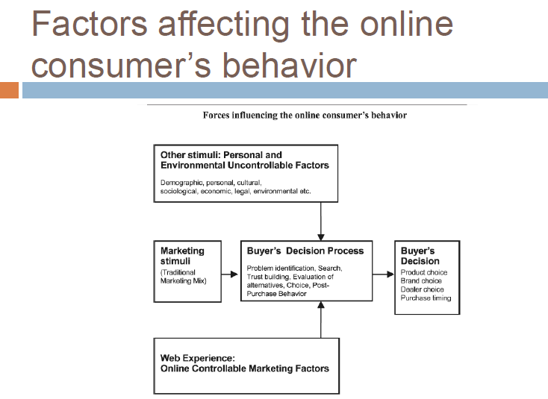

Slide 7
Web Experience
Consumer’s total impression about the online company, resulting from his/her exposure to a combination of virtual marketing tools, under the marketer’s direct control likely to influence the buying behaviour of the online consumer.

Slide 8
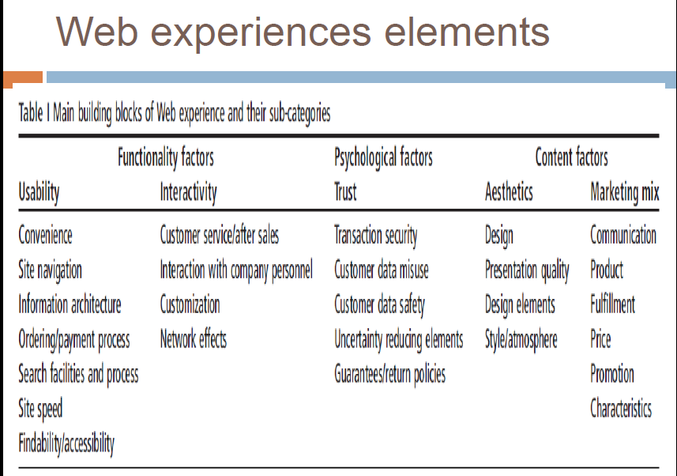

Slide 9
Strategic Applications of Word of Mouth
Social Networks
Tie Strength – the degree of intimacy & frequency of contacts between the information seeker and the source
Similarity among the group’s members in terms of demographics & lifestyles.
Source Credibility – the information seeker’s perceptions of the source’s expertise
2. Brand Communities - A specialized non-geographically bound community formed on the basis of attachment to a product or brand. (Save The Tiger)
3. Weblogs (Customer problem of a Bicycle)
4. Stimulating Word-of-Mouth (E.g. A Campaign for Vaseline Clinical Therapy)
5. Viral Marketing/Viral Advertising
6. Buzz Agents
Notes:
Word of Mouth taking place online is called e-wom
1. A study identified 3 dimensions underlying consumers engagement in e-wom:

Slide 10
Web Tracking
Definition –
the activity (and ability) of a website (using special software tools) to keep tabs on website visitors.
Ways of Web Tracking –
IP Addresses
HTTP Cookies
First Party Cookies
Third Parties
Notes:
HTTP cookies are information that is saved by your web browser. When a user visits a website, the site might store a cookie so it can recognize the users device in the future. When the user returns to the site, it can read the cookie to remember the user from the last visit. Cookies can be used to customize the users browsing experience and used to deliver targeted ads.^{[7]} Some browsing activities that cookies can store are:
Pages and content you looked at
What you searched online
When you clicked on an online advertisement
What time you visited a site
First party cookies are created by the domain the user is visiting. These are the cookies that are considered good. They help provide a better experience for users.
Third parties are created by sites other than the one users are visiting. They insert additional tracking methods to record what you do online. On-site analytics refers to data collection on the current site. It is used to measure many aspects if user interactions including the number of times a user visits

Slide 11
Methods of Web Tracking –
Canvas fingerprinting allows websites to identify and track users using HTML5 canvas elements instead of using a browser cookie
2. Cross-device tracking are used by advertisers to help identify which channels are most successful in helping convert browsers into buyers
3. Click-through rate is used by advertisers to measure the number of clicks they receive on their ads per number of impressions.
4. Mouse tracking collects the users mouse cursor positions on the computer.

Slide 12
5. Browser fingerprinting relies on your browser and is a way of identifying users every time the go online and track your activity. Through fingerprinting, websites can determine the users operating system, language, time zone, and browser version without your permission.
6. Supercookies or "evercookies" can not only be used to track users across the web. They are hard to detect and difficult to remove since they are stored in a different place than the standard cookies.
7. Session replay scripts allows the ability to replay a visitor's journey on a web site or within a mobile application or web application
8. Web beacons are commonly used to check whether or not an individual who received an email actually read it.

