Slide 1
Market Segmentation
Consumer Buyer Behavior

Slide 2
Marketing: the name of the Game
The days of “one size fits all” are over
No longer can one say “You can have any colour as long as it is black”
Need to follow the “horses for courses” policy - no more mass marketing

Slide 3

Market Segmentation
The process of dividing a potential market into distinct subsets of consumers and selecting one or more segments as a target market to be reached with a distinct marketing mix.

Slide 4
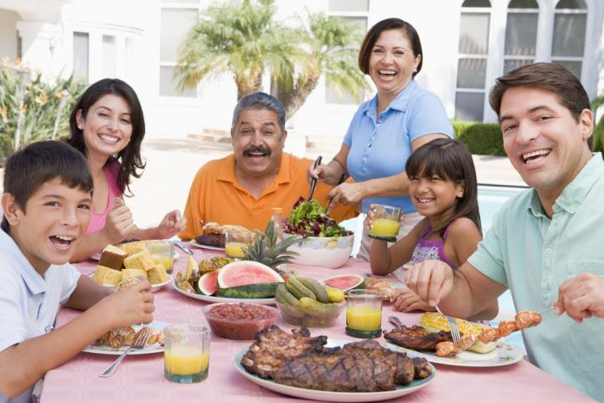
Why Segmentation is Necessary
Consumer needs differs
Differentiation helps products compete
Segmentation helps identify media
To identify the gaps (opportunities) in the market
To help identifying repositioning requirements
Notes:
Not all consumers are alike – different customers have different needs. By segmenting the market and choosing target markets, companies can differentiate their products to provide the benefits that the segments desire. Once a marketer has identified their segment, they can choose media that is targeted to that segment for their advertising.

Slide 5
Demographic Segmentation
Age
Gender
Occupation
Education
Marital Status
Religion
Family size
Family life cycle
Race
Generation
Income
Nationality
Notes:
Demographics are the core of almost all segmentation because they are easy and logical. In addition, they are a cost-effective way to reach segments and demographic shifts are easier to identify than other types of shifts. When researching segmentation and media exposure, a consumer researcher will learn that media exposure is often directly related to demographics. Age segmentation includes segments such as the baby boomers and generations X and Y. Family life-cycle is based on the premise that many families pass through similar phases in their lives and share major life events such as moving, marriage, birth of a child, and retirement. Income, education, and occupation tend to tie together and lead to segmentation based on social class.

Slide 6




Slide 7


Slide 8
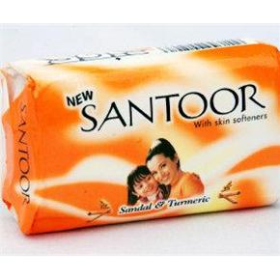
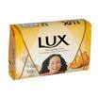



Slide 9
Geographic Segmentation
“Birds of a feather flock together”
The division of a total potential market into smaller subgroups on the basis of geographic variables.
(e.g., region, state, or city)
People who live close to one another are likely to be similar in tastes, incomes, lifestyles & consumption. They might eat similar foods, like the same movies, and take the same types of vacations.

Slide 10


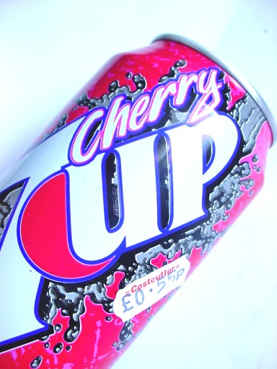

Segmentation Base
Localizes its marketing efforts to specific geographic regions

Slide 11
Psychographic Segmentation
Motivations
Personality
Perceptions
Learning
Attitudes

Slide 12
Segmentation Base
Grouping customers together based on social class, lifestyles and psychological characteristics (attitudes, interests and opinions)
Useful but more difficult to identify and measure compared to demographic variables

Slide 13
ACTUALIZERS
High Resources
Principle Oriented
Status Oriented
Action Oriented
FULFILLEDS
ACHIEVERS
EXPERIENCERS
BELIEVERS
STRIVERS
MAKERS
STRUGGLERS
Low Resources

Slide 14

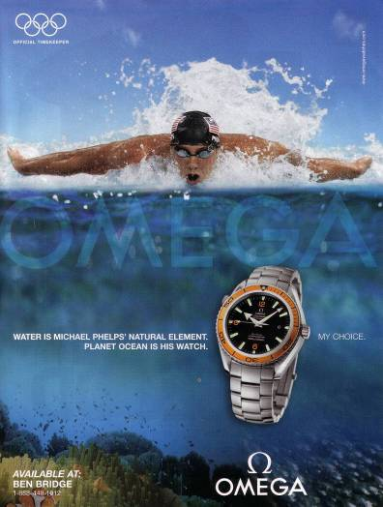
Two High-End Watches for Different Psychological Segments

Slide 15

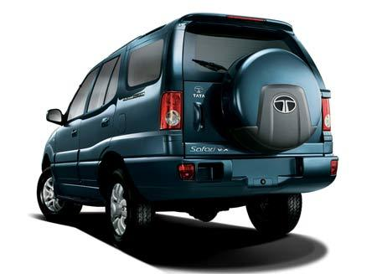
LIFESTYLE
PERSONALITY
VALUES

Slide 16

SOCIAL CLASS

Slide 17
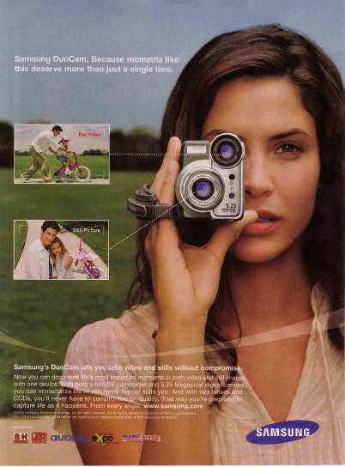
Family Life Cycle Advertising
Video cameras are often purchased by young couples with children.

Slide 18
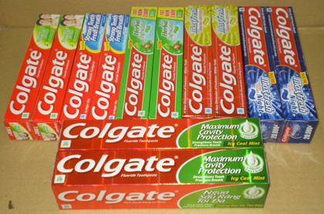
Benefit segmentation
Segmented on the basis of benefits sought by consumers
Toothpaste
General benefits that consumers seek are cleanliness and hygiene in all segments. Other key benefits are:-
Cosmetic
Fluoride
Herbal
Protection against foul smell, modernity and cosmic value. Eg-Colgate, Prudent
Family health, extra protection for children. Eg-Colgate Fluoride, Cibaca Fluoride.
Family health and welfare. Traditionally good for health. Eg-Neem, Dabur.

Slide 19
Consumers’ perceived benefits of Two-wheelers
Motorcycle brands
Enfield | sturdy, good for long rides and high resale value.
Hero-Honda | Fuel efficient, high pick up and stylish
Kawasaki bajaj | High pickup, sleek model
Scooter brands
Bajaj chetak cub | Fuel efficient, lifelong, high resale value
Kinetic Honda | Electronic ignition, easy to ride, trouble free.

Slide 20
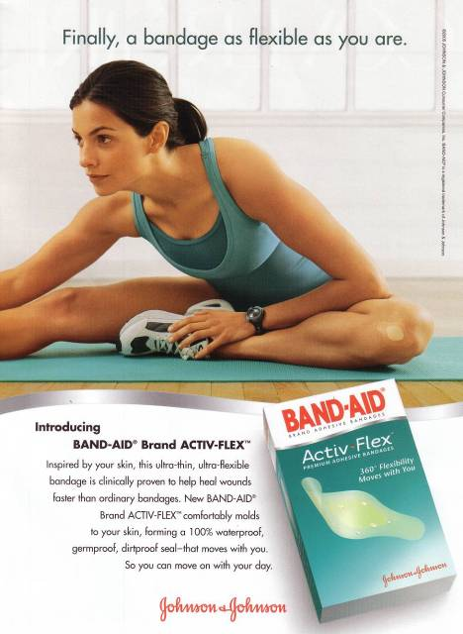
Band-aid offers “flex” as a
benefit to consumers.

Slide 21
Usage – Situation Segmentation
Segmenting on the basis of special occasions or situations
Example Statements:
  Whenever our daughter Jamie gets a raise, we always take her out to dinner.
  When I’m away on business, I try to stay at a suites hotel.
  I always buy my wife flowers on Valentine’s Day.

Slide 22

OCCASSIONS – COCA COLA, RASNA

Slide 23
Behavioral Segmentation
Decision Roles
Initiator
Influencer
Decider
Buyer
User
Behavioral Variables
Occasions
Benefits
User Status
Usage Rate
Buyer-Readiness
Loyalty Status
Attitude

Slide 24
Use-Related Segmentation
Rate of Usage
  Heavy, Medium, Light or Non users.
Awareness Status
  Aware vs. Unaware

Slide 25


BUYER READINESS STAGE – BAJAJ ALLIANZE

Slide 26
Targeting Strategy
1.Undifferentiated/Single/Mass marketing
2.Differentiated marketing
3.Concentrated/Focused/Niche marketing
4.Micro marketing

Slide 27
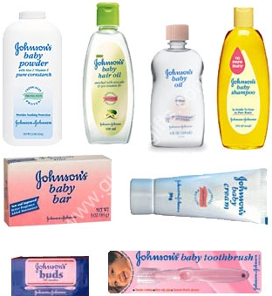

Slide 28
