Slide 1
PERCEPTION

Slide 2
Perception
The process by which an individual selects, organizes, & interprets stimuli into a meaningful and coherent picture of the world
How we see the world around us

Slide 3


Slide 4
How it happens?
Selective about the stimuli we recognise
Subconsciously organise the stimuli we recognise
Interpret the stimuli based on our expectations.

Slide 5
Elements of Perception
  Sensation
  Absolute threshold
  Differential threshold

Slide 6
Sensory Stimuli & Sensory Receptors
Sensory Stimuli | Sensory Receptors
Sight | Eyes
Smell | Nose
Sound | Ears
Taste | Mouth
Texture | Skin

Slide 7
Sensation
A stimulus is any input to any of the senses – products, packaging, commercials, brand names, etc.
Sensory receptors are the human organs that receive the sensory inputs.
Sensory Branding- Burning sensation of Pain killer balms, strong tea, smooth skin, silky hair…
Volkswagon – Talking newspaper.

Slide 8


Slide 9
Sensory Thresholds
The Absolute Threshold
The Differential Threshold

Slide 10
The Absolute Threshold
Threshold – the lowest intensity of a stimulus that can be registered.
Absolute Threshold- The lowest level at which an individual can experience a sensation.
For example, in an experiment on sound detention, researchers may present a sound with varying levels of volume. The smallest level that a participant is able to hear is the absolute threshold.

Slide 11


Slide 12
The Differential Threshold
The minimum difference that can be detected between two stimuli is called the ‘differential threshold’ or j.n.d. – just noticeable difference.

Slide 13


Slide 14


Slide 15
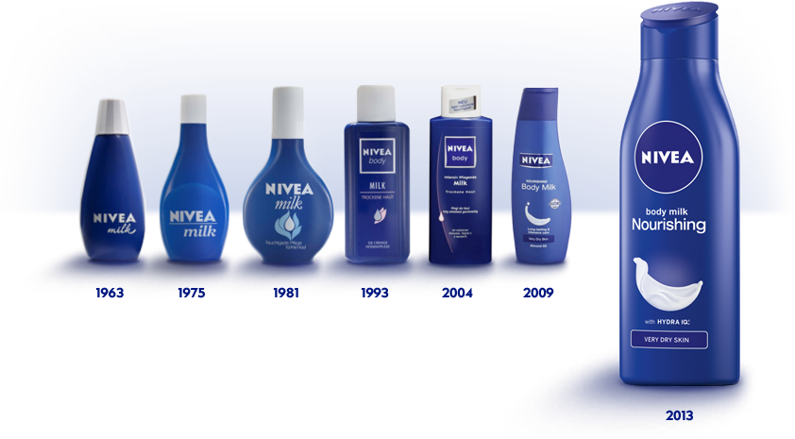

Slide 16


Slide 17
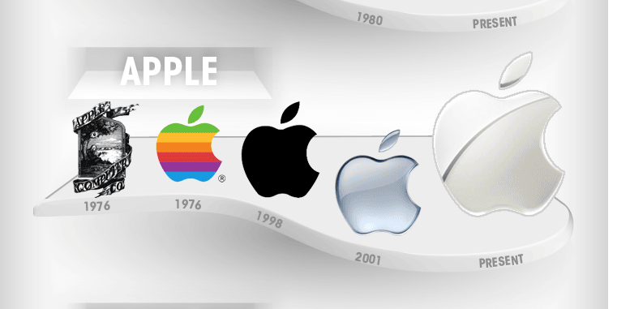

Slide 18


Slide 19


Slide 20
Perceptual Process
STIMULI
Sights
Sounds
Smells
Tastes
Textures
Sensory Receptors –
EXPOSURE
Attention
Selection
organize
interpretation

Slide 21

Why Are Consumers
Likely to Notice This Ad?

Slide 22

Fevicol – Catching the attention

Slide 23
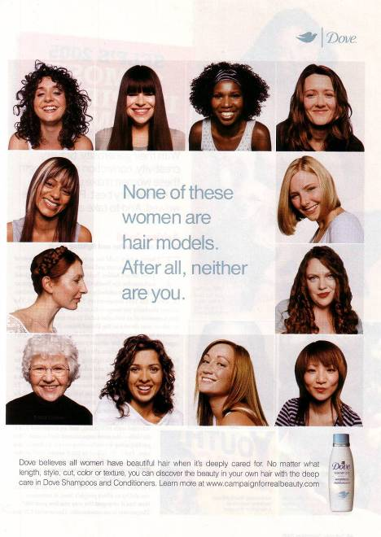
Dove’s campaign stresses the everyday woman.

Slide 24
Rin detergent – thundering light
Raymond’s – “feels like heaven” / “Complete man”
Some individuals may be very much receptive and can immediately sense the message that an ad is trying to convey, while others might not be quick enough to sense it.

