Slide 1
Consumer Beliefs & Attitude

Slide 2



What Is Your Attitude Toward the Product Advertised? What Is Your Attitude Toward the Ad Itself? Are the Two Attitudes Similar or Different?

Slide 3
You May Have Liked the Product but Disliked the Ad or Vice Versa

Slide 4
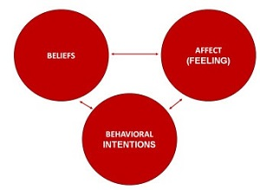
Components of Attitude

Slide 5
Consumer Beliefs
Beliefs are the knowledge and inferences that a consumer has about products and the possible benefits derived from using them
Beliefs result from cognitive learning

Slide 6
Consumer Beliefs
Companies or Retailers mark up prices before putting them on sale
Lower prices generally means inferior quality
Shopping in a departmental store saves money
Celebrities are admired by their followers though they do not use the product they endorse

Slide 7
Attitude
A learned predisposition to behave in a consistently favorable or unfavorable manner with respect to a given object.
(situation – fav or unfav)
Notes:
We have attitudes toward many things – to people, products, advertisements, ideas, and more. For the most part, these attitudes have been learned and guide our behavior toward the object. It is important to understand these four concepts. The first is that we must clearly define the object which we are discussing or measuring the attitude toward. Is it a product category, a specific brand, or a particular model? The second is the agreement among researchers that attitudes are learned, either through direct experience or from others. Attitudes are consistent, they are not necessarily permanent and can change over time. We all know how our attitude can be affected by a situation – think about the times you have to eat foods that are not necessarily your favorite but they are what is available or what you are being served at a friend’s house.

Slide 8

What Information Does This Ad Provide to Assist
Consumers in Forming Attitudes Toward the Saturn Vue Hybrid?

Slide 9
It is Stylish, Safe, and
Good for the Environment

Slide 10
Structural Models of Attitudes
Tricomponent Attitude Model
Multiattribute Attitude Model
The Trying-to-Consume Model
Attitude-Toward-the-Ad Model
Notes:
These are models that attempt to understand the relationships between attitude and behavior. They will be explained in more detail on the following slides.

Slide 11
A Simple Representation of the Tricomponent Attitude Model
Cognitive
Affective
Conative
Notes:
The tricomponent attitude model has three components, as seen on this figure – the cognitive, affective, and conative components. Each of these will be explained in more detail in the slides that follow.

Slide 12
The Tricomponent Model
Components
It is what you know or think about an object.
This can be formed through direct experience or what you learn from others.
The knowledge you acquire becomes a belief.
Cognitive
Affective
Conative

Slide 13
The Tricomponent Model
Components
A consumer’s emotions or feelings about a particular product or brand
Cognitive
Affective
Conative
Notes:
How you feel about a brand, the emotions you have toward it, constitutes the affective component of the model. These feelings often tend to be overall good or bad feelings.

Slide 14
The Tricomponent Model
Components
The likelihood or tendency that an individual will undertake a specific action or behave in a particular way with regard to the attitude object
Cognitive
Affective
Conative
Notes:
The conative component describes the likelihood that you will do something in regard to the object. One of the most important is your intention to buy a certain object.

Slide 15
Discussion Questions
Explain your attitude towards “FAST FOOD” based on the tricomponent attribute model.
Or
Explain your attitude toward product of your choice based on the tricomponent attribute model.
Notes:
You probably have an overall positive or negative feeling toward your university. Try to break this affective component down a bit more – what do you like and not like? You can now look to the cognitive to determine what beliefs you have about these different parts of your university. Finally, how does this influence what you do? Will you come back for a graduate degree? Recommend your little brother or sister attend? Send your children here? Donate money as an alumnus?

Slide 16
Multiattribute Attitude Models
Notes:
Just as the name implies, these are models that breakdown overall attitude into the attributes or beliefs which form an overall opinion. There are several of these models, as you will see on the next few slides.

Slide 17
Multiattribute Attitude Models
Types
Useful to measure attitudes toward product and service attributes
E.g. buying a house –
2 bhk +2 freshrooms + back yard.
The attitude-toward-object model
The attitude-toward-behavior model
Theory-of-reasoned-action model
Notes:
According to the attitude-toward-object model, consumers will like a brand or product that has an adequate level of attributes that the consumer thinks are positive. For example, if you are buying a home, there is a list of attributes that the home must have – 2 bedrooms, 2 bathrooms, air conditioning, and a back yard. With this model, an attitude is positive for the house that has the most of these attributes.

Slide 18

Positive attitudes toward brands help with brand extensions

Slide 19
Multiattribute Attitude Models
Types
Is the attitude toward behaving or acting with respect to purchasing an object, rather than the attitude toward the object itself
How likely are you to purchase brand X rather than how highly do you rate brand X.
The attitude-toward-object model
The attitude-toward-behavior model
Theory-of-reasoned-action model
Notes:
Instead of asking people what product they like and have positive attitudes toward, the attitude-toward-behavior model is based on how positive someone's attitude is toward acting a certain way, for instance purchasing a certain brand. The question is now how likely are you to purchase brand X rather than how highly do you rate brand X.

Slide 20
Multiattribute Attitude Models
Types
Includes cognitive, affective, and conative components
Includes subjective norms in addition to attitude
The attitude-toward-object model
The attitude-toward-behavior model
Theory-of-reasoned-action model
Notes:
Like other models, the theory of reasoned action has the three components, cognitive (think), affective (feel), and conative (do). In this model, we also need to understand subjective norms or how a consumer is influenced by others.

Slide 21
Discussion Question
Now use the theory of reasoned action to describe your attitude toward your college/university when deciding on which school to attend.
Notes:
This will lead you to think about the subjective norm and your attitude toward the behavior.

Slide 22
Theory of Trying to Consume
The theory of trying to consume addresses the fact that many people may want to purchase but in many cases they cannot. This may occur for personal reasons, such as not having enough money, or situational reasons, such as not being able to go to a particular store.
Notes:
The theory of trying to consume addresses the fact that many people may want to purchase but in many cases they cannot. This may occur for personal reasons, such as not having enough money, or situational reasons, such as not being able to go to a particular store.

Slide 23
Attitude-Toward-the-Ad Model
The attitude-toward-the-ad model helps us understand how advertising impacts attitudes and behaviors
Notes:
The attitude-toward-the-ad model helps us understand how advertising impacts attitudes. The model is more thoroughly diagramed on the next slide.

Slide 24
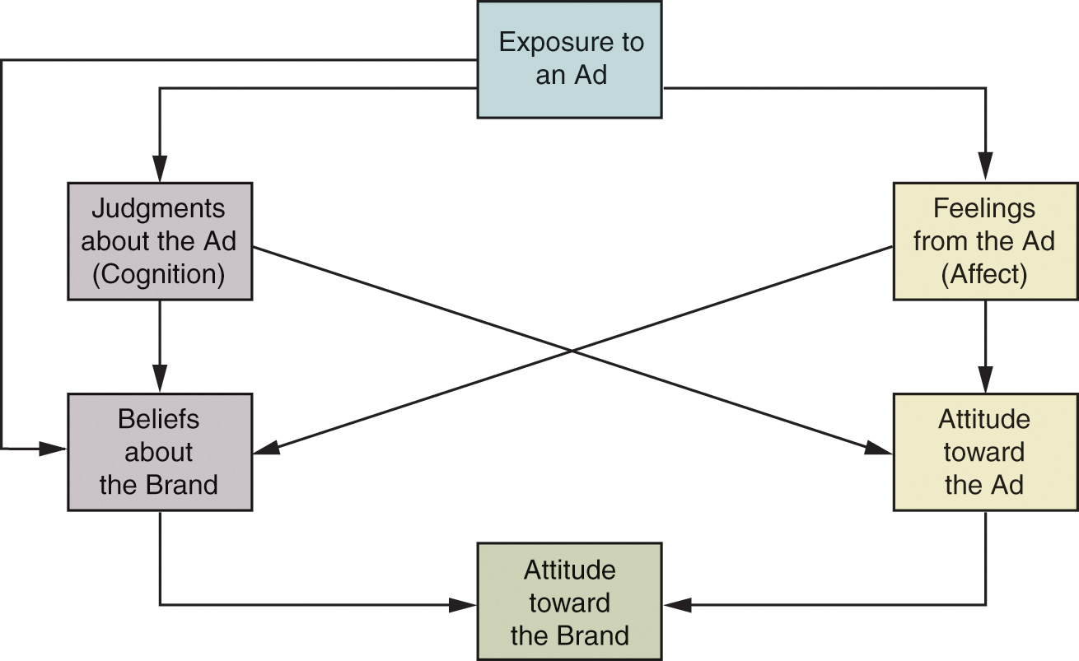
A Conception of the Relationship Among Elements in an Attitude-Toward-the-Ad Model
Notes:
Here we see that everything begins with exposure to the ad. After this exposure, the consumer has feelings (affect) and thoughts (cognition) regarding the ad. This forms an attitude which works with beliefs about the brand to help form an attitude toward the brand.

Slide 25
Attitude Formation
Sources of influence on attitude formation
  Personal experience
  Influence of family
  Direct marketing and mass media
Personality factors

Slide 26

How Does a Favorably Known Brand Name Impact the Formation of Consumer Attitudes
Toward a New Product?

Slide 27

How Does Offers Impact Consumers’ Attitudes?

Slide 28
New Customers Will Try the Product,
Existing Customers will be Rewarded.

Slide 29
Functions of Attitudes
Utilitarian
Ego-defensive
Value-expressive
Knowledge
Notes:
Changing the basic motivational function means to change the basic need that a consumer is trying to fulfill. Utilitarian function is how the product is useful to us. A marketer might want to create a more positive attitude toward a brand by showing all it can do. An ego-defensive function would show how the product would make them feel more secure and confident. A value-expressive function would more positively reflect the consumer’s values, lifestyle, and outlook. Finally, the knowledge function would satisfy the consumer’s “need to know” and help them understand more about the world around them.
It is important for marketers to realize that they might have to combine functions because different customers are motivated to purchase their products for different reasons. Someone might buy a product because it tastes good and fills them up (utilitarian), while another thinks it is low fat and will make them healthy and therefore look better (ego-defensive).

Slide 30

Why and How Does This Ad Appeal to the Utilitarian Function?

Slide 31
The Product is Green and Works as Well or Better than Other Products.

Slide 32

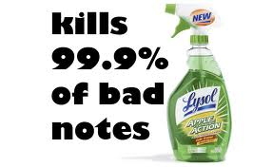

Slide 33
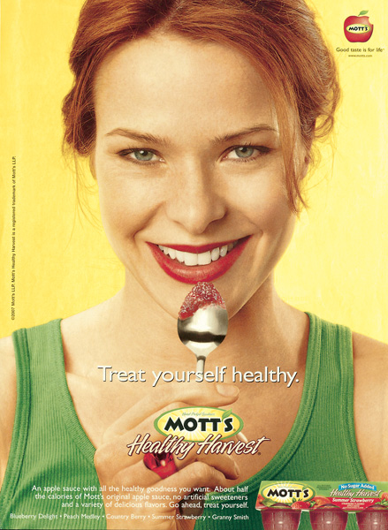
Which Lifestyle- Related Attitudes Are Expressed or Reflected in This Ad?

Slide 34
Healthy Eating and Snacking Lifestyle

Slide 35

How Does This Ad Provide Information to Establish or Reinforce Consumer Attitudes?

Slide 36
It Raises the Question About UVA Rays and then Provides Information on Sun Protection.

Slide 37

Value Expressive Function

Slide 38

Crest uses a knowledge appeal.

Slide 39
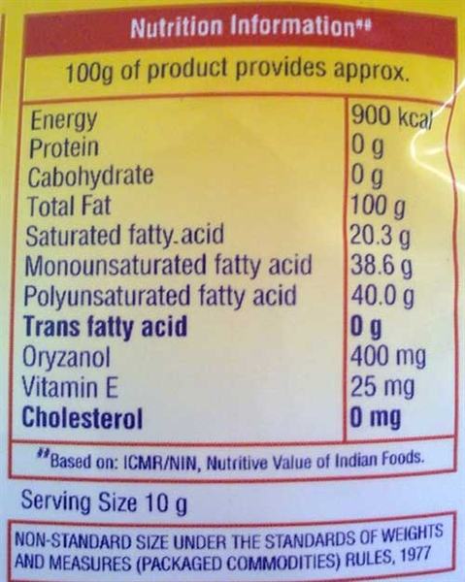
Knowledge Function

Slide 40

Resolving two conflicting attitudes
Moving from negative to positive attitude
Example: Conflicting attitude - Saffola oil though healthy not tasty.

Slide 41
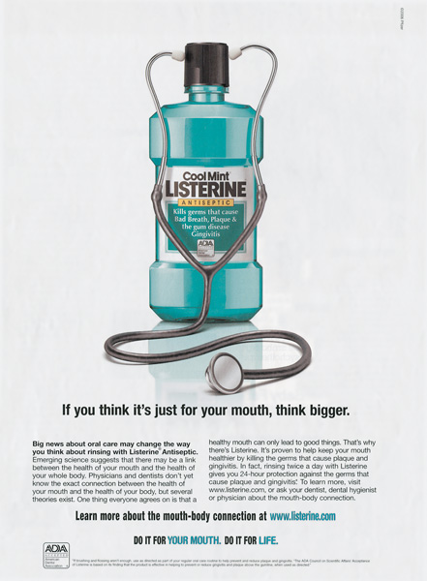
How Is This New Benefit Likely to Impact Consumers’ Attitudes Toward the Product?

Slide 42
The Consumer Will Have a More Positive Attitude Overall from the New Attribute.

