Slide 1



Slide 2
Session 7
Personality and Consumer Behavior

Slide 3
Personality and
The Nature of Personality
The inner psychological characteristics that both determine and reflect how a person responds to his or her environment
The Nature of Personality:
  Personality reflects individual characteristics
  Personality is consistent and long-lasting
  Personality can change
Notes:
The study of personality has been approached in many different ways. Heredity, early childhood experiences, and other social influences have a strong effect on who you become. The definition given here is on inner characteristics which distinguish one individual from others.
There are some interesting findings regarding the nature of personality. First of all, personality reflects individual differences. Because no two people are exactly the same, marketers can look for certain similar personality traits in different consumers. These consumers can then be grouped together based on this identified personality train. Personality is consistent and enduring. This helps marketers predict consumer behavior over time in terms of personality. Finally, personality can change due to major life events, such as marriage. You may notice personally that your personality has changed somewhat as you have grown – certainly your personality now is somewhat different then from when you were 7 years old.

Slide 4

Discussion Questions
How would you describe your personality?
How does it influence products that you purchase?
Notes:
You will probably describe your personality in terms of qualities, attributes, traits, factors and mannerisms. These personality traits influence products, including food, vacations, education, clothing, and more.

Slide 5
Theories of Personality
Freudian theory
  Unconscious needs or drives are at the heart of human motivation
Neo-Freudian personality theory
  Social relationships are fundamental to the formation and development of personality
Notes:
These are the three major theories of personalities. There are many more but these three have been chosen because they are important to the relationship between personality and consumer behavior. Each will be discussed in detail on the next couple of slides.

Slide 6
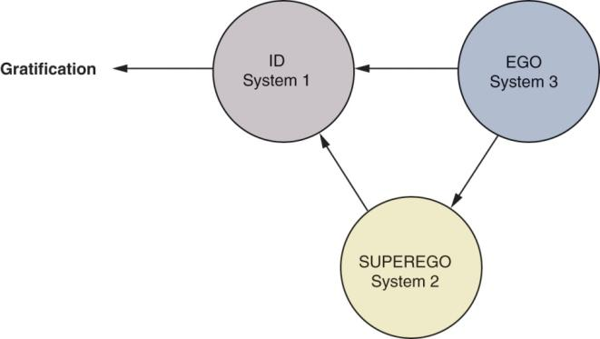
Freudian Theory
Id
  pleasure principle
The Superego:
  social, moral, & ethical inhibitions
The Ego:
  mediator between id’s impulses & superego’s restrictions
Notes:
Sigmund Freud was one of the most important and influential psychiatrists of all time.
Freudian theory itself is based on the existence of unconscious needs or drives as the heart of human motivation and personality. According to Freud, human personality consists of these three systems, the id, super ego and the ego. The Id is the “warehouse” of primitive drives, basic physiological needs such as hunger, thirst. The superego drives the individual to fulfill their needs in a socially acceptable function. Finally, the ego is the internal monitor that balances the needs of the id and the superego.

Slide 7
Snack Foods and Personality Traits
Snack Foods | Personality Traits
Potato chips | Ambitious, successful, high achiever, impatient with less than the best.
Tortilla chips | Perfectionist, high expectations, punctual, conservative, responsible.
Pretzels | Lively, easily bored with same old routine, flirtatious, intuitive, may over commit to projects.
Snack crackers | Rational, logical, contemplative, shy, prefers time alone.
Cheese curls | Conscientious, principled, proper, fair, may appear rigid but has great integrity, plans ahead, loves order.

Slide 8
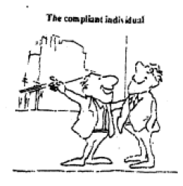
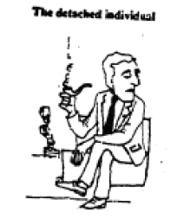
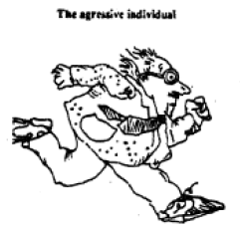
Neo-Freudian Personality Theory
Social relationships are fundamental to personality
  Compliant: move toward others
  Aggressive: move against others
  Detached: move away from others
Notes:
As opposed to Freud’s theories which were based heavily on development, Neo-Freudian’s are concerned with social relationships. These relationships are formed to reduce feelings of inferiority or tension. Furthermore, people can be classified as to how they interact with others – are they compliant, aggressive, or detached. A compliant individual desires attention, an aggressive desires admirations, and a detached person desires independence and freedom from obligation. What is particularly interesting is how research has shown that these different personality groups differ in their brand usage.

Slide 9
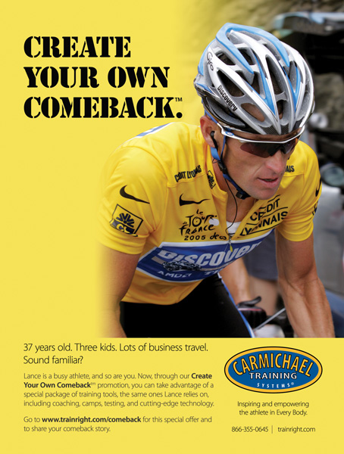
Why Is Appealing to an Aggressive Consumer a Logical Position for This Product?

Slide 10
Because its Consumer Seeks to Win and Achieve Recognition

Slide 11
Consumer Innovativeness
Willingness to innovate
Further broken down for hi-tech products
  Global innovativeness
  Domain-specific innovativeness
  Innovative behavior
Notes:
Consumer innovators are the group of consumers that are very open to new ideas and are usually the first to purchase products. Innovativeness is the underlying trait that describes a consumer’s willingness to try new products. Companies have found this very important when introducing brand extensions because it is a key factor in the consumer’s likelihood to try the new product. For hi-tech products, we see that innovativeness can be explained at three levels. The first, global innovativeness, is the overall innovative level of the consumer. Drilling down further, domain-specific innovativeness has to do with the particular product category, and finally, the innovative behavior is the actual purchase of the new product.

Slide 12
Dogmatism
A personality trait that reflects the degree of rigidity a person displays toward the unfamiliar information that is contrary to his or her own established beliefs
Notes:
Dogmatic is a personality trait that describes how rigid or open a person is to new and unfamiliar ideas and products. A person who is highly dogmatic approaches the unfamiliar defensively and with discomfort. They will rarely consider the unfamiliar and tend to be very close minded. Marketers have realized this type of customer appreciates advertising appeals with celebrities and other experts.

Slide 13
Variety-Novelty Seeking
Measures a consumer’s degree of variety seeking
Examples include:
  Exploratory Purchase Behavior
  Use Innovativeness
  Vicarious Exploration
Notes:
Consumers seek variety in many ways. Some exhibit exploratory purchase behavior where they switch brands often to experience new products. Other consumers display variety by use innovativeness, using an existing product in a new way. Finally, vicarious exploration, which often does not involve actual purchase about the product, refers to daydreaming or thinking often about a new product. Ask yourself, for product categories, how do you exhibit variety-novelty seeking?

Slide 14

Cognitive Personality Factors
Need for cognition (NFC)
  A person’s craving for enjoyment of thinking
  Individual with high NFC more likely to respond to ads rich in product information
.
Notes:
Researchers are aware that cognitive personality factors influence consumer behavior. In fact, it has been realized that the level of a consumer’s need for cognition affects how they are likely to respond to certain types of advertisements. Those that are high in need for cognition tend to respond to ads that supply product information as opposed to those who are low in need for cognition who tend to be attracted to the background of the ad, attractive models, and cartoon characters.

Slide 15
Cognitive Personality Factors
Visualizers
Verbalizers
Notes:
Another cognitive personality factor that researchers have isolated is whether a consumer is a visualizer who prefers visual information or a verbalizer who prefers written or verbal information. This difference in cognitive personality factors would affect how they respond to a print ad.

Slide 16
One or Multiple Selves
A single consumer will act differently in different situations or with different people
We have a variety of social roles
Marketers can target products to a particular “self”
Notes:
To understand multiple selves, think of the way you present yourself and think about yourself at a formal university function (career fair perhaps) vs. a party with good friends. Next, think of the clothing you would purchase for these events. It would likely be very different as you are presenting a different “self” at each event.

Slide 17


Self-Image / Self-concept
Self-Image Congruence
  When self-image matches brand-user image.

Slide 18
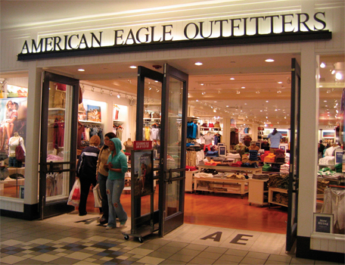
Self-Congruency
Does this store match ur self-concept?

Slide 19

Which Consumer
Self-Image Does This Ad Target, and Why?

Slide 20
Actual self-image because it tells middle-age women who like their hair long to continue doing so.

Slide 21
