Slide 1
Consumer Learning

Slide 2
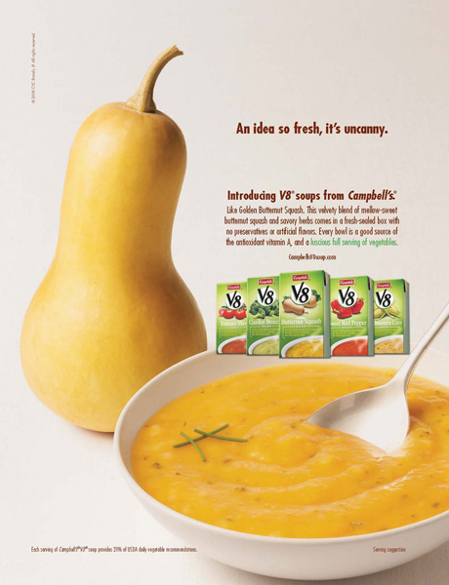
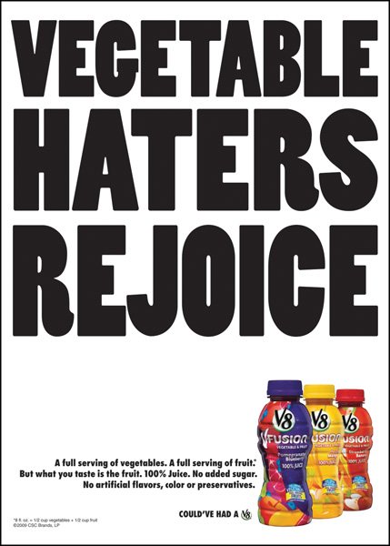
In Terms of Consumer Learning, Are These New Products Likely to Succeed?

Slide 3
These Ads Might Induce Consumers to eat Vegetables

Slide 4
Learning:
The process by which individuals acquire the purchase and consumption knowledge and experience that they apply to future related behavior
Marketers must teach consumers:
  where to buy
  how to use
  how to maintain
  how to dispose of products
Notes:
This definition of learning can be looked at more specifically. It is important to realize that it is a process, that it changes over time as new knowledge and experiences are gained by the consumer. New knowledge and experience serve as feedback to the consumer and will influence their future behavior.

Slide 5
Learning Processes
Intentional
  learning acquired as a result of a careful search for information
Incidental
  learning acquired by accident or without much effort

Slide 6
Two Major Learning Theories:
Behavioral Learning
Based on observable behaviors (responses) that occur as the result of exposure to stimuli
Cognitive Learning
Learning based on mental information processing
Often in response to problem solving
Also known as stimulus response theory.
Notes:
These are the two general categories of learning that will be discussed in this chapter. Each is covered in extensive detail on future slides.

Slide 7
Elements of Learning Theories:
Motivation
Cues
Response
Reinforcement
Unfulfilled needs lead to motivation
Stimuli that direct motives
Consumer reaction to a drive or cue
Increases the likelihood that a response will occur in the future as a result of a cue
Notes:
There are the four major elements of all learning theories. Motivation is important because it will differ from one consumer to the next. We may all have a need, but some are more motivated to fulfill the need versus another. Often, a consumer does not realize they have a need. A cue is the stimulus that helps direct a consumer’s motives. They include price, styling, packaging, advertising, and store displays. A consumer will have a response to a drive or a cue. The response is how the consumer behaves after being exposed to a cue or developing motivation. Finally, reinforcement is tied to the likelihood that the response will occur in the future.

Slide 8
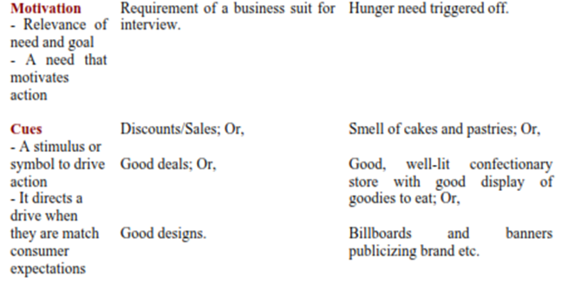
1.

Slide 9
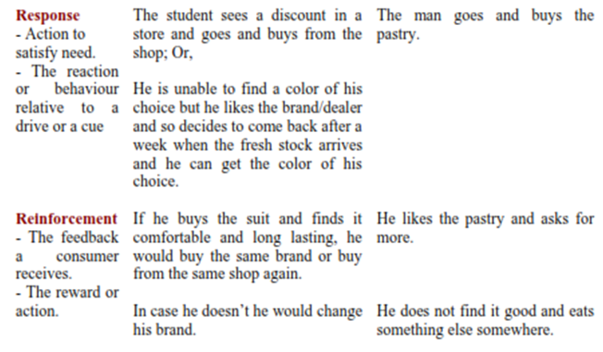
2.

Slide 10
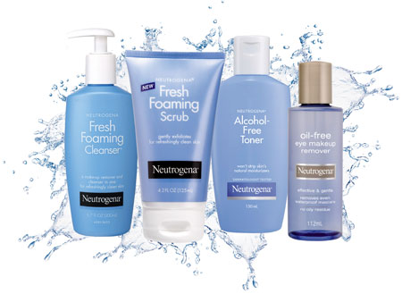

Slide 11
Behavioral Learning Theories
Classical Conditioning
Instrumental (Operant) Conditioning

Slide 12
Classical Conditioning
A behavioral learning theory according to which a stimulus is paired with a conditioned response
Notes:
Many of you may be familiar with Pavlov’s dog. In this situation, Pavlov sounded a bell, then applied meat paste to the dog’s tongue. Over time, the dog began to associate the bell with the meat paste. Eventually, when Pavlov rang the bell, the dog would salivate because he expected the meat paste to be applied. What happened was learning or conditioning. The dog learned that the meat paste, which is called the unconditioned stimulus, was associated with the bell, which is the conditioned stimulus. He began to have a conditioned response to the bell when he learned that the bell meant food. The experiment is provided in more detail on the following slide.

Slide 13
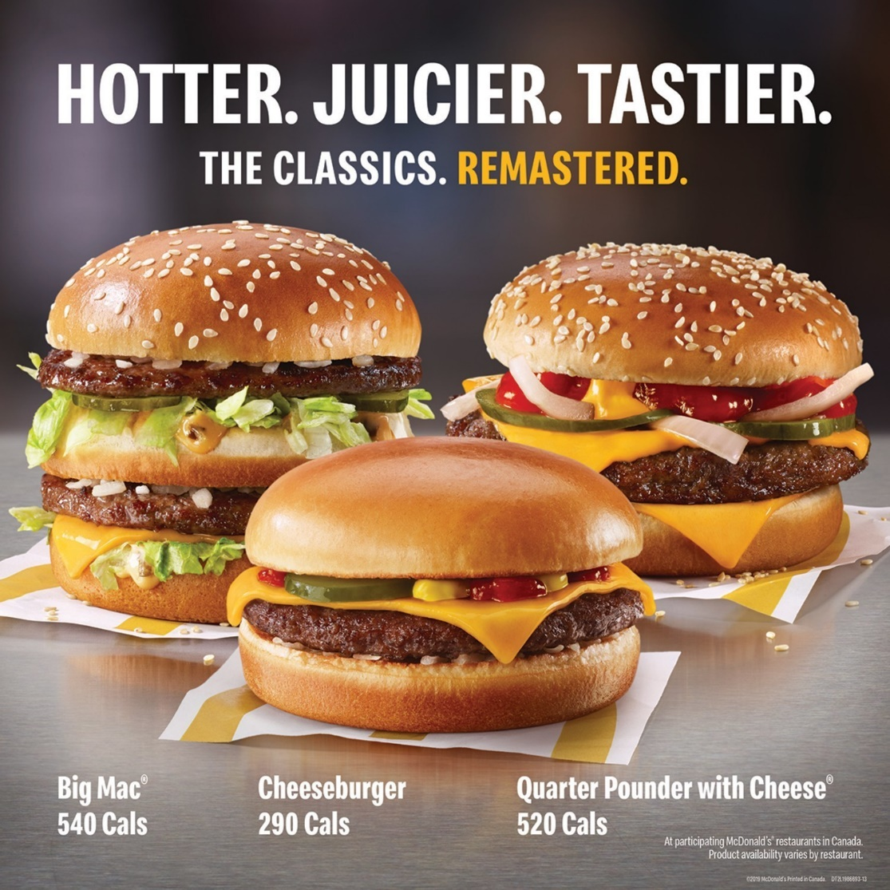
Examples of Classical Conditioning

Slide 14
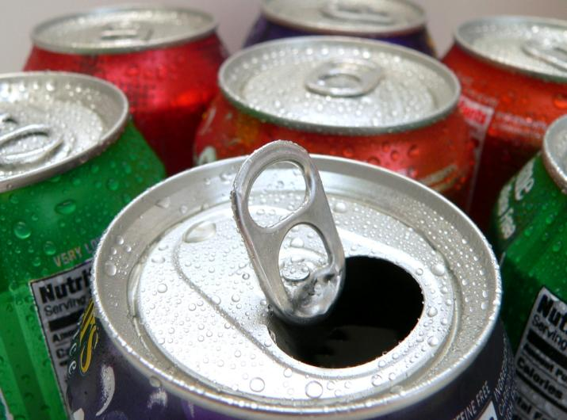
Discussion Questions
For Coca-Cola or another beverage company:
  How have they used classical conditioning in their marketing?
Notes:
Think about the advertisements for these ads. The smiling people and music.

Slide 15
Instrumental (Operant) Conditioning
A behavioral theory of learning based on a trial-and-error process, with habits forced as the result of positive experiences (reinforcement) resulting from certain responses or behaviors.
Notes:
Instrumental conditioning also requires a link between a stimulus and a response. The difference between this and classical conditioning is that the learned response is the one that is most satisfactory of responses. The famous psychologist B.F. Skinner is associated with this type of conditioning. He pointed out that learning occurs based on rewards. Through trial and error, consumers learn which behaviors lead to rewards and which do not.

Slide 16
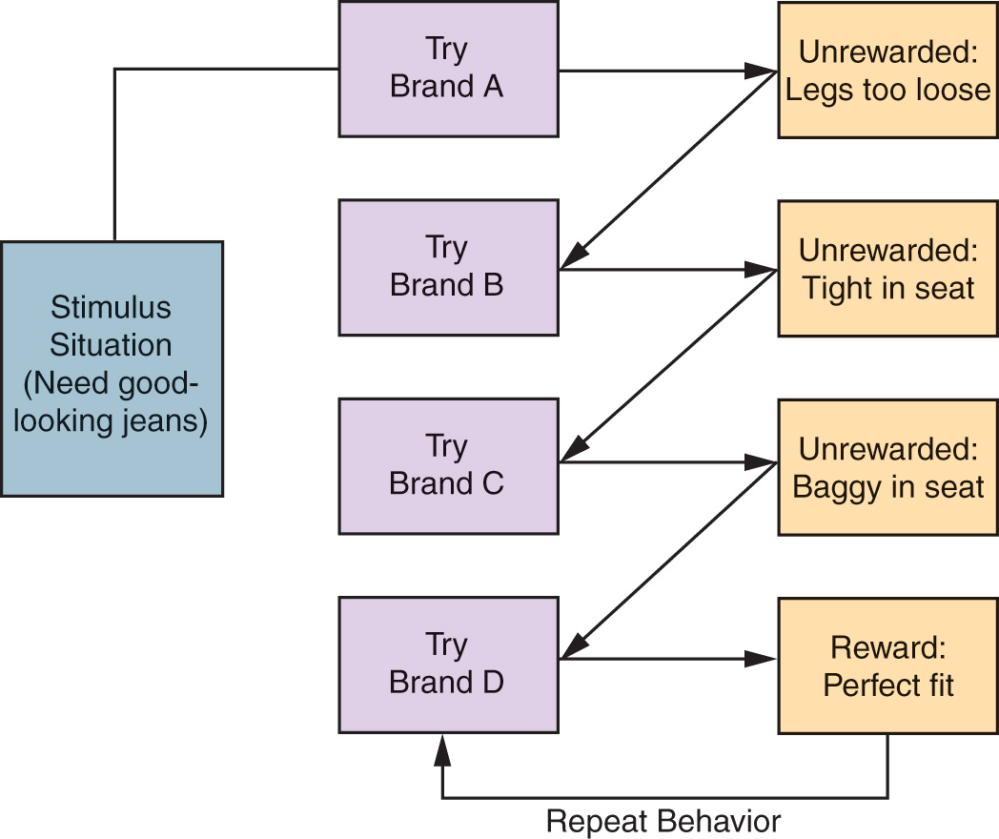
A Model of Instrumental Conditioning:
Notes:
Here is a model of instrumental conditioning. You can see this consumer tried on four brands. The first three brands ended with no rewards – they simply did not fit. The final brand, Brand D gave the consumer the reward of a perfect fit. The consumer has learned that these jeans are a good fit and will likely repeat this behavior the next time they are in the stimulus situation of needing good-looking jeans.

Slide 17
Observational Learning
A process by which individuals observe how others behave in response to certain stimuli and reinforcements. Also known as modeling or vicarious learning.

Slide 18

The consumer observes a positive response by two teens.

Slide 19
Discussion Question
How do advertisers drive consumers to rehearse information?
When does this work against the advertiser?
Can you think of examples of advertisements which drive you to rehearse?

Slide 20
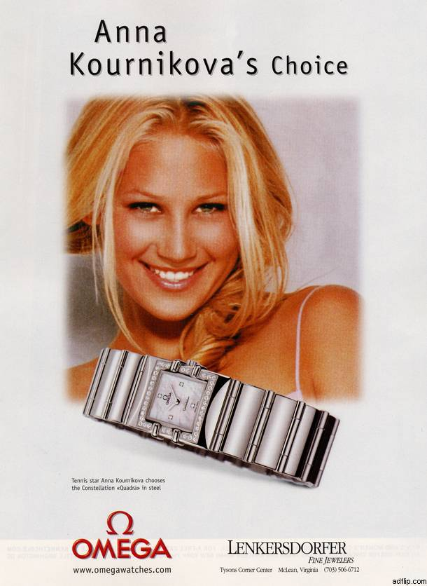

Slide 21


