Slide 1

Social Media Marketing
Session 16 & 17

Slide 2
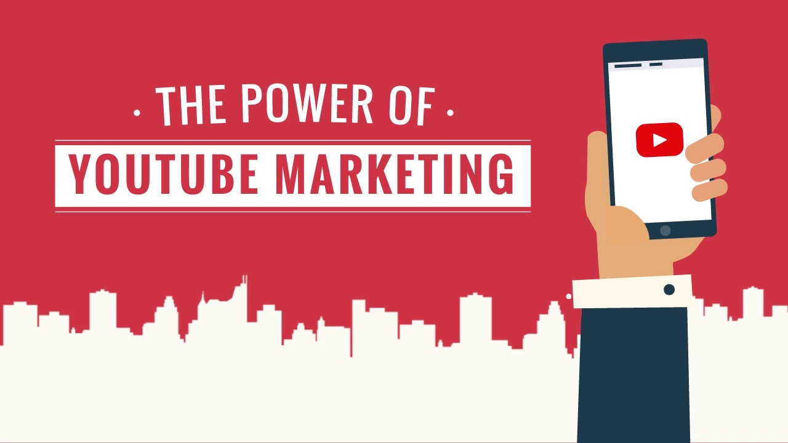
YouTube
Let’s start with some stats!
YouTube has more than 2 billion logged-in monthly users.
YouTube is the world’s second-most visited website
40.9% of YouTube watchtime happens on mobile
View of videos with variations of “beginner” in the title increased more than 50% between March and July 2020.
70% of viewers bought from a brand after seeing it on YouTube.
YouTube Is the Second-Most Popular Search Engine After Google

Slide 3
YouTube
Oh god! These are a lot of stats
Viewers who complete TrueView ads—were 23 times more likely to visit or subscribe to a brand channel, watch more by that brand, or share the brand video.
59% of executives say they would rather watch a video than read text.
Viewers retain 95% of a message when they watch it in a video, compared to 10% when reading it in text.
A website is 53 times more likely to reach the front page of Google if it includes video.

Slide 4
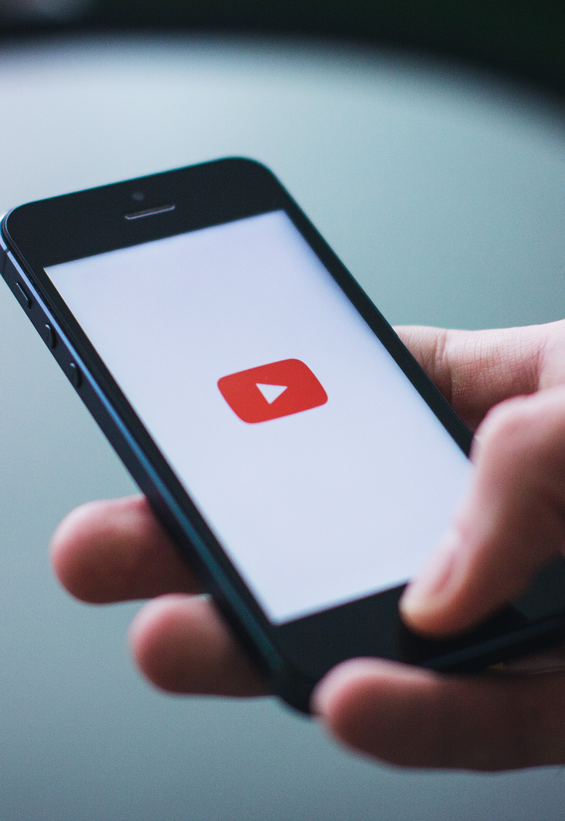
Monetization
How to earn from YouTube
Subscribers: 1,000
Watch hours: 4,000
All in 12 months!

Slide 5
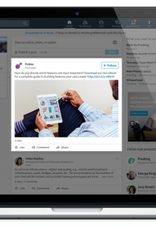
Ad Formats
What is allowed on LinkedIn Ads?
Static Images
Carousels
Videos
Text Ad
Spotlight Ad
Message Ad
Conversation Ad

Slide 6
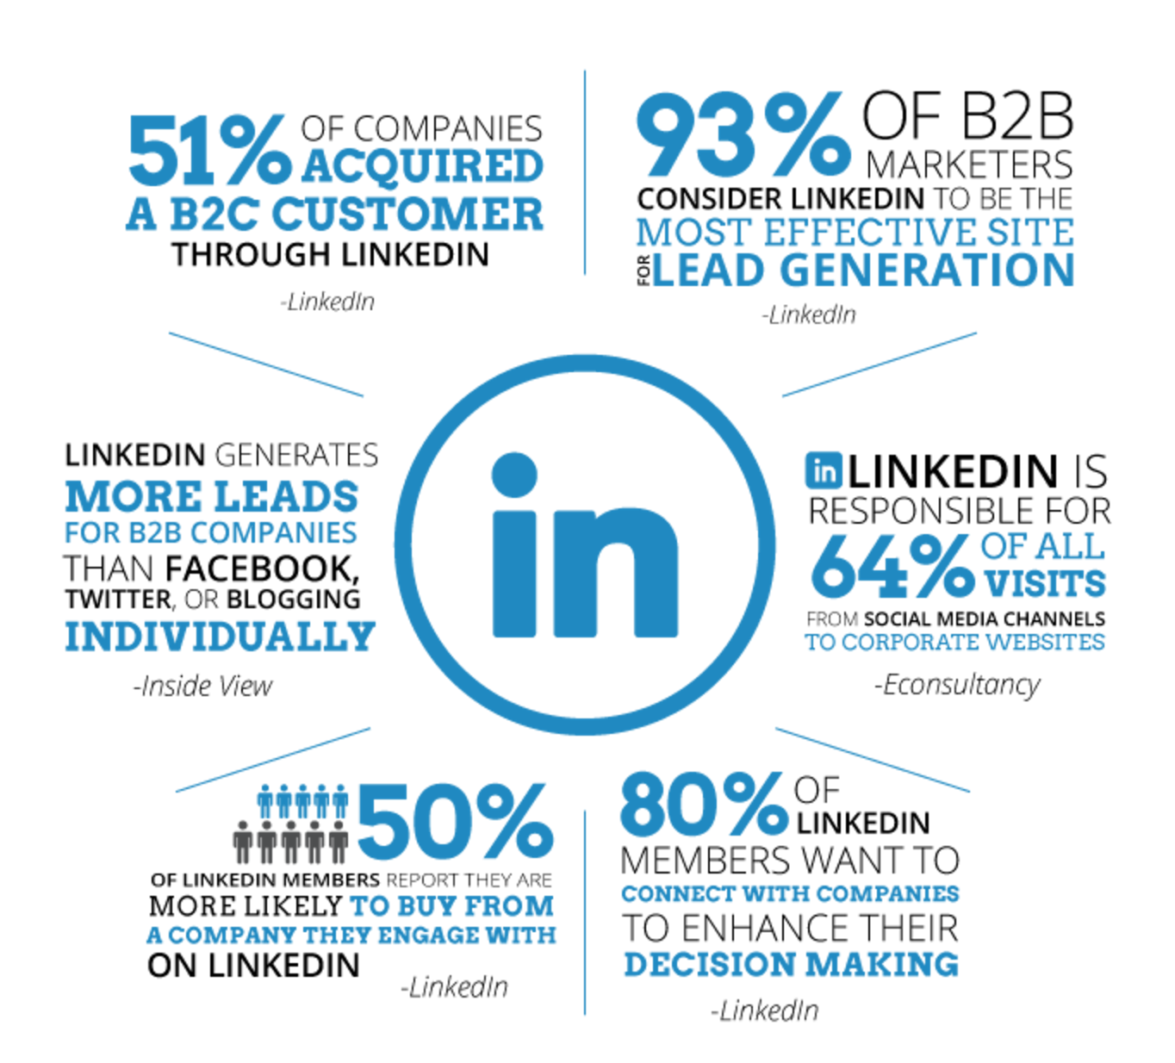
LinkedIn – A Synopsis

Slide 7
LinkedIn Marketing Tactics
Do leverage them
Join groups and post/comment regularly
Ask your employees to share your content – they become influencers for your organization in their circles
Post as if you are starting a conversation.
Promote product/service trials and not sales.
Publish news regularly about your product/service/organization

Slide 8

THANK YOU!

