Slide 1

Social Media Marketing
Session 16 & 17

Slide 2

YouTube
Let’s start with some stats!
YouTube has more than 2 billion logged-in monthly users.
YouTube is the world’s second-most visited website
40.9% of YouTube watchtime happens on mobile
View of videos with variations of “beginner” in the title increased more than 50% between March and July 2020.
70% of viewers bought from a brand after seeing it on YouTube.
YouTube Is the Second-Most Popular Search Engine After Google

Slide 3
YouTube
Oh god! These are a lot of stats
Viewers who complete TrueView ads—were 23 times more likely to visit or subscribe to a brand channel, watch more by that brand, or share the brand video.
59% of executives say they would rather watch a video than read text.
Viewers retain 95% of a message when they watch it in a video, compared to 10% when reading it in text.
A website is 53 times more likely to reach the front page of Google if it includes video.

Slide 4
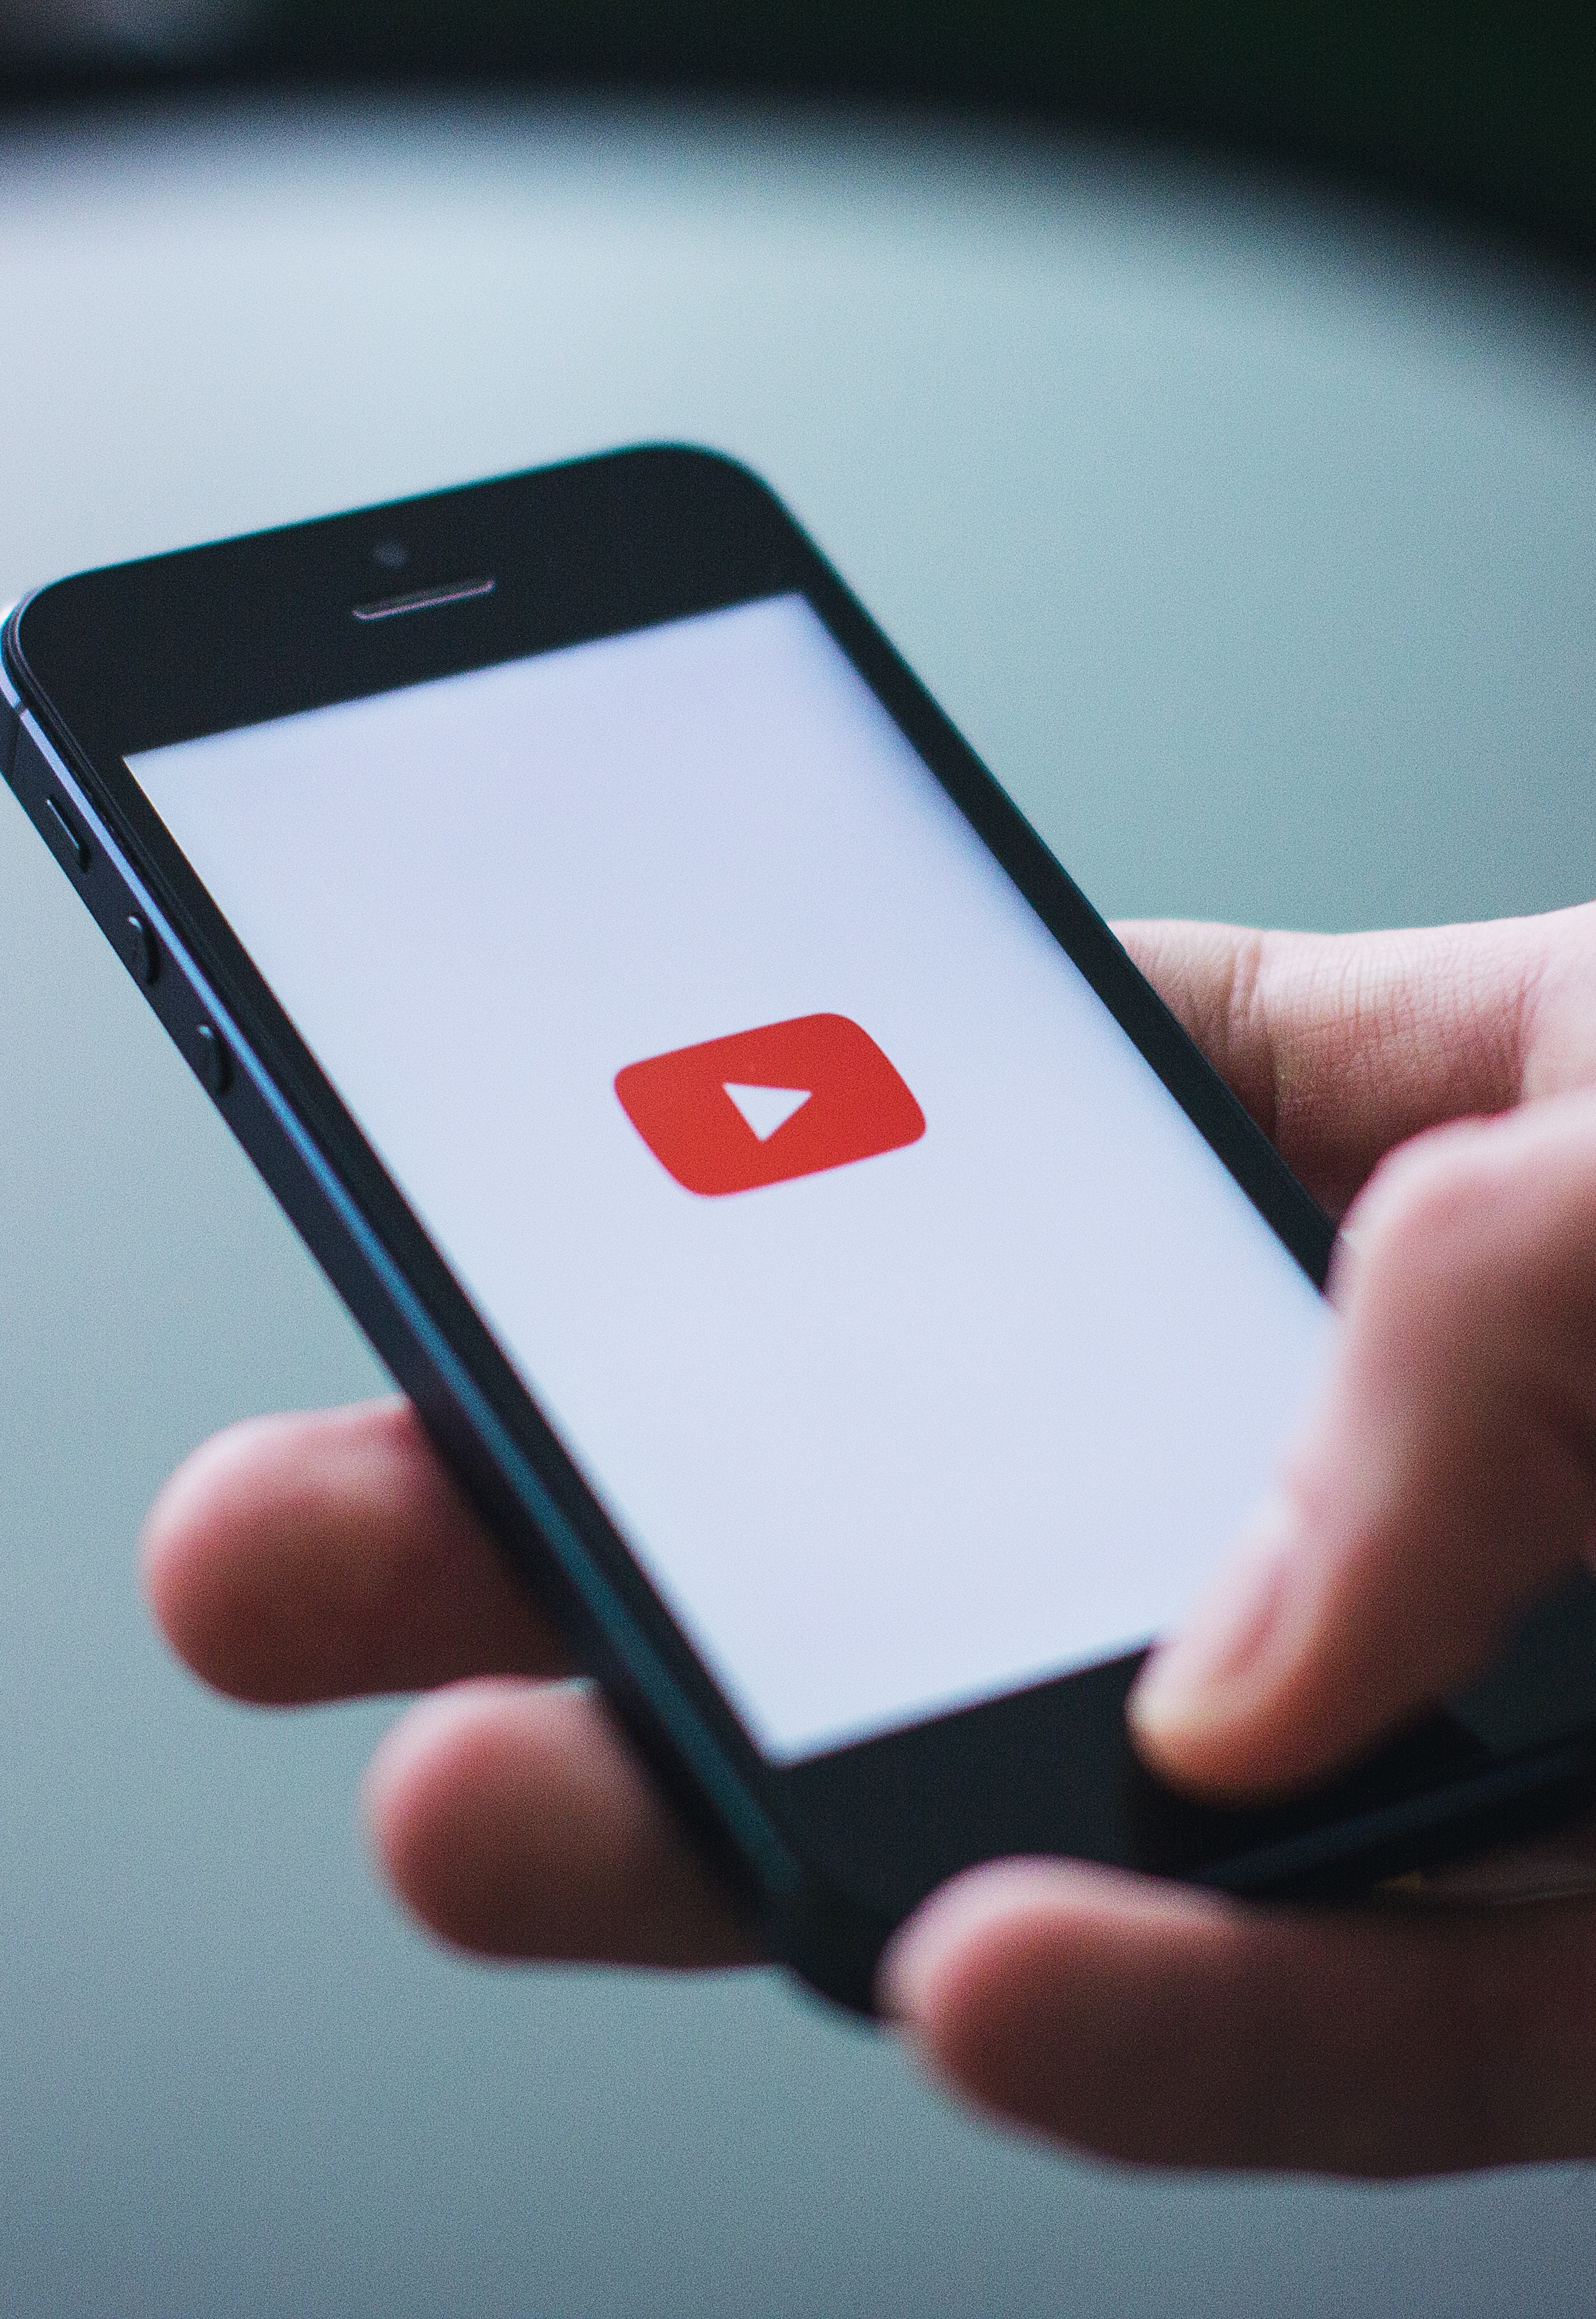
Monetization
How to earn from YouTube
Subscribers: 1,000
Watch hours: 4,000
All in 12 months!

Slide 5
Grow on YouTube
Complete your channel basics
Research your competitors
Optimize your videos to get views and subscribers
Add cards, end screens and watermarks.
Create a channel trailer for both – subscribers and new comers
Organize videos into playlists
Add captions and playlists
Work with Influencers/collaborations
Take advantage of Analytics!
Leverage other social media platforms

Slide 6
YouTube Marketing Tactics
Do leverage them
Start with posting videos under 5 minutes. If your audience likes them, increase the video length.
Post product launch, how to’s, reviews, offers, interviews, Q&As, BTS,
Post 30 minutes before uploading the final video on YouTube.
Be consistent in uploading and replying to comments.
Build a community.
Use content marketing – Unacedemy in Kota Factory

Slide 7

THANK YOU!

