Slide 1

Social Media Marketing
Session 3 & 4

Slide 2

Facebook
Let’s start with some stats!
Users 65 years and older are the fastest-growing group on Facebook
Fewer teens are using (read – uploading stuff on) Facebook now than in previous years
Highest traffic occurs mid-day Wednesday and Thursday
94% of Facebook Ad revenue is from mobile
Users watch 85% of Facebook videos without sound
Facebook users are 4x more likely to watch live streams than recorded videos
Square Facebook videos get 35% more views than landscape videos

Slide 3
The Conclusion
What to learn from the above stats?
If you have a product/service whose age group is 60+, use FB and not any other platform (including Instagram) to advertise your products. Google is already trying to attract this age group. Proof: https://youtu.be/cVG6PR-1DXc
People say that teens don’t use Fb so it’s not wise to target them on the platform – WRONG! The age group does-not upload personal stuff, thoughts on FB due to fear of being seen by their family. They still use the platform and are one of the top early adopters of most products and services.
The statistic is due to the fact that office goers/employees all around the world are a bit free on these 2 days. So schedule your posts targeting this group on these 2 days. Also, you can increase your overall budgets by 20 – 30% for these 2 days.
Optimize your ad creative, video and landing page for mobile first and then other devices.
Although videos give the best results, it is always advisable to place captions on the video for viewer delight.
Being a part of live programs makes the viewer feel a part of the celebration/event. Hence, it is always advised to host live sessions of all the product launches, Q&A sessions, teach how to use your product/app/service, interviews etc.
Have your cinematographer/editor/creative team shoot/design square videos.

Slide 4
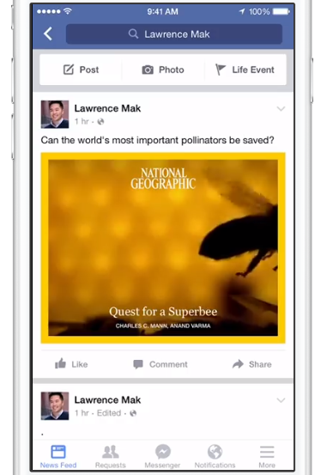
Post Formats
What is allowed on Facebook Page?
Profile Picture: Mobile – 128*128 px | Desktop – 170*170 px
Cover Picture: Mobile – 640*360 px | Desktop – 820*312 px
Popular Feed Post Formats:
1080*1080 px – Square
1920*1080 px – Horizontal rectangle
1200*1500 px – Vertical Rectangle
Story Format:
1080*1920 px – Vertical Rectangle
Video Posts:
1920*1080 px
Max Length – 240 Minutes (4 hrs)

Slide 5
Fb Algorithm
Factors affecting your FB Feed
Affinity: Fb will show posts from close friends, family, people you follow closely more often than others.
Type of Content: algorithm leans toward the quality of the posts. Amongst the contents with a better acceptance in the social network are: Videos, Live Transmissions, GIFs, Images
Interactions: Likes, Comments, Share
Timing: Recent publications will appear in the latest newsfeed.
Variety: Post a mix of photos, videos, GIFs, events, links, lives.

Slide 6

Ad Formats
What is allowed on Facebook Ads?
Static Images
Carousels
Videos
Slideshows

Slide 7
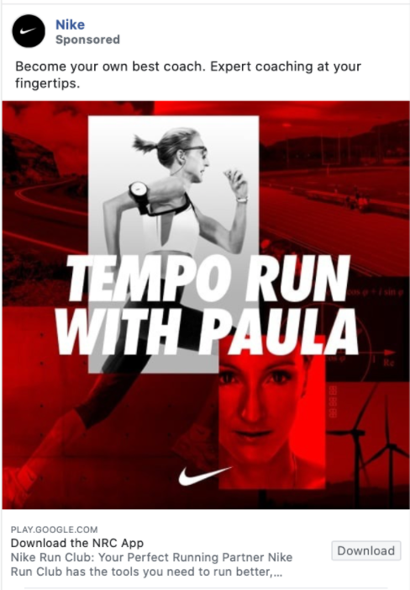
Static Ads
Single Image posts with the aspect ratios – 9:16 to 16:9.
No more then 20% text on the creative is advised for best ad experience.
Recommended Character Limits:
Primary Text: 125 Character
Title: 25 Characters
Description: 30 Characters
Primary Text
Title
Description
Call To Action

Slide 8




Carousel
Image/Video posts with the aspect ratio– 1:1 (mostly 1080*1080 px).
No more then 20% text on the creative is advised for best ad experience.
Each image/video gets its own title, description & landing page link.
Works best for ecommerce industry.
Also works for Brand awareness in case you are able to tell stories through it.

Slide 9
Ad Placements
What is allowed on Facebook Ads?
Facebook ads can be shown on 4 platforms:
Facebook
Instagram
Messenger
Audience Network

Slide 10
FB Pixel
What is it?
It is a snippet of code place on all pages of your website which enables FB to track people viewing and clicking on your ads.
The pixel helps in tracking conversions and retargeting.
Commonly known as ‘Cookies’

Slide 11
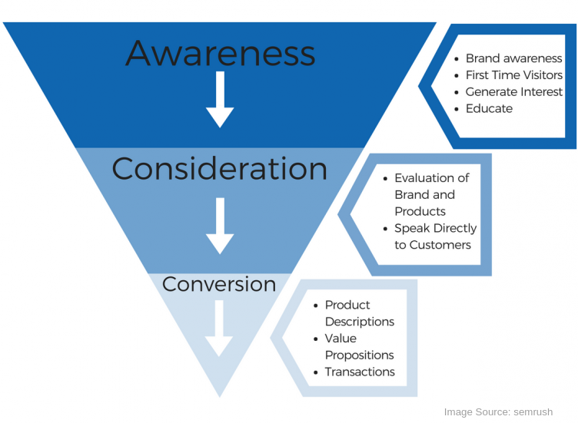
The Consumer Funnel

Slide 12

THANK YOU!

